Slide 1
pyMusk
Nov 02, 2017
Vikash Saini

Slide 2
Introduction
pyMusk
pyMusk is a Light weight Framework designed for Test projects. It provides an environment to test case developers for developing the test cases faster and in efficient manner without worrying about underneath services such as logging and test report etc.
Small scale test projects to large scale test projects are supported with pyMusk

Slide 3
pyMusk Properties
pyMusk is developed in python 3.x
It supports a Test project written in python 2.X and 3.x
pyMusk provides manageable and easy to analyze logging mechanism.

Slide 4
Framework Basic services
Provide a good design frame for project
Automatic mails after execution
Provide a mechanism for test reports after execution.
Provide Logging services

Slide 5
pyMusk Design
Test Project
Config File
Test File
Test Case 1
Test Case 2
Etc.
Job File
Run Test 1
Run Test 2
etc
Test library
pyMusk Framework
Execute Test Case and subtest Case
Test Properties
Send Mail
Logging
Test Report

Slide 6
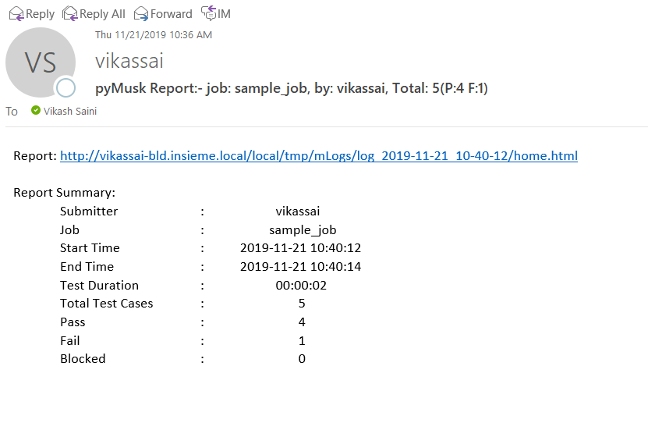
pyMusk services
Automatic mails after execution

Slide 7
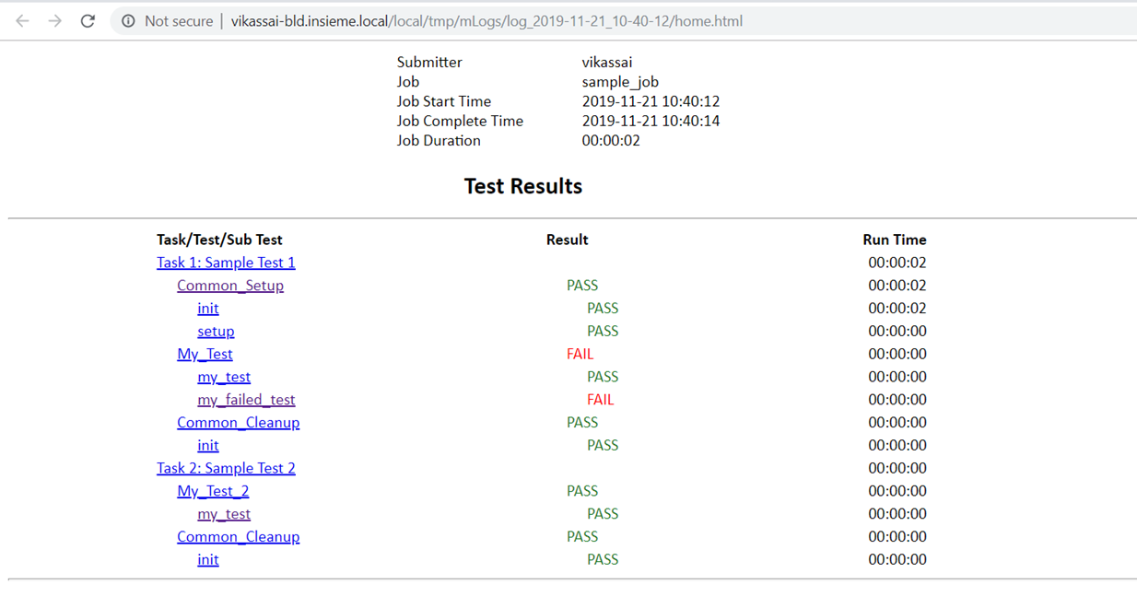
pyMusk services cont.
Provide a mechanism for test reports after execution

Slide 8
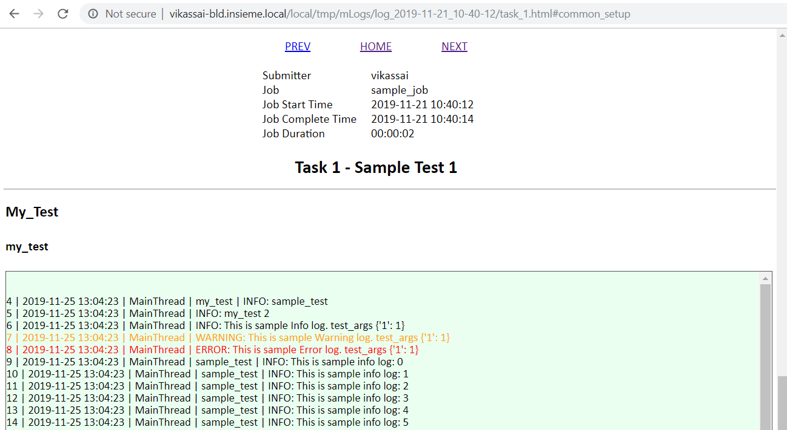
pyMusk services cont.
Provide efficient Logging services

Slide 9
Thanks
Vikash Saini

