Slide 1

Protecting User Password Keys at Rest (on the Disk)
Name: Vikash Kumar Roll: 2105083
College: KIIT Semester:7th

Slide 2
CONTENTS
Problem Statement
Unique Idea Brief (Solution)
Features Offered
Process flow
Architecture Diagram
Technologies used
Conclusion

Slide 3
Problem Statement
Develop a secure system that encrypts files or directories using a user-specified passphrase, with a focus on protecting encryption keys and passphrases from being stored in plaintext. This solution is essential for safeguarding sensitive data and ensuring secure key management in a Linux environment, while integrating seamlessly with existing file systems and maintaining compatibility across different Linux distributions.
Ensure the encryption keys are protected from exposure, even if the storage medium is compromised.
Prevent unauthorized access to sensitive files by implementing robust encryption methods.

Slide 4
Unique Idea Brief (Solution)
Create an application that encrypts files using the AES-256 algorithm and secures the encryption key with a user passphrase. This passphrase will be used to generate a deterministic key via a Key Derivation Function (KDF) to encrypt the file encryption key. The application will ensure the secure storage and retrieval of both the user passphrase and the encryption keys.
Continued on next slide...

Slide 5
Unique Idea Brief (Solution)
The system leverages industry-standard cryptographic algorithms to ensure high security.
It uses a layered approach to encryption, where the file encryption key is further protected by the user's passphrase-derived key.
The application is designed to be lightweight and efficient, minimizing the performance impact on the system.
It supports both individual file and entire directory encryption to accommodate different user needs.
The solution emphasizes simplicity in its design, making it accessible even to users with limited technical expertise.

Slide 6
Features Offered
AES-256 encryption for files and directories.
Secure key management using user passphrases and KDF.
Encrypted storage of the file encryption key.
User authentication for secure file decryption.
Intuitive command-line interface for user interactions.
Automatic generation and secure handling of random file encryption keys.
Detailed error messages and logging to assist in troubleshooting and ensure transparency.
Compatibility with automated scripts for batch processing of multiple files.
Option to securely delete original files after encryption to prevent data leakage.

Slide 7
Processflow
User Input: User selects a file/directory and provides a passphrase.
File Encryption: Generate a random file encryption key and encrypt the selected file using AES-256.
Key Protection: Use the passphrase to generate a deterministic key with a KDF and encrypt the file encryption key.
Storage: Store the encrypted file encryption key securely.
Decryption Process: Upon user authentication, decrypt the file encryption key using the passphrase and decrypt the file.

Slide 8
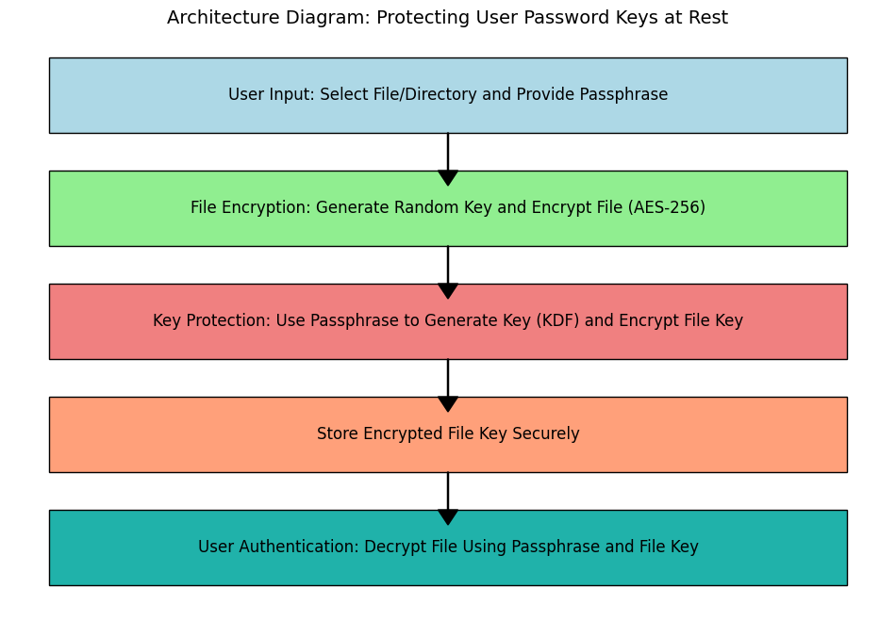
Architecture Diagram
This diagram visually represents the flow of the encryption and decryption process, ensuring a clear understanding of each step involved in protecting user password keys at rest

Slide 9
Technologies Used
Programming Language: Python
Cryptography Libraries: PyCryptodome
Key Derivation Function: PBKDF2
Operating System: Linux
File System Operations: Python's os and shutil libraries for interacting with the Linux file system.
File Management: Use of temporary files and secure deletion techniques to ensure data integrity and security.
Testing Framework: Use of unittest or pytest for developing a comprehensive test suite to validate the application's functionality

Slide 10
Conclusion
The project implements a robust and secure file encryption system to protect user password keys at rest, using strong cryptographic algorithms and secure key management practices.
The user-friendly design and comprehensive feature set make the application accessible to a broad audience, and its open-source nature ensures easy integration into various Linux environments.
Detailed documentation and a clear workflow facilitate ease of understanding and adoption, empowering users to take control of their file encryption needs.
The project provides significant learning outcomes, including a deep understanding of cryptographic principles, practical experience in secure programming, and the ability to translate complex security requirements into functional software solutions.

Slide 11
Thank You

