Slide 1

One-Stop
Group No.18
Presented By:-
Vikash Sharma 2142000294
Vishnu Singh 2142000305
Umesh Kumar 2142000281
Vanisha Kumari 2142000288
Vasudev Pandey 2142000290
Umesh Raghav 2142000282
Utkarsh Tiwari 2142000284
Utkarsh Yadav 2142000285
Under The Supervision of:-
Mr. Dhirendra prasad yadav
(Asst. Professor)
Department of CEA
GLA University, Mathura

Slide 2
Content
Introduction
Hardware And Software Requirement
Objective
Ddatabase tables
Screenshots
Conclusion

Slide 3
Introduction
As the technology is increasing day by day and the new fields is introduces in the computer science.
Ex: stack overflow , Quora, google blogs etc
We create a blogging website where we can upload and delete blog posts related to new technology
And delete blog posts related to new technology.
We also create a admin panel where we can manage the posts add, delete, edit the posts.
The project divide into four modules
Home page:
In this page we shows the blogs and this is the front page of the website.
About page:
this page shows the description of the website and about the team members.
Contact:
this is the contact page where user can contact with us by sending the mail
Login:
this is the login page of website from where admin can enters in dashboard section and manage theirs posts
dashboard:
when user enters the username and password correctly it enters in dashboard where he/she can manage their posts.

Slide 4
Hardware And Software Specification
HTML, CSS and JavaScript (frontend)
bootstrap 5
python programming language (backend)
Jinja templating (template inheritance)
Flask framework
Flask mail services
Xampp local production server
MySQL Database
laptop
internet connectivity

Slide 5
Html, CSS, JavaScript (frontend)
HTML
provides the basic structure of sites, which is enhanced and modified by other technologies like CSS and JavaScript.
CSS
stands for Cascading Style Sheets. This programming language dictates how the HTML elements of a website should actually appear on the frontend of the page. CSS is used to control presentation, formatting, and layout.
Bootstrap 5:
Bootstrap is a free and open-source framework for creating websites and web applications. It's the most popular HTML, CSS, and JS framework for developing responsive, mobile first projects on the web. As the web evolves more and more toward responsive design, it can be a real challenge for web developers to keep up.
JavaScript
JavaScript is a more complicated language than HTML or CSS, and it wasn't released in beta form until 1995. Nowadays, JavaScript is supported by all modern web browsers and is used on almost every site on the web for more powerful and complex functionality.

Slide 6
MySQL database
MySQL is an open source relational database management system. For WordPress sites, that means it helps you store all your blog posts, users, plugin information, etc. It stores that information in separate “tables” and connects it with “keys”, which is why it's relational.
local production server xampp
XAMPP has the ability to serve web pages on the World Wide Web. A special tool is provided to password-protect the most important parts of the package. XAMPP also provides support for creating and manipulating databases in MariaDB and SQLite among others.
python programming language(backend)
Python is a full-stack language. It is used in backend development while its frameworks are used in frontend development. A Python program can be written in MAC OS and the same program can run in Linux, therefore Python is also a cross-stage language
flask framework
Flask is a web application framework written in Python. Armin Ronacher, who leads an international group of Python enthusiasts named Pocco, develops it. Flask is based on Werkzeug WSGI toolkit and Jinja2 template engine. Both are Pocco projects.

Slide 7
flask mail services
A web-based application is often required to have a feature of sending mail to the users/clients. Flask-Mail extension makes it very easy to set up a simple interface with any email server. At first, Flask-Mail extension should be installed with the help of pip utility.
Jinja templating:
Jinja is a web template engine for the Python programming language. It was created by Armin Ronacher and is licensed under a BSD License. Jinja is similar to the Django template engine but provides Python-like expressions while ensuring that the templates are evaluated in a sandbox
Template inheritance allows you to build a base “skeleton” template that contains all the common elements of your site and defines blocks that child templates can override. Sounds complicated but is very basic. It's easiest to understand it by starting with an example.

Slide 8
Objective
The main objective of this website is to provide the knowledge about new technologies introducing day by day.
Here users can find the posts related to new technologies.
User can also upload the blog post and share their ideas on various points of technology
In gla university there are many events happens day by day,
Students can add their event information in this website so all events information are available in this website

Slide 9
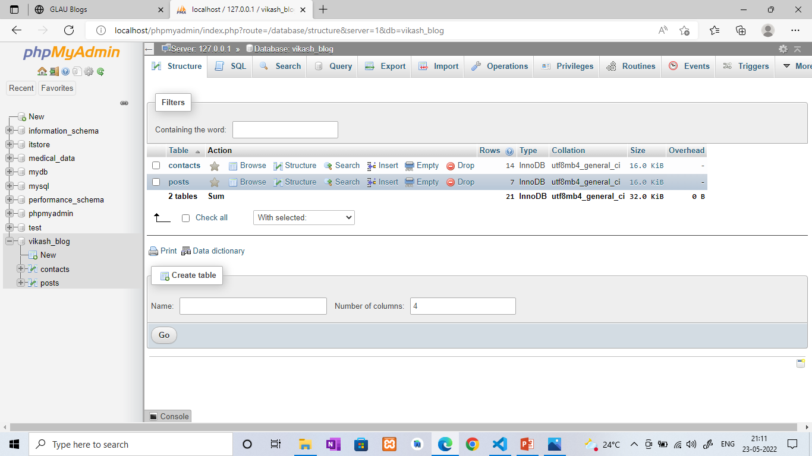
Database tables
Level 0

Slide 10
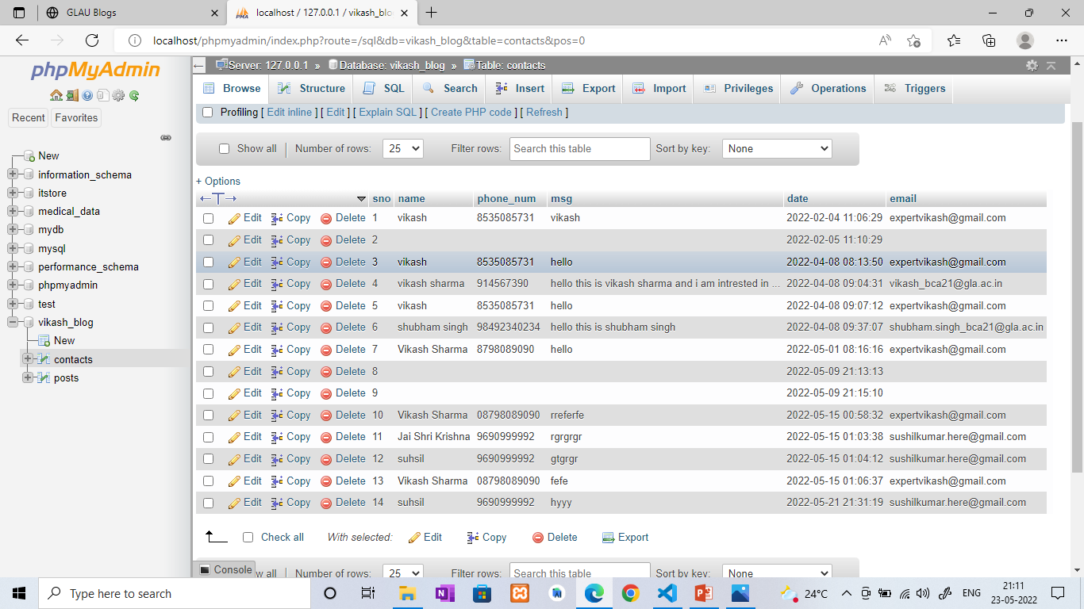
Level 1

Slide 11
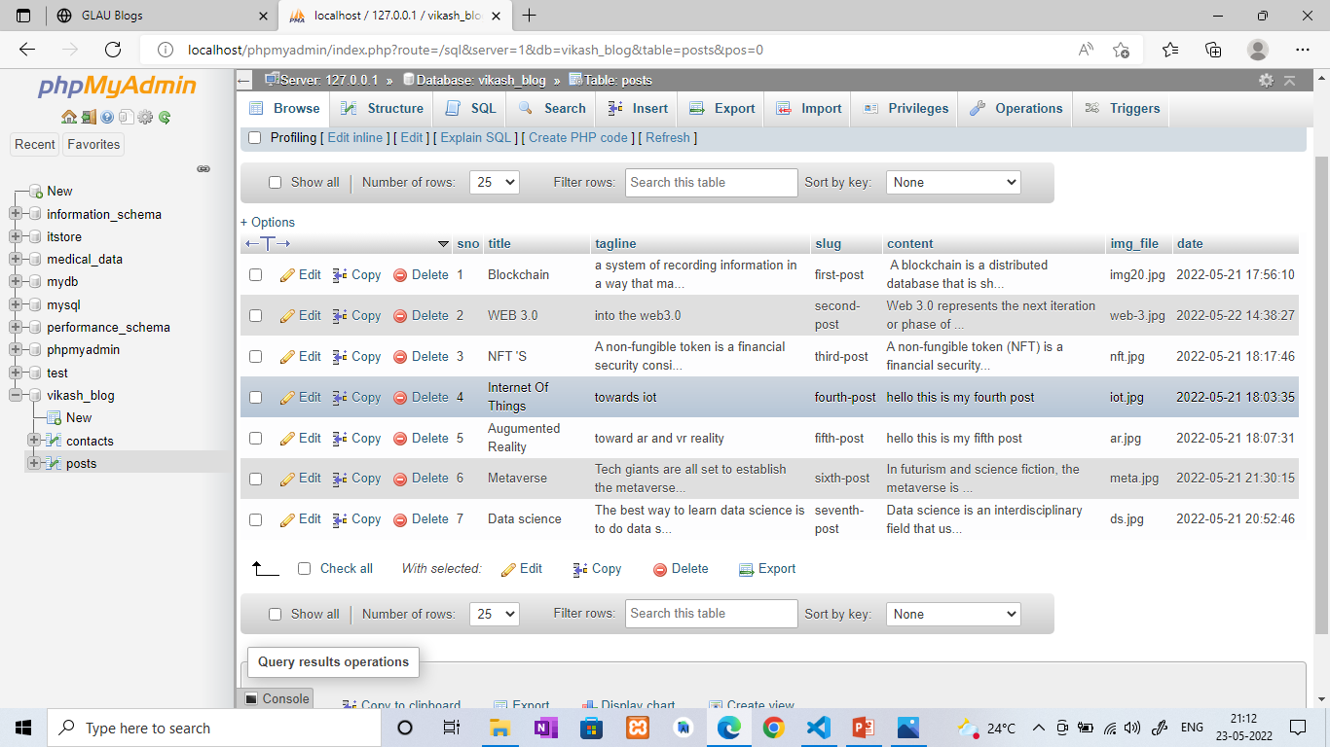

Slide 12
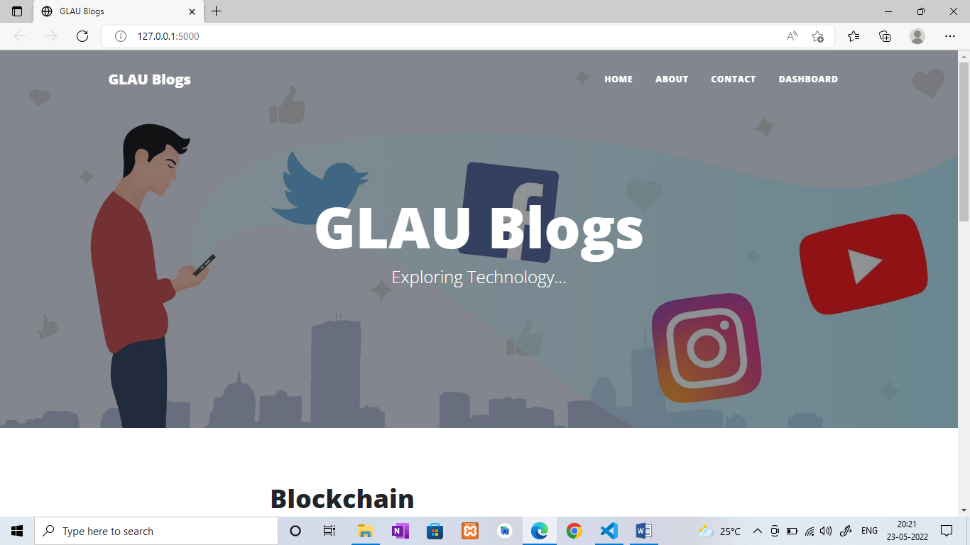
Screenshots

Slide 13
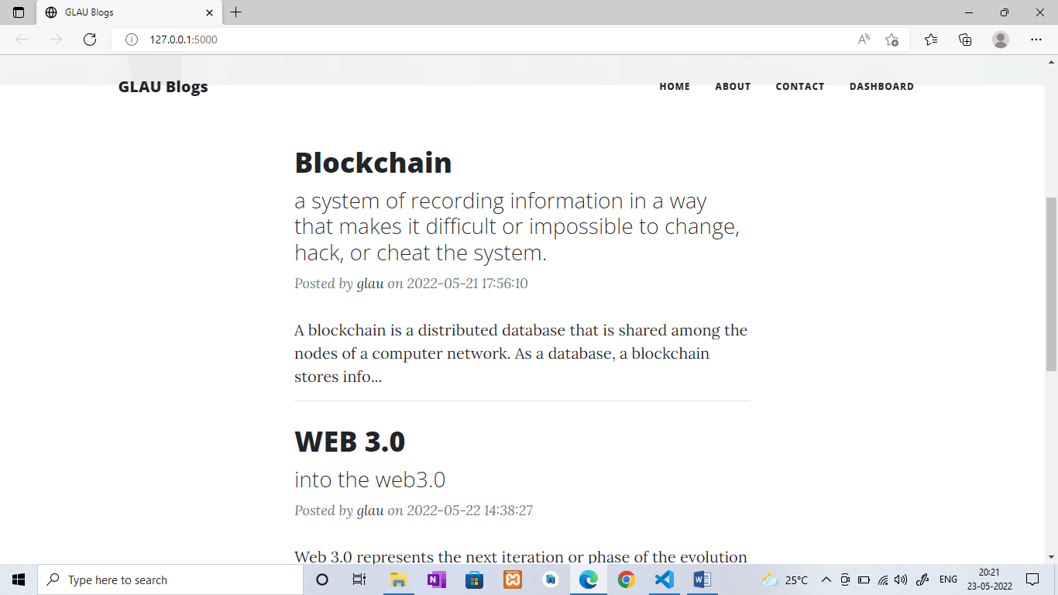

Slide 14
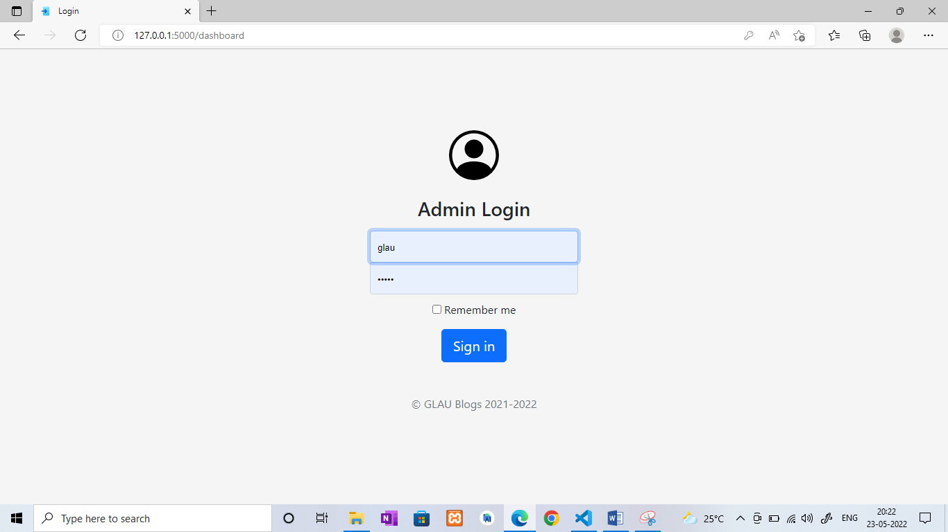

Slide 15
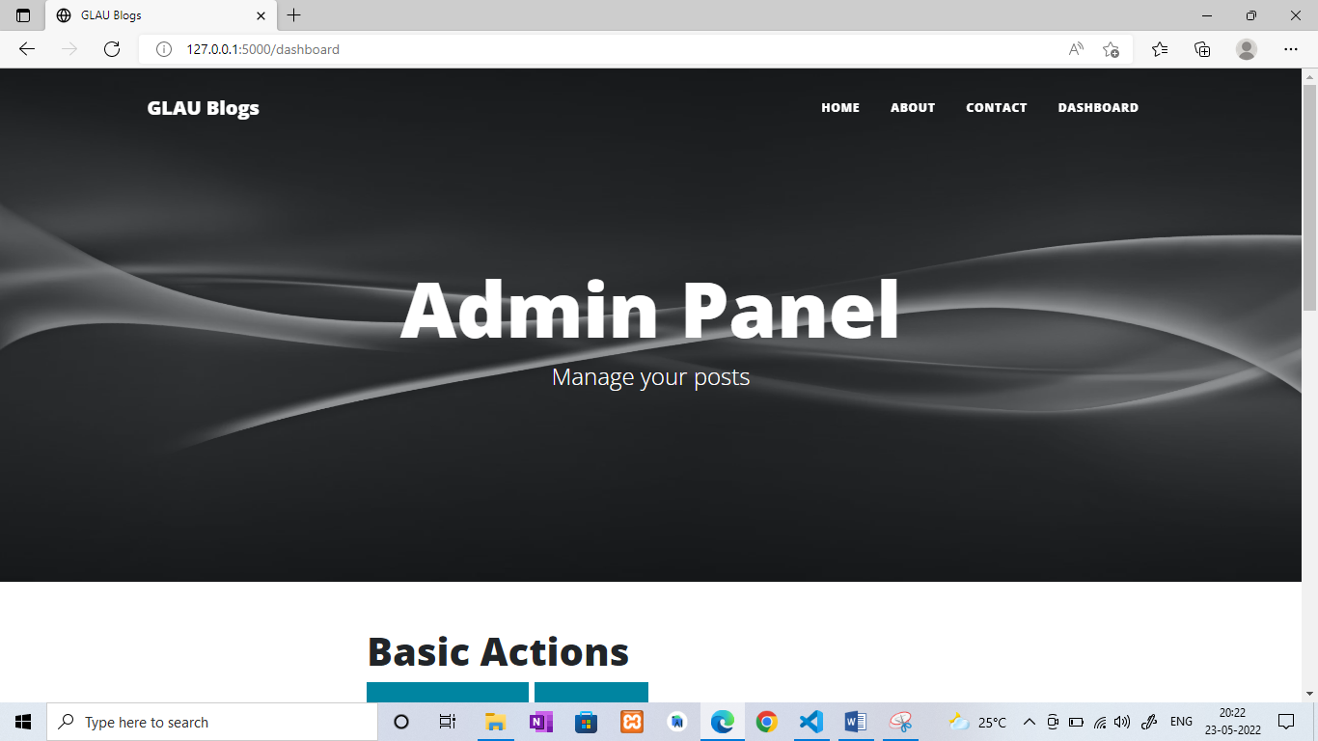

Slide 16
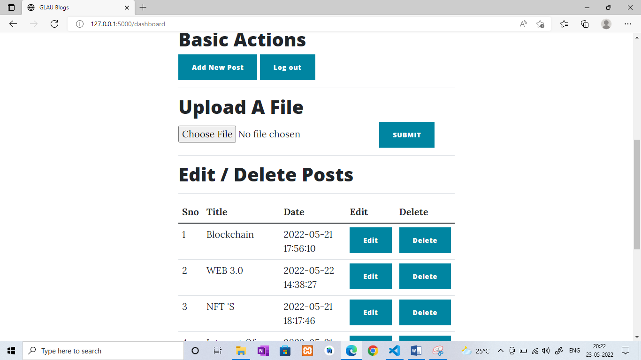

Slide 17
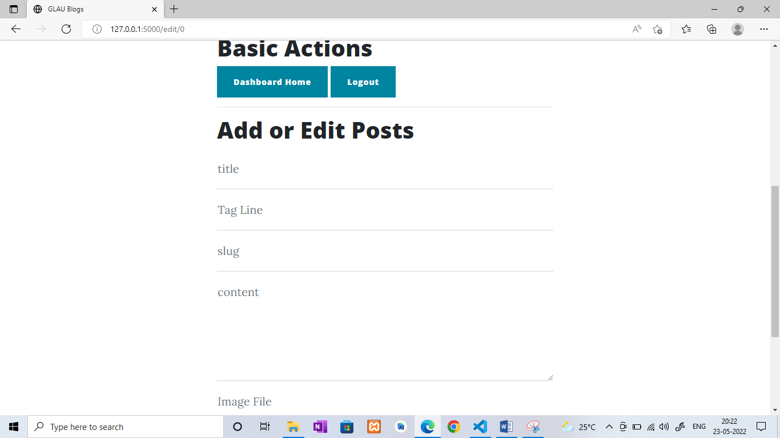

Slide 18
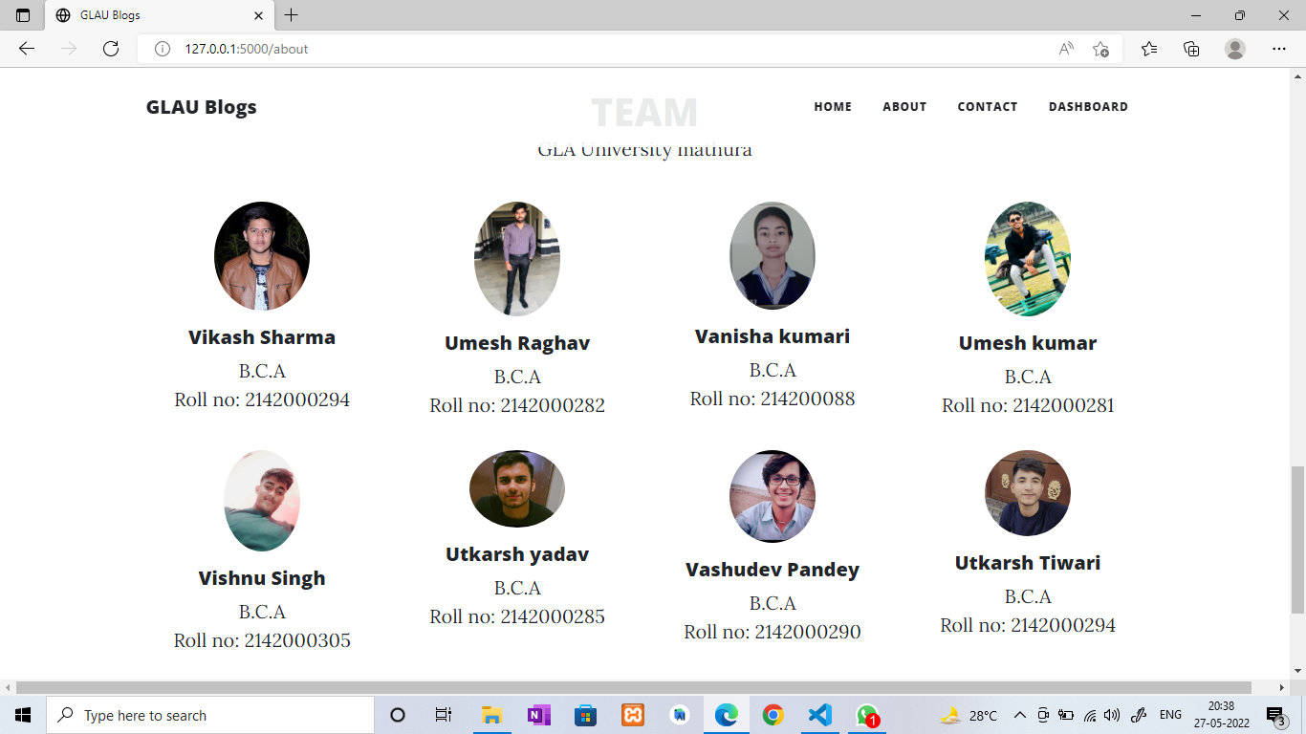

Slide 19
Project Scope
Admins will be able to login
Login through the dashboard page of the website
Admin should be able to edit / delete/add new blog post
Event relates information of gla university can also upload
We also implement api in this website so that new users can create their account
Simple

Slide 20
Conclusion
If students use this website they should be much aware about new fields of computer science.
Students should be able to see events happening in the university
In the single platform

Slide 21
References
Welcome to Flask — Flask Documentation (2.1.x) (palletsprojects.com)
3.10.4 Documentation (python.org)
Python Programming Language - GeeksforGeeks

Slide 22
THANK YOU!!!

