Slide 1



Enterprise Programming (303105309)

Slide 2
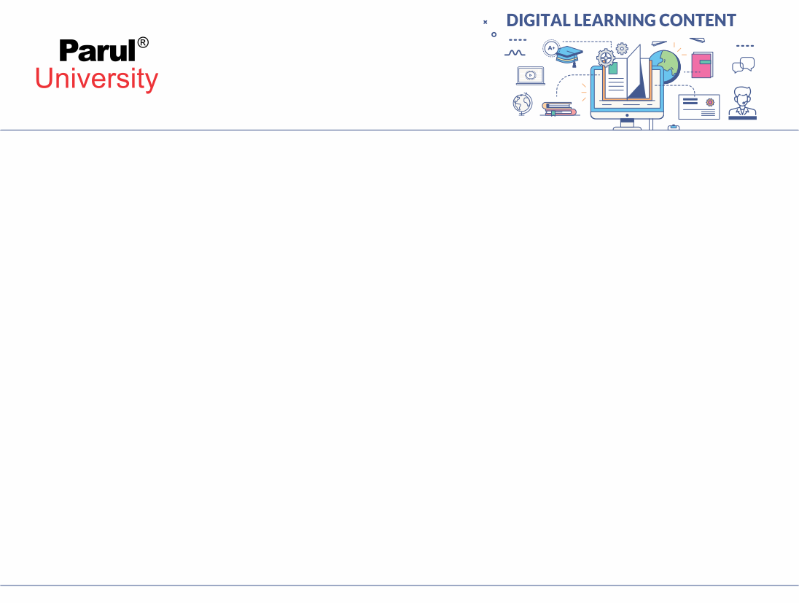

CHAPTER-2
Servlets

Slide 3
Introduction to Servlets
Servlets provide a component-based, platform-independent method for building Webbased applications, without the performance limitations of CGI programs. Servlets have access to the entire family of Java APIs, including the JDBC API to access enterprise databases. This tutorial will teach you how to use Java Servlets to develop your web based applications in simple and easy steps.
Using Servlets, you can collect input from users through web page forms, present records from a database or another source, and create web pages dynamically.
Java Servlets often serve the same purpose as programs implemented using the Common Gateway Interface (CGI). But Servlets offer several advantages in comparison with the CGI.

Slide 4
Java Servlets Architecture
Java servlets container play a very important role. It is responsible for handling important tasks like load balancing, session management and resource allocation, it makes sure that all the requests are process efficiently under high traffic. The container distribute requests across multiple instances, which helps improve the system performance.
Servlet Architecture can be depicted from the image itself as provided below as follows:

Slide 5
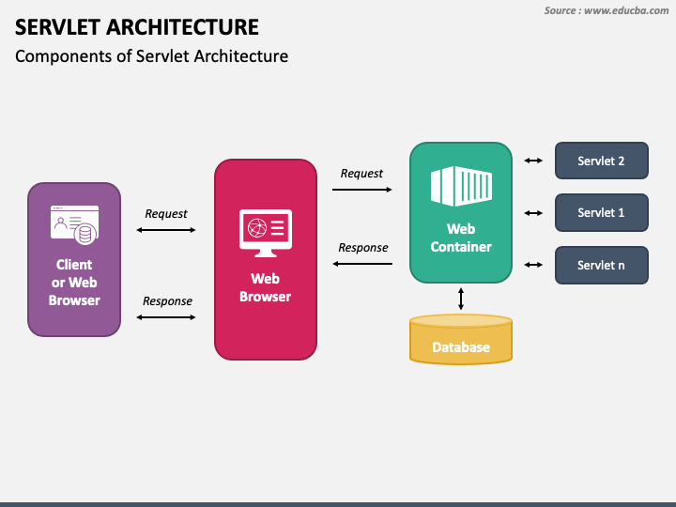
Java Servlets Architecture

Slide 6
Execution of Java Servlet
Execution of Servlets basically involves Six basic steps:
The Clients send the request to the Web Server.
The Web Server receives the request.
The Web Server passes the request to the corresponding servlet.
The Servlet processes the request and generates the response in the form of output.
The Servlet sends the response back to the webserver.
The Web Server sends the response back to the client and the client browser displays it on the screen.

Slide 7
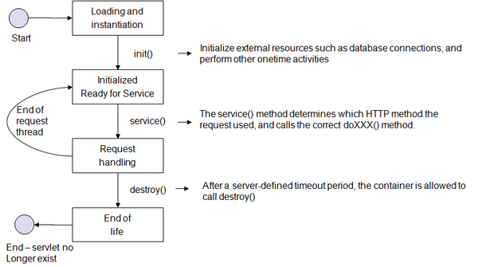
Life Cycle of a Servlet

Slide 8
Life Cycle of a Servlet
Servlet life cycle can be defined as the stages through which the servlet passes from its creation to its destruction. The servlet life cycle consists of these stages:
Servlet is created
Servlet is initialized
Servlet is ready to service
Servlet is servicing
Servlet is not ready to service
Servlet is destroyed

Slide 9
Life Cycle of a Servlet
1. Loading a Servlet
The first stage of the Servlet lifecycle involves loading and initializing the Servlet. The Servlet container performs the following operations:
Loading: The Servlet container loads the Servlet class into memory.
Instantiation: The container creates an instance of the Servlet using the no-argument constructor.
The Servlet container can load the Servlet at one of the following times:
During the initialization of the web application (if the Servlet is configured with a zero or positive integer value in the deployment descriptor).
When the Servlet is first requested by a client (if lazy loading is enabled).

Slide 10
Life Cycle of a Servlet
2. Initializing a Servlet
After the Servlet is instantiated, the Servlet container initializes it by calling the init(ServletConfig config) method. This method is called only once during the Servlet's life cycle.

Slide 11
Life Cycle of a Servlet
3. Handling request
Once the Servlet is initialized, it is ready to handle client requests. The Servlet container performs the following steps for each request:
Create Request and Response Objects
The container creates ServletRequest and ServletResponse objects.
For HTTP requests, it creates HttpServletRequest and HttpServletResponse objects.
Invoke the service() Method
The container calls the service(ServletRequest req, ServletResponse res) method.
The service() method determines the type of HTTP request (GET, POST, PUT, DELETE, etc.) and delegates the request to the appropriate method (doGet(), doPost(), etc).

Slide 12
Life Cycle of a Servlet
4. Destroying a Servlet
When the Servlet container decides to remove the Servlet, it follows these steps which are listed below
Allow Active Threads to Complete: The container ensures that all threads executing the service() method complete their tasks.
Invoke the destroy() Method: The container calls the destroy() method to allow the Servlet to release resources (e.g., closing database connections, freeing memory).
Release Servlet Instance: After the destroy() method is executed, the Servlet container releases all references to the Servlet instance, making it eligible for garbage collection

Slide 13
Servlets - Environment Setup
Setting up Java Development Kit
You can download SDK from Oracle's Java site − Java SE Downloads.
Once you download your Java implementation, follow the given instructions to install and configure the setup. Finally set PATH and JAVA_HOME environment variables to refer to the directory that contains java and javac, typically java_install_dir/bin and java_install_dir respectively.
If you are running Windows and installed the SDK in C:\jdk1.8.0_65, you would put the following line in your C:\autoexec.bat file.

Slide 14
Servlets - Environment Setup
Setting up Web Server − Tomcat
Apache Tomcat is a free, open-source web server that supports Java Servlets and JSP. It can run as a standalone server or integrate with Apache HTTP Server. To set it up:
Download Tomcat from https://tomcat.apache.org
Extract it and set the CATALINA_HOME environment variable
Start Tomcat using startup.bat (Windows) or startup.sh (Linux/Unix) Once started, access it at http://localhost:8080/

Slide 15
Creating Servlet Example in Eclipse
Step 1: Create a Dynamic Web Project
Step 2: servlet-api.jar file
As we are working with servlets, we need to have the servlet-api.jar file in our project. This jar is a library that contains all the interfaces and classes of the Servlet API, so we can use its functionality to develop our web application.
In this example, we are using the Apache Tomcat server to run the project.
Tomcat container is an open-source Java servlet container that implements several core Java enterprise functionalities like the Java Servlet, JSP, etc., so it provides this servlet-api.jar file by default.
You can check the jar file in the below path if you are using the Tomcat server only.

Slide 16
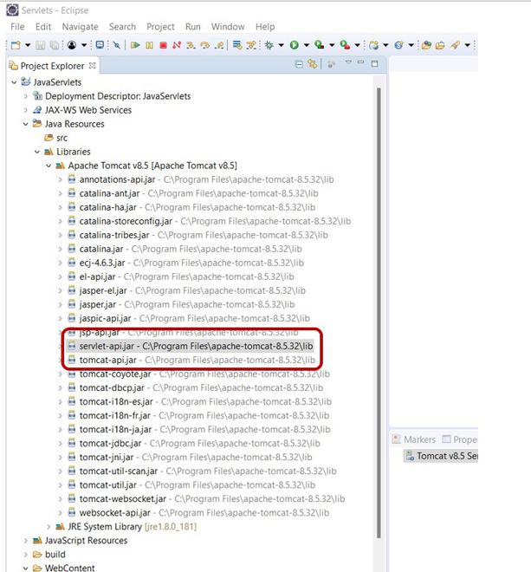
Creating Servlet Example in Eclipse
s we can see, under Apache Tomcat, there is a servlet-api.jar file by default.
For Different servers: In case, if you are using a different server and the servlet-api.jar file is not there, you can download it from Maven Repository. Add the downloaded jar file as an external jar to your project like below:

Slide 17
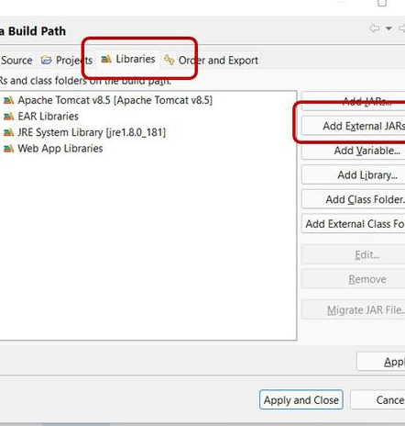
Creating Servlet Example in Eclipse
Go to the project name and right-click on it. Go to Build Path -> Configure Build Path

Slide 18
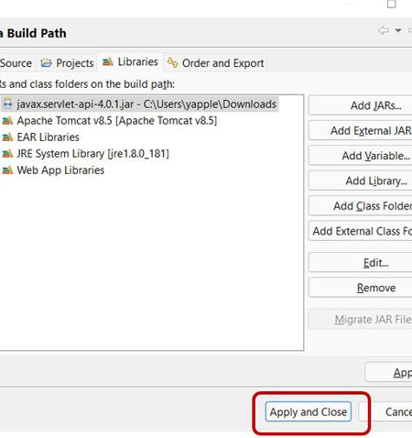
Creating Servlet Example in Eclipse
In this window, it will show all the libraries that are associated with the project, and also you can add any required jar files to your project.
Go to the Libraries tab and click on Add External JARs.
Select the servlet-api.jar file from the location you downloaded and add.

Slide 19
Servlet API
Servlets are the Java programs that run on the Java-enabled web server or application server. They are used to handle the request obtained from the webserver, process the request, produce the response, then send a response back to the webserver. In Java, to create web applications we use Servlets. To create Java Servlets, we need to use Servlet API which contains all the necessary interfaces and classes. Servlet API has 2 packages namely,
javax.servlet
javax.servlet.http
javax.servlet
This package provides the number of interfaces and classes to support Generic servlet which is protocol independent.
These interfaces and classes describe and define the contracts between a servlet class and the runtime environment provided by a servlet container.

Slide 20
Servlet API
Servlets are the Java programs that run on the Java-enabled web server or application server. They are used to handle the request obtained from the webserver, process the request, produce the response, then send a response back to the webserver. In Java, to create web applications we use Servlets. To create Java Servlets, we need to use Servlet API which contains all the necessary interfaces and classes. Servlet API has 2 packages namely,
javax.servlet
javax.servlet.http
javax.servlet
This package provides the number of interfaces and classes to support Generic servlet which is protocol independent.
These interfaces and classes describe and define the contracts between a servlet class and the runtime environment provided by a servlet container.

Slide 21
Servlet API
GenericServlet | To define a generic and protocol-independent servlet.
ServletContextAttributeEvent | To generate notifications about changes to the attributes of the servlet context of a web application.
ServletContextEvent | To generate notifications about changes to the servlet context of a web application.
ServletInputStream | This class provides an input stream to read binary data from a client request.
ServletOutputStream | This class provides an output stream for sending binary data to the client.
ServletRequestAttributeEvent | To generate notifications about changes to the attributes of the servlet request in an application.
ServletRequestEvent | To indicate lifecycle events for a ServletRequest.
ServletRequestWrapper | This class provides the implementation of the ServletRequest interface that can be subclassed by developers to adapt the request to a Servlet.
ServletResponseWrapper | This class provides the implementation of the ServletResponse interface that can be subclassed by developers to adapt the response from a Servlet.

Slide 22
Servlet API
Filter | To perform filtering tasks on either the request to a resource, or on the response from a resource, or both.
FilterChain | To provide a view into the invocation chain of a filtered request for a resource to the developer by the servlet container.
FilterConfig | To pass information to a filter during initialization used by a servlet container.
RequestDispatcher | It defines an object to dispatch the request and response to any other resource, means it receives requests from the client and sends them to a servlet/HTML file/JSP file on the server.
Servlet | This is the main interface that defines the methods in which all the servlets must implement. To implement this interface, write a generic servlet that extends javax.servlet.GenericServlet or an HTTP servlet that extends javax.servlet.http.HttpServlet.
ServletConfig | It defines an object created by a servlet container at the time of servlet instantiation and to pass information to the servlet during initialization.

Slide 23
Servlet API
ServletContext | It defines a set of methods that a servlet uses to communicate with its servlet container. The information related to the web application available in web.xml file is stored in ServletContext object created by container.
ServletContextAttributeListener | The classes that implement this interface receive notifications of changes to the attribute list on the servlet context of a web application.
ServletContextListener | The classes that implement this interface receive notifications about changes to the servlet context of the web application they are part of.
ServletRequest | It defines an object that is created by servlet container to pass client request information to a servlet.
ServletRequestAttributeListener | To generate the notifications of request attribute changes while the request is within the scope of the web application in which the listener is registered.
ServletRequestListener | To generate the notifications of requests coming in and out of scope in a web component.

Slide 24
Servlet API
Exception Name | Description
ServletException | A general exception thrown by a servlet when it encounters difficulty.
UnavailableException | Thrown by a servlet or filter to indicate that it is permanently or temporarily unavailable.

Slide 25
Servlet Collaboration In Java Using RequestDispatcher and HttpServletResponse
What is Servlet Collaboration?
The exchange of information among servlets of a particular Java web application is known as Servlet Collaboration. This enables passing/sharing information from one servlet to the other through method invocations.
What are the principle ways provided by Java to achieve Servlet Collaboration? The servlet api provides two interfaces namely:
javax.servlet.RequestDispatcher
javax.servlet.http.HttpServletResponse

Slide 26
Servlet Collaboration In Java Using RequestDispatcher and HttpServletResponse
The RequestDispatcher interface provides the option of dispatching the client's request to another web resource, which could be an HTML page, another servlet, JSP etc. It provides the following two methods:
public void forward(ServletRequest request, ServletResponse response)throws ServletException, java.io.IOException: The forward() method is used to transfer the client request to another resource (HTML file, servlet, jsp etc). When this method is called, the control is transferred to the next resource called. On the other hand, the include() method is used to include the content of the calling file into the called file. After calling this method, the control remains with the calling resource, but the processed output is included into the called resource.

Slide 27
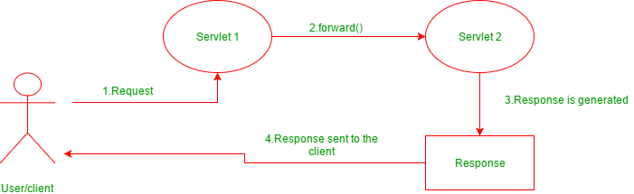
Servlet Collaboration In Java Using RequestDispatcher and HttpServletResponse

Slide 28
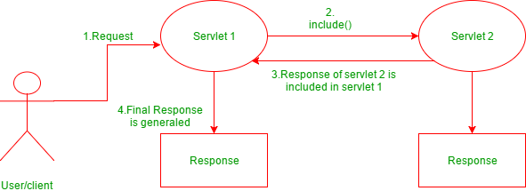
Servlet Collaboration In Java Using RequestDispatcher and HttpServletResponse

Slide 29
Servlet - Session Tracking
Servlets are the Java programs that run on the Java-enabled web server or application server. They are used to handle the request obtained from the webserver, process the request, produce the response, then send a response back to the webserver
HTTP is a "stateless" protocol, which means that each time a client requests a Web page, the client establishes a new connection with the Web server, and the server does not retain track of prior requests.
The conversation of a user over a period of time is referred to as a session. In general, it refers to a certain period of time.
The recording of the object in session is known as tracking
Session tracking is the process of remembering and documenting customer conversations over time. Session management is another name for it.
The term "stateful web application" refers to a web application that is capable of remembering and recording client conversations over time.

Slide 30
Servlet - Session Tracking
Why is Session Tracking Required?
Because the HTTP protocol is stateless, we require Session Tracking to make the client-server relationship stateful.
Session tracking is important for tracking conversions in online shopping, mailing applications, and E-Commerce applications.
The HTTP protocol is stateless, which implies that each request is treated as a new one. As you can see in the image below.

Slide 31
Servlet - Session Tracking
Deleting Session Data
We have numerous alternatives once you've finished processing a user's session data.
Remove a specific attribute You can delete the value associated with a specific key by calling the public void removeAttribute(String name) function.
Delete your whole session. To delete an entire session, use the public void invalidate() function.
Setting Session Timeout You may set the timeout for a session separately by calling the public void setMaxInactiveInterval(int interval) function.
Log the user out On servers that support servlets 2.4, you may use the logout method to log the client out of the Web server and invalidate all of the users' sessions.
web.xml Configuration If you're using Tomcat, you may set the session timeout in the web.xml file, in addition to the ways listed above.

Slide 32
Servlet - Session Tracking
<session-config>
<session-timeout>20</session-timeout>
</session-config>
The timeout is specified in minutes and overrides Tomcat's default timeout of 30 minutes.
In a servlet, the getMaxInactiveInterval() function delivers the session's timeout period in seconds. GetMaxInactiveInterval() returns 900 if your session is set to 20 minutes in web.xml.

Slide 33
Servlet - Session Tracking
Session Tracking employs Four Different techniques
Cookies
Hidden Form Field
URL Rewriting
HttpSession
A. Cookies
Cookies are little pieces of data delivered by the web server in the response header and kept by the browser. Each web client can be assigned a unique session ID by a web server. Cookies are used to keep the session going. Cookies can be turned off by the client.
B. Hidden Form Field
The information is inserted into the web pages via the hidden form field, which is then transferred to the server. These fields are hidden from the user's view. <input type = hidden' name = 'session' value = '12345' >

Slide 34
Servlet - Session Tracking
C. URL Rewriting
With each request and return, append some more data via URL as request parameters. URL rewriting is a better technique to keep session management and browser operations in sync.
D. HttpSession
A user session is represented by the HttpSession object. A session is established between an HTTP client and an HTTP server using the HttpSession interface. A user session is a collection of data about a user that spans many HTTP requests.
Illustration:
HttpSession session = request.getSession( );
Session.setAttribute("username", "password");

Slide 35
Servlet - Session Tracking
public Object getAttribute(String name) | This method returns the object in this session bound with the supplied name, or null if no object is bound with the name.
public Enumeration getAttributeNames() | This function returns an Enumeration of String objects with the names of all the items associated with this session.
public long getCreationTime() | This method returns the milliseconds since midnight January 1, 1970 GMT, when this session was created.
public String getId() | This function returns a string that contains the session's unique identification.
public long getLastAccessedTime() | This function returns the session's most recent accessible time in milliseconds since midnight on January 1, 1970 GMT.

Slide 36
Servlet - Session Tracking
public int getMaxInactiveInterval() | The maximum time interval (seconds) for which the servlet container will keep the session open between client requests is returned by this function.
public void invalidate() | This function unbinds any objects connected to this session and invalidates it.
public boolean isNew() | If the client is unaware of the session or decides not to join it, this function returns true.
public void removeAttribute(String name) | The object bound with the supplied name is removed from this session using this method.
public void setAttribute(String name, Object value) | This function uses the supplied name to tie an object to this session.
public void setMaxInactiveInterval(int interval) | This function defines the interval between client requests before the servlet container invalidates this session in seconds.

Slide 37


www.paruluniversity.ac.in

