Slide 1
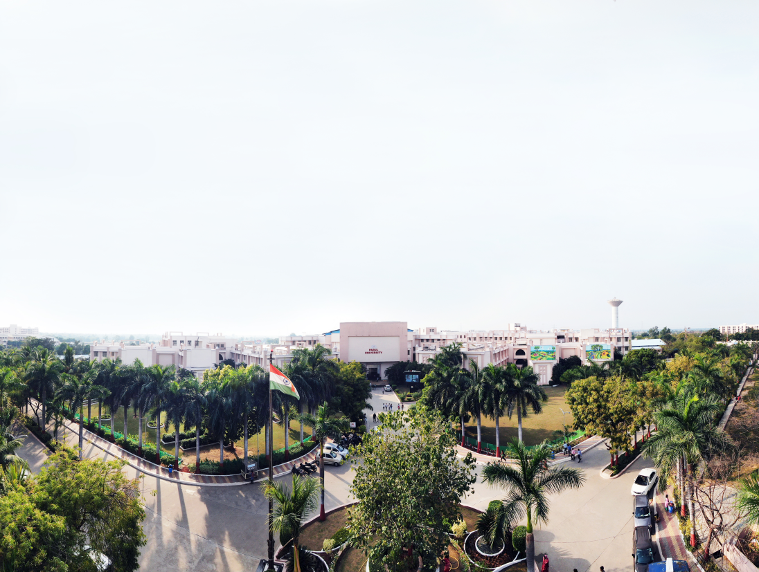


Design and Analysis of Algorithm
(303105218)

Slide 2


CHAPTER-1
Introduction to Algorithms ng

Slide 3

Introduction to Algorithms
What is an Algorithm?
A step-by-step procedure to solve a problem.
Can be implemented in any programming language.
Used in computational problem solving.

Slide 4

Properties of Algorithms
Finiteness: It must terminate after a finite number of steps.
Definiteness: Each step must be clearly defined.
Input/Output: Must have zero or more inputs and one or more outputs.
Effectiveness: Basic operations must be simple and feasible.

Slide 5
Types of Algorithms
Brute Force
Divide and Conquer
Greedy
Dynamic Programming
Backtracking and Branch & Bound

Slide 6
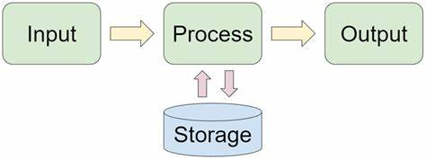
Steps to Write an Algorithm
1. Understand the problem statement.
2. Define inputs and outputs.
3. Write steps clearly and sequentially.
4. Use control structures as needed

Slide 7
Algorithm Analysis Parameters
Time Complexity
Space Complexity
Input Size
Scalability

Slide 8
Design Techniques of Algorithms
Divide and Conquer
Greedy Approach
Dynamic Programming
Backtracking
Randomized Algorithms

Slide 9
CHAPTER-2
Asymptotic Analysis

Slide 10
Asymptotic Notations
Used to describe the running time of algorithms.
Helps in comparing algorithms independent of machine specifics.

Slide 11
Big Oh (O)
Represents the upper bound.
Describes the worst-case time complexity.

Slide 12
Big Omega (Ω)
Represents the lower bound.
Describes the best-case time complexity.

Slide 13
Big Theta (Θ)
Represents the tight bound.
Describes the average-case time complexity.

Slide 14
Types of Analysis
Best Case: Minimum time taken by the algorithm.
Worst Case: Maximum time taken by the algorithm.
Average Case: Expected time considering all inputs.

Slide 15
CHAPTER-2
Algorithm Correctness & Recurrences

Slide 16
Substitution Method
Guess the form of the solution.
Use induction to prove the guess.

Slide 17
Recursion Tree Method
Draw the tree to visualize the cost.
Add costs at each level to get the total.

Slide 18
Master Method
Provides a direct way to get time complexity.
Useful for divide and conquer algorithms.

Slide 19
CHAPTER-3
Sorting Algorithms with Analysis

Slide 20
Bubble Sort
Repeatedly swap adjacent elements if they are in wrong order.
Time Complexity: O(n^2)
Space Complexity: O(1)

Slide 21
Selection Sort
Select the minimum element and place it at the beginning.
Time Complexity: O(n^2)
Space Complexity: O(1)

Slide 22
Insertion Sort
Builds the final sorted array one item at a time.
Time Complexity: O(n^2), Best: O(n)
Space Complexity: O(1)

Slide 23
Sorting Comparison
Bubble Sort: Simple but inefficient.
Selection Sort: Minimizes swaps.
Insertion Sort: Efficient for small or nearly sorted datasets.

