Slide 1
Design Pattern
Overview
https://csharp-video-tutorials.blogspot.com/2017/06/design-patterns-tutorial-for-beginners.html

Slide 2
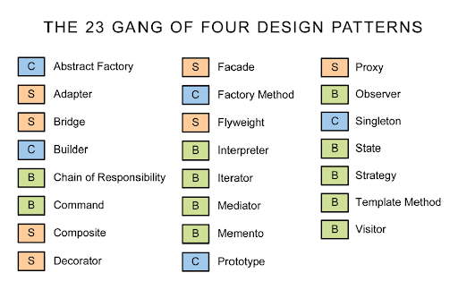
23 GANG OF FOUR DESIGN PATTERNS

Slide 3
Important Design Patterns
Singleton Pattern: Ensures a class has only one instance and provides a global point of access to it.
Factory Pattern: Defines an interface for creating objects but lets subclasses alter the type of objects that will be created.
Builder Pattern: Allows for the creation of complex objects step by step. It separates the construction of a complex object from its representation.
Observer Pattern: Defines a one-to-many dependency between objects so that when one object changes state, all its dependents are notified and updated automatically.
Decorator Pattern: Allows behavior to be added to individual objects, either statically or dynamically, without affecting the behavior of other objects from the same class.
Adapter Pattern: Allows incompatible interfaces to work together by wrapping an object around an interface to convert its methods into the expected interface.
Strategy Pattern: Defines a family of algorithms, encapsulates each one, and makes them interchangeable. It lets the algorithm vary independently from clients that use it.

Slide 4
Important Design Patterns
Facade Pattern: Provides a unified interface to a set of interfaces in a subsystem. It defines a higher-level interface that makes the subsystem easier to use.
Composite Pattern: Composes objects into tree structures to represent part-whole hierarchies. It lets clients treat individual objects and compositions of objects uniformly.
Template Method Pattern: Defines the skeleton of an algorithm in the superclass but lets subclasses override specific steps of the algorithm without changing its structure.
Iterator Pattern: Provides a way to access the elements of an aggregate object sequentially without exposing its underlying representation.
Chain of Responsibility Pattern: Allows an object to pass a request along a chain of handlers. Upon receiving a request, each handler decides either to process the request or to pass it along the chain.
Proxy Pattern: Provides a placeholder for another object to control access to it. It allows you to create a substitute or placeholder for another object.

Slide 5
What are Design Pattern?
Design Patterns are reusable solutions to the problems that we encounter in the day-to-day programming.
They are generally targeted at solving the problems of object generation and integration.
In other words, Design patterns acts as templates which can be applied to the real-world programming problems.

Slide 6
Types of Design Patterns
Creational
Structural
Behavioral

Slide 7
Creational Design Pattern
These patterns deal with object creation and initialization.
Creational pattern gives the program more flexibility in deciding which objects need to be created for a given case.
Example of Creational Design patterns category:- Singleton, Factory & Abstract factory etc.

Slide 8
Structural Design Pattern
This pattern deals with class and object composition. In simple words, This pattern focuses on decoupling interface, implementation of classes and its objects.
Example of Structural design patterns category: Adapter, Facade and Bridge etc.

Slide 9
Behavioral Design Pattern
These patterns deal with communication between classes and objects.
Examples of behavioral design patterns: Chain of Responsibility, Command and Interpreter etc.

Slide 10
Design Pattern Types
Creational | Structural | Behavioral
Factory Method Abstract Factory Singleton Prototype Builder Object Pool | Adapter Bridge Composite Decorator Facade Flyweight Proxy | Chain of Responsibility Command Template Iterator Observer State Memento Strategy

Slide 11
Use Case Design Pattern Type
Builder ( While Writing Unit Tests )
Prototype ( Cloning )
Adapter ( asList , toString )
Chain Of Responsibility ( Exception handling, logging )
Singleton
Factory ( Action Mapping )
Proxy ( Url Proxy )
Observer ( Event Listener )

Slide 12

Creational DP Types beginning ……..

Slide 13
Singleton Design Pattern
Singleton pattern belongs to creational Type pattern.
This pattern is used when we need to ensure that only one object of a particular class need to created. All further References to the objects are referred to the same underlying instance created.

Slide 14
Singleton Implementation Guidelines
We need to choose Factory Pattern when
Concurrent access to the resource is well managed by singleton design pattern.
As part of the Implementation guidelines, we need to ensure that only one instance of the class exists by declaring all constructors of the class to be private. Also, to control the singleton access we need to provide a static property that returns a single instance of the object.

Slide 15
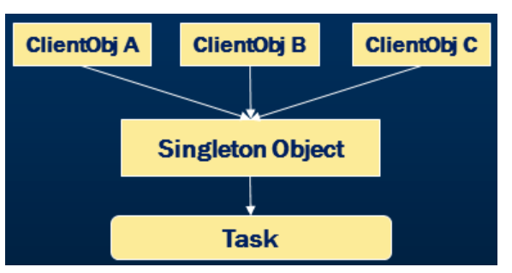
Singleton Diagram

Slide 16
Lazy vs Eager initialization
Lazy Loading
Improves the performance
Avoids unnecessary load till the point object is accessed
Reduces the memory footprint on the start-up
Faster application load
Non-lazy or Eager Loading
Pre-instantiation of the object
Commonly used in lower memory footprints

Slide 17
Static vs Singleton
Static is a keyword and singleton is a design pattern
Static classes can contain only static members
Singleton is an object creational pattern with one instance of the class
Singleton can implement interfaces, inherit from other classes and it align with the OOPS concepts
Singleton object can be passed as a reference
Singleton supports object disposal
Singleton object is stored on heap
Singleton objects can be cloned

Slide 18
Singleton Real World Usages
Logging
Managing a connection or a pool of connection to database
Printer spooling
File
Configuration
Cache
Session based Shopping cart

Slide 19
Singleton Design Pattern Example
public sealed class Singleton
{
private static readonly Lazy<Log> instance = new Lazy<Log>();
private Log()
{
}
public static Log GetInstance
{
get
{
return instance.Value;
}
}
}

Slide 20
Why is singleton class sealed?
create multiple instances of the singleton using the nested derived class. This violates the principle of singleton. Singleton and make the class as sealed.

Slide 21
Factory Design Pattern
“Define an interface for creating an object, but let subclasses decide which class to instantiate. The factory method lets a class defer instantiation it uses to subclasses”
Factory pattern is one of the most used design patterns in real world applications
Factory pattern creates object without exposing the creation logic to the client and refer to newly created object using a common interface

Slide 22
Factory Implementation Guidelines
We need to choose Factory Pattern when
The Object needs to be extended to subclasses
The Classes doesn’t know what exact sub-classes it has to create
The Product implementation tend to change over time and the Client remains unchanged

Slide 23

Factory Diagram

Slide 24
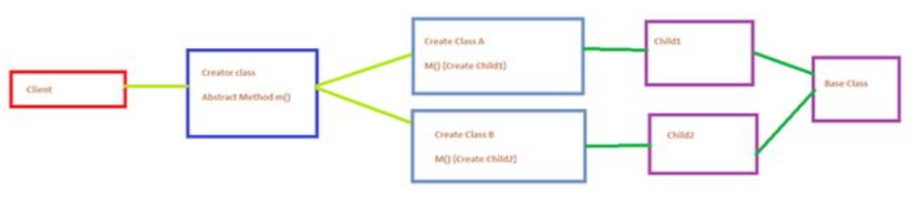
Factory Method Design Pattern
The client maintains a reference to the abstract creator class but instantiates with one of the sub-classes. The responsibility of creating the instance is delegated to the sub-class methods. So, the name Factory Method Pattern.

Slide 25
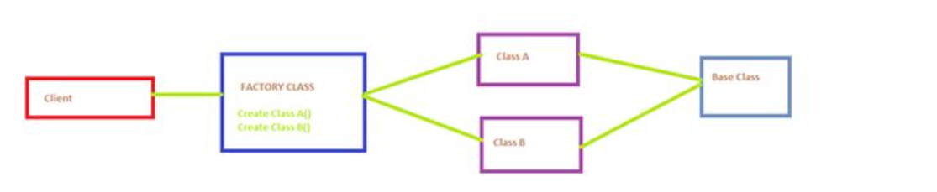
Factory Design Pattern Vs. Factory Method Design Pattern
Factory Design Pattern
A client uses a Factory Class to get instances of classes that implement the same interface or are derived from the same base class.
Factory Method Design Pattern
The client maintains a reference to the abstract creator class but instantiates with one of the sub-classes. The responsibility of creating the instance is delegated to the sub-class methods. So the name Factory Method Pattern.

Slide 26
When should I choose factory design pattern?
The Object needs to be extended to subclasses
The Classes doesn’t know what exact sub-classes it has to create
The Product implementation tend to change over time and the Client remains unchanged
Example:- Differentiate employees as permanent and contract and segregate their pay scales as well as bonus based on their employee types.

Slide 27
Abstract Factory Design Pattern
Gang Of Four Definition : "The Abstract factory pattern provides a way to encapsulate a group of individual factories that have a common theme without specifying their concrete classes" The Abstract Factory Pattern provides an interface for creating families of related or dependent objects without specifying their concrete classes Abstract Factory pattern belongs to creational patterns and is one of the most used design patterns in real world applications Abstract factory is a super factory that creates other factories

Slide 28
Abstract Factory Implementation Guideline
We need to Choose Abstract Factory Pattern when
The application need to create multiple families of objects or products
We need to use only one of the subset of families of objects at a given point of time
We want to hide the implementations of the families of products by decoupling the implementation of each of these operations

Slide 29
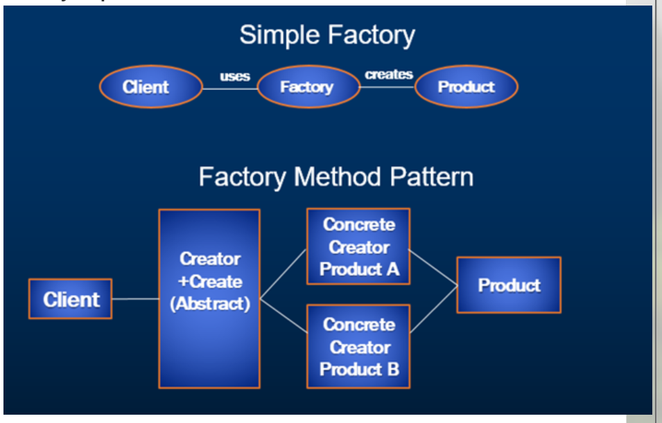
Abstract Factory Diagram

Slide 30
Business Requirement
Handout computers to Contract and Permanent employees based on the designation and employee type with below specifications
Permanent Employee
Managerial Position is eligible for Apple MAC Book Laptop
Non Managerial Position is eligible for Apple IMac desktop
Contract Employee
Managerial Position is eligible for Dell Laptop
Non Managerial Position is eligible for Dell desktop

Slide 31
Difference between Factory & Abstract Factory Design Pattern?
Abstract factory pattern adds a layer of abstraction to the factory method pattern
Abstract factory pattern implementation can have multiple factory methods
Similar products of a factory implementation are grouped in Abstract factory
Abstract Factory uses object composition to decouple applications form specific implementations
Factory Method uses inheritance to decouple applications form specific implementations

Slide 32
Builder Design Pattern
Definition : "Separate the construction of a complex object from its representation so that the same construction process can create different representations" Builder Pattern solves the situation of increasing constructor parameters and constructors of a given class by providing a step-by-step initialization of Parameters. After step-by-step initialization, it returns the resulting constructed Object at once.

Slide 33
Builder Implementation Guidelines
We need to Choose Builder Design Pattern when
We need to break up the construction of a complex object
We need to create a complex object and it should be independent of the parts that make up the object
The construction process must allow multiple representations of the same class

Slide 34
Business Requirement
Provide an option to choose and build configuration of the system which is allocated to the employees. The configuration options that user can choose are RAM, HDD, USB Mouse etc.

Slide 35
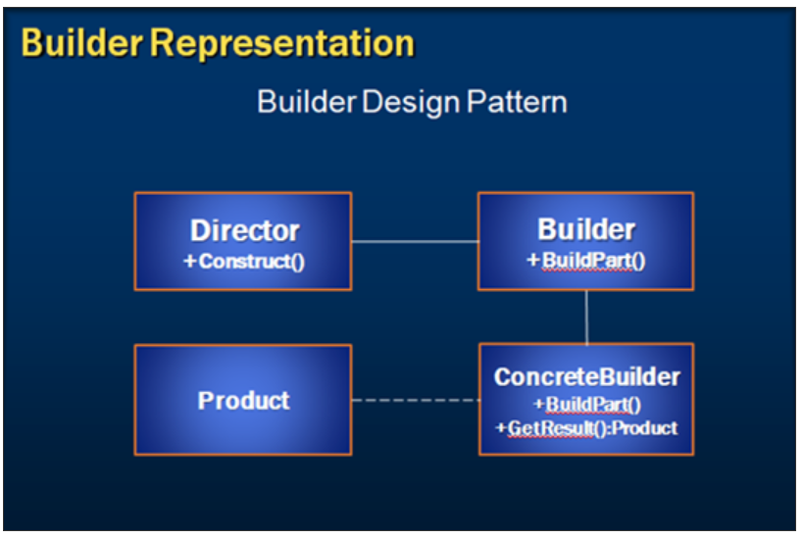
Builder Design Pattern Diagram

Slide 36
Builder DP vs Factory and Abstract Factory DP
Builder design pattern encapsulates complex creation into a single method.
Builder design pattern focus on construction of object in a step-by-step manner whereas Abstract Factory pattern is used to solve problems related to the creation of families of products.
Builder design pattern returns the object after step-by-step construction of the complex object whereas in Abstract Factory pattern or Factory pattern, we return the created product immediately.
To conclude, Many application designs start out using Factory which is less complex and evolve towards Abstract Factory and Builder as the complexity increases with a demand of flexibility.

Slide 37
Fluent Builder Design Pattern
The idea behind a fluent interface is that one can apply multiple properties to an object by connecting them with dots and without having to re-specify the object each time.
C# uses fluent programming extensively in LINQ to build queries using the standard query operators. The implementation is based on extension methods.

Slide 38
Fluent Builder Implementation Guidelines

Slide 39
Fluent Builder Diagram

Slide 40
Builder Vs Factory and Abstract Factory
Builder design pattern encapsulates complex creation into a single method.
Builder design pattern focuses on construction of object in a step-by-step manner whereas Abstract factory pattern is used to solve problems related to the creation of families of products.
Builder design pattern returns the object after step-by-step construction of the complex object whereas in Abstract factory or Factory pattern, we return the created product immediately.
To conclude, many application designs start out using Factory which is less complex and evolve towards Abstract Factory and Builder as the complexity increases with a demand of flexibility.

Slide 41
ProtoType Design Pattern
“Prototype Design Patter Specify the kind of objects to create using a prototypical instance and create new objects by copying this prototype.
To Simply, Instead of creating object from scratch every time, you can make copies of an original instance and modify it as required.

Slide 42
ProtoType Implementation Guidelines
Choose Prototype Design Patter When
Creating an object is an expensive operation and it would be more efficient to copy an object.
System should be independent of how its products are created, composed, and represented.
Objects are required that are similar to existing objects.
We need to hide the complexity of creating new instance from the client.

Slide 43
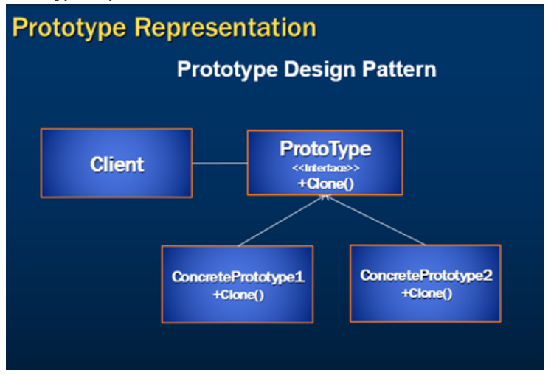
ProtoType Diagram

Slide 44
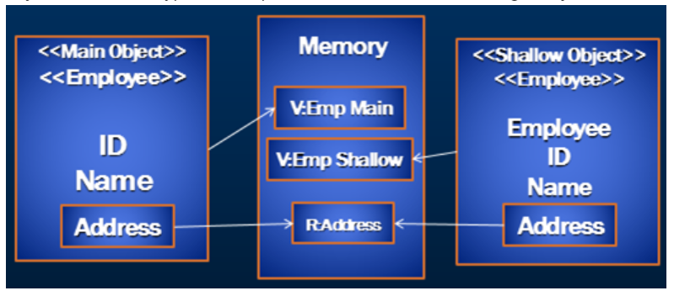
Shallow Copy
Shallow Copy copies an objects value type fields type into the target object and the objects reference types are copied into the target object.

Slide 45
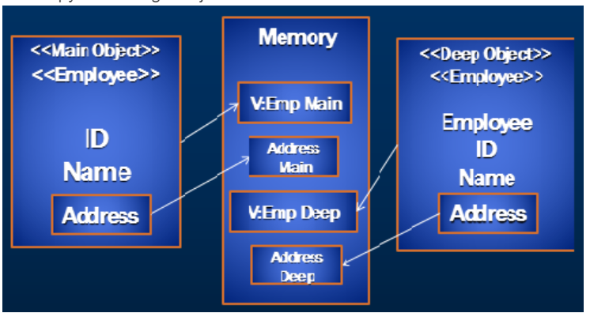
Deep Copy
Deep Copy copies and objects value and reference types into a complete new copy of the target objects.

Slide 46
MemberwiseClone and Icloneable Interface

Slide 47
Structural DP Types beginning ……..

Slide 48
Adapter Design Pattern
Adapter Design Pattern is a Structural Design pattern.
Adapter “Matches interface of different classes”
An adapter allows two incompatible interfaces to work together
The Adapter design pattern incompatible classes to interact with each other by converting the interface of one class into an interface expected by the clients.
Leveraging on Adapter pattern Improves reusability of older functionality.

Slide 49
Adapter Implementation Guidelines
Choose Adapter Design Pattern When
A class need to be reused which does not have an interface
We need to work through a separate Adapter that adapts the interface of an existing class without changing it
Client don’t know whether they work a Target class directly or through another alternative that does not have the target interface
Example:-
The Ac adapter is the best example for Adapter Pattern

Slide 50
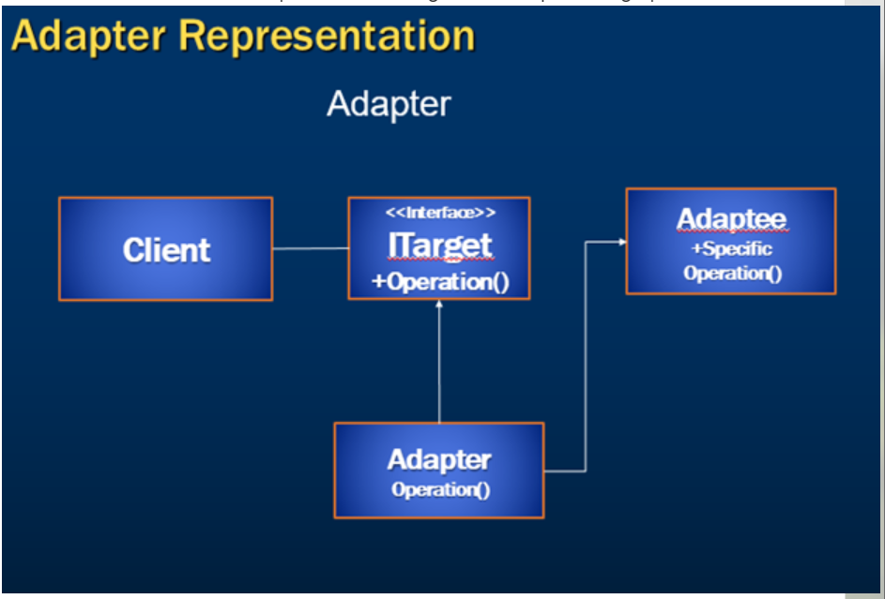
Adapter Diagram

Slide 51
Bridge Design Pattern
Separates an objects interface from its implementation
The bridge uses encapsulation, aggregation, and can use inheritance to separate responsibilities
Decouple an abstraction from its implementation

Slide 52
Bridge Implementation Guidelines
Choose Bridge Design Pattern
We need to avoid a permanent binding between an abstract and its implementation
Both abstraction and their implementation should be extensible
No impact on clients
We need to share an implementation among multiple objects
We need to hide the implementation of an abstraction completely from clients

Slide 53
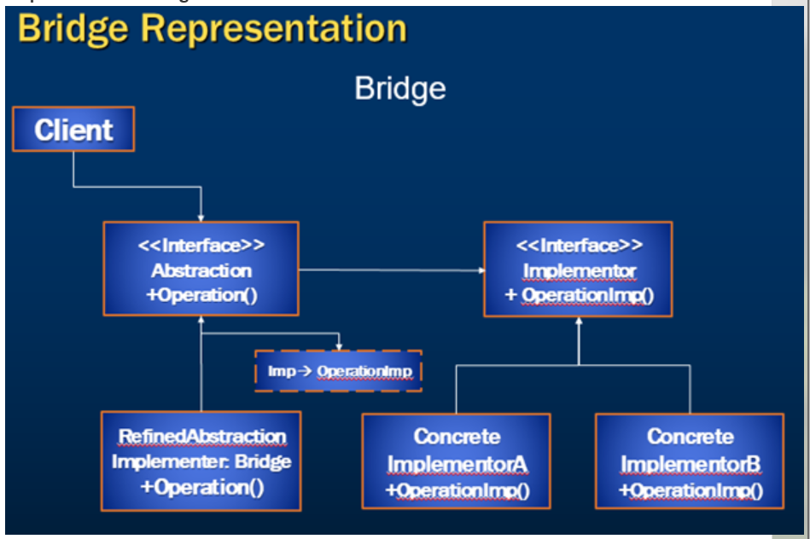
Bridge Diagram

Slide 54
Composite Design Pattern
Composite is a tree structure of simple and composite objects
Enables hierarchical tree structures of varying complexity
Group of objects are treated in the same way as a single instance of an object
Difference between compositions of objects and individual objects is hidden from clients

Slide 55
Composite Design Pattern
Gang Of Four Definition
“Compose objects into tree structures to represent part-whole hierarchies. Composite lets clients treat individual objects and compositions of objects uniformly.”
A thing up of several parts or elements
The composite pattern is a partitioning design pattern and it describe that the group of objects are treated same way as a single instance of the same type of the object.

Slide 56
Composite Implementation Guidelines

Slide 57
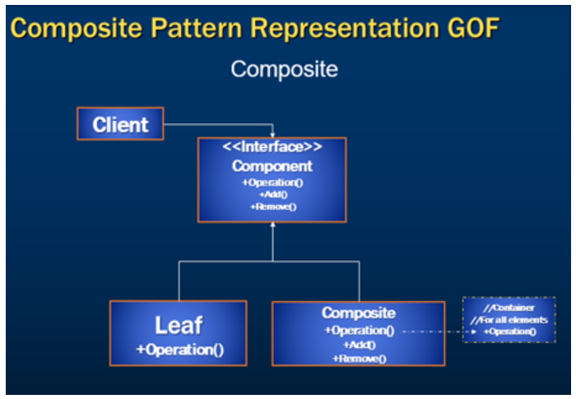
Composite Diagram

Slide 58
Decorator Design Pattern
Add responsibilities to objects dynamically
The Decorator pattern attaches additional responsibilities to an object dynamically to provide a flexible alternative to changing object functionality without using static inheritance

Slide 59
Decorator Design Pattern
Gan of Four Definition
“Attach additional responsibilities to an object dynamically. Decorators provide a flexible alternative to sub classing for extending functionality”.
Falls under the category of Structural Design pattern and it is also known as Wrapper.

Slide 60
Decorator Design Pattern Implementation Guidelines
Choose Decorator Design Pattern
Need to add responsibilities to individual objects dynamically and transparently
The Extension by sub classing is impractical
Class definition may be hidden
Classes are unavailable for sub classing

Slide 61
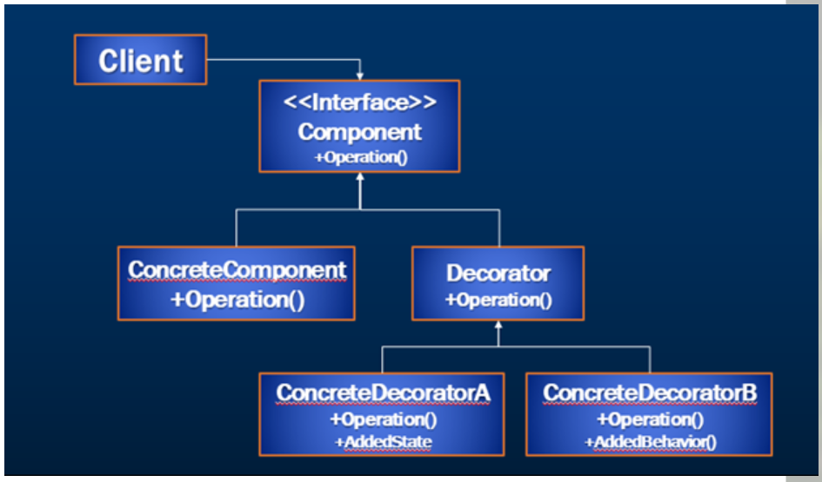
Decorator Design Pattern Diagram

Slide 62
Facade Design Pattern
A single class that represents an entire subsystem
The Façade pattern defines a higher-level single interface
Reduces coupling between subsystems

Slide 63
Facade Implementation Guidelines

Slide 64
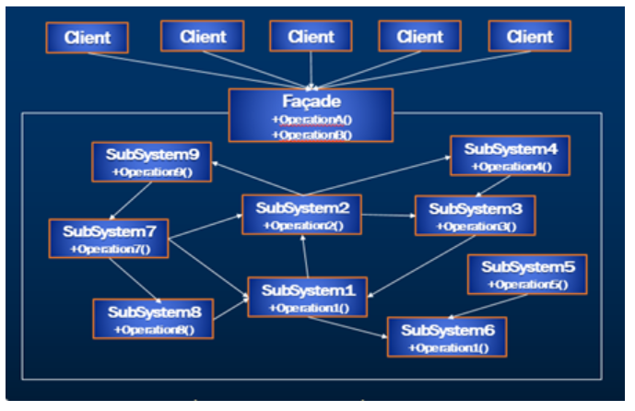
Facade Diagram

Slide 65
Flyweight Design Pattern
Flyweight : A fine-grained instance used for efficient sharing The Flyweight pattern reduces the number of low-level, detailed objects within a system by sharing objects.
The Flyweight pattern defines a structure for sharing objects and focuses its capabilities for space efficiency.
Applications that use lots of objects must pay careful attention to the cost of each object. Substantial savings can be achieved by sharing objects instead of replicating them.
Leveraging on Flyweight pattern reduces in the number of objects to handle.
We need to use flyweight pattern when the application uses a large number of objects and the Storage costs are high because of the quantity of objects and when the application does not depend on object identity.

Slide 66
Flyweight Implementation Guidelines

Slide 67
Flyweight Diagram

Slide 68
Proxy Design Pattern
Proxy : An object representing another object The Proxy pattern provides a surrogate or placeholder object to control access to the original object.
We should use the proxy pattern when we need a more versatile or sophisticated reference to an object than a simple pointer.
Remote proxy and Virtual proxy are some of the implementations of the Proxy design patterns with virtual proxy being the most common used implementation.

Slide 69
Proxy Implementation Guidelines

Slide 70
Proxy Diagram

Slide 71
Behavioral DP Types beginning ……..

Slide 72
Observer Design Pattern
The Gang of Four book (Design Patterns: Elements of Reusable Object-Oriented Software, 1995) says that the Observer design pattern should "Define a one-to-many dependency between objects so that when one object changes state, all its dependents are notified and updated automatically".
The Observer pattern is to notify the interested observers about some change occurred. We can add more observers in runtime as well as remove them. Example: We have a form to select the color. For each color change we need to update the entire application. There will be observers listening to the color change event for updating themselves.

Slide 73
Observer DP Implementation Guideline

Slide 74
Observer DP Diagram

Slide 75
Observer Example

Slide 76
Strategy Design Pattern
The strategy design pattern is a behavioral design pattern in computer programming that allows you to define a family of algorithms and make them interchangeable. This pattern lets you select an algorithm at runtime, depending on the context, instead of implementing a single algorithm directly.

Slide 77
Strategy Design Pattern Implementation Guideline

Slide 78
Strategy Design Pattern Diagram

Slide 79
Repository Design Pattern
Repository Design Pattern: Simplifying Data Access
The repository pattern is a structural design pattern.
The Repository Design Pattern is a software design pattern that acts as an intermediary layer between an application’s business logic and data storage.
Its primary purpose is to provide a structured and standardized way to access, manage, and manipulate data while abstracting the underlying details of data storage technologies.
This pattern promotes a clear separation of concerns, making software more maintainable, testable, and adaptable to changes in data sources, without entangling the core application logic with data access intricacies.
In essence, the Repository Design Pattern is a blueprint for organizing and simplifying data access, enhancing the efficiency and flexibility of software systems.
Example:- the Repository Design Pattern works as a librarian between a program and data (like books in a library). Instead of the program directly looking for data, it asks for repository to find save, update, or delete the data it needs.

Slide 80
Advantages of Repository Design Pattern
Centralized Data Access: The pattern centralizes and abstracts data access logic, allowing the rest of the application to interact with data through a consistent interface. This simplifies code maintenance by managing all data-related operations in one place.
Enhanced Testability: Separating data access logic from the business logic facilitates easier unit testing. With a clear interface for data operations, mocking or substituting the repository makes it simpler to test other parts of the application independently.
Improve Code Maintainability: The repository design pattern promotes clean code by isolating data access logic. This separation allows developers to make changes or optimize data access without affecting the rest of the application.
Reusability and Extensibility: By adhering to the repository contract, multiple parts of the application can reuse the same data access methods. It allows for easy addition of new data sources or technologies without having to change the main logic of the application.

Slide 81
Disadvantages of Repository Design Pattern
Overhead for Simple Applications: Implementing the repository design pattern might introduce unnecessary complexity in smaller or straightforward applications. In such cases, the added layers of abstraction might be more cumbersome than beneficial.
Learning Curve and Development Time: Adopting the repository design pattern might require additional time for development, as it involves creating interfaces, defining contracts, and implementing concrete repository classes. This learning curve could impact project timelines.
Potential Abstraction Leaks: In some cases, the repository design pattern might leak underlying implementation details to higher layers, making the abstraction less effective. This can happen if the repository needs to cater to complex queries or operations.

Slide 82
Use Cases for Repository Design Pattern
Web Applications: Repositories are commonly used in web applications to manage data access to databases. They abstract the interaction with the database and make it easier to switch to a different database system.
APIs and Services: When building APIs or microservices, the Repository Pattern can help manage data access in a clean and organized way. It enables multiple services to interact with data consistently.
Large and Complex Systems: For large, complex systems where data access logic can become tangled and messy, the Repository Pattern offers a tidy way to handle how data is accessed. This makes the code easier to maintain and manage.
Testing Environments: It’s valuable in testing environments where you want to isolate data access for testing purposes. Mock repositories can be created to simulate data access without modifying the actual data source.
Data Migration: When migrating data from one database to another, the Repository Pattern allows for a smoother transition. You can replace the repository’s implementation to work with the new data source while keeping the rest of the application intact.

Slide 83
Chain Of Responsibility Design Pattern
The Chain of Responsibility design pattern is a behavioral design pattern that allows an object to pass a request along a chain of handlers. Each handler in the chain decides either to process the request or to pass it along the chain to the next handler.
This pattern is frequently used in the chain of multiple objects, where each object either handles the request or passes it on to the next object in the chain if it is unable to handle that request.
This pattern encourages loose coupling between sender and receiver, providing freedom in handling the request.
Usage examples: The Chain of Responsibility is pretty common in C#. It’s mostly relevant when your code operates with chains of objects, such as filters, event chains, customer service department with multiple levels of support staff etc.

Slide 84
Characteristics of the Chain of Responsibility Design Pattern
Loose Coupling: The pattern promotes loose coupling between the sender and receiver of a request, as the sender doesn’t need to know which object will handle the request and the receiver doesn’t need to know the structure of the chain.
Dynamic Chain: The chain can be modified dynamically at runtime, allowing for flexibility in adding or removing handlers without affecting the client code.
Single Responsibility Principle: Each handler in the chain has a single responsibility, either handling the request or passing it to the next handler, which helps in maintaining a clean and modular design.
Sequential Order: Requests are processed sequentially along the chain, ensuring that each request is handled in a predefined order.
Fallback Mechanism: The chain can include a mechanism to handle requests that are not handled by any handler in the chain, providing a fallback or default behavior.
Variants: The pattern has variants like a linear chain, where each handler has a single successor, or a tree-like structure, where a handler can have multiple successors, allowing for more complex processing logic.
Enhanced Flexibility: The pattern allows for enhanced flexibility in handling requests, as the chain can be configured or modified to suit different requirements without changing the client code.

Slide 85
Chain Of Responsibility Design Pattern Implementation Guideline

Slide 86
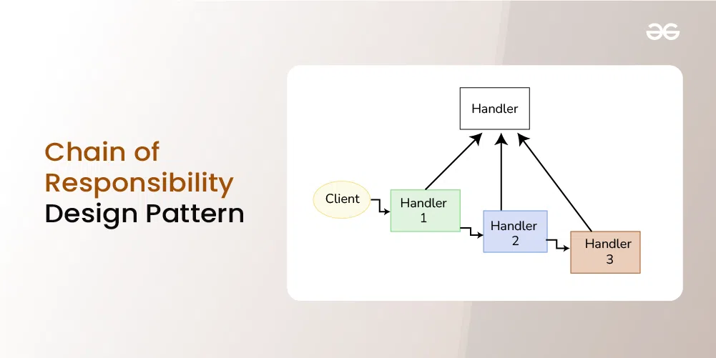
Chain Of Responsibility Design Pattern Diagram

Slide 87
Template Design Pattern
The Template Method design pattern is a behavioral design pattern that defines the skeleton of an algorithm in a superclass but allows subclasses to override specific steps of the algorithm without changing its structure. It promotes code reuse by encapsulating the common algorithmic structure in the superclass while allowing subclasses to provide concrete implementations for certain steps, thus enabling customization and flexibility.
The overall structure and sequence of the algorithm are preserved by the parent class.
Template means Preset format like HTML templates which has a fixed preset format. Similarly in the template method pattern, we have a preset structure method called template method which consists of steps.
These steps can be an abstract method that will be implemented by its subclasses.
This is one of the easiest to understand and implement. This design pattern is used popularly in framework development and helps to avoid code duplication.

Slide 88
Template Design Pattern Implementation Guideline

Slide 89
Template Design Pattern Diagram

Slide 90
Iterator Design Pattern

Slide 91
Iterator Design Pattern Implementation Guideline

Slide 92
Iterator Design Pattern Diagram

