Slide 1

Graphs in Computer Science
Graph provides a conceptual framework for solving problems that might be difficult or impossible
~ Sriya ~ Oam Kakde
~ Santosh
~ Vikash

Slide 2
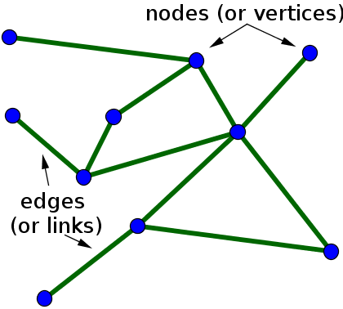
Introduction
It has points called “nodes” and lines connecting these points called “edges”
Degree is equal to number of edges connecting
Path is a sequence of vertices connected by edges

Slide 3
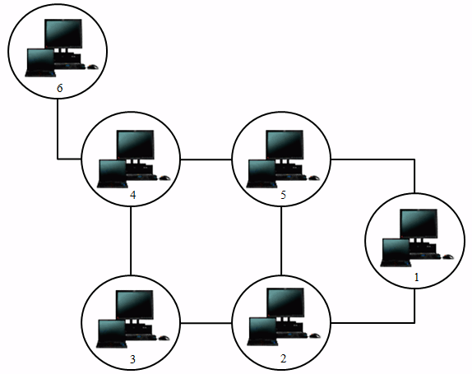
Applications
One of the most important direct applications are network,mapping and navigation.
Networks
Graphs Theory used for
security purpose
or to schematize
network topologies.
Source: google images

Slide 4
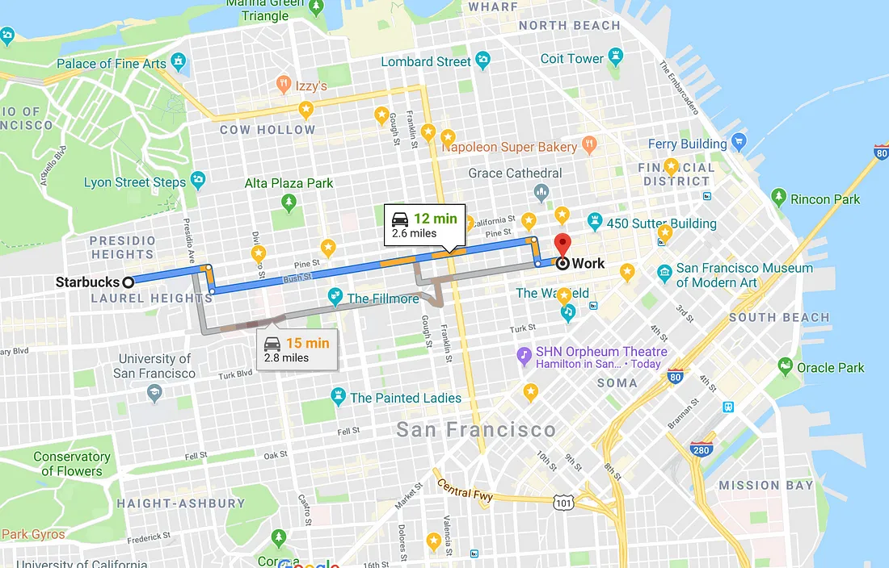
Google Maps

Slide 5
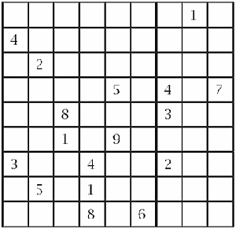
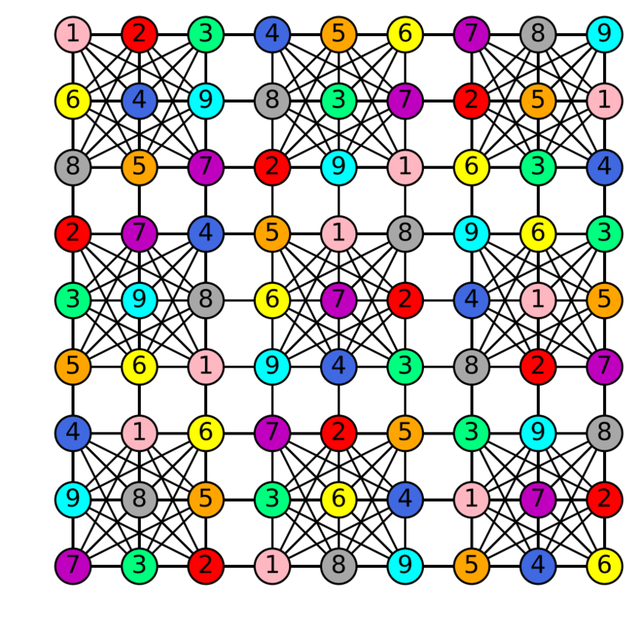
Sudoku
Source: google images

Slide 6
Conclusion
Think of a friendship network. It shows people (nodes) and their friendship (edges), without detailing every interaction. This abstraction helps you see social connections clearly.

Slide 7
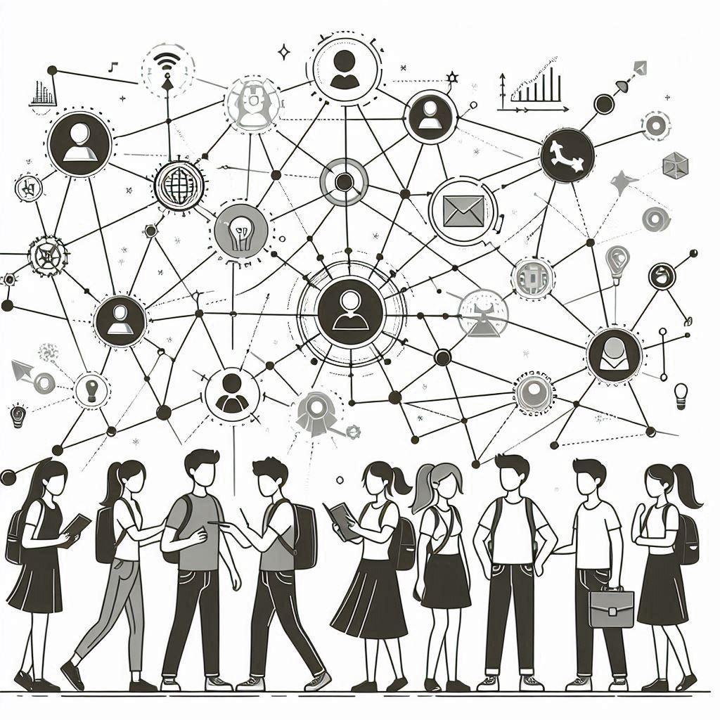

Slide 8
Thank You

