Slide 1

Session Name:
Numerical Optimization
Local/Global Optimum • Convexity • Techniques • Gradient vs Derivative-Free Methods
Course: Evolutionary Algorithms and Numerical Optimization
University: Chandigarh University, India
Notes:
Opening: Position optimization as a decision-making discipline. The goal is to help students understand how mathematical models find the best decision under business constraints.

Slide 2

Learning Objectives
By the end of this session, students should be able to explain and apply the following.
Differentiate between local optimum and global optimum using simple graphs.
Explain convex and non-convex optimization in business language.
Identify common numerical optimization techniques and when they are used.
Apply gradient-based and derivative-free optimization concepts through solved numerical.
Attempt MCQs and mini exercises related to optimum, convexity and optimization methods.
Numerical Optimization | Chandigarh University
Notes:
Set the expectation that this is not an advanced mathematics lecture. It is a decision-science lecture with formulas only where they clarify the idea.

Slide 3
Numerical Optimization: The Big Picture
Optimization converts a business question into a best-decision search.
1
Define the decision
2
Measure success
3
Respect limits
4
Search intelligently
What can we control?
Example: price, stock level, ad budget, machine settings.
Objective function.
Maximize profit or accuracy; minimize cost, time or error.
Constraints.
Budget, capacity, service-level, risk, legal or business limits.
Numerical method.
Use an iterative technique when solving directly is difficult.
Notes:
Use a business example: a company has many possible prices, inventory levels, or ad spends; optimization helps select the best option rather than relying only on intuition.

Slide 4
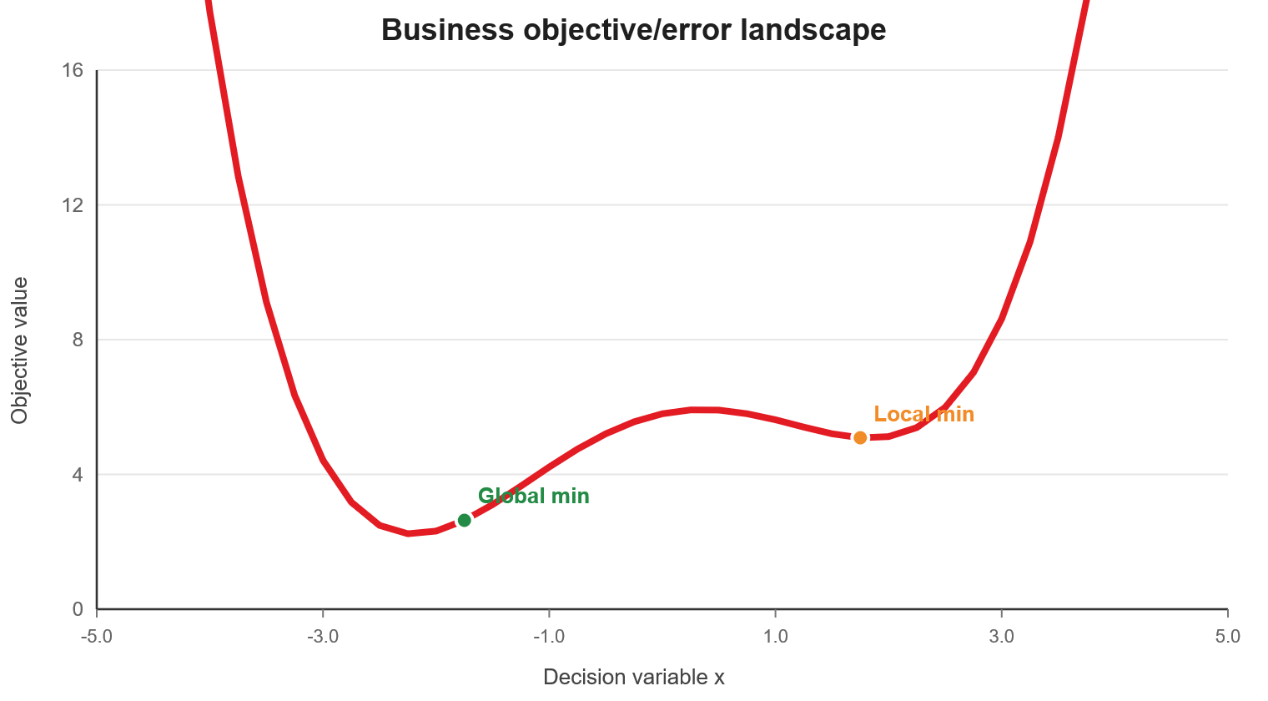
1. Local and Global Optimum
A local optimum is best nearby; a global optimum is best overall.
Key definitions
Local minimum/maximum: best within a small neighborhood.
Global minimum/maximum: best across the entire feasible region.
Starting point matters when the surface has many hills and valleys.
Local optimum: good nearby
Global optimum: best overall
“Local is best near me; global is best everywhere.”
Notes:
Explain with a travel analogy: choosing the best nearby restaurant vs the best restaurant in the city. Local optimum is not necessarily bad; it is just not guaranteed to be the best possible.

Slide 5
Numerical: Local vs Global Minimum
Objective function
Minimize f(x) = x⁴ − 6x² + x + 10
Local minimum
Global minimum
Best point in a nearby region — like a local valley.
Best point across the entire function — the deepest valley.

Slide 6
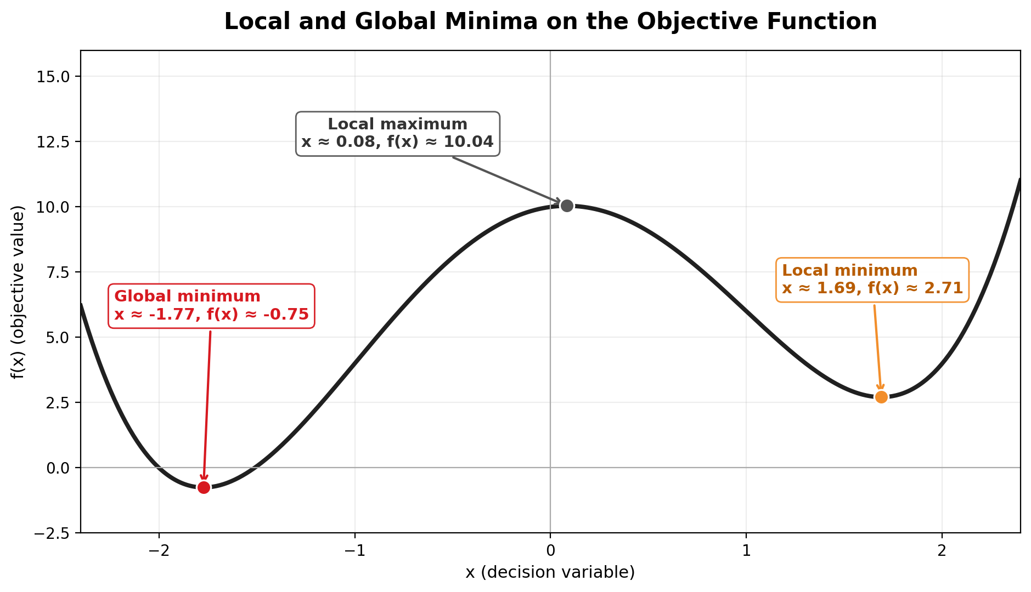
Numerical: Local vs Global Minimum
Use the graph to see valleys first; then use calculus to verify them.
Objective function
Minimize f(x) = x⁴ − 6x² + x + 10
Local minimum
Global minimum
Best point in a nearby region — like a local valley.
Best point across the entire function — the deepest valley.
Read the graph simply:
There are two valleys. The left valley is lower, so it is the global minimum. The right valley is only a local minimum.
“Local means best nearby; global means best overall.”

Slide 7
Step-by-Step Solution: Find and Classify the Critical Points
Use derivative = 0 to find candidate points, then compare objective values.
1
Differentiate the objective function
f′(x) = 4x³ − 12x + 1
x
f″(x)
2
Set derivative equal to zero
4x³ − 12x + 1 = 0
Critical points: x ≈ −1.77, 0.08, 1.69
3
Use the second derivative test
f″(x) = 12x² − 12
If f″(x) > 0 → local minimum
If f″(x) < 0 → local maximum
4
Compare f(x) at all minima
Lowest f(x) = global minimum

Slide 8
Step-by-Step Solution: Find and Classify the Critical Points
Use derivative = 0 to find candidate points, then compare objective values.
1
Differentiate the objective function
Classification Table
f′(x) = 4x³ − 12x + 1
x
f″(x)
Type
f(x)
2
Set derivative equal to zero
−1.77
+25.69
Local min
−0.75
4x³ − 12x + 1 = 0
Critical points: x ≈ −1.77, 0.08, 1.69
0.08
−11.92
Local max
10.04
3
Use the second derivative test
1.69
+22.22
Local min
2.71
f″(x) = 12x² − 12
If f″(x) > 0 → local minimum
If f″(x) < 0 → local maximum
Global minimum because this is the lowest objective value
Remember: For minimization, lower f(x) is better.
4
Compare f(x) at all minima
Lowest f(x) = global minimum
Final answer: Global minimum at x ≈ −1.77 with f(x) ≈ −0.75; another local minimum occurs at x ≈ 1.69.

Slide 9
Poll 1: Local vs Global Optimum
MCQ: In a minimization problem, a point is called a global minimum when:
A. It has the lowest value compared only with nearby points.
B. It has the lowest value among all feasible points.
C. It is found by any algorithm in the first iteration.
D. It always occurs at x = 0.
Notes:
Ask students to answer before revealing. Reinforce the difference between local and global using “nearby” vs “entire search space.”

Slide 10
Poll 1: Local vs Global Optimum
MCQ: In a minimization problem, a point is called a global minimum when:
A. It has the lowest value compared only with nearby points.
B. It has the lowest value among all feasible points.
C. It is found by any algorithm in the first iteration.
D. It always occurs at x = 0.
Answer: B. Global means best across the entire feasible region, not just nearby.
Notes:
Ask students to answer before revealing. Reinforce the difference between local and global using “nearby” vs “entire search space.”

Slide 11
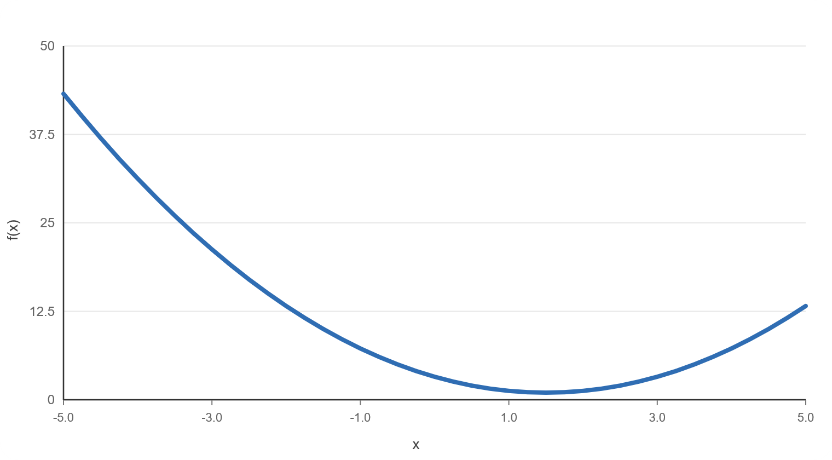
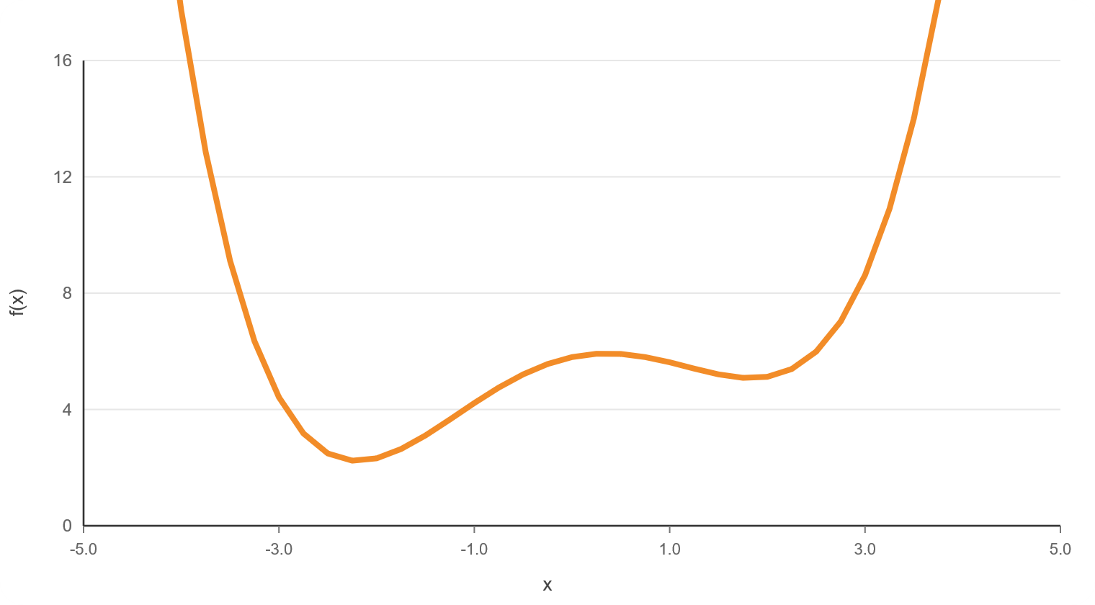
2. Convex and Non-Convex Optimization
Convex problems are easier because every local optimum is also global.
Convex: one smooth bowl
Non-convex: many valleys
Any valley bottom is the best valley bottom (global minima).
The algorithm may stop in a local minima, not the global minima.
Notes:
Use the “bowl” analogy. For MBA students, the key implication is risk: convex problems are predictable; non-convex problems require multiple starts, heuristics, or global methods.

Slide 12
Numerical 2: Finding the Minimum of a Convex Function
A simple calculus-based optimization example.
Problem
Minimize f(x) = (x − 3)² + 5
Numerical Optimization | Chandigarh University
Notes:
This is a good place to connect derivative with slope. The optimum occurs where the slope becomes zero in a convex bowl.

Slide 13
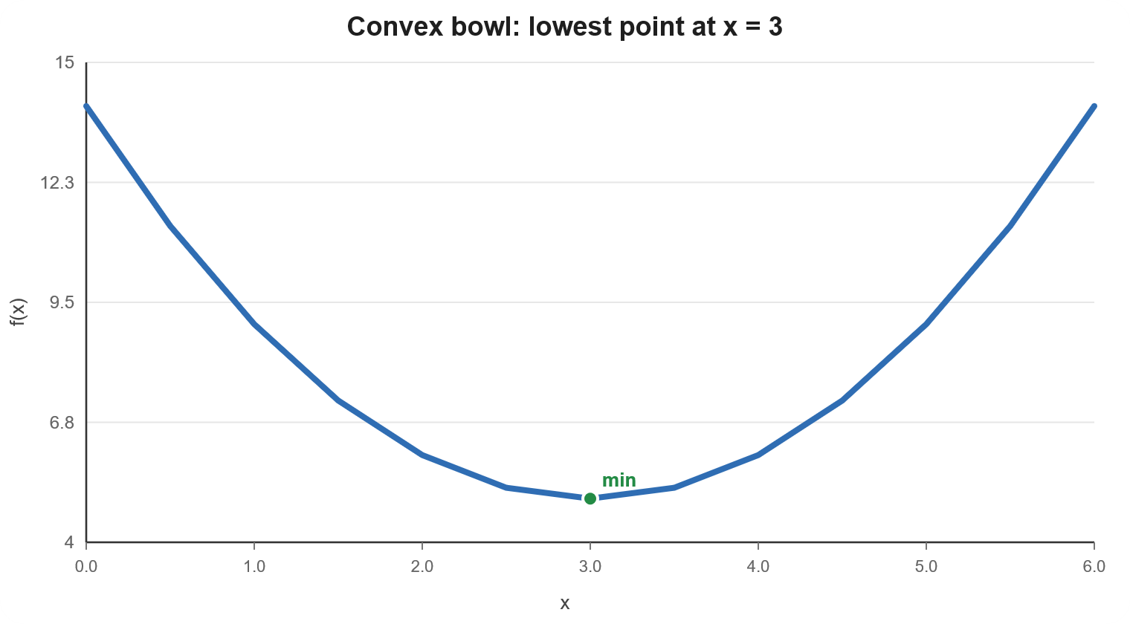
Numerical 2: Finding the Minimum of a Convex Function
A simple calculus-based optimization example.
Problem
Minimize f(x) = (x − 3)² + 5
Steps
Derivative: f′(x) = 2(x − 3)
Set derivative to zero: 2(x − 3) = 0
Therefore: x = 3
Minimum value: f(3) = (0)² + 5 = 5
Answer: x = 3 and minimum value = 5
Numerical Optimization | Chandigarh University
Notes:
This is a good place to connect derivative with slope. The optimum occurs where the slope becomes zero in a convex bowl.

Slide 14
3A. Gradient-Based Optimization Methods
These methods use the slope to decide the direction of improvement.
Gradient descent update
xₖ₊₁ = xₖ − α ∇f(xₖ)
Core idea
If the slope is positive, move left.
If the slope is negative, move right.
Keep moving until the slope is close to zero.
Meaning of symbols
xₖ = current solution
∇f(xₖ) = gradient/slope
α = learning rate or step size
Move opposite the gradient for minimization
Simple formula
new x = old x − learning rate × slope
Notes:
Use the hill analogy: if your goal is to minimize, the gradient points uphill, so you move in the opposite direction.

Slide 15
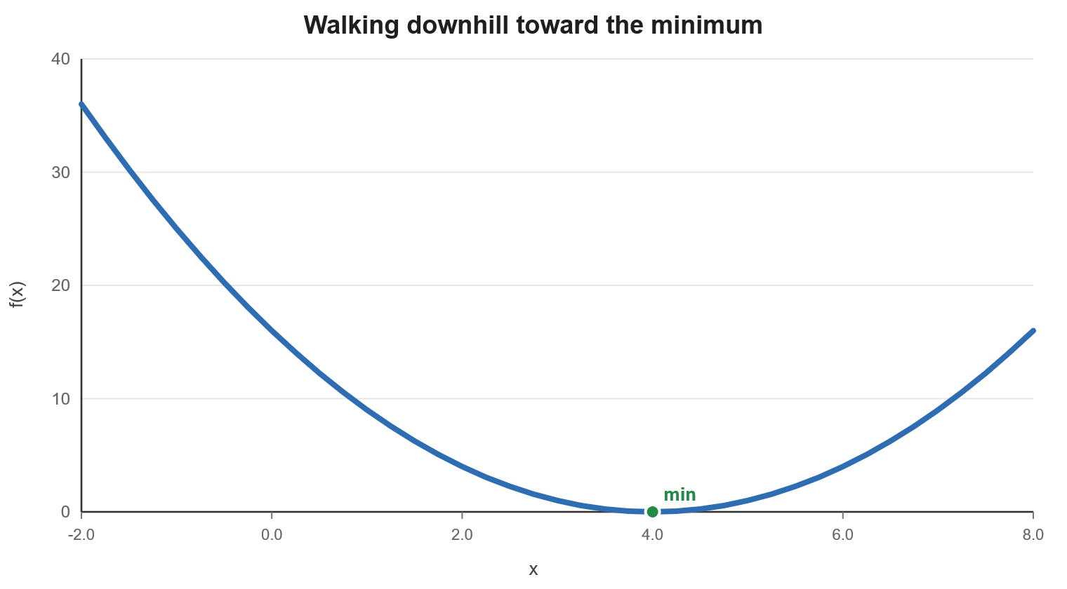
3A. Gradient-Based Optimization Methods
These methods use the slope to decide the direction of improvement.
Gradient descent update
xₖ₊₁ = xₖ − α ∇f(xₖ)
Meaning of symbols
xₖ = current solution
∇f(xₖ) = gradient/slope
α = learning rate or step size
Move opposite the gradient for minimization
Notes:
Use the hill analogy: if your goal is to minimize, the gradient points uphill, so you move in the opposite direction.

Slide 16
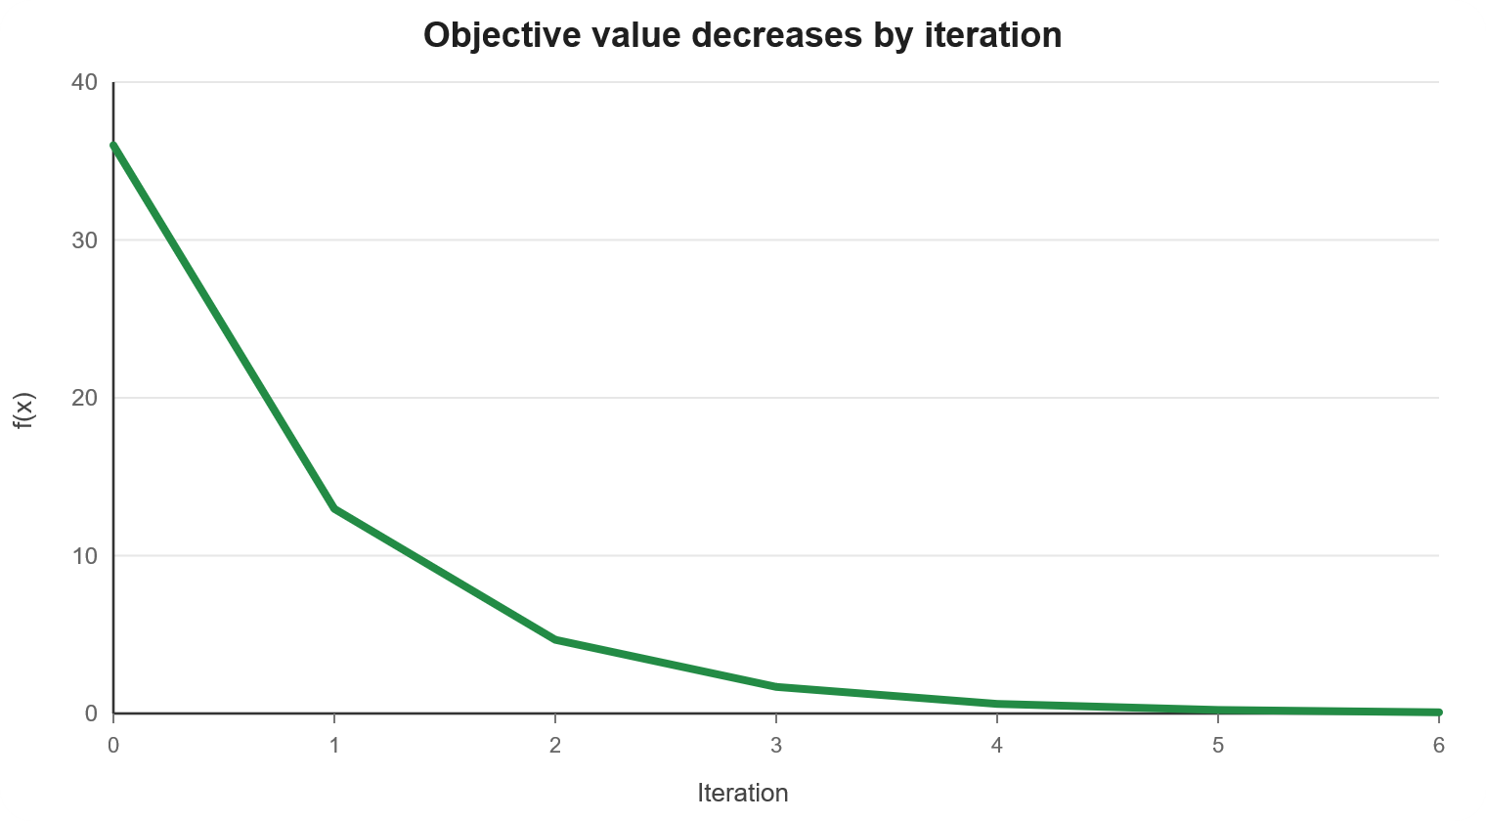
Numerical: Gradient Descent in 4 Steps
Minimize f(x) = (x − 4)² starting from x₀ = 10 with α = 0.2.
Update rule
f′(x)=2(x−4)
xₖ₊₁ = xₖ − 0.2 × f′(xₖ)
k
xₖ
f′(xₖ)
xₖ₊₁
0
10.000
12.000
7.600
1
7.600
7.200
6.160
2
6.160
4.320
5.296
3
5.296
2.592
4.778
Interpretation: x moves from 10 toward 4, and f(x) keeps decreasing.
Numerical Optimization | Chandigarh University
Notes:
Students can calculate the next row. Ask them: what will happen if the learning rate is too large? Then discuss overshooting.

Slide 17
3B. Derivative-Free Optimization Methods
Useful when gradients are unavailable, unreliable or expensive.
When do we use them?
Common examples
The function is non-smooth or has many local optima.
The objective is noisy: repeated evaluations may change slightly.
The variables are discrete, mixed or categorical.
Grid search / random search
Genetic Algorithms
Differential Evolution
Particle Swarm Optimization
Derivative-free methods ask: “Which trial worked better?” not “What is the exact slope?”
Notes:
Connect this to later parts of the syllabus: evolutionary algorithms and swarm intelligence are largely derivative-free search methods.

Slide 18
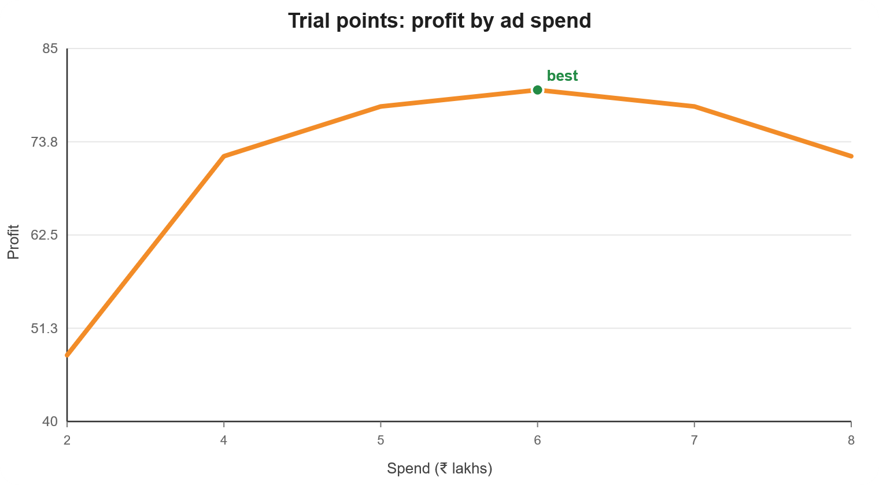
Numerical: Simple Derivative-Free Search
Choose an advertising spend level without using derivatives.
Business objective
Maximize expected profit: P(x) = −2(x − 6)² + 80
where x = advertising spend in ₹ lakhs.
Spend x
Profit P(x)
2
48
4
72
5
78
6
80
7
78
Best observed value: x = 6 lakhs, profit = ₹80 lakhs.
8
72
Notes:
This is a simple grid-search mindset. In real projects, derivative-free algorithms explore intelligently rather than testing every possibility.

Slide 19
Gradient-Based vs Derivative-Free: Which One Should We Choose?
Method choice depends on the problem structure.
Question
Gradient-Based
Derivative-Free
Needs slope?
Yes
No
Speed
Often fast
Often slower
Best for
Smooth, continuous objectives
Black-box, noisy, non-smooth problems
Risk
Can get trapped in local optimum
May require many evaluations
Managerial decision rule: Use gradient-based methods when the model is smooth and transparent; use derivative-free methods when the model behaves like a black box.
Notes:
This slide prepares students for evolutionary algorithms. Explain that genetic algorithms and PSO are not magic; they are derivative-free search techniques for hard optimization landscapes.

Slide 20
Poll: Convexity
MCQ: In a convex minimization problem, why is a local minimum very important?
A. It is always worse than the global minimum.
B. It is also a global minimum.
C. It can exist only when the function is linear.
D. It occurs only at the boundary of the feasible region.
Notes:
Ask students to relate this to business confidence in a solution. Convexity reduces the fear that we have found only a weak local answer.

Slide 21
Poll: Convexity
MCQ: In a convex minimization problem, why is a local minimum very important?
A. It is always worse than the global minimum.
B. It is also a global minimum.
C. It can exist only when the function is linear.
D. It occurs only at the boundary of the feasible region.
Answer: B. In convex minimization, every local minimum is global; this makes the solution more reliable.
Notes:
Ask students to relate this to business confidence in a solution. Convexity reduces the fear that we have found only a weak local answer.

Slide 22
Session Summary
In this session, we discussed the following.
Local optimum is best nearby; global optimum is best over the full feasible region.
Convex problems are easier because a local optimum is also global.
Non-convex problems can have many local optima and need more careful search.
Numerical optimization methods improve a candidate solution step by step.
Gradient-based methods use slope; derivative-free methods use trial evaluations.
Notes:
Close by connecting this session to upcoming evolutionary algorithms. Evolutionary algorithms are powerful search strategies for complex non-convex and derivative-free optimization problems.

Slide 23

Happy Learning!
Next: Evolutionary Computing Metaphor and Search Process
Notes:
Thank students and preview the next topic.

