Slide 1
Personal Finance Dashboard
A Creative Overview

Slide 2
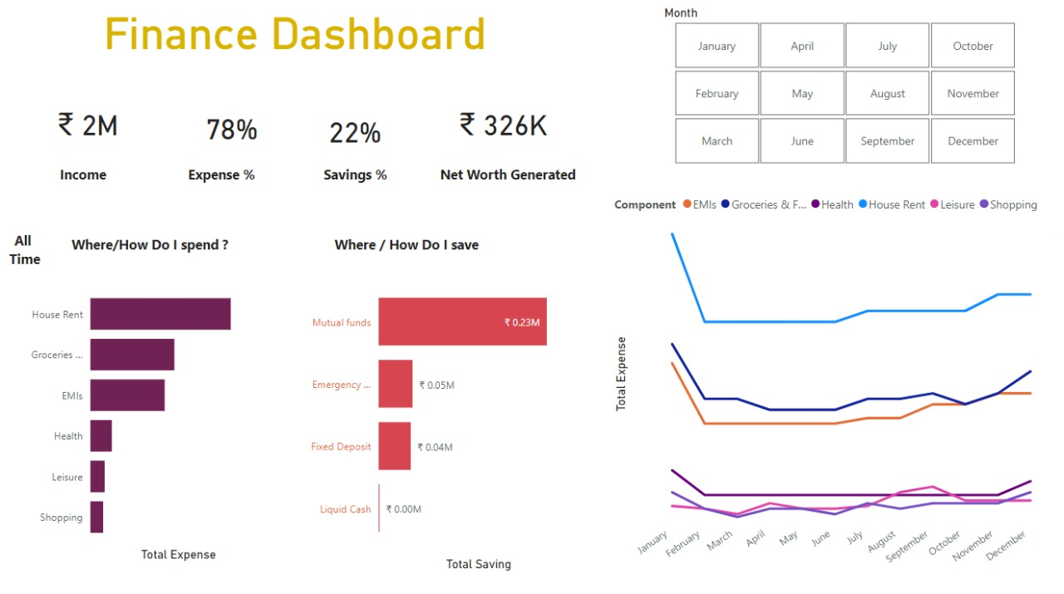
Dashboard Overview

Slide 3
Key Financial Metrics
• Income: ₹2M
• Expenses: 78%
• Savings: 22%
• Net Worth Generated: ₹326K

Slide 4
Expense Analysis
• Top Spending Areas:
- House Rent
- Groceries
- EMIs
• House Rent is the highest expense!

Slide 5
Savings Analysis
• Top Saving Modes:
- Mutual Funds: ₹0.23M
- Emergency Funds: ₹0.05M
- Fixed Deposit: ₹0.04M
• Major savings directed towards Mutual Funds.

Slide 6
Monthly Expense Trends
• Tracking House Rent, EMIs, Groceries, Health, Leisure, Shopping
• Steady rise in December
• Significant dip around March

Slide 7
Key Takeaways
• Major expenses are fixed essentials.
• Consistent investment behavior, dominated by Mutual Funds.
• Expense spikes noticed towards year-end.
• Savings behavior is positive and growing.
"Managing money is mastering life!"

