Slide 1


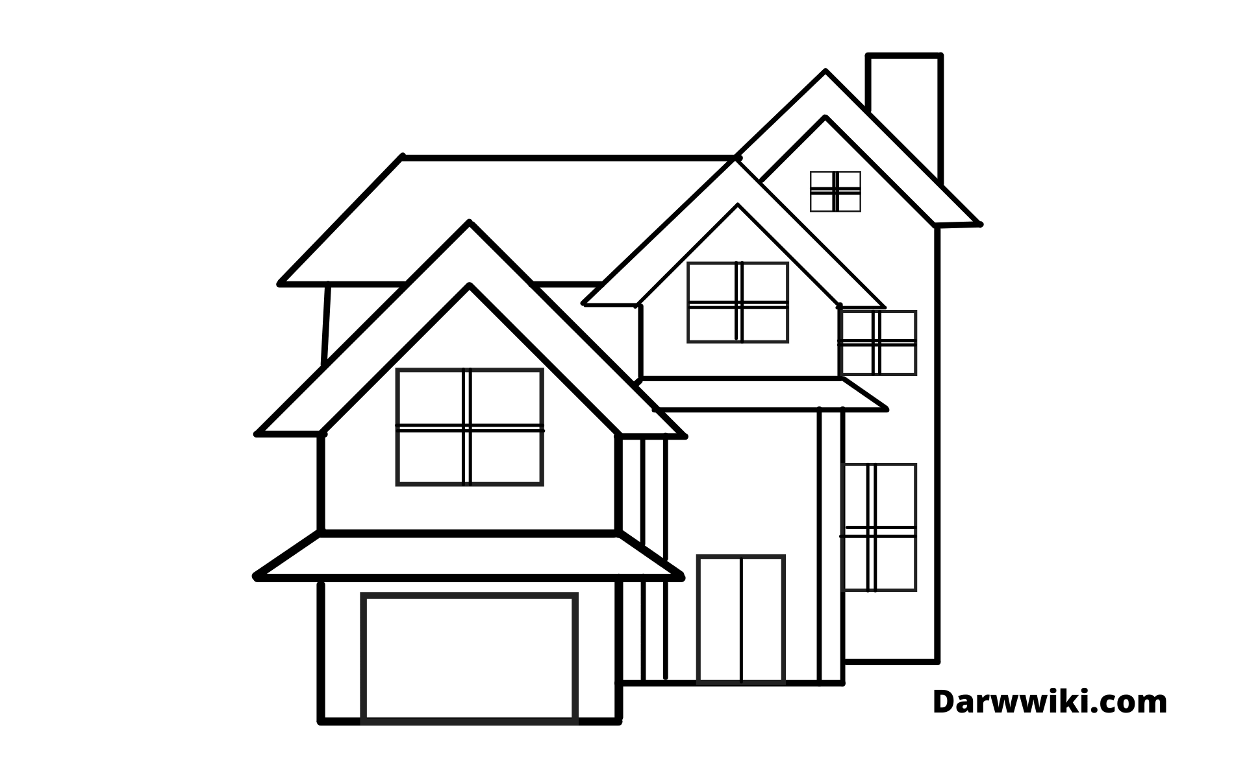
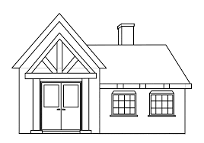
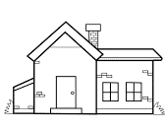



Property Management Dashboard
Real Estate
Property Analysis Report
Over view
Very Good
Good
Bad
Location
About

