Slide 1
Name- Bhawana Dewangan
Course- Python
Project- Snake game

Slide 2
Table of content
Introduction
Objective
Abstract
Purpose
Explanation
Project file structure
Class diagram
Data diagram
Output
Summary

Slide 3
Introduction
snake game using python library pygame
Python is an interpreted,object-oriented, high-level programming language with dynamic.
Python is a computer programming language often used to build websites and software, automate tasks, and conduct data analysis.

Slide 4
Abstract
In this step,we will create the GUI for our Project.
snake game using python library pygame

Slide 5
abstract

Slide 6
Snake pygame
Snake game is one of the most popular arcade game of all time.
In this game ,the main object of the player is to catch the maximum number of fruits without hitting the wall or itself.
We are use pygame to create this snake game.Pygame is a open-source library that is designed for making video games.it has inbuilt graphics and sounds libraries.

Slide 7
Step to create snake pygame:
Installing pygame
Create the Screen
Create the Snake
Moving the Snake
Game over when the snake hits the boundaries
Adding the food
Increasing the length a screen
Displaing the score and High score

Slide 8
Instralling Pygame
To install the pygame in command promt and give the command :-Pip install Pygame
Module and function use in this Project
Function like:-init(),display.set.mode,Quit(),
Set_caption(),event.get(),.fill(),update(),etc.
os,random,etc.

Slide 9
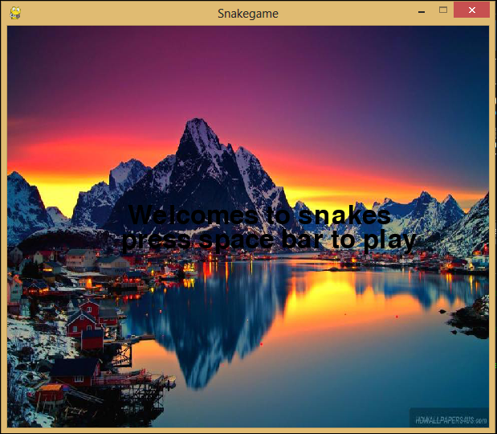

Slide 11
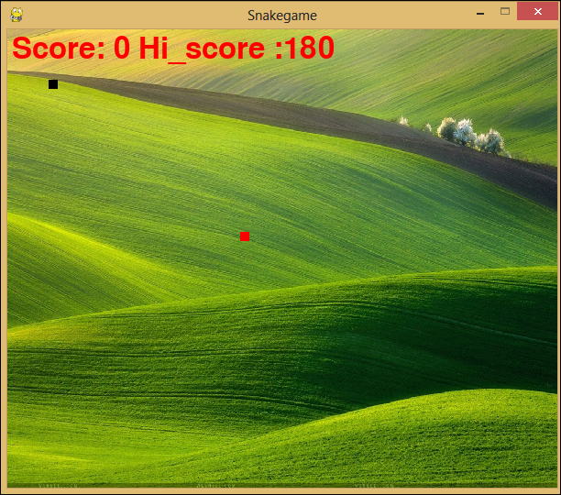

Slide 12
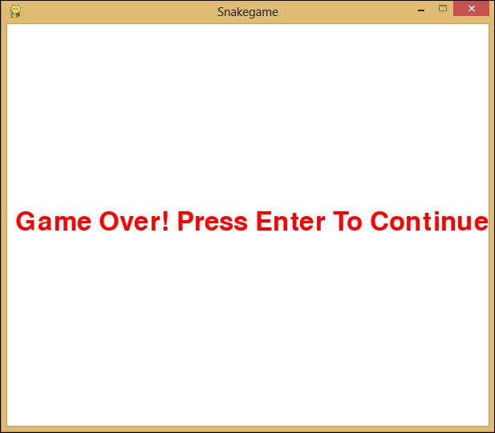

Slide 14
summary

Slide 15
conclution

Slide 16
Thank you

