Slide 1
Computer Aided Process Planning
Project Guide : Mr. Vinod Kumar P P

Slide 2
Contents
Introduction
Modular Description & Challenges
Design Guidelines
Data Extraction module & Algorithm
Hurdles to cross
Conclusion
Reference

Slide 3
Introduction
Manual process planning depends on intelligence and experience of process engineer, with no automation.
CAPP (Computer Aided Process Planning) is the method that is mainly used by industries to sequence processes without human intervention.

Slide 4
Introduction Contd.
CAPP is basically of two types , variant and generative CAPP.
Variant Process Planning: If feature of object is not stored in the database then the new processes are created by the process engineer and entered in the database.
Generative Process Planning: Process plans are generated by means of decision logic, formulas, technology algorithms, and geometry based data to perform uniquely processing decisions.
We focus on Generative Approach for this proposed software.

Slide 5
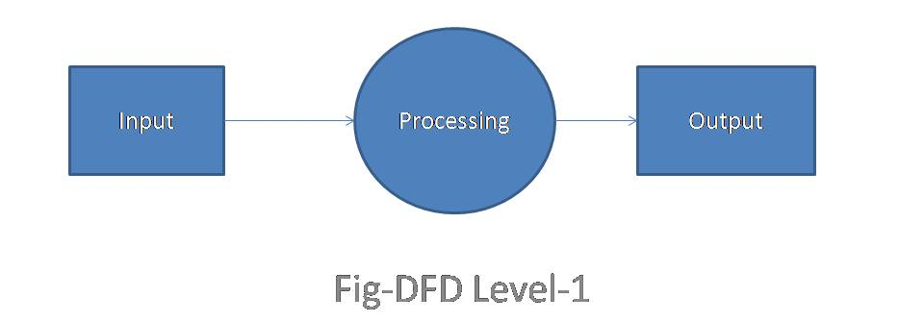
Modular Description
The proposed software is divided into 5 modules which includes taking input drawing file , processing the drawing and generating the output datasheet.

Slide 6
Modular Description contd..
Data Extraction module
Object Identification Module
Object-Process Mapping Module
Process sequencing Module
Output Generating Module

Slide 7
Challenges in Data Extraction
No standard structure: Different CAD or geometric modeling packages store the design related information in their own databases which are structurally different from each other.
Data Exchange Format (DXF) is a common structure, which is widely used for this purpose. But it is yet to be matured enough to transform design information into manufacturing information automatically

Slide 8
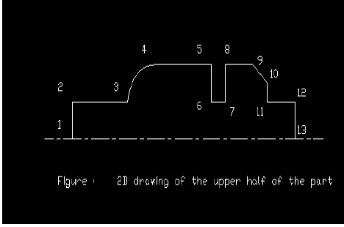
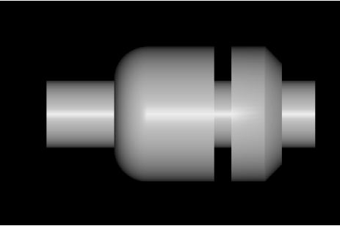
Design Guidelines
1.As the machined surfaces of a rotational part are symmetrical about their axis. They can be designed easily by revolving a line similar to the profile of the upper half of the part about the axis, i.e. a 2D profile of upper half of the part will represent the 3D part completely.

Slide 9
Design Guidelines contd..
2. Each line/arc in the 2D profile represents a surface or feature of the 3D part.Though it is possible to create the 2D profile using ‘polyline’ command we use respective entities to create it.

Slide 10
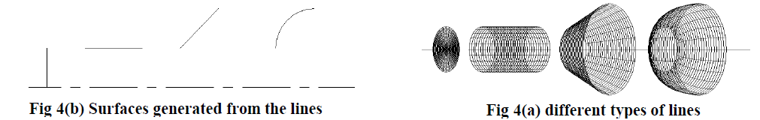
Design Guidelines contd..
Figure 4 (a) and 4 (b) shows four different types of lines and corresponding types of surfaces.

Slide 11
Getting Started with Data Extraction module:
Structure of the DXF file
There are six sections in a DXF file . They are: HEADER, CLASSES, BLOCKS, TABLES, OBJECT and ENTITIES.
Only ENTITIES section contains geometric information(stored as different DXF numbers or codes) regarding any object drawn in the design file . So, part feature information (Object Identification Module)is extracted from the section
Basic algorithm and approach to extract these codes has been explained in later slides.

Slide 12
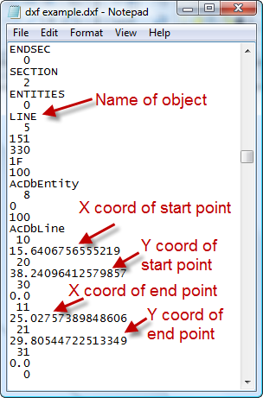


Data Extraction module
Extracting data from .dxf file.

Slide 13
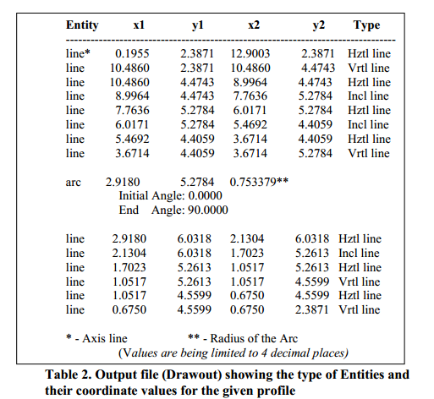
Extraction module contd.

Slide 14
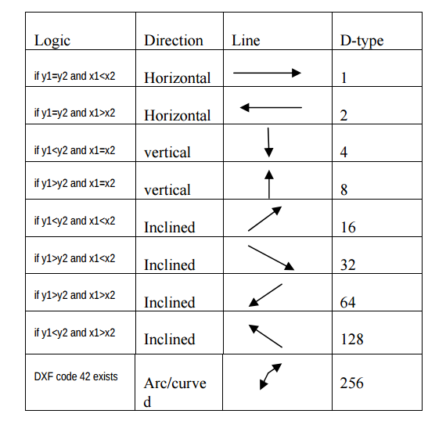
Extraction Module Contd..
Figure : Different logics used to determine line property

Slide 15
Algorithm for Data Extraction
Step1. Save the AutoCAD drawing as .dxf
Step2. Execute the developed file reading program to find the word “ENTITIES”. (This section contains all the geometric information of entities used in the drawing)
Step3. Find the type of entity, by which the part profile is drawn (POLYLINE, LINE and ARC etc.,).

Slide 16
Algorithm contd..
Step4. If the entity is POLYLINE, then execute subprogram 1.
Explanation: This subprogram extracts the X and Y coordinates of the vertex points (values below the DXF codes 10 and 20 are the coordinate values of X and Y respectively).
(Else)
Step5. If the entity is LINE, then execute a subprogram 2.
Notes:
pink color aanu silu… namuk algrthm position mattam

Slide 17
Algorithm contd..
Explanation: Subprogram extracts the X and Y coordinates of the starting and ending points of the line. Values below the DXF codes 10 and 20 are starting point coordinates and values below 11 and 21 are the ending point coordinates of line.
(Else)
Step6. If the entity is ARC, then execute subprogram 3.

Slide 18
Algorithm contd..
Explanation: The values below the DXF codes 10 and 20 represent the coordinate values of the center point of the arc. And the value below the DXF code 40 is the radius of the arc. The values below the Flags 50 and 51 are the starting and ending angles of the arc.
Step7. Repeat steps 3-6 until it reaches ‘ENDSEQ’, i.e. the end of the entity section.

Slide 19
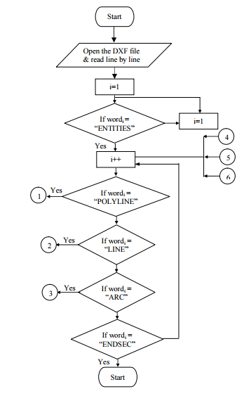
Flow chart
Flow chart showing the overall structure of the Extraction Program

Slide 20
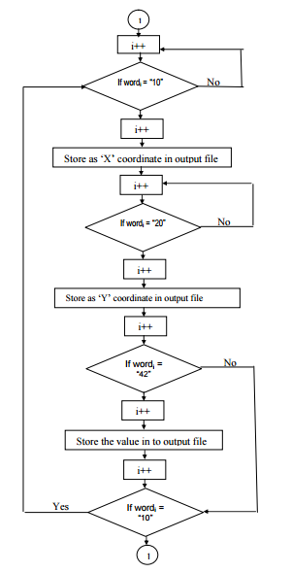
Flow chart contd.
Flow chart for feature extraction of profiles drawn by POLYLINE command

Slide 21
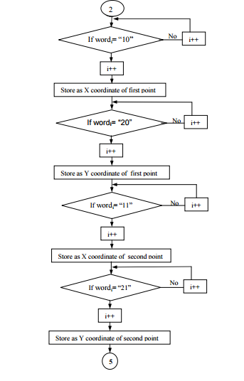
Flow chart contd
Flow chart for feature extraction of profiles drawn by LINE command

Slide 22
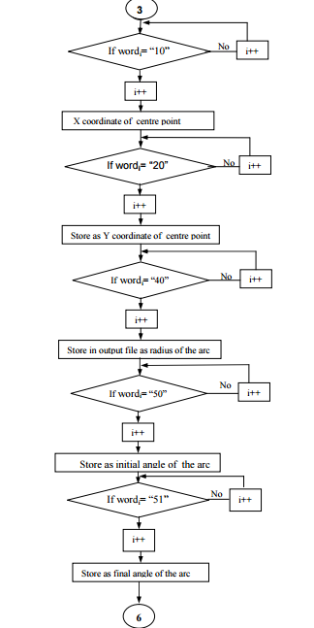
Flow chart contd
Flow chart for feature extraction of profiles drawn by ARC command

Slide 23
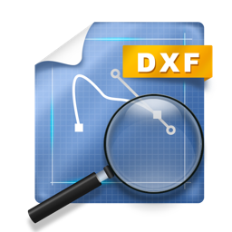
Data Extraction module contd..
DXFGrabber is a python library to extract data from the DXF drawings.
DXFViewer is a free viewer for DXF files, it enables you to quickly open and read DXF files.

Slide 24
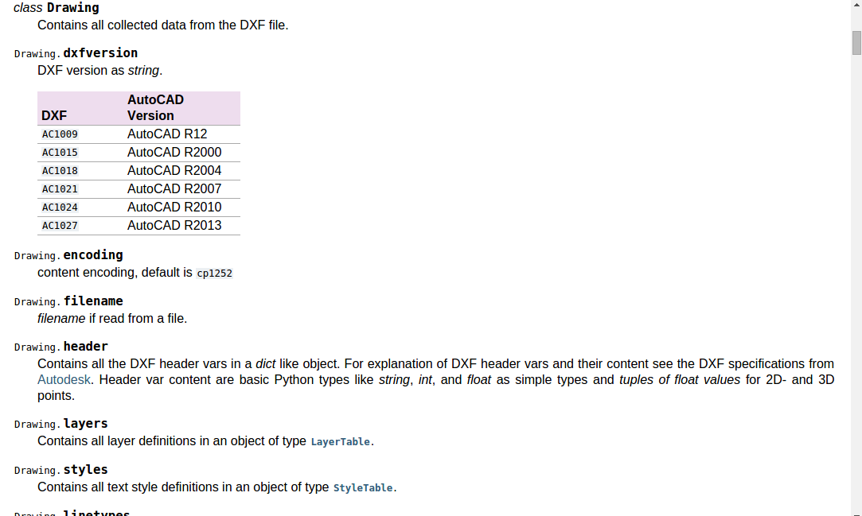
DXFGrabber

Slide 25
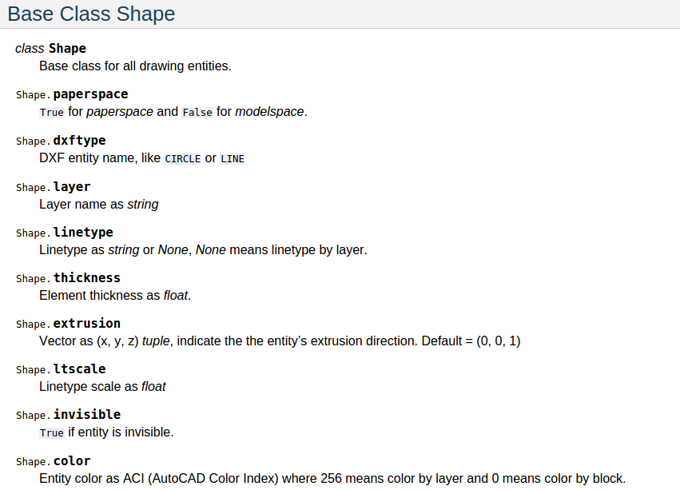
DxfGrabber contd

Slide 26
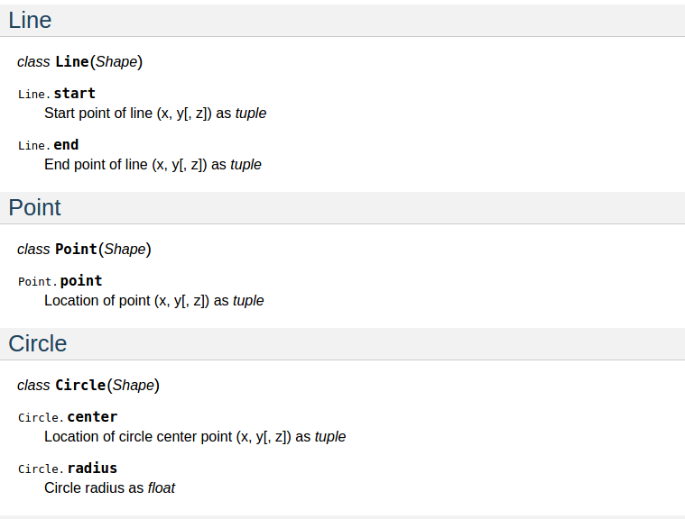
DxfGrabber contd

Slide 27
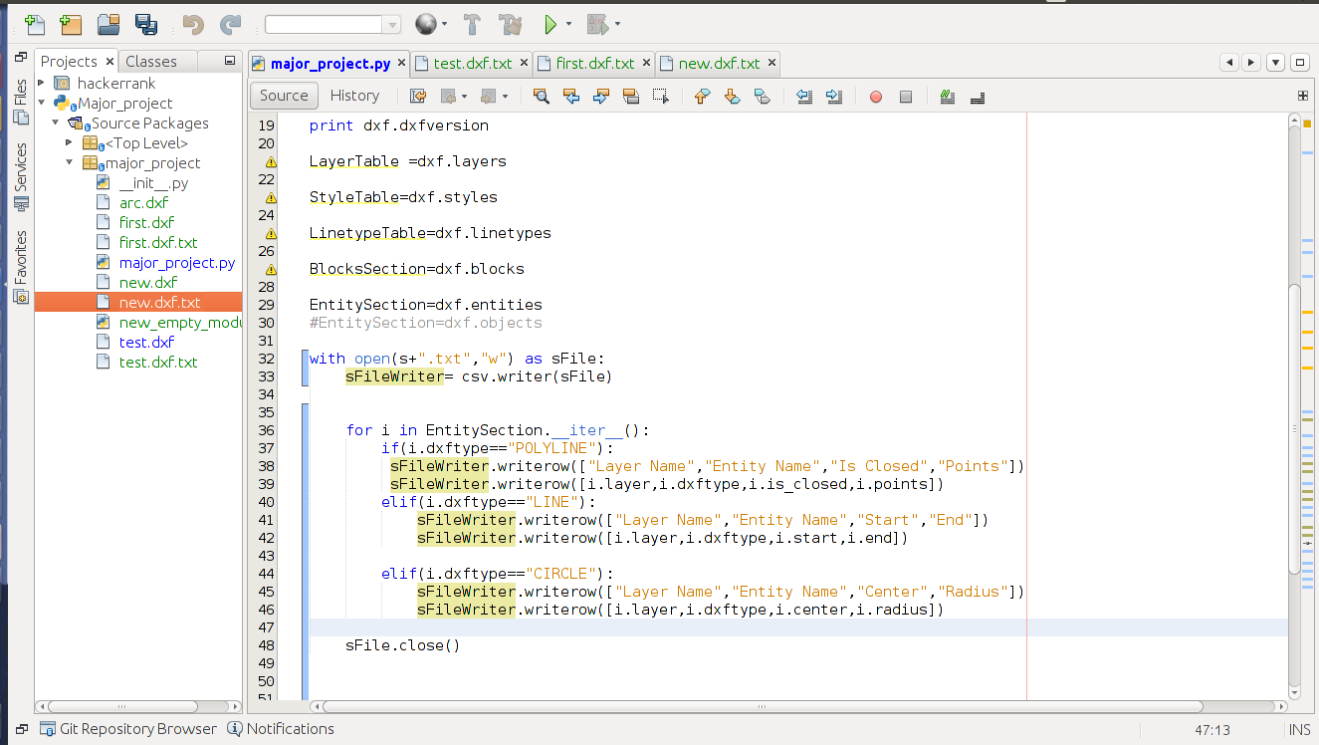
Screenshots - Code

Slide 28
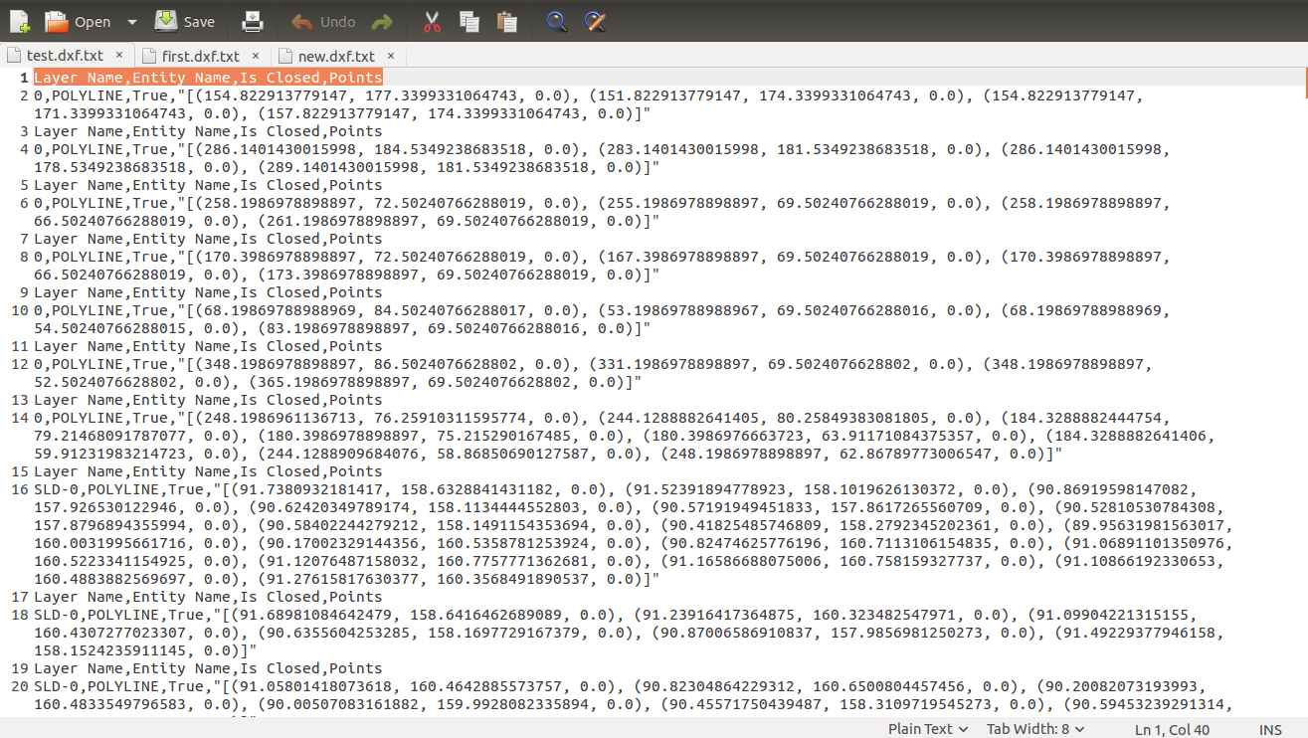
Screenshots - Output

Slide 29
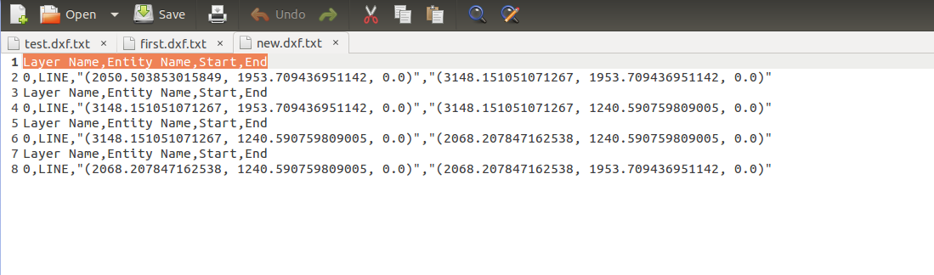
Screenshot - Output

Slide 30
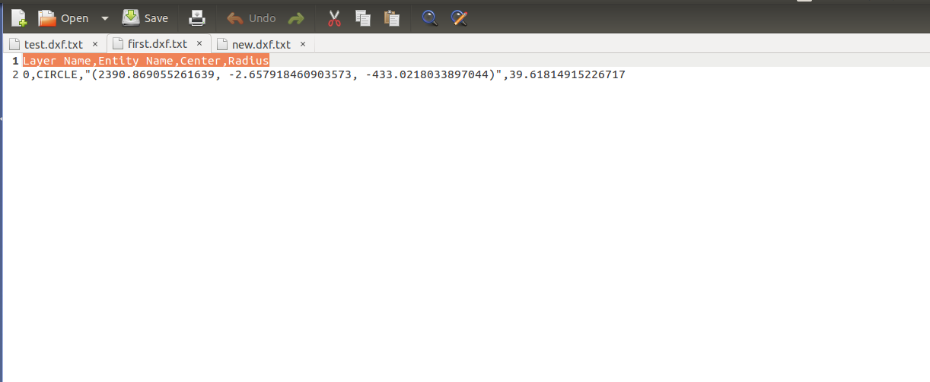
Screenshot - Output

Slide 31
Hurdles to Cross:
The language of CAD is geometry based with geometric entities such as ‘line’, ‘arc’, ‘circle’ and so on to represent the finished part.
Downstream in CAM, features such as ‘face’, ’taper’, ‘groove’, ‘chamfer’ and associated attributes are common language.one of the major challenges is to translate the CAD language to a CAM language and this requires a part feature recognition system

Slide 32
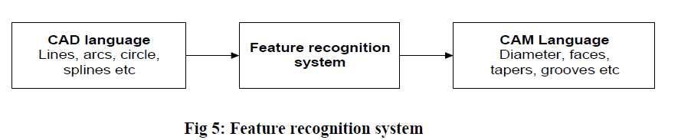
Hurdles to Cross contd..
Part data are extracted from the DXF file consist of some coordinates of different points and have very little significance for manufacturing until different features and their attributes of the part are identified.

Slide 33
Object Identification Module
Optiz Code = nine (9) digits
Digits 1 through 5 = FORM CODE – primary shape
and design attributes (hierarchical structure)
Digits 6 through 9 = SUPPLEMENTARY CODE –
attributes that are useful in manufacturing
(eg- dimensions, starting material)

Slide 34
Object Identification Module contd..
Digits 10 through 13 = SECONDARY CODE
production operation type and sequence
(Eg :- Turning , milling etc..)

Slide 35
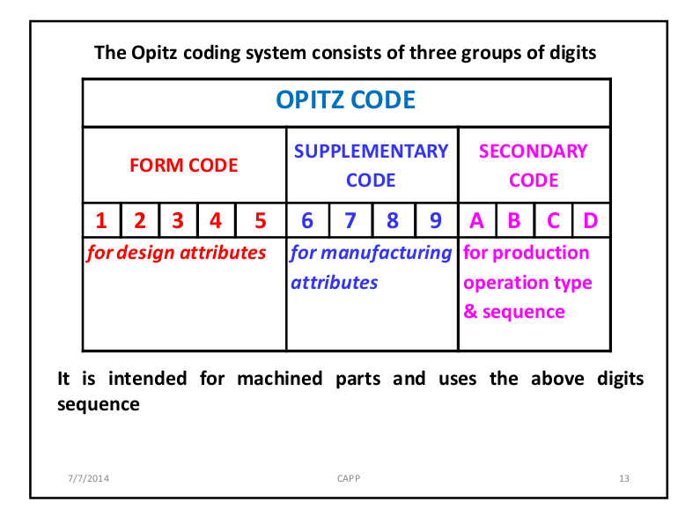
Object Identification Module contd..

Slide 36
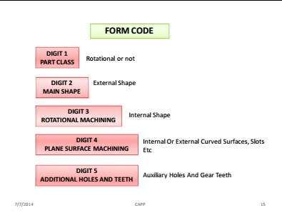
Object Identification Module Contd...

Slide 37
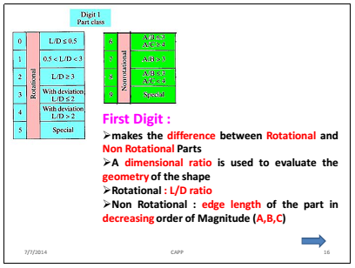
Object Identification Module Contd...

Slide 38
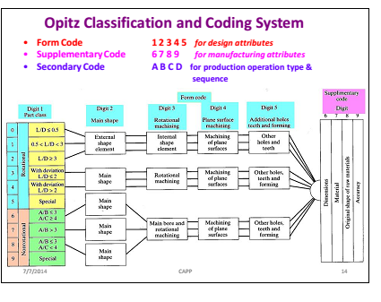
Object Identification Module Cntd...

Slide 39
Conclusion
An algorithm for the extraction of design feature data from DXF files is generated.
The algorithm gives out the feature data even when the profile is drawn with a combination of commands Eg: LINE, POLYLINE and ARC

Slide 40
Reference contd..
[3]. S. Linardakis and A.R. Mileham, 1995, “ A Methodology for extracting manufacturing features for prismatic components from CAD DXF files”, Proceedings of the twelfth conference of the Irish Manufacturing Committee. Pp.71-77
[4]. Pande S S., and Prabhu B S., 1990 “An Expert System for Automatic Extraction of Machining Features and Tooling Selection for Automats”, Computer-Aided Engineering Journal, pp 99-103.

Slide 41
Reference
[1]. Gindy, N. N. Z.,”A hierarchical structure for form features”, International Journal of Production Research, Vol. 27, No. 12, pp. 2089-2103
[2]. Jaekoo, J., et. Al., “Efficient feature-based process planning for sculpture pocket machining”, Computers and Industrial Engineering

