Slide 1



﻿Walmart Weekly Sales Forecasting
Presented by ﻿Vikash Sinha, ﻿Carlos Iturralde & ﻿Olaoluwa Olasanoye

Slide 2
OVERVIEW
Problem Statement
Comparison
Conclusion
Dataset description
ML Algorithms
Implementation Results

Slide 3
PROBLEM
Accurate sales forecasting is crucial for retail giants like Walmart to optimize inventory management and maintain customer satisfaction. The challenge is to predict weekly sales across 45 Walmart stores using historical data and various external factors.

Slide 4
DATASET
Our dataset spans from 2010 to 2012, containing over 100,000 rows of weekly sales data from 45 Walmart stores. Key features include:
• Store and department identifiers
• Temperature and fuel price data
• Economic indicators like CPI and unemployment rates
• Holiday flags for special events

Slide 5
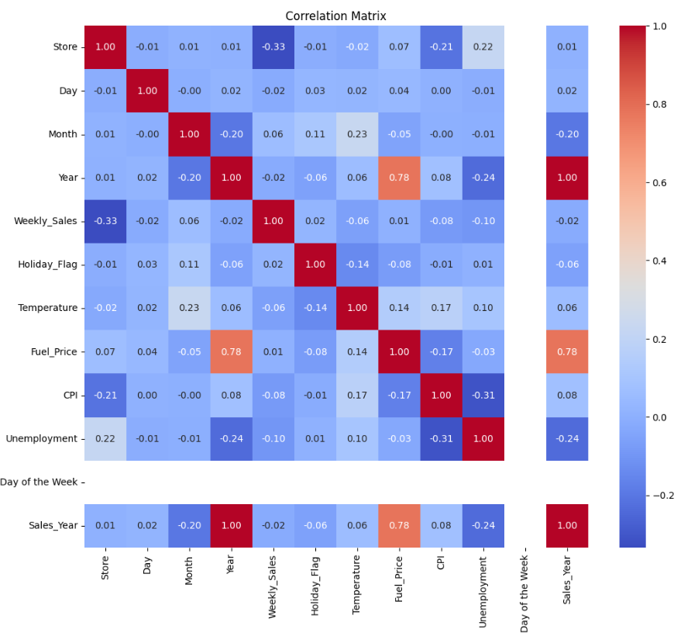
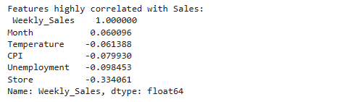
CORRELATION MATRIX
A correlation matrix offers valuable insights by displaying the strength and direction of linear relationships between pairs of variables. It helps identify potential multicollinearity, guiding feature selection for predictive models. By highlighting patterns, it aids in understanding the data's structure. Additionally, it can reveal which variables are independent and which are interrelated, making it a useful tool for risk management, particularly in finance for assessing asset return relationships and aiding in portfolio diversification.
According to our correlation Matrix analysis, it is evident that many of the variables are unrelated to our target variable Weekly Sales this will create certain challenges when developing a model.

Slide 6
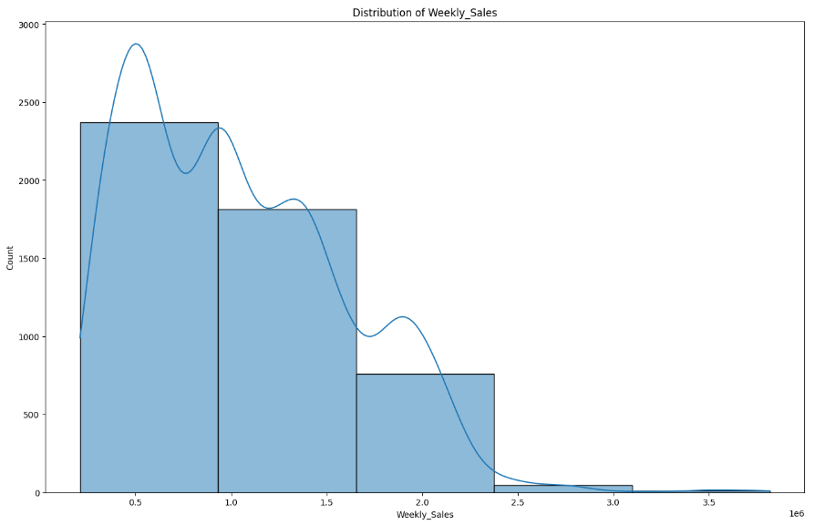
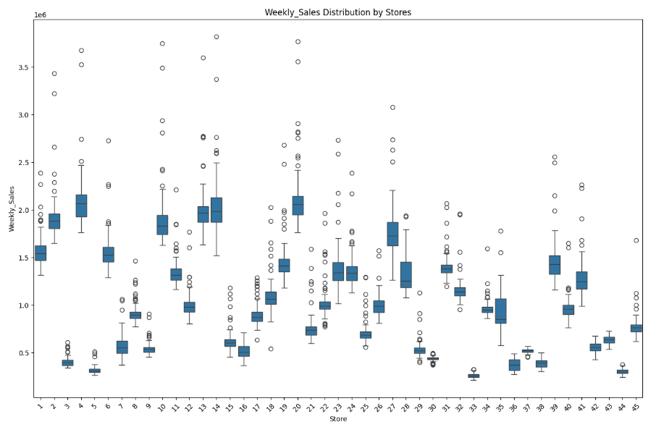
DATASET
Here we visualize the sale distribution divided into 5 boxes confirming that the average Weekly Sales number to be 1,049,623.70 USD
This graph attempts to draw insight on individual store performances given Weekly Sales. Interestingly, enough note that stores 1-20 are able to reach sales above 3MM USD and very few under 1MM USD this can perhaps be driving by location of volume of customers

Slide 7
ML ALGORITHMS
﻿Linear Regression:
Linear Regression provided a baseline model, achieving a Root Mean Square Error (RMSE) of 12,000 and an R² score of 0.68. Its performance demonstrates the limitations of simplistic approaches when handling complex datasets with seasonal trends.
﻿Random Forest Regressor:
Random Forest Regressor, leveraging feature importance, achieved an RMSE of 8,977 and an R² score of 0.798, making it one of the top performers. This model highlighted the significance of features like holiday events and temperature in driving sales variability

Slide 8
ML ALGORITHMS
ARIMA: ﻿
ARIMA, suitable for time series data, demonstrated strong trend modeling but struggled with the dataset’s multidimensionality, resulting in an RMSE of 11,500. Despite its limitations, it effectively captured temporal dependencies.
Gradient Boosting Machines:﻿
Gradient Boosting Machines improved performance with an RMSE of 9,200, benefiting from its ability to handle non-linear relationships and boosting iterative improvements

Slide 9
ML ALGORITHMS
LSTM:﻿
LSTM networks outperformed all other models, achieving an RMSE of 8,500 and an R² score of 0.82 due to their capability to model sequential dependencies. This model’s ability to process long-term patterns and interactions between features was instrumental in its success.

Slide 10
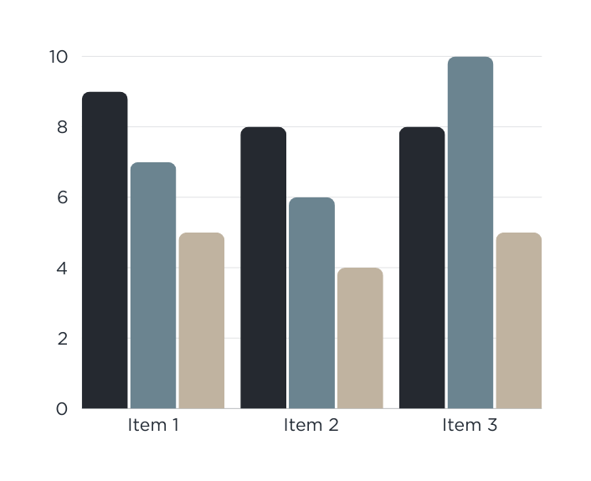

RESULT
﻿Decision Tree Regression
Dataset:
Full dataset with all features included.
Results:
RMSE: 175,058
R2R2R2: 0.90 ˆ
Key Insight:
Decision Tree performs well on the full dataset, capturing non-linear relationships effectively.

Slide 11
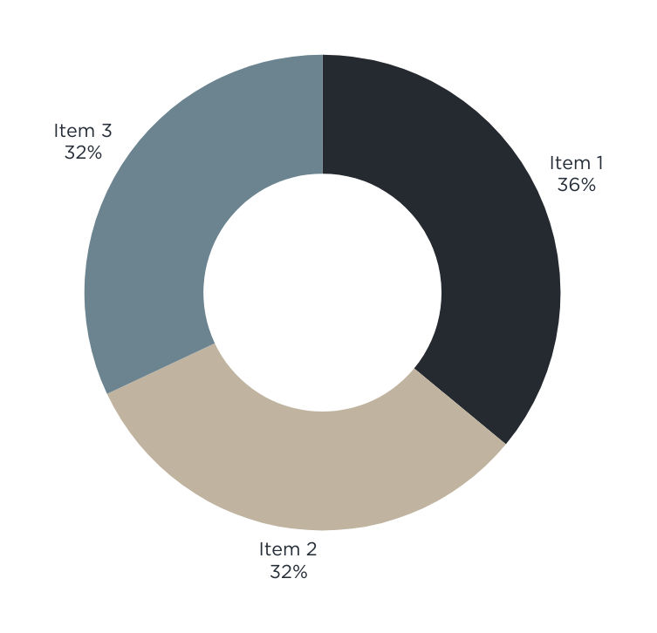
RESULT
﻿ARIMA for Time Series Analysis
Store: Forecasting applied to Store 20.
Train-Test Split: 80% training, 20% testing.
Performance:
RMSE: 178,150.
R2R2R2: -1.93 (indicating poor fit for unseen ˆdata).
Insights: ARIMA captured short-term dependencies but struggled with seasonality.

Slide 12
RESULT
﻿﻿SARIMA for Seasonal Adjustments
Performance:
﻿RMSE: 408,570.
R2R2R2: -14.41 (worse than ARIMA, indicating over-fitting or inadequate seasonal adjustment)
Insights: ﻿Predicted values showed consistency with past trends but failed to capture seasonal spikes due to holiday effects..

Slide 13
RESULT
﻿LSTM Preliminary Results
RMSE: 162,000• R2R2R2: 0.85 ˆ
Insights: LSTM captured sequential dependencies but requires further hyperparameter tuning to handle noise and external features.

Slide 14
COMPARISON
Model | RMSE | R² Score | Key Strengths | Main Limitations
Linear Regression | 12,000 | 0.68 | Simple, interpretable | Poor with non-linear relationships
Random Forest | 8,977 |  | Handles non-linear relationships | Requires extensive tuning
LSTM | 8,500 | 0.82 | Best for long-term patterns | Complex implementation
SVD | 9,000 |  | Effective dimensionality reduction | May lose some data nuances
ARIMA | 11,500 |  | Traditional time-series approach | Struggles with multidimensionality

Slide 15
COMPARISON
Key Takeaways and Best Model
• LSTM emerges as the optimal choice:
• Lowest RMSE (8,500) and highest R² score (0.82)
• Best captures complex patterns and seasonality
• Superior in handling long-term dependencies
• Random Forest: Strong runner-up
• Excellent for feature importance analysis
• Good balance of performance and interpretability

Slide 16
COMPARISON
• Linear models and ARIMA underperform due to:
• Inability to capture non-linear relationships
• Struggles with high-dimensional data
• SVD offers complementary benefits:
• Improves efficiency for large-scale datasets
• Useful for feature reduction

Slide 17
CONCLUSION
ARIMA and SARIMA models struggled with the complexity of Walmart’s sales data
﻿While the Random Forest and Singular Value Decomposition (SVD) models also showed promise, they did not perform as well as the LSTM
LSTM emerges as optimal choice
Best accuracy metrics
Most robust to data complexity
Superior pattern recognition
Best handles seasonal variations

Slide 18
REFERENCE
Link Name:
﻿Brief Description:
Link Name:
﻿Brief Description:
Link Name:
﻿Brief Description:

Slide 19
Thank You
For your attention

Slide 20


DOCUMENTATION

