Slide 1
Blood Bank Management System
Vikash .
161768
AppsTwo CSDLine, Pune

Slide 2
Blood Bank Management System
The Main Objective of this System is to design an Android Application to maintain considerable information of the Donors and a Web Application for Patients, report details.
In this proposed management system the admin can add patient and donor can register himself to volunteer blood donation.

Slide 3
Architecture
Mongo DB
REST API
Admin
Donor

Slide 4
REQUIREMENT ANALYSIS
Java 8
Spring Boot
Android
SQLite
MongoDB
HTML/CSS
Javascript
Bootstrap
Msg9

Slide 5
Project Outline
Web Application (Admin)
Android Application (Donor)
Login
Login Validation
Password encoding
View All Patients
All added patients till now
Add new Patient
Add new Patient searching for blood
Enter Patient’s Blood Group
Fetches valid Donors for that Patients
Notify All Donors via SMS
View All Donors
All Donors from Android Database
Splash Screen for Interactive UI
Login Screen
Validation of Credentials
Error Handling
Registration Screen
Validation of fields
Error Handling
Introduction Page
Eligibility
Importance of Blood Donation
Show All Patients
Basic Information of Patients

Slide 6
Scope Of Blood Bank Management System
Security
Ideas
Operations
Communication
Uses
Password Encoding for Admin Login
Validations for respective inputs
Navigation can be added from donor to Patient
Donors can be sorted on the basis of distance parameter
View All Donors
Add new Patients
View Donors on Blood Group basis
Rest Api (GET, POST)
Can be accessed by many Donors
Blood Donors can be find easily
Social Integrity

Slide 7
Snapshot
Web Application
Admin : Adding and managing Patients for blood requirement.

Slide 8
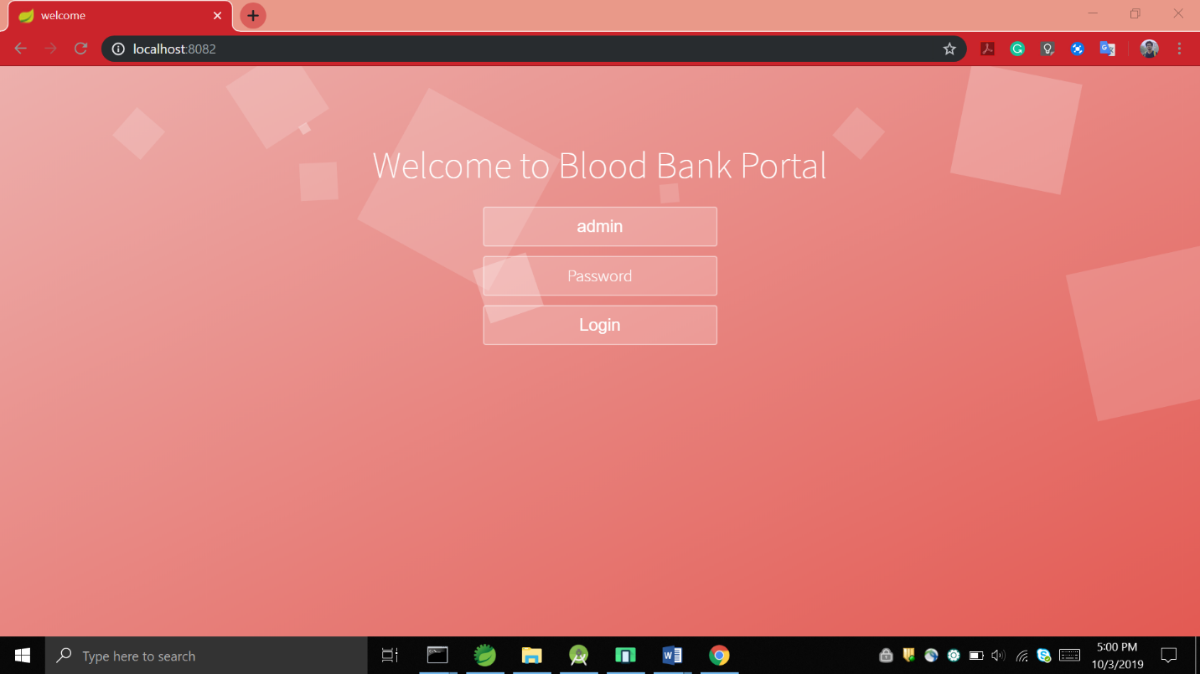
1
Welcome Page

Slide 9
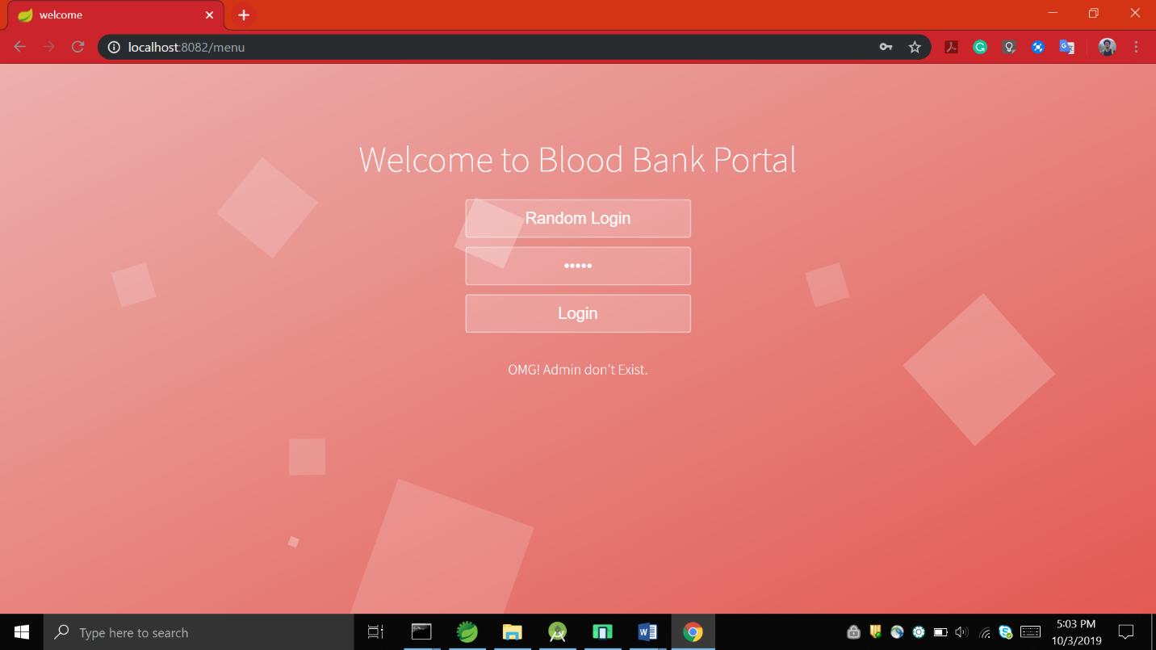
Wrong Credentials Login
2

Slide 10
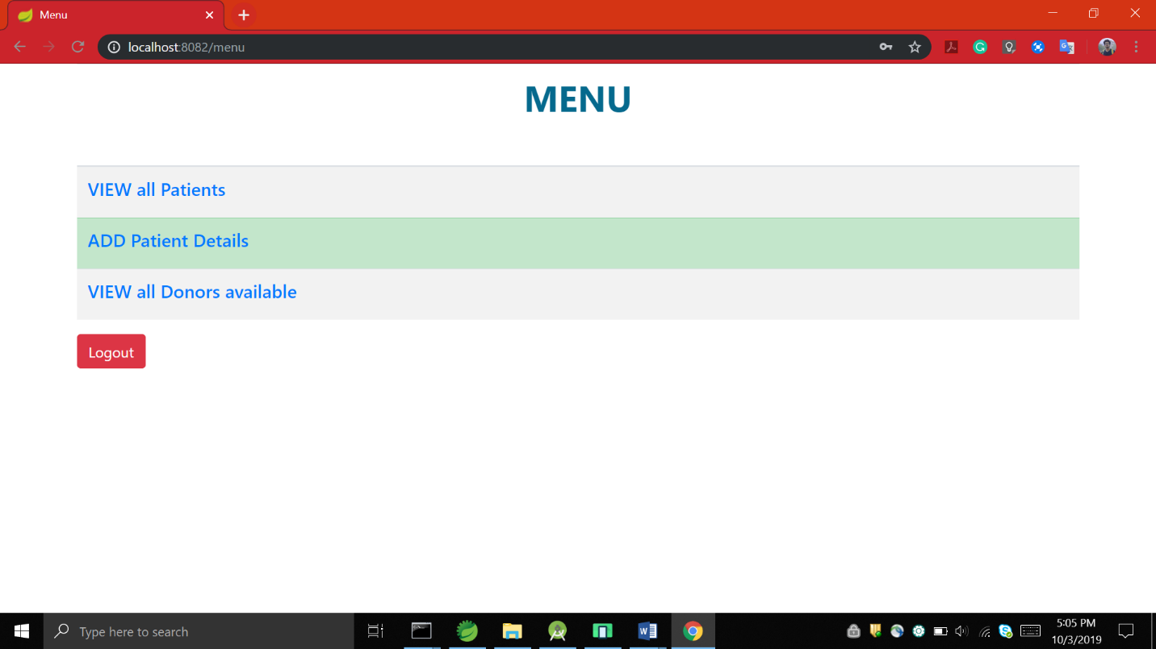
Admin Functionalities
3

Slide 11
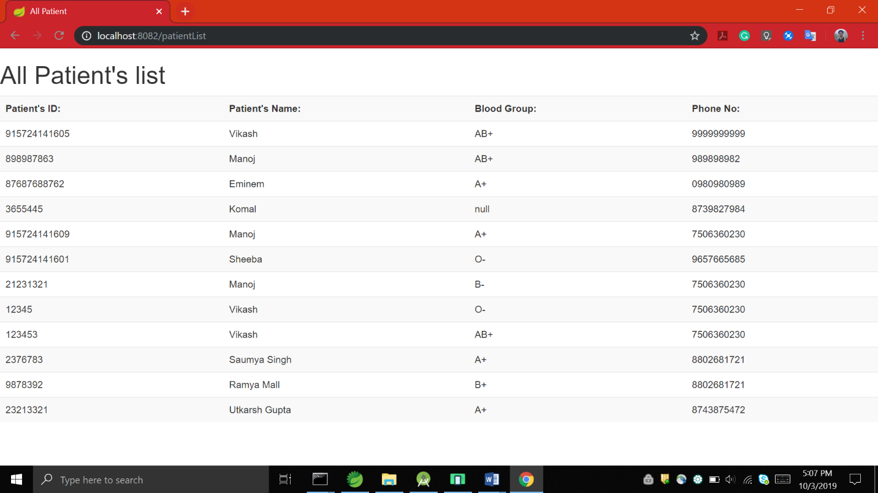
List of all Patients
3.1

Slide 12
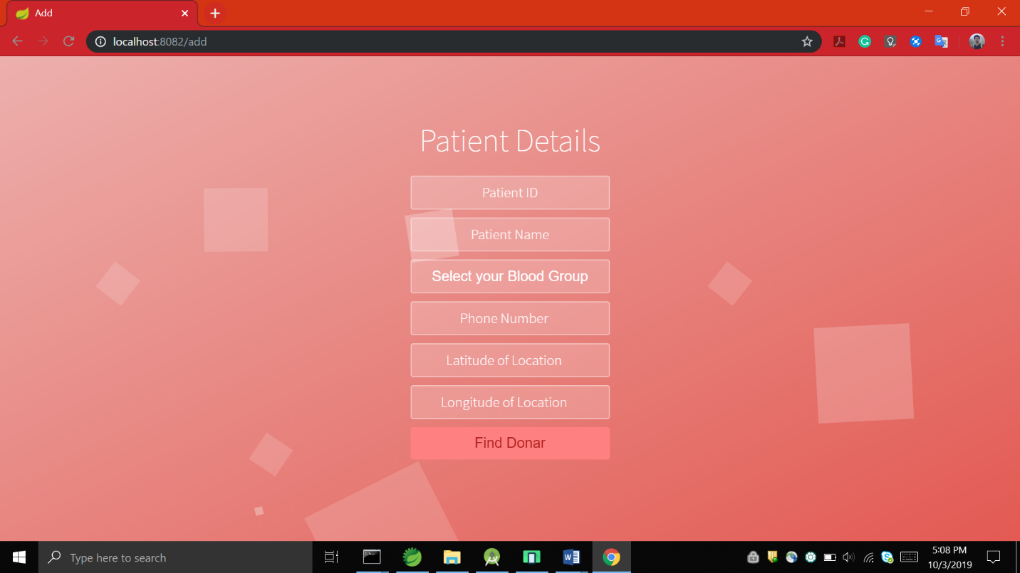
Add Patient Details
3.2

Slide 13
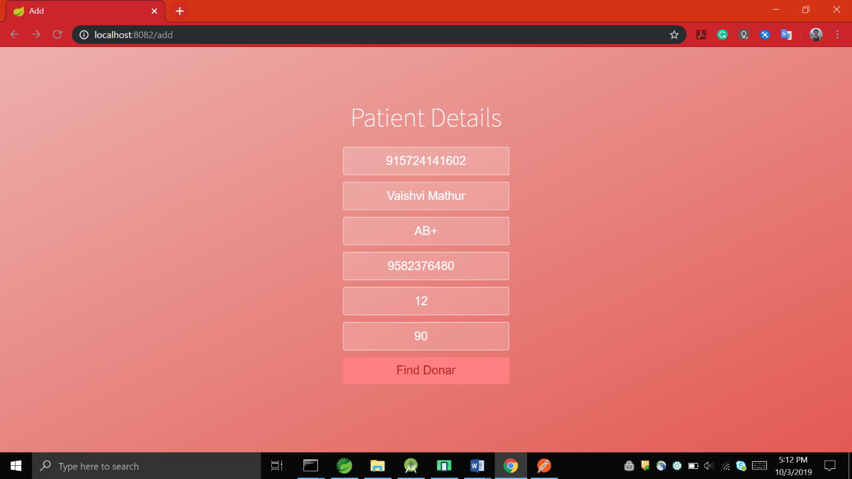
List of donors having same blood group
3.2I

Slide 14
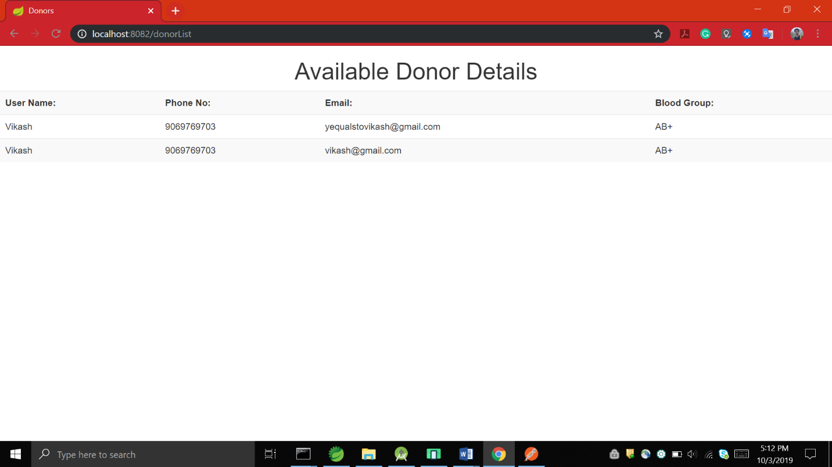
Available Donors
3.2II

Slide 15
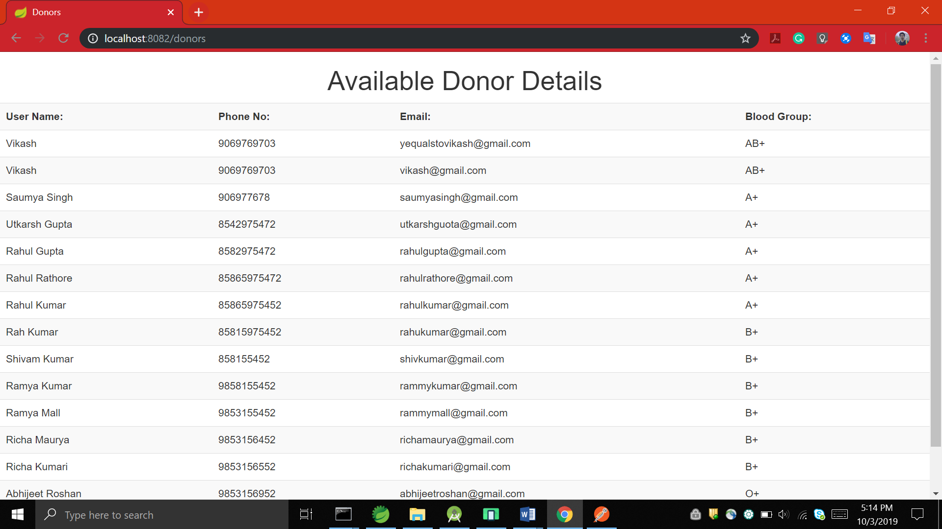
List of All Donors
3.3

Slide 16
Logout
4

Slide 17
Snapshot
Android Application
Donors : Registering through Mobile App to donate blood.

Slide 18
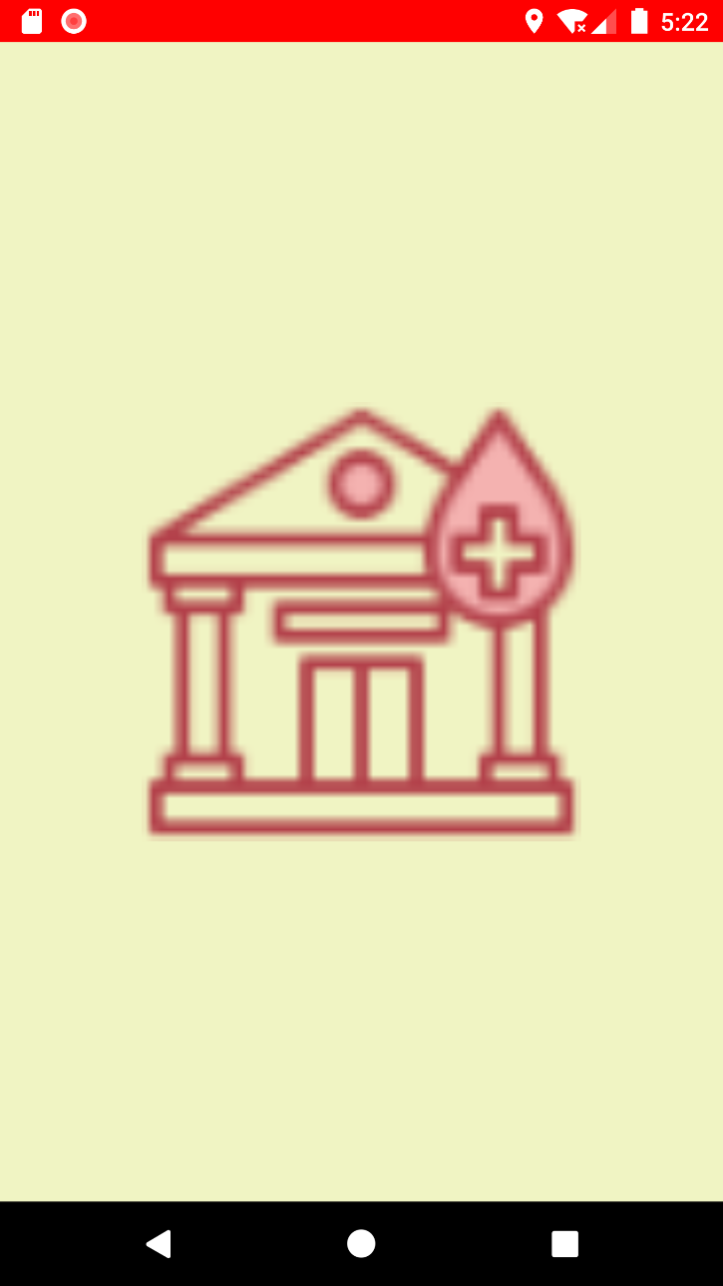
Splash Activity
1

Slide 19
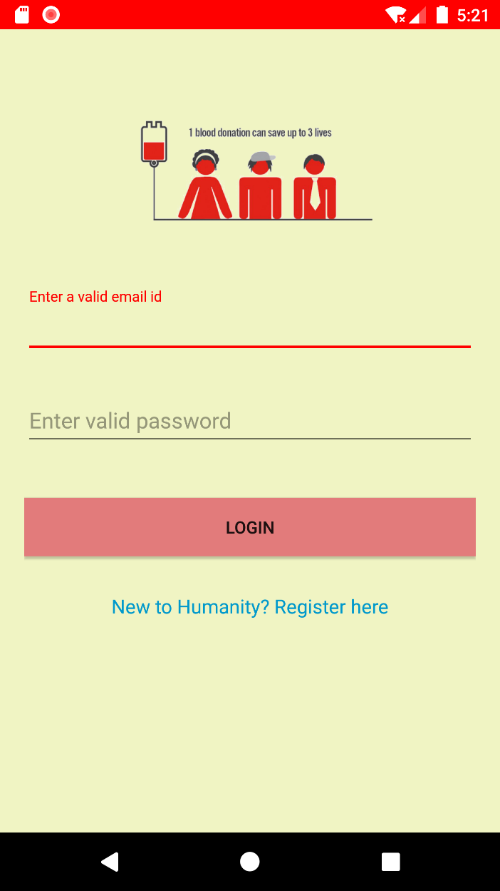
Login Page for Donor
2

Slide 20
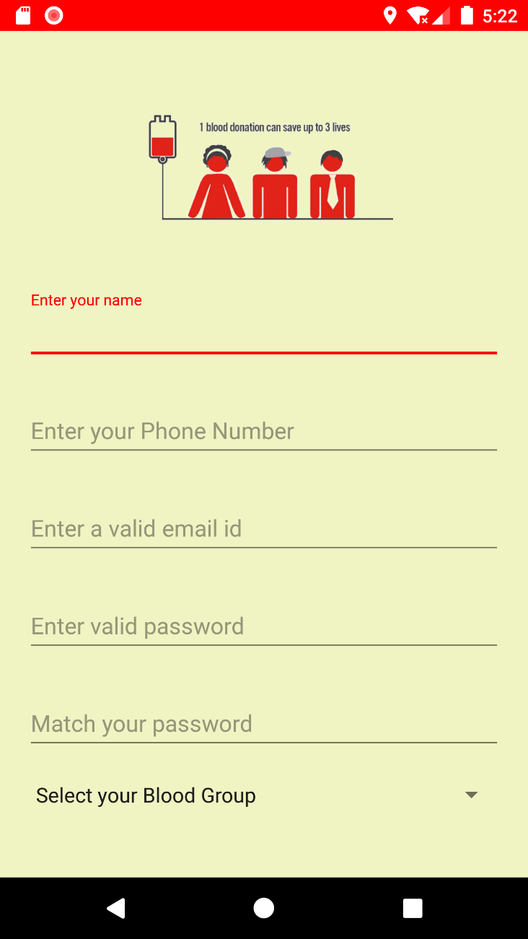
Registration Page
3

Slide 21
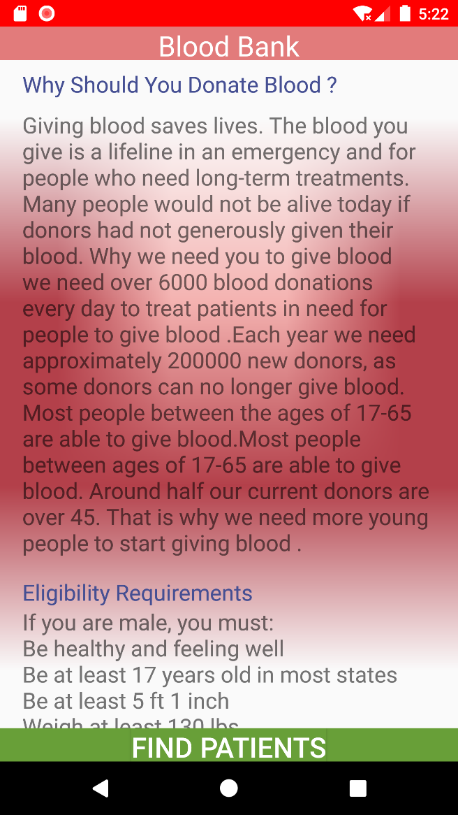
Motto of Blood Bank
4

Slide 22
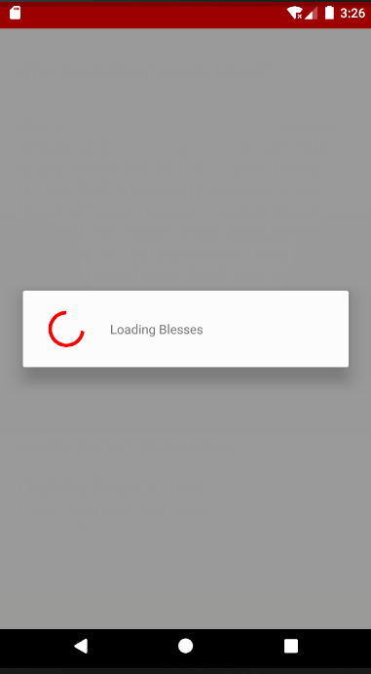
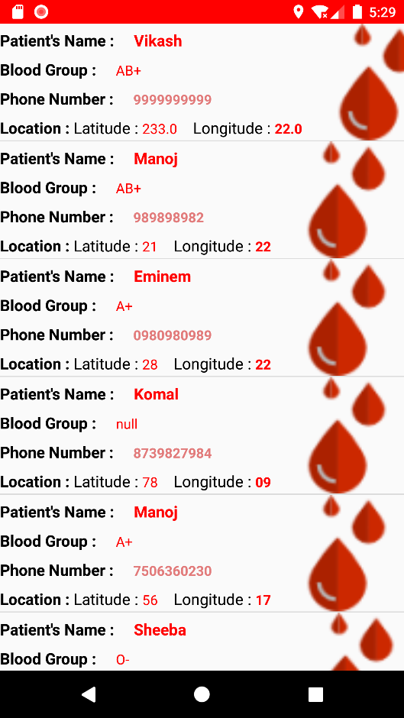
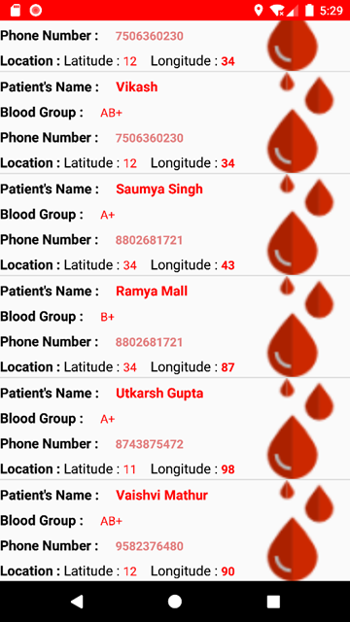
Fetching Patient Details from web Application
5

Slide 23
Gantt Chart
Task/Days
1
2
3
4
5
6
7
8
9
10
11
12
ADMIN PAGE with login, add patients page with Patients db
DONOR App with login and Registeration
Use of REST Api
View All Patients in Android App
View All Donors in Web App
UI imporovement
Notification for Donor
Debugging

