Slide 1
Electricity Billing System
Rishab Maity
Rohit Kumar
Raj Bhushan
Poonamchand Sahu
Midhun Kumar
Vikash

Slide 2
Electricity Billing System
This system is made to keep the records about the bills of the customers.
The admin can manage all the accounts and customers can only manage their own accounts. This system helps in maintaining the bills and the payments.
Customer can only manage his account and admin can manage all the accounts including the customers and his own account.

Slide 3
Architecture
DataBase
REST API
Admin
Customer

Slide 4
REQUIREMENT ANALYSIS
Java 8
Spring Boot
Angular 9
MySQL
HTML/CSS
Bootstrap
Rest API
JWT

Slide 5
Project Outline
Application (Admin)
Application (Customer)
Login
Login Validation
Password encoding
View All Customers
All added customers till now
View All Bills
View all bills irrespective of customer id
CRUD Operations on Bills
Add new bill to customer
Update/Edit bill
Delete a bill
Login Screen
Validation of Credentials
Error Handling
Registration Screen
Validation of fields
Error Handling
Google Security
View/Edit Profile
Customer can view his profile
Customer can edit his profile
View Bill History
Customer can view own bills as per customer id
Make Payment
Customer can pay his/her non-paid bills
Feedback
Customer can give his/her valuable feedback as per service

Slide 6
Scope Of Electricity Billing System
Security
Ideas
Operations
Communication
Uses
Password Encoding for Admin Login
Validations for respective inputs
Easy to operate
Be expandable
Easy to understand by user and operator
View All Customers
Add new Customer
Admin can view/edit/delete/update/generate bills for customers
Customers can pay their non-paid bills which is generated by admin
Rest Api (GET, POST)
Can be accessed by many users
Electricity bills can be paid easily
Social Integrity

Slide 7
Snapshot
Application
Admin : Adding and managing Customers for Bill Payment

Slide 8
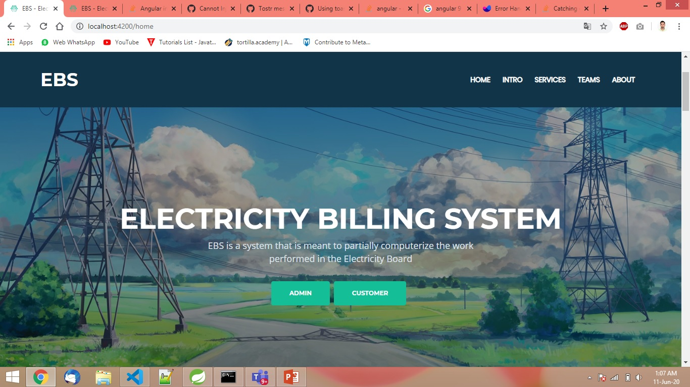
1
Welcome Page

Slide 9
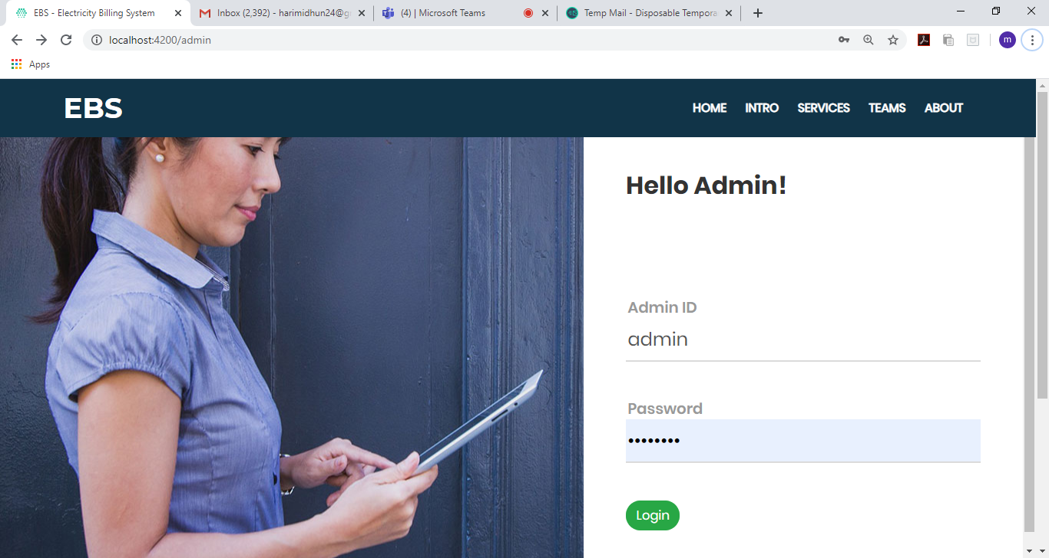
Admin Login Page
2

Slide 10
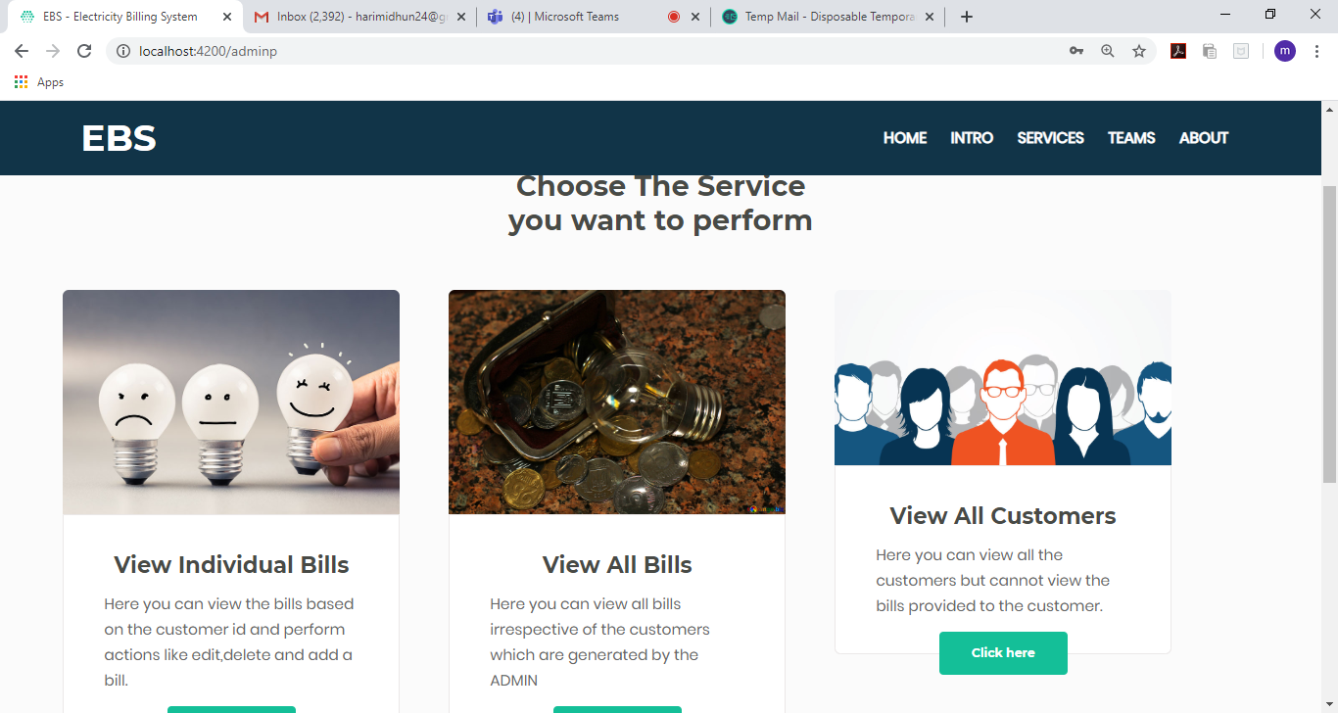
Admin Functionalities
3

Slide 11
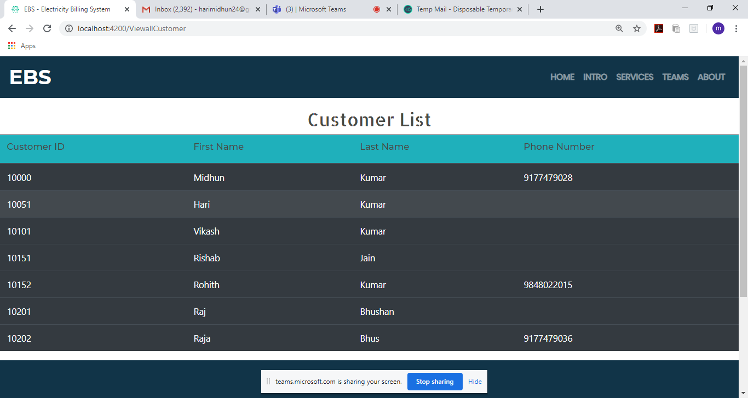
List of all Customers
3.1

Slide 12
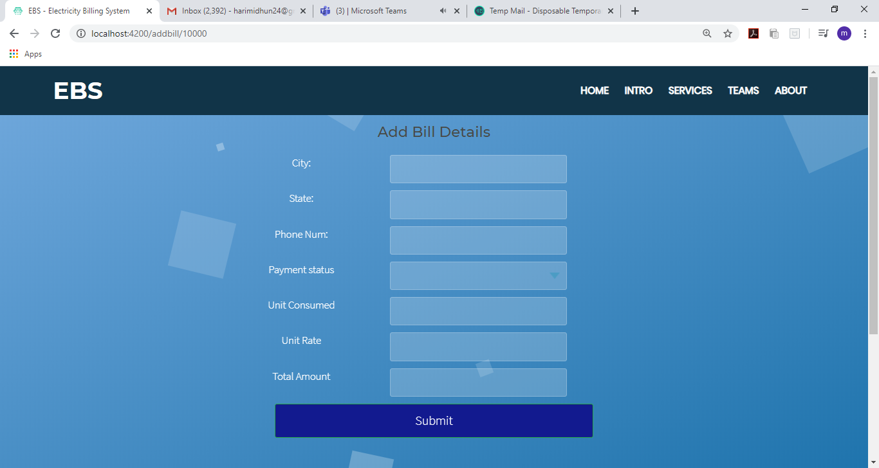
Add Bill Details
3.2

Slide 13
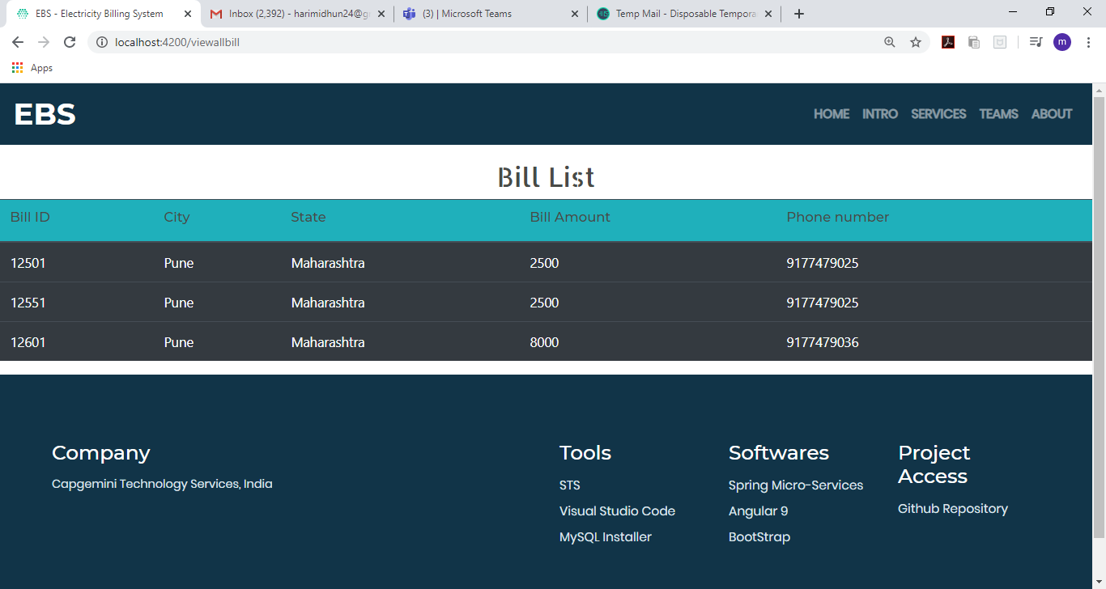
List of Bill Details
4

Slide 14
Snapshot
Application
Customers : Registering for electricity connections and paying bills

Slide 15
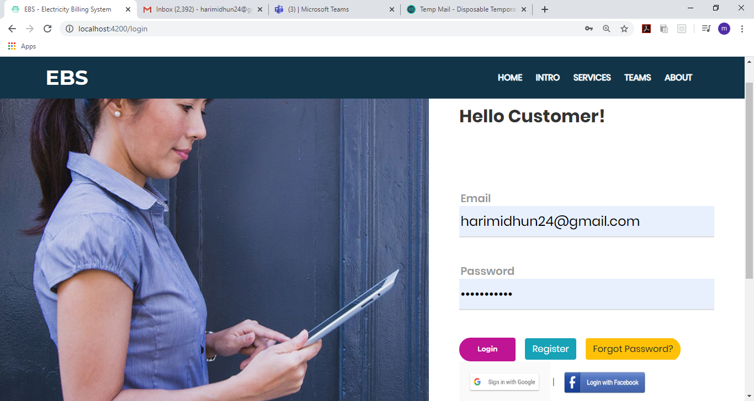
Login Page for Customer
1

Slide 16
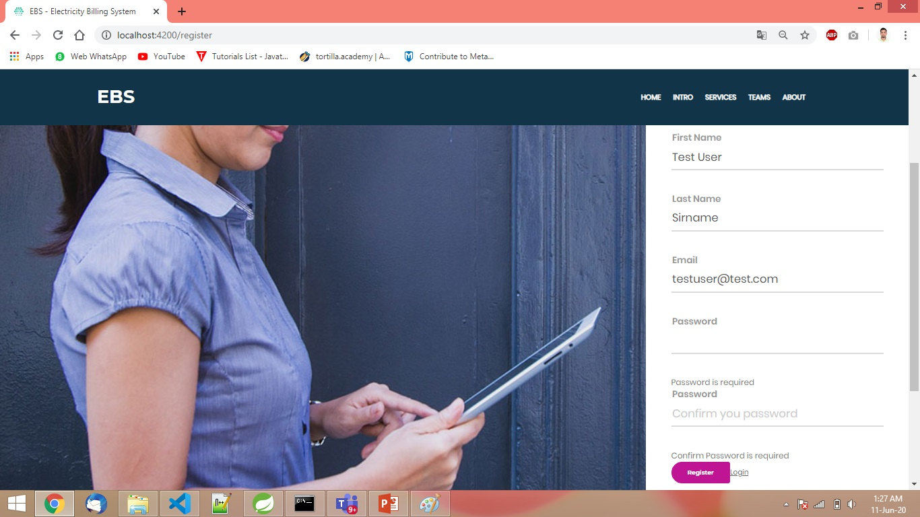
Registration Page
2

Slide 17
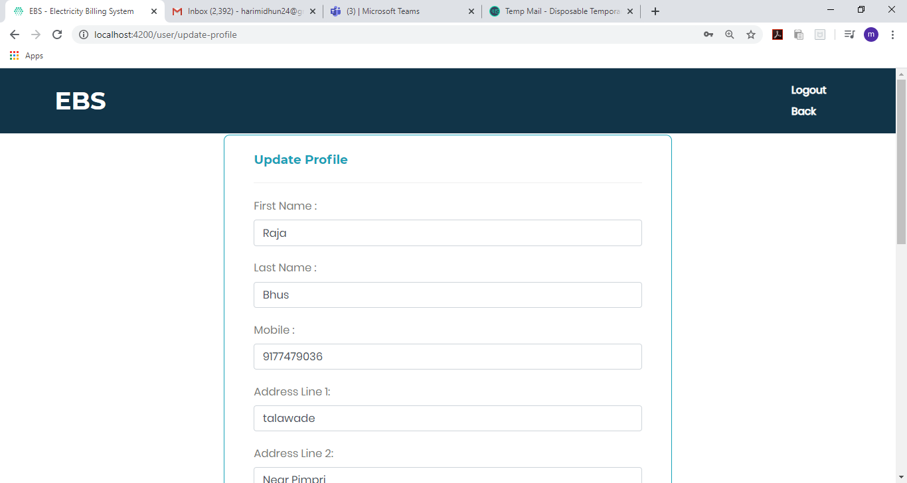
Update Profile Details
3

Slide 18
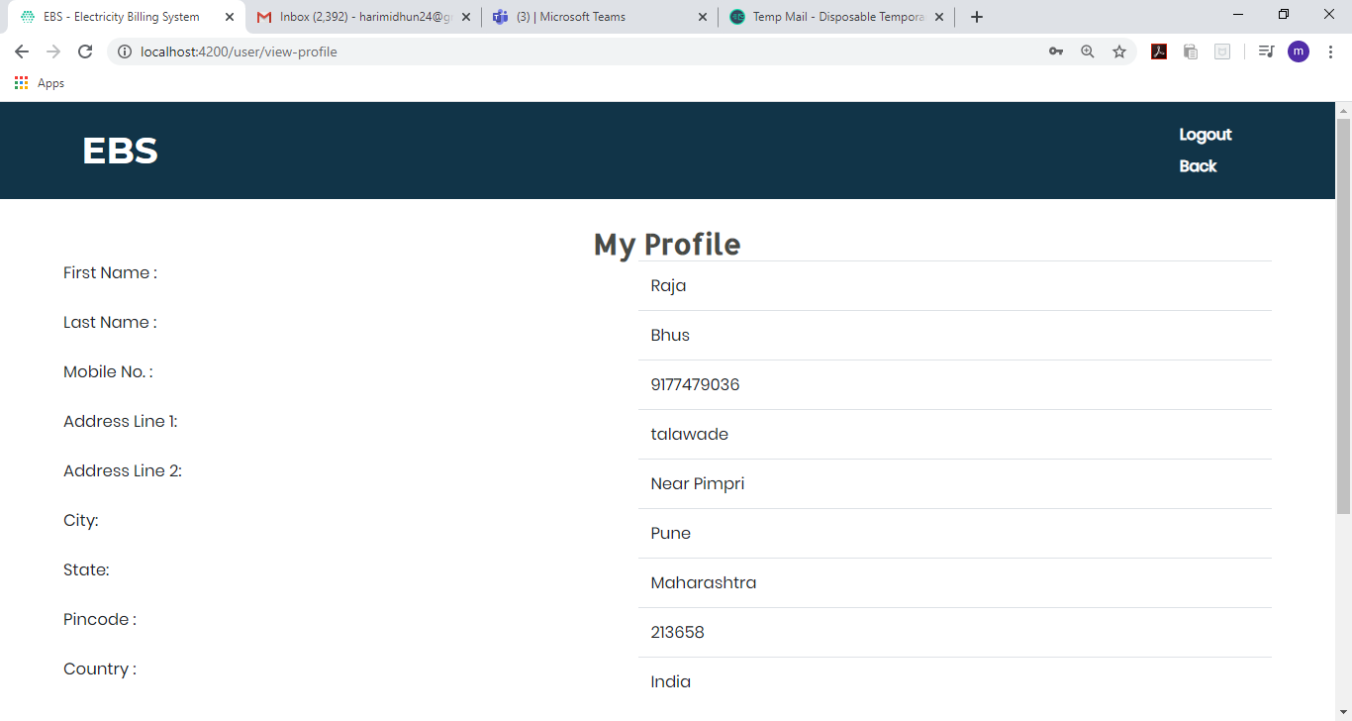
View profile
4

Slide 19
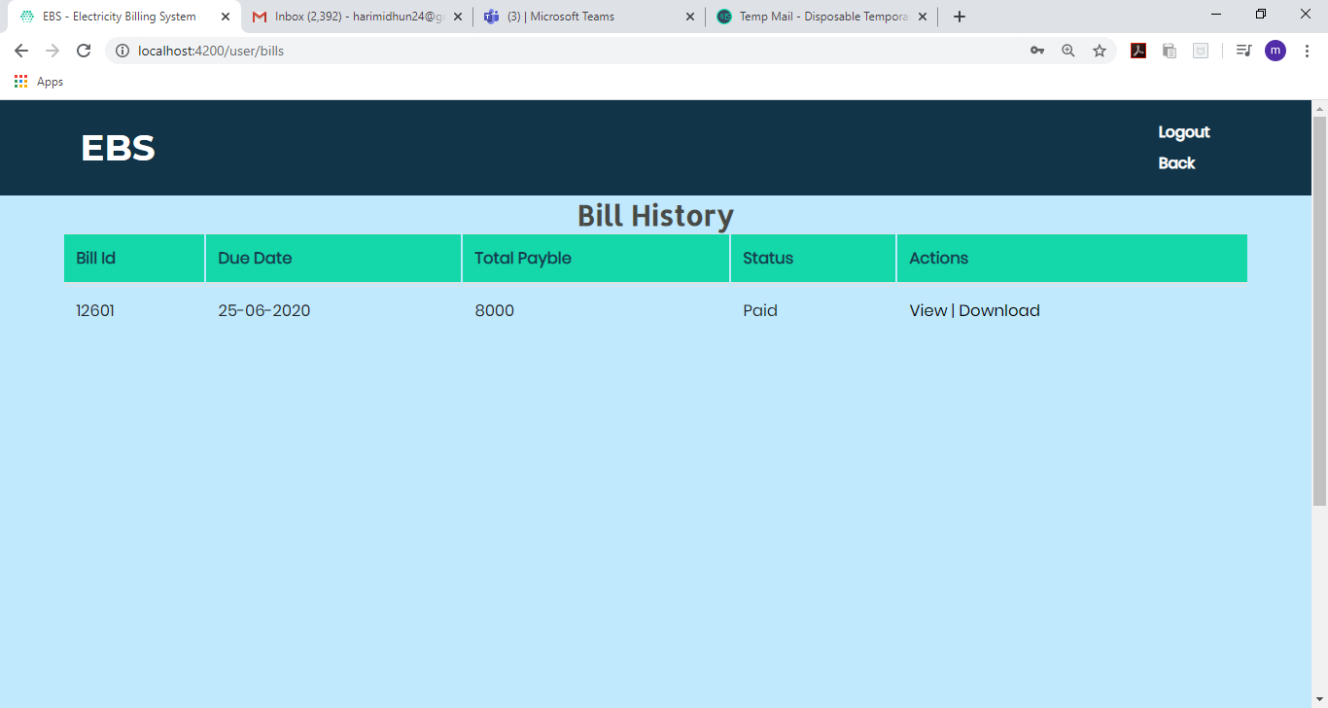
View bill history
5

Slide 20
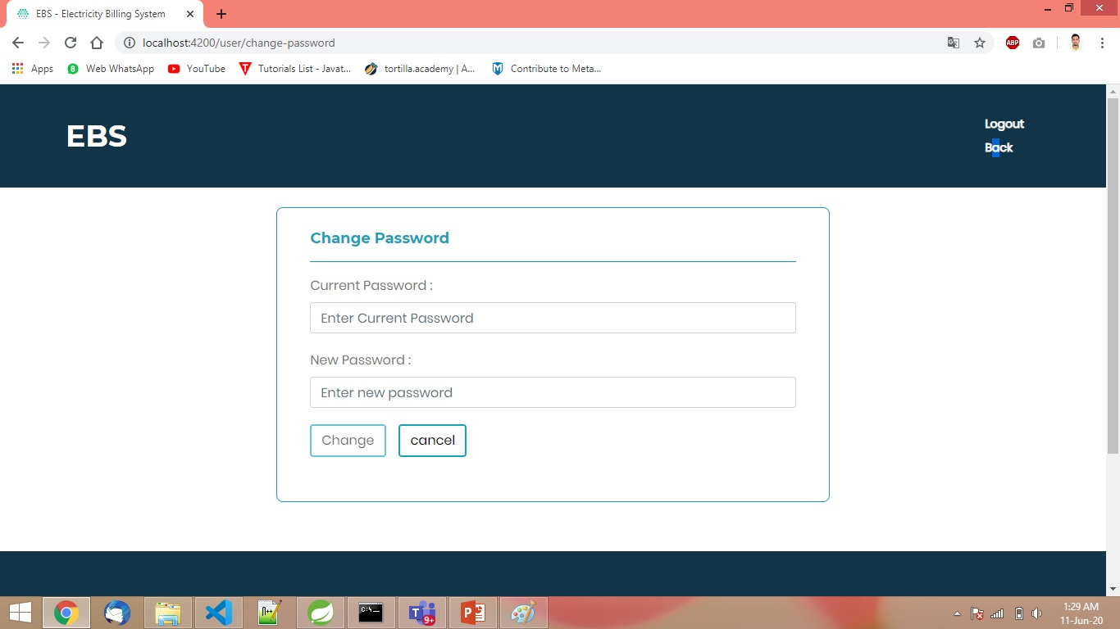
Change Password
6

Slide 21
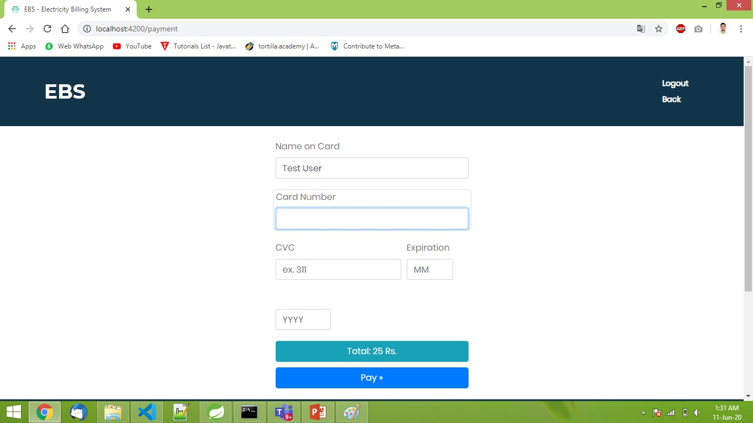
Make Payment
7

Slide 22
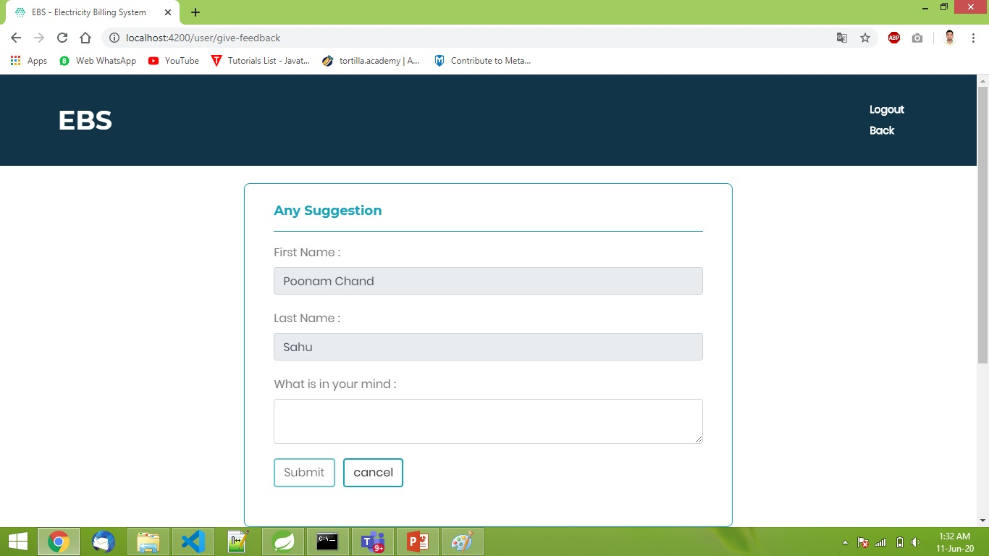
Feedback
8

