Slide 1


Slide 2
Response Variable - Charges - Individual Medical costs billed by health insurance.
Explanatory Variables:
Age - Age of primary beneficiary.
Sex - Primary benefiaciary gender male or female.
BMI - Body mass index, providing an understanding of body weights that are relatively high or low relative to height, objective index of body weight (kg/m^2) using the ratio of height to weight, ideally 18.5 to 24.9.
Children - Number of dependent children covered by health insurance.
Smoker - Primary beneficiary smokes or not.
Region - Primary beneficiary region in the United States, northeast, southeast, southwest, northwest.

Slide 3
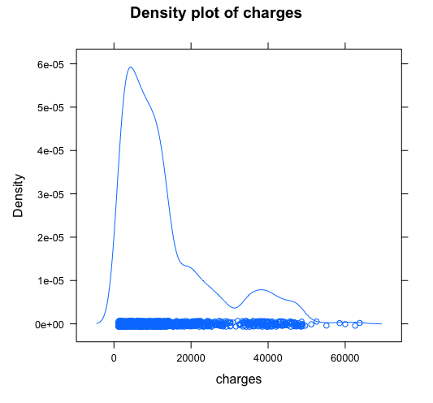

Slide 4
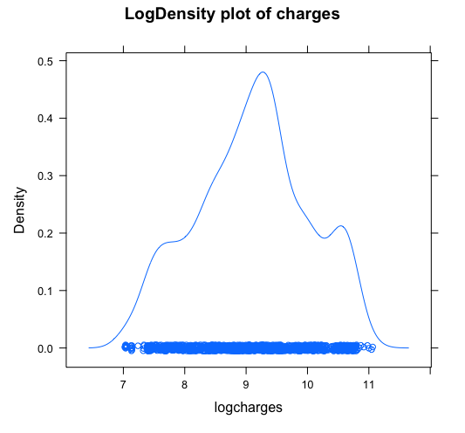

Slide 5
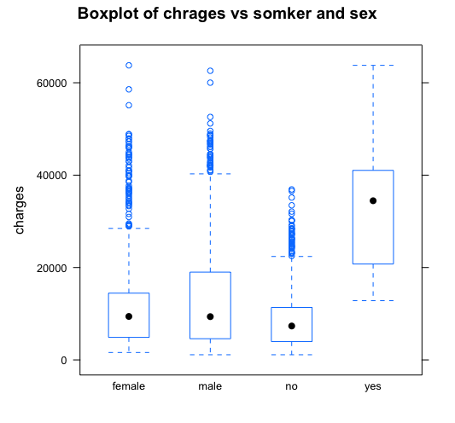

Slide 6
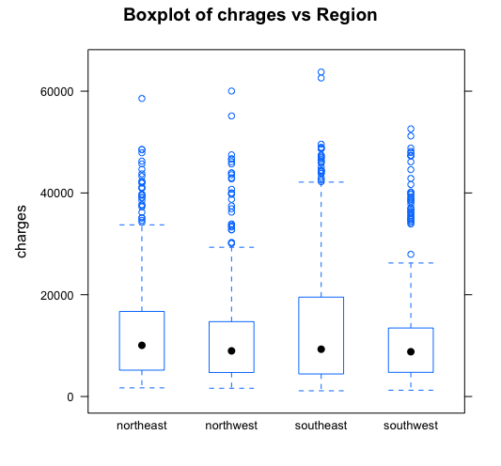

Slide 7
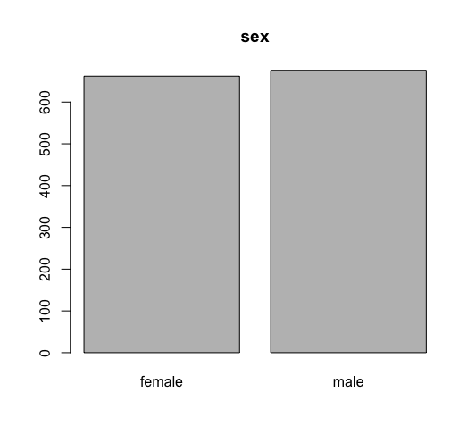

Slide 8
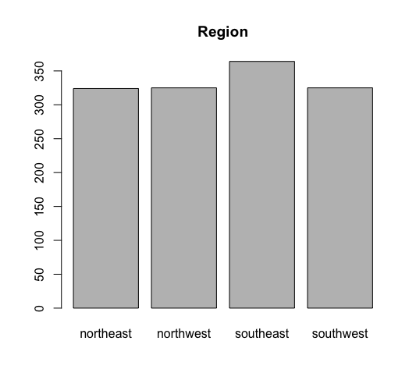

Slide 9
Multiple linear regression model:
{log(charges)|age,sex,bmi,children,smoker,region}= B0+B1age+B2sex+B3*bmi
B4*children+B5*smoker+B6*nortwest+B7*southeast+B8*southwest
{charges)|age,sex,bmi,children,smoker,region} = exp(B0+B1age+B2sex
+B3bmi+B4children+B5smoker+B6northwest+B7southeast+B8southwest)
{sex=1 if male else 0}
{smoker =1 if smoker else 0}
{Region northwest =1 if northeast else 0}
{Region southeast = 1 if southeast elso 0}
{Region southwest =1 if southwest else 0}

Slide 10
Correlation Matrix:
D.charges D.age D.bmi D.children
D.charges 1.00000000 0.2990082 0.1983410 0.06799823
D.age 0.29900819 1.0000000 0.1092719 0.04246900
D.bmi 0.19834097 0.1092719 1.0000000 0.01275890
D.children 0.06799823 0.0424690 0.0127589 1.00000000

Slide 11
lm(formula = logcharges ~ age + sex + bmi + children + smoker +
region, data = D)
Residuals:
Min 1Q Median 3Q Max
-1.07186 -0.19835 -0.04917 0.06598 2.16636
Coefficients:
Estimate Std. Error t value Pr(>|t|)
(Intercept) 7.0305581 0.0723960 97.112 < 2e-16 ***
age 0.0345816 0.0008721 39.655 < 2e-16 ***
sexmale -0.0754164 0.0244012 -3.091 0.002038 **
bmi 0.0133748 0.0020960 6.381 2.42e-10 ***

Slide 12
children 0.1018568 0.0100995 10.085 < 2e-16 ***
smokeryes 1.5543228 0.0302795 51.333 < 2e-16 ***
regionnorthwest -0.0637876 0.0349057 -1.827 0.067860 .
regionsoutheast -0.1571967 0.0350828 -4.481 8.08e-06 ***
regionsouthwest -0.1289522 0.0350271 -3.681 0.000241 ***
---
Signif. codes: 0 ‘***’ 0.001 ‘**’ 0.01 ‘*’ 0.05 ‘.’ 0.1 ‘ ’ 1
Residual standard error: 0.4443 on 1329 degrees of freedom
Multiple R-squared: 0.7679, Adjusted R-squared: 0.7666
F-statistic: 549.8 on 8 and 1329 DF, p-value: < 2.2e-16

Slide 13
95% confidence interval of B0,B1,B2,B3,B4,B5,B6,B7,B8
> exp(confint(lm1))
2.5 % 97.5 %
(Intercept) 980.9633614 1303.2039241
age 1.0334171 1.0369590
sexmale 0.8840113 0.9728285
bmi 1.0093060 1.0176405
children 1.0855038 1.1293808
smokeryes 4.4589886 5.0214745
regionnorthwest 0.8761099 1.0046996
regionsoutheast 0.7977019 0.9154192
regionsouthwest 0.8206433 0.9415407

Slide 14
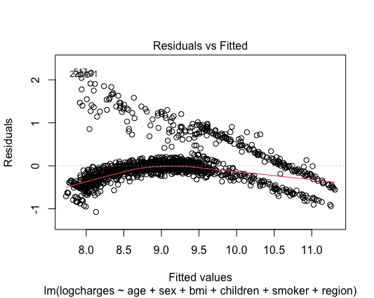

Slide 15
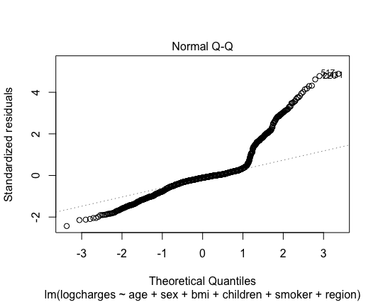

Slide 16
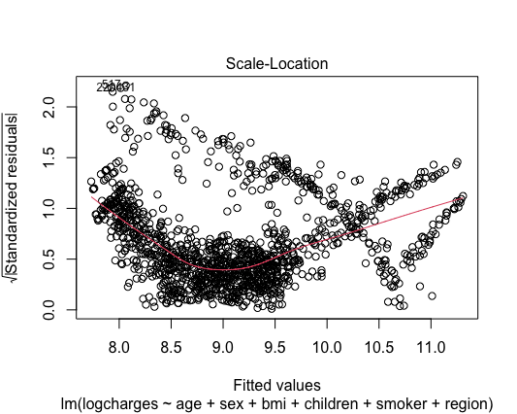

Slide 17
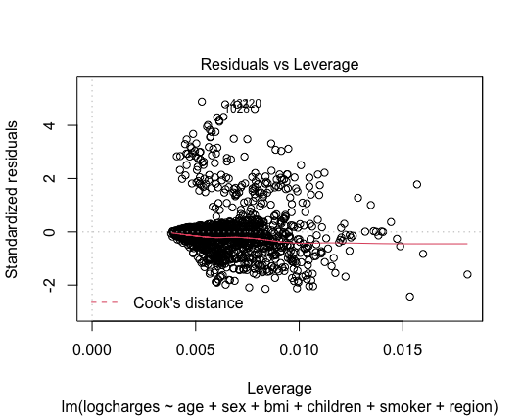

Slide 18
lm2=lm(charges~age+sex+bmi+bmi*smoker+children+smoker+region,data=D)
> summary(lm2)
Call:
lm(formula = charges ~ age + sex + bmi + bmi * smoker + children +
smoker + region, data = D)
Residuals:
Min 1Q Median 3Q Max
-14580.7 -1857.2 -1360.8 -475.7 30552.4
Coefficients:
Estimate Std. Error t value Pr(>|t|)
(Intercept) -2223.454 865.611 -2.569 0.01032 *
age 263.620 9.516 27.703 < 2e-16 ***
sexmale -500.146 266.518 -1.877 0.06079 .
bmi 23.533 25.601 0.919 0.35814
smokeryes -20415.611 1648.277 -12.386 < 2e-16 ***

Slide 19
smokeryes -20415.611 1648.277 -12.386 < 2e-16 ***
children 516.403 110.179 4.687 3.06e-06 ***
regionnorthwest -585.478 380.859 -1.537 0.12447
regionsoutheast -1210.131 382.750 -3.162 0.00160 **
regionsouthwest -1231.108 382.218 -3.221 0.00131 **
bmi:smokeryes 1443.096 52.647 27.411 < 2e-16 ***
---
Signif. codes: 0 ‘***’ 0.001 ‘**’ 0.01 ‘*’ 0.05 ‘.’ 0.1 ‘ ’ 1
Residual standard error: 4846 on 1328 degrees of freedom
Multiple R-squared: 0.8409, Adjusted R-squared: 0.8398
F-statistic: 780 on 9 and 1328 DF, p-value: < 2.2e-16

Slide 20
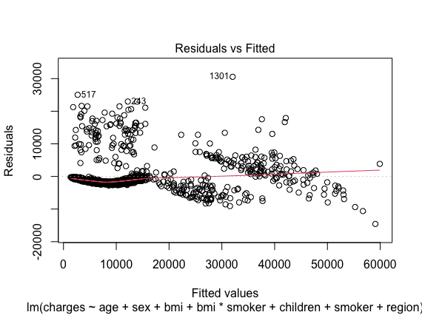

Slide 21
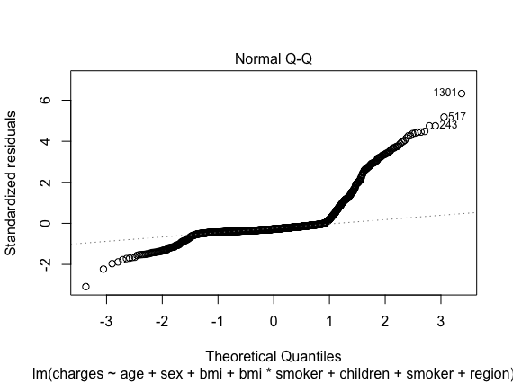

Slide 22
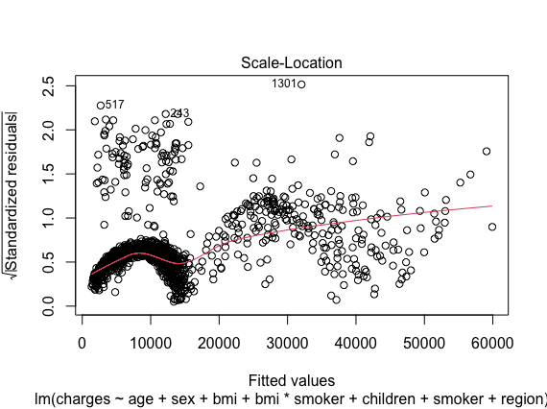

Slide 23
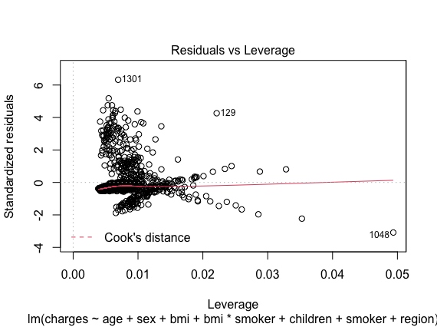

Slide 24
> anova(lm1,lm2)
Analysis of Variance Table
Model 1: logcharges ~ age + sex + bmi + children + smoker + region
Model 2: logcharges ~ age + sex + bmi + children + smoker + region + bmi *
smoker
Res.Df RSS Df Sum of Sq F Pr(>F)
1 927 178.16
2 926 167.66 1 10.503 58.012 6.425e-14 ***

Slide 25
dt = sort(sample(nrow(D), nrow(D)*.7))
> train=D[dt,]
> test=D[-dt,]
lm1=lm(logcharges~age+sex+bmi+children+smoker+region,data=train)
lm2=lm(logcharges~age+sex+bmi+children+smoker+region+bmi*smoker,data=train)
pred1=predict(lm1,newdata=test)
pred2=predict(lm2,newdata=test)
mae(train$logcharges,predict(lm1))
[1] 0.2712938
> mae(train$logcharges,predict(lm2))
[1] 0.2570767
mae(test$logcharges,pred1)
[1] 0.2861339
mae(test$logcharges,pred2)
[1] 0.2706264

