Slide 1
CS777 Bigdata Term Project
Telecom Customer Churn Prediction
Vikas Kasyap Konda

Slide 2
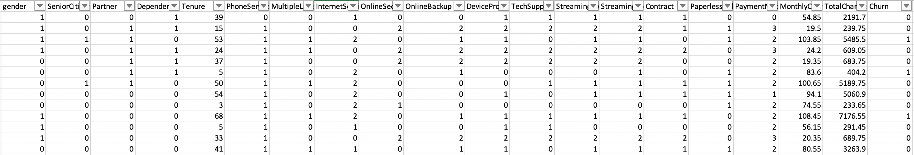
About the Data:
Telecom Customer Data
Data set has 19 attributes of a telecom customers with some important parameters like types of services, bill amount, protection type, payment types , length of stay, security and
Interested Variable is if the customer has churned or NOT

Slide 3
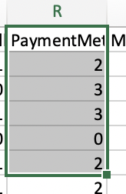
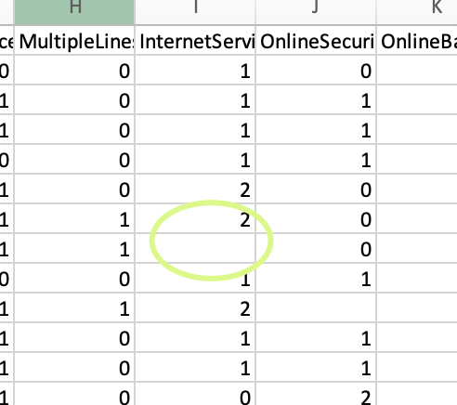
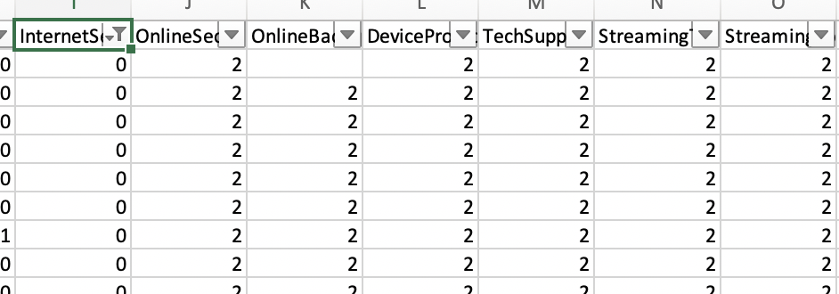
Data Cleaning
Handling Nulls, duplicate check
Converting few categorical variables into binary ex: whether Autopay,
Contract type - M2M or bound by contract
Assess the reason of no data in few columns and replace logically
(Empty values for few variables like streaming tv , online security as a result of not having internet, identify )
Clean Data with Features and Labels

Slide 4
Gradient Boosting Trees
- Min info gain, step size, setmaxbins
Logistic
- weightcol, Threshold, maxiter, family
Naive Bayes
-model type, weightcol, smoothing
SVM:
- Maxiter, regparam, aggregationdepth, maxblocksize, weightcol
Random Forests
- Tree Depth, num of trees, impurity, maxbins, subsamplingrate
Classification Models and Parameters

Slide 5
Results Heat Map
Model Name | Precision | Recall | Fmeasure | TP | FP | FN | TN
Logistic Regression | 0.588 | 0.685 | 0.633 | 190 | 133 | 87 | 603
SVM | 0.819 | 0.518 | 0.635 | 525 | 50 | 211 | 227
Random Forests | 0.794 | 0.491 | 0.606 | 508 | 57 | 228 | 220
GradientBoostingTrees | 0.874 | 0.451 | 0.595 | 442 | 35 | 294 | 242
NaiveBayes | 0.707 | 0.431 | 0.536 | 478 | 81 | 258 | 196

Slide 6
Conclusion
Highlights:
SVM Regression has high Fmeasure
Gradient Boosting Trees has high Precision
Logistic has high Recall Value
Addressing Research Question:
Since we are most interested in whether a customer is going to churn or NOT, our choice in this exercise would be SVM algorithm with high True Positives, however we need to verify on larger data set.
Next Steps:
- Run current and compute intensive models like ANNs on a very large data set
- Hyperparameter tuning on large data
- Validate results and optimize

Slide 7
Conclusion
Highlights:
SVM Regression has high Fmeasure
Gradient Boosting Trees has high Precision
Logistic has high Recall Value
Addressing Research Question:
Since we are most interested in whether a customer is going to churn or NOT, our choice in this exercise would be SVM algorithm with high True Positives, however we need to verify on larger data set.

Slide 8
Appendix

