Slide 1
A Greedy algorithm is an algorithmic paradigm that builds up a solution piece by piece, always choosing the next piece that offers the most obvious and immediate benefit. So the problems where choosing locally optimal also leads to a global solution are best fit for Greedy.
For example, consider the Fractional Knapsack Problem. The local optimal strategy is to choose the item that has maximum value vs weight ratio. This strategy also leads to global optimal solution because we allowed taking fractions of an item.
Dynamic programming is mainly an optimization over plain recursion. Wherever we see a recursive solution that has repeated calls for the same inputs, we can optimize it using Dynamic Programming. The idea is to simply store the results of sub problems so that we do not have to re-compute them when needed later. This simple optimization reduces time complexities from exponential to polynomial. For example, if we write a simple recursive solution for Fibonacci Numbers, we get exponential time complexity and if we optimize it by storing solutions of subproblems, time complexity reduces to linear.

Slide 2
Feature | Greedy method | Dynamic programming
Feasibility | In a greedy Algorithm, we make whatever choice seems best at the moment in the hope that it will lead to global optimal solution. | In Dynamic Programming we make decision at each step considering current problem and solution to previously solved sub problem to calculate optimal solution .
Optimality | In Greedy Method, sometimes there is no such guarantee of getting Optimal Solution. | It is guaranteed that Dynamic Programming will generate an optimal solution as it generally considers all possible cases and then choose the best.
Recursion | A greedy method follows the problem solving heuristic of making the locally optimal choice at each stage. | A Dynamic programming is an algorithmic technique which is usually based on a recurrent formula that uses some previously calculated states.
Memorization | It is more efficient in terms of memory as it never look back or revise previous choices | It requires dp table for memoization and it increases it’s memory complexity.
Time complexity | Greedy methods are generally faster. For example, Dijkstra’s shortest path algorithm takes O(ELogV + VLogV) time. | Dynamic Programming is generally slower. For example, Bellman Ford algorithm takes O(VE) time.
Fashion | The greedy method computes its solution by making its choices in a serial forward fashion, never looking back or revising previous choices. | Dynamic programming computes its solution bottom up or top down by synthesizing them from smaller optimal sub solutions.
Example | Fractional knapsack . | 0/1 knapsack problem

Slide 3
In this article, we will discuss what is Brute Force Algorithm and what are its pros and cons. Below given are some features of the brute force algorithm are:
It is an intuitive, direct, and straightforward technique of problem-solving in which all the possible ways or all the possible solutions to a given problem are enumerated.
Many problems solved in day-to-day life using the brute force strategy, for example exploring all the paths to a nearby market to find the minimum shortest path.
Arranging the books in a rack using all the possibilities to optimize the rack spaces, etc.
In fact, daily life activities use a brute force nature, even though optimal algorithms are also possible.
PROS AND CONS OF BRUTE FORCE ALGORITHM:
Pros:
The brute force approach is a guaranteed way to find the correct solution by listing all the possible candidate solutions for the problem.
It is a generic method and not limited to any specific domain of problems.
The brute force method is ideal for solving small and simpler problems.
It is known for its simplicity and can serve as a comparison benchmark.
Cons:
The brute force approach is inefficient. For real-time problems, algorithm analysis often goes above the O(N!) order of growth.
This method relies more on compromising the power of a computer system for solving a problem than on a good algorithm design.
Brute force algorithms are slow.
Brute force algorithms are not constructive or creative compared to algorithms that are constructed using some other design paradigms.

Slide 4
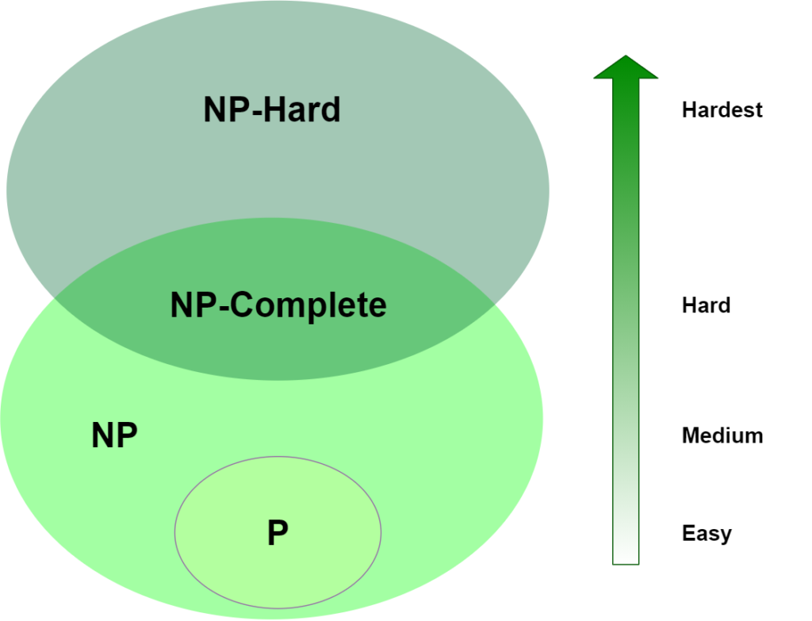

Slide 5
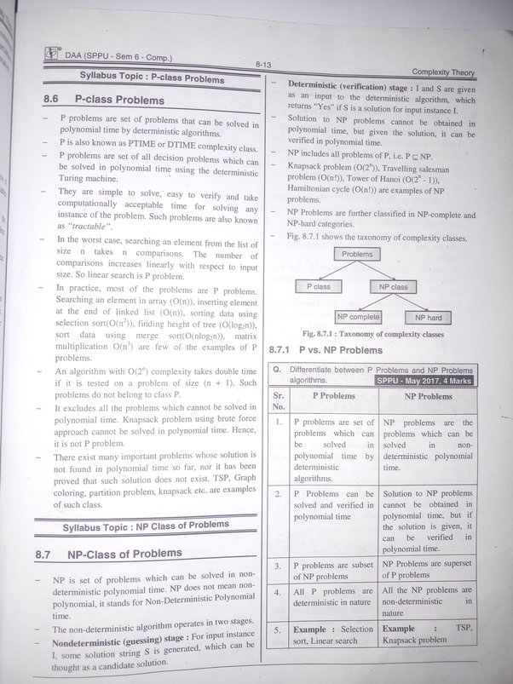

Slide 6
NP-hard | NP-Complete
NP-Hard problems(say X) can be solved if and only if there is a NP-Complete problem(say Y) that can be reducible into X in polynomial time. | NP-Complete problems can be solved by a non-deterministic Algorithm/Turing Machine in polynomial time.
To solve this problem, it do not have to be in NP . | To solve this problem, it must be both NP and NP-hard problems.
Do not have to be a Decision problem. | It is exclusively a Decision problem.
Example: Halting problem, Vertex cover problem, etc. | Example: Determine whether a graph has a Hamiltonian cycle, Determine whether a Boolean formula is satisfiable or not, Circuit-satisfiability problem, etc.

Slide 7
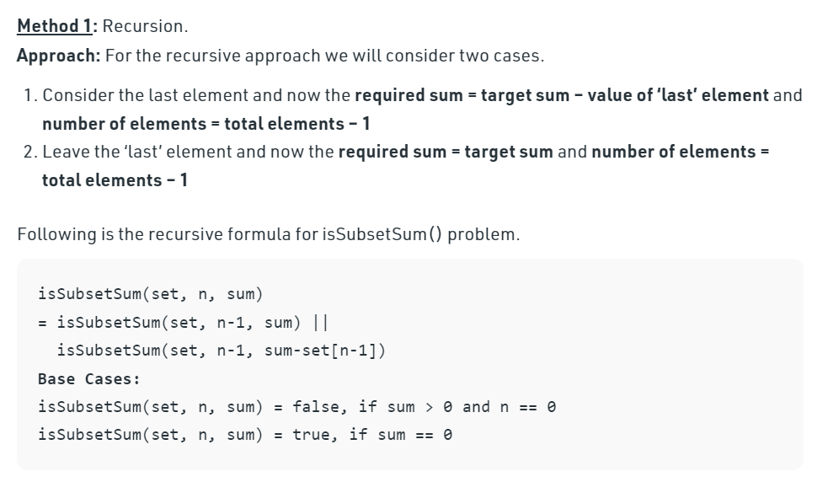
Sum of Subset

Slide 8
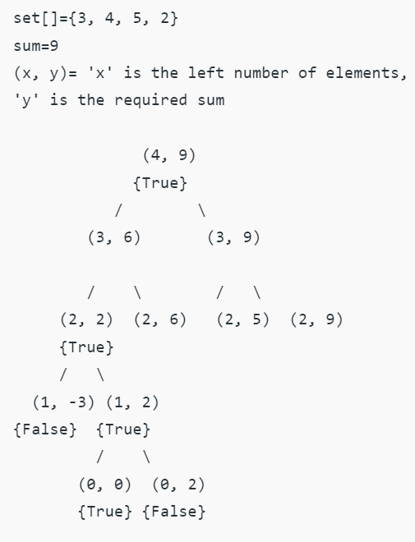

Slide 9
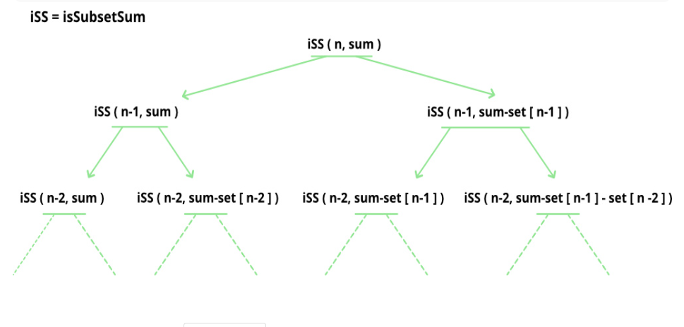

Slide 10
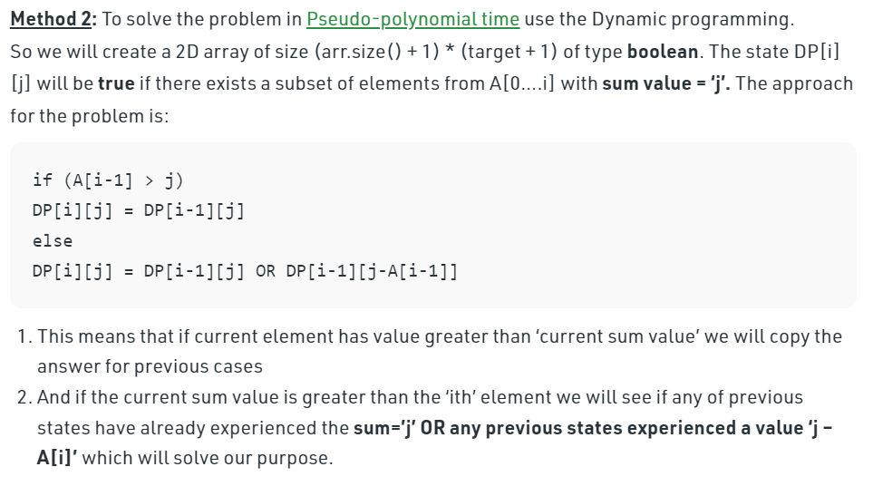
Sum of Subset Dynamic Programming

Slide 11
