Slide 1
Twitter Sentiment Analysis on
Tourism using Lexicon Based Approach
Name: Vikas Kodag
Roll No.: 3373
Guided By: Prof. M.S. Takalikar

Slide 2
Motivation
Thoroughly dealt by Alec Go, Richa Bhayani and Lei Huang, Computer Science graduate students of Stanford University.
Prompt response and more number of user.
Estimate the changes and additional services required.
Movies and product reviews.
Predicting the results of electoral polls.

Slide 3
Literature Survey
Sr No. | Paper | Technique Used
1 | J. C. L. Menchavez and K. J. P. Espinosa, "Fun in the Philippines: Automatic Identification and Sentiment Analysis of Tourism-Related Tweets," 2015 IEEE International Conference on Data Mining Workshop (ICDMW), Atlantic City, NJ, 2015, pp. 660-667.mdoi: 10.1109/ICDMW.2015.184 | Logistic Regression, Naive Bayes, Support Vector Machines.
2 | Colhon, M, Badica, C, & Sendre, A (2014). Relating the Opinion Holder and the Review Accuracy in Sentiment Analysis of Tourist Reviews. In Knowledge Science, Engineering and Management (pp.246-257). Springer International Publishing. | Lexicon Approach
3 | Himada, K., Inoue, S., & Endo, T (2012, September). On-site likelihood identification of tweets for tourism infonnation analysis. In Advanced Applied lnformatics (11A1AA1), 2012 IIAl International Conference on (pp. 117-122). IEEE. | Support Vector Machine
4 | P. Prameswari, I. Surjandari and E. Laoh, "Opinion mining from online reviews in Bali tourist area," 2017 3rd International Conference on Science in Information Technology (ICSITech), Bandung, 2017, pp. 226-230. doi: 10.1109/ICSITech.2017.8257115 | Recusive Neural Tensor Network

Slide 4
Dataset
Twitter API (GujaratTourism)
Collected from period of May 26, 2016 - March 20, 2018
Tweets gathered - 1000

Slide 5
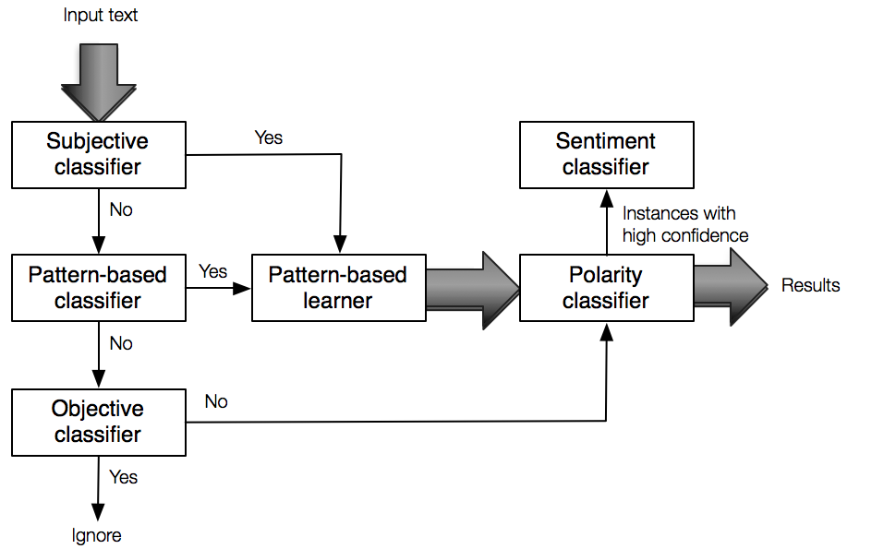
System Overview

Slide 6
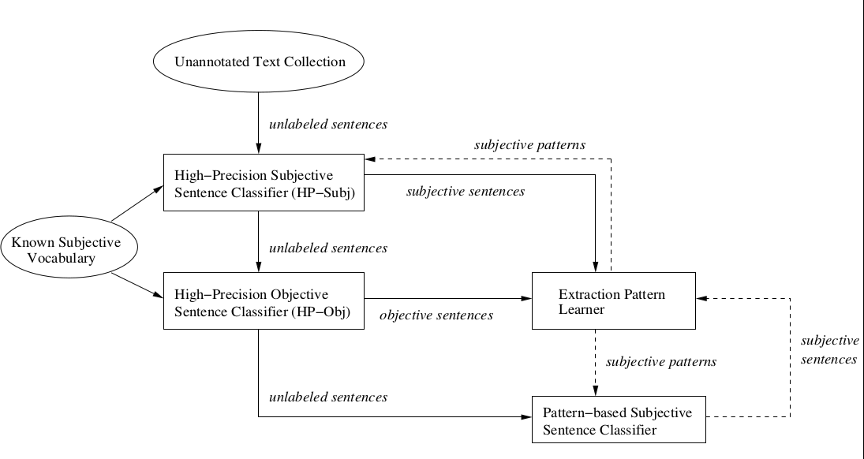
Bootstrapping Process

Slide 7
Results
Positive Sentiments | 681
Negative Sentiments | 50
Neutral Sentiments | 259
 | Manual Results | Analysis Result
Positive Sentiments | 152 | 199
Negative Sentiments | 202 | 205
Neutral Sentiments | 66 | 16

Slide 8
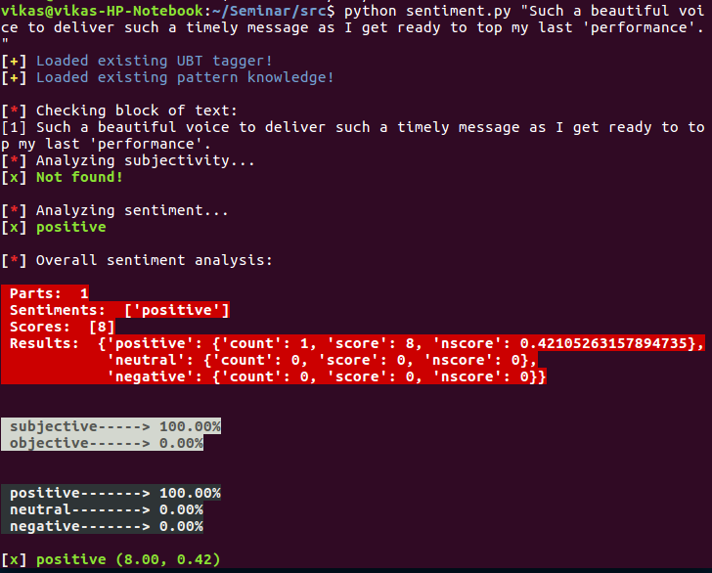

Slide 9
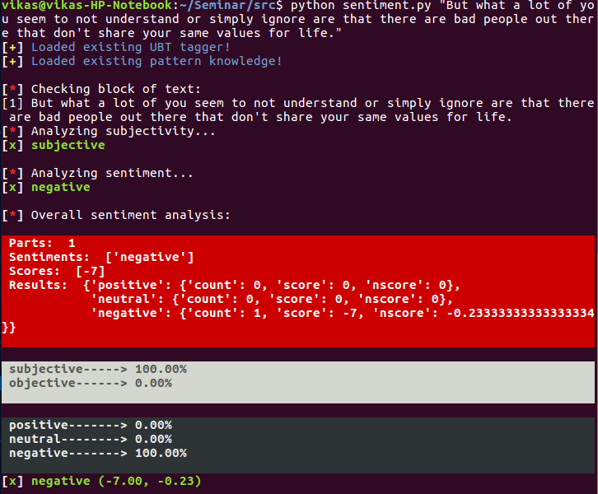

Slide 10
Conclusion
Tweets from “GujaratTourism” were studied.
Lexicon Based Approach was used.
High precision subjectivity classifiers were used.
Overall accuracy : 63%
Higher accuracy for negative sentiment classification.

Slide 11
Future Scope
Machine Learning methods
Sarcasm Detection
WSD methods (handles word context problem)

Slide 12
References
Himada, K., Inoue, S., & Endo, T (2012, September). On-site likelihood identification of tweets for tourism infonnation analysis. In Advanced Applied lnformatics (11A1AA1), 2012 IIAl International Conference on (pp. 117-122). IEEE.
Colhon, M, Badica, C, & Sendre, A (2014). Relating the Opinion Holder and the Review Accuracy in Sentiment Analysis of Tourist Reviews. In Knowledge Science, Engineering and Management (pp.246-257). Springer International Publishing.
H. Kaur, V. Mangat and Nidhi, "A survey of sentiment analysis techniques," 2017 International Conference on I-SMAC (IoT in Social, Mobile, Analytics and Cloud) (I-SMAC), Palladam, 2017, pp. 921-925. Doi: 10.1109/I-SMAC.2017.8058315
https://www.safaribooksonline.com/library/view/natural-language-annotation/9781449332693/ch01.html

Slide 13
Thank You !

