Slide 1


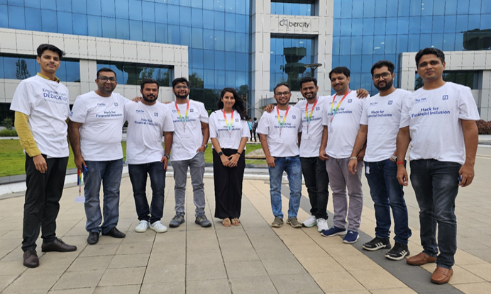
FinAI Mitra
Global Hackathon For Financial Inclusion
Your intelligent assistant for financial insights
Team Coding Ninjas
Manu Goel
Ayush Sahu
Niraj Kumar
Sourabh Mhaske
Ankit Soin
Vikas Singh
Bharat Karanjule
Aniket Gholap
Rahul Hundare
Sonam Kumari

Slide 2
Responsible AI Practices
Security ,Safety & Technical Robustness
Fairness & bias
Transparency & Explainability
Accountability
Education & Training
Privacy
Human Oversight
Aligned

Slide 3
Global Hackathon For Financial Inclusion Challenges
AI Powered Financial Coach
Financial Literacy for Small Businesses
Localised Financial Education

Slide 4
Overview
Introduction
Key Features
Upload documents: PDF, image, or paste text
Automated OCR & classification
Support for multiple languages & Region (English, Hindi, German)
Text-to-Speech functionality for audio playback
Conversational Q&A with AI
User-friendly Interface with Streamlit
AI-powered web app for financial insights
Automates the end-to-end process: extraction, classification, simplification, and summarization
Cuts down on manual tasks, reduces human error, and boosts productivity
Enhances accessibility and scalability

Slide 5



Use Cases
Future Scope
📑 Loan processing, Invoice reconciliation
🧾 Simplifying customer onboarding and KYC automation
🧠 Financial research and risk analysis
Financial Planning
🦮 Accessibility for visually impaired
📈 Trend/KPI analysis and risk flagging
📤 Structured data export (CSV/JSON)
Video Simulation on the generated
summary
📊 Interactive visual dashboards
🌐 More Country and language supports
Financial Product recommendation
🔗 Integration with financial systems``

Slide 6
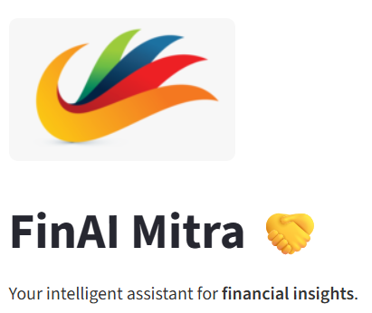
Financial Inclusion
https://finai-mitra-839010118558.us-central1.run.app/

Slide 7
Thank You !

