Slide 1
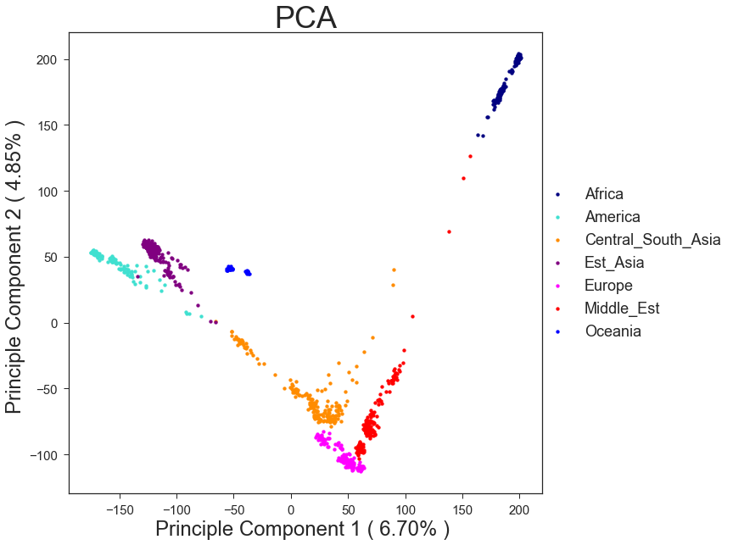
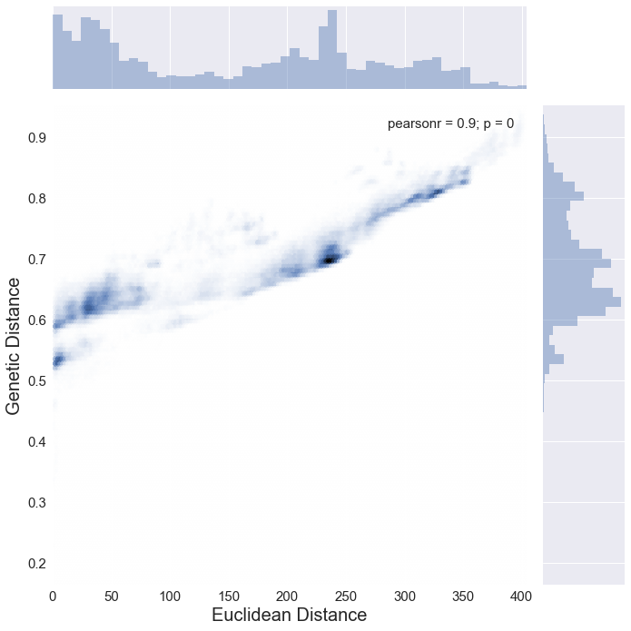
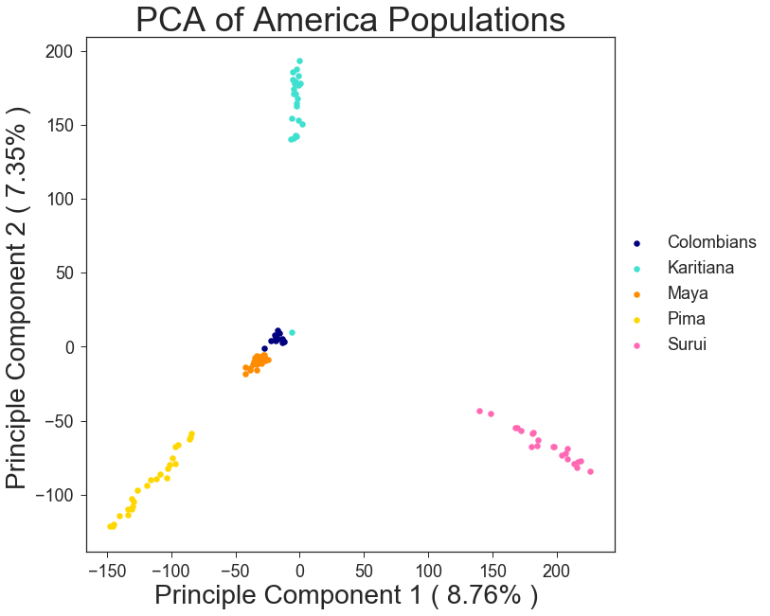
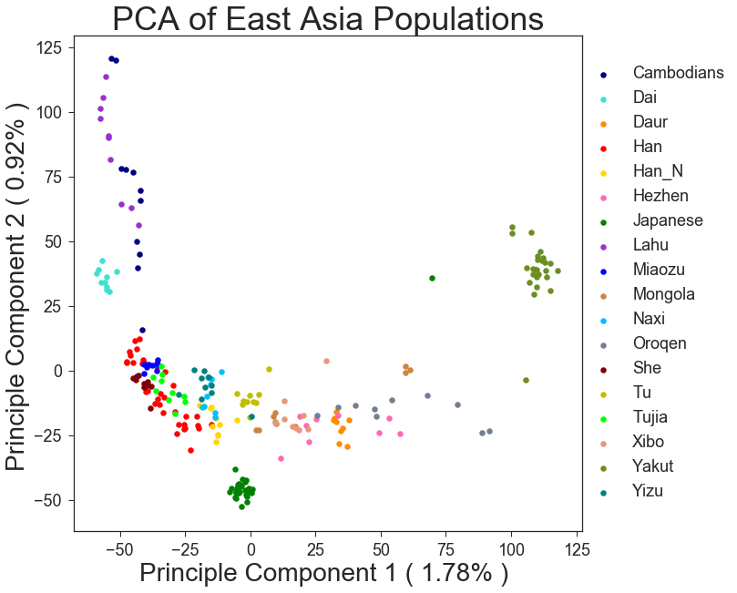
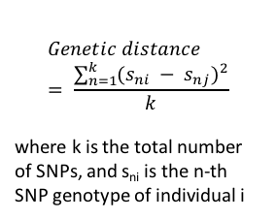
CSIS5011 Mini-project 1: Comparison between PCA and network topology analysis for population variations
CHEN Yiyun (ychenab@connect.ust.hk) ZENG Wenshu (wzengaa@connect.ust.hk)
Division of Life Science, HKUST
1. Introduction
3. Results
4. Conclusion
During the process of human migration and evolution, populations continuously evolved and diversified. Using genetic data generated from microarrays and sequencing platforms, we can elucidate the evolution history and connections among populations, which has been challenging for archaeology studies. In this mini-project, we analyzed single nucleotide polymorphism (SNP) data from the Human Genome Diversity Panel (HGDP-CEPH) collection, which includes 660,000 SNP genotype information of 1064 individuals from various populations and geographic regions. Our study compared the classical principal component analysis (PCA) and network topology analysis in illustrating the population structure.
A B
Figure 1. The Euclidean distance on PCA correlates with genetic distance. A. PCA analysis of populations from 7 regions. B. Comparison of genetic distance and Euclidean distance generated from PCA.
Population from 7 regions are well-separated by PCA (Figure 1A), and the result supports the out-of-Africa hypothesis of human evolution. Linear correlation of pairwise Euclidean distance on PCA and the genetic distance (Figure 1B) indicates that the principal components represent the genetic diversity among populations.
Further analysis of population structures using genetic distance network demonstrated similar results as PCA analysis in America populations (Figure 2), where individuals from different regions diverge vastly, forming densely connected intra-regional networks.
However, in a more complex population, such as East Asia, PCA analysis shows a continuous spectrum without detailed information on the genetic connections among populations (Figure 3A). In comparison, genetic distance network is more informative in showing both the genetic similarity and interactions among populations (Figure 3B & C). Interestingly, the majority of populations in East Asia are closely related as a central network, while several ethnic minority groups in China are genetically separated, suggesting that they may live separately from Han and propagate within their own group.
A B
C
Figure 2. PCA analysis and network topology analysis of populations in America.
A. PCA analysis of 5 America populations. B. Network analysis by pairwise genetic distance illustrates the structure of the 5 different America populations. C. Analysis and parameters of the networks in Figure 2B.
2. SNP dataset and methods
SNP data set
The HGDP-CEPH dataset of 660918 SNPs from 1064 individuals are pre-processed to include the successfully genotyped loci only. In total, 1043 individuals and 488919 SNPs are used in our analysis. The 1043 individuals come from 51 populations, including Africa, America, Europe, Middle East, South/Central Asia, East Asia, and Oceania.
Objectives
Compare PCA and network analysis in representing genetic diversity and population structures and connections.
Analysis methods
PCA is plotted by python packages sklearn and matplotlib. Pairwise genetic distance (defined by the equation below) is applied in network analysis, which is then plotted and analyzed by Cytoscape.
5. Discussion
Network | All | Colombians | Karitiana | Maya | Pima | Surui
Number of nodes | 102 | 13 | 23 | 16 | 25 | 21
Avg. number of neighbors | 16.843 | 11.077 | 22 | 3.875 | 23.28 | 20
Network density | 0.167 | 0.923 | 1 | 0.258 | 0.97 | 1
Network centralization | 0.072 | 0.091 | 0 | 0.467 | 0.033 | 0
Clustering coefficient | 0.872 | 0.947 | 1 | 0.517 | 0.976 | 1
PCA is a very powerful and robust tool in dimensionality reduction, especially in representing high-dimensional data such as human populations. However, it has difficulties in preserving the complete information and explaining all variations. In comparison, network analysis using genetic distance informs both the variation and detailed structures and connections among populations. Failure to include outliers and difficulties in selecting cut-offs during network construction are the shortcomes of network analysis. Combination of both methods might be a solution in genetic data representation.
A B
C
Figure 3. PCA analysis and network topology analysis of populations in East Asia. A. PCA analysis on East Asia populations. B. Network analysis by pairwise genetic distance shows an inter-connected central network and several separated dense networks in East Asia populations. C. Analysis and parameters of the central and the separated network in Figure 3B.
SNP
Data process
PCA
Genetic distance
Network Analysis
$$Genetic distance= \frac{\sum_{n=1}^{k}{{(s_{ni} − s_{nj})}^{2}}}{k}$$
where k is the total number of SNPs, and s_{ni} is the n-th SNP genotype of individual i
6. References
Jun Z. Li, Devin M. Absher et al. Worldwide Human Relationships Inferred from Genome-Wide Patterns of Variation. Science Vol 319 2008
7. Contribution
Network | All | Central cluster | Naxi纳西 | Daur达斡尔 | Hezhen赫哲 | Lahu拉祜 | Oroqen鄂伦春 | Yakut (in Siberia)
Number of nodes | 155 | 110 | 2 | 5 | 7 | 10 | 6 | 15
Avg. number of neighbors | 5.871 | 7.091 | 1 | 1.6 | 1.714 | 6.6 | 2 | 2
Network density | 0.038 | 0.065 | 1 | 0.4 | 0.286 | 0.733 | 0.4 | 0.143
Network centralization | 0.159 | 0.214 | nan | 0.583 | 0.3 | 0.333 | 0.9 | 0.659
Clustering coefficient | 0.396 | 0.45 | nan | 0 | 0 | 0.778 | 0.35 | 0.135
PCA Analysis
CHEN Yiyun & ZENG Wenshu
Genetic Distance and Network Analysis
CHEN Yiyun & ZENG Wenshu

