Slide 1
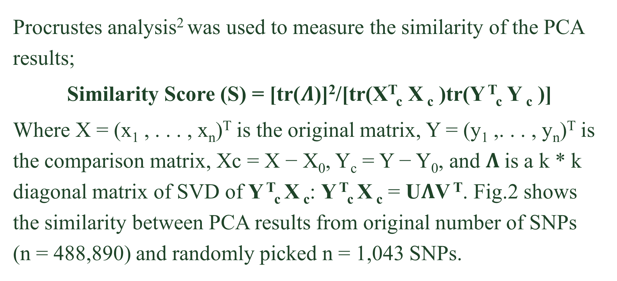
CSIC 5011 Project 1
Fall 2017
Genomic Variation Reveals Regional Information
Presented by
Wang Genomics Lab
Quanhua Mu¹ and Yoonhee Nam² {qmu, ynam}@connect.ust.hk
¹ Department of Chemical and Biological Engineering, HKUST, ² Division of Life Science, HKUST
Introduction
Results
Part3. Sample prediction
We used seven of our own available data whom we already know are Chinese. 7/7 of them were predicted obviously as East Asian in the PCA projection. Fig.4 shows one example (CGGA_1346, the orange point) where 868 available SNPs (0.2% of 488,890) were used in PCA.
Principal component analysis (PCA) can infer regional origin based on single-nucleotide polymorphisms (SNPs) data. In this project, we explored the minimum number of SNPs to make a clear separation, and further tested if PCA can predict the region of an unknown sample. As a result, randomly selected SNPs guarantee 99% similarity to PCA with all the SNPs, given p>n; and selected SNPs give higher similarity if p<n. We also show that using around 1,000 SNPs, the region of an unknown sample was able to be predicted precisely under the projection of PCA.
Part 1. PCA results can separate the 7 regions by SNPs data
A
All SNPs
B
5,000 SNPs
C
5 SNPs
CGGA_1346
Figure 1
Classical PCA with various number of SNPs. Total number of SNPs (n= 488,890) used in Fig.1A, 5,000 and 5 randomly selected SNPs used in Fig.1B and Fig.1C. Using 5,000 SNPs we can see similar shape with the original PCA, but when the number of SNPs decreased to 5, the shape gets disrupted.
Dataset
Part 2. PCA with reduced number of SNPs; random selection vs. ANOVA selected SNPs
Figure 4
Instead of using professor Yao’s SNPs data directly, we downloaded the original data¹ (http://www.hagsc
.org/hgdp/files.html) in order to get more information. The SNPs were filtered as below.
The number of subjects used was 1043, those who successfully passed the quality control done by the authors of the original paper. Therefore, a full data matrix X ∈ R^{n*p} was used in this study where p = 488,890 rows of SNPs and n = 1043 columns of people.
Procrustes analysis² was used to measure the similarity of the PCA results;
Similarity Score (S) = [tr($Λ$)]²/[tr(X^{T}_{c} X _{c} )tr(Y ^{T}_{c} Y _{c} )]
Where X = (x₁ , . . . , x_{n})^{T} is the original matrix, Y = (y₁ ,. . . , y_{n})^{T} is the comparison matrix, Xc = X − X₀, Y_{c} = Y − Y₀, and $Λ$is a k * k diagonal matrix of SVD of Y ^{T}_{c} X _{c}: Y ^{T}_{c} X _{c} = U$Λ$V ^{T}. Fig.2 shows the similarity between PCA results from original number of SNPs (n = 488,890) and randomly picked n = 1,043 SNPs.
Discussion
From our study, we saw the result of PCA can the reproduced by smaller number of SNPs, and even more smaller using selected SNPs. However, to reach a significant (>0.99) similarity score, the number of SNPs need to be over 500, where there was no difference between random and ANOVA based selection.
Interestingly, among the top 10 SNPs, rs1834640 was reported previously to be related to skin pigmentation³.
We also showed the possibility of PCA to predict the continental origin of unknown samples. This will be useful, because targeted sequencing is widely used, and targeted sequencing provides information for only a limited number of SNPs.
660918
644258
488919
488890
Original number of SNPs
SNPs on autosomes
Without missing values
SNPs that varies across groups
S = 0.984,
1043 SNPs
Figure 2
Fig.3A shows boxplots from randomly selected SNPs and the similarity scores to the original result (repeated 5 times per number of SNPs). One-way ANOVA was performed to rank the SNPs by its significance of difference within the regions.
A
B
The red-line in Fig.3A shows similarity score from ANOVA selected SNPs which drops much slower compared to random selection. Fig.3B
shows one of the top 5 SNPs (rs11175577, rs2823882, rs2426552, rs7018273, rs1834640) .
References
Li, Jun Z., et al. "Worldwide human relationships inferred from genome-wide patterns of variation." Science 319.5866 (2008): 1100-1104.
Wang, Chaolong, et al. "Comparing spatial maps of human population-genetic variation using Procrustes analysis." Statistical applications in genetics and molecular biology (2010).
Casto, Amanda M., and Marcus W. Feldman. "Genome-wide association study SNPs in the human genome diversity project populations: does selection affect unlinked SNPs with shared trait associations?." PLoS genetics 7.1 (2011): e1001266.
Figure 3
Contribution
Only African is enriched with 0(AA) genotype.
PCA, Procrustes analysis
→ Quanhua Mu
PCA, ANOVA analysis
→ Yoonhee Nam

