Slide 1
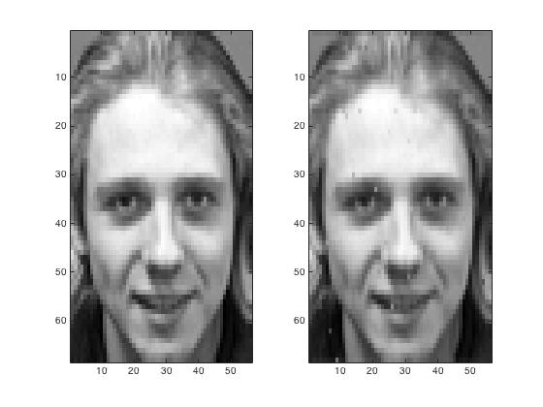
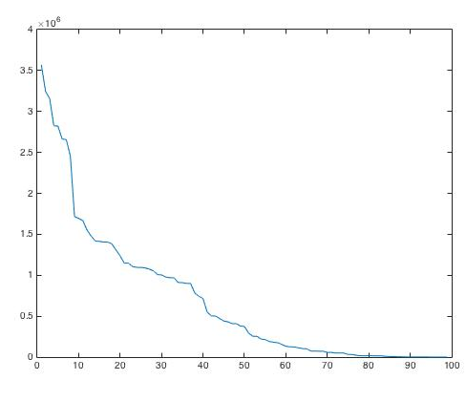
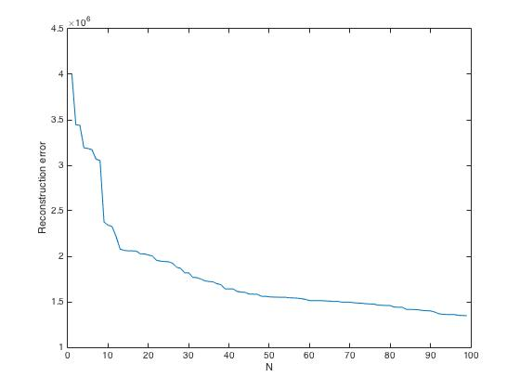
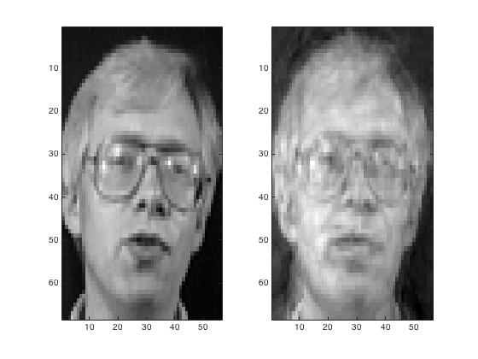
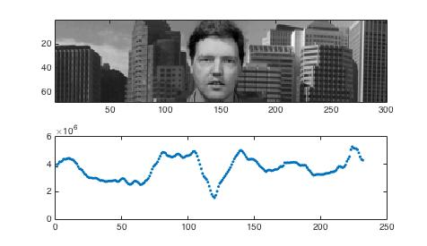
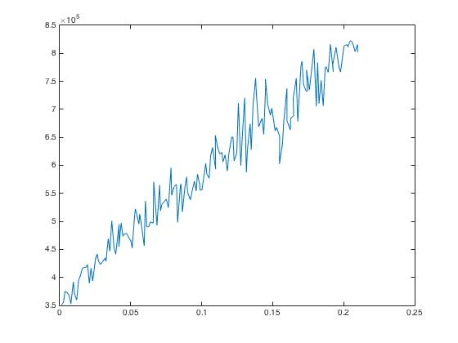
CSIC 5001 Min-Project 1 - PCA-Based Face Detection with Uncertainty
WU Aoyu
1. Introduction
3. PCA with Uncertainty
5. Results
Eigenfaces is an efficient face recognition algorithm based on PCA. However, few researches ever addressed the uncertainty issue. In this project, I aim to measure the performance of Eigenfaces with uncertainty in terms of efficiency and accuracy. Various algorithms and uncertainty distributions will be explored. To narrow down the problem, I define uncertainty as missing values.
I examine three PCA variations for missing values, namely, alternating least squares (ALS), pairwise deletion (PD) and listwise deletion (LD). Two uncertainty distributions are explored: block & random. Block uncertainty means image block losses while random uncertainty is like salt-and-pepper noises.
Efficiency
The fundamental challenge of this project is scalability. Since the training data is images, the covariance matrix is of large size and dense.
While ALS is theoretically believed to yield best results, I find it not scalable since it takes too much running time. In my test, it does not terminate after 5 minutes.
Neither does PD, which takes 16.82 seconds in existence of 1 NaN value but increases to 92.15 seconds with 5 missing values.
LD terminates within 1 second, however, since it deletes the entire row containing missing values, it yields less number of principal components, and leads to empty result with massive missing values.
The right image shows the original image and reconstruction image using 50 principal components in existence of 10% missing values in training images.
This suggests that my interpolation methods work pretty good for PCA of 2D images with missing values.
2. Eigenfaces by PCA
Implementation
I implement Eigenfaces algorithms with PCA and measure the reconstruction SSE errors using the top N principal components. The training data contains 100 images (5 expression of 20 persons) of size 68*56 pixels. The reconstruction image is out of the training data.
6. Conclusion
In this project, I address the uncertainty issue for PCA of 2D images. I find the existing mathematical PCA variations such as ALS, PD and LD not scalable, since the covariance matrix is of great size due to the nature of image. Inspired by the interpixel redundancy of image, I utilize the interpolation method to fill the missing values. This algorithm proves to work well.
I learnt three important lessons from this project. First, I realized that images are a distinct datatype in terms of data reduction. The fundamental challenge lies in the scalability. Second, in terms of data reduction, it is essential to consider the data nature before choosing algorithms. Third but potentially most importantly, research involves repeated trial-and-error progress. Many well-established methods might fail in particular cases. This motivates critical thinking which leads to identify new problems and propose novel solutions.
Results
The first image shows that using the top 10 principle components yield effective reconstruction of both training and test images.
The second image presents the reconstruction of test images using 99 PCs, capturing most facial features.
The third image suggests the face detection by scanning the window. The nadir of errors corresponds to face.
Conclusion
PCA works well with face reconstruction and detection.
4. Interpolation Method
Very frustratingly, the above implementation and test suggest those mathematical PCA variations could not address the uncertainty issue in terms of 2D images efficiently. But this leads me to tackle this problem from the perspective of image nature. Motivated by the interpixel redundancy, I resort to the interpolation method. Specifically, I first apply interpolation method to fill the missing values, followed by a standard PCA algorithm.
The left images shows the reconstruction errors versus percentage of missing values.
7. Reference
(Up) Reconstruction SSE Errors of N PCs:
left - training image; right – test image
(Middle) Reconstruction using 99 PCs
(Down) Face Detection by Sliding Window
Dataset Source: F. Samaria and A. Harter, "Parameterization of a stochastic model for human face identification”, 2nd IEEE Workshop on Applications of Computer Vision, December 1994, Sarasota (Florida).

