Slide 1
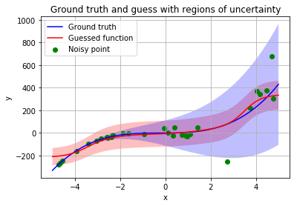
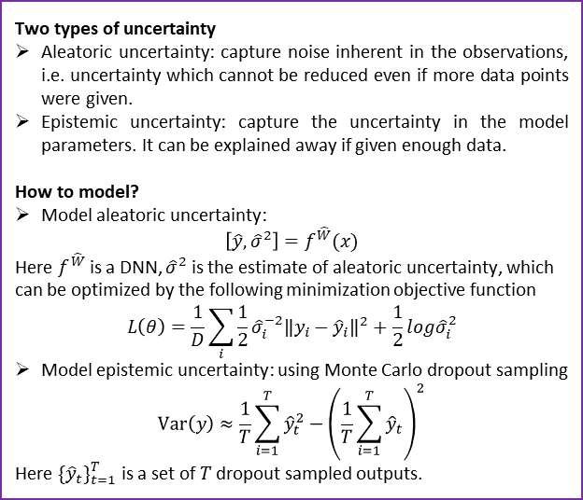
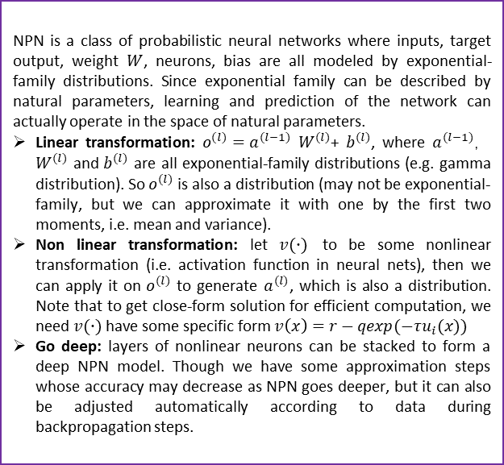
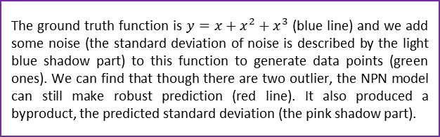
CSIC 5011 Mini-Project 2: Application of Bayesian Neural Network
Ye Yushi and Mao Hongyu {yyeaf, hmaoab }@ust.hk
Department of Mathematics, HKUST
1. Introduction
4. Natural-Parameter Networks – Wang etc. (2016)
Nowadays everybody talks about deep neural network (DNN). Some branches, such as recurrent neural network (RNN), convolutional neural networks (CNN), are also very popular. Here we want to examine the idea behind Bayesian neural network (BNN) and its application on famous datasets like MNIST. BNN’s most notable advantage is it can not only make prediction values based on input data, but also give the confidence or uncertainty about its prediction. This is very important for many cases such as object recognition in assisted driving system.
NPN is a class of probabilistic neural networks where inputs, target output, weight $W$, neurons, bias are all modeled by exponential-family distributions. Since exponential family can be described by natural parameters, learning and prediction of the network can actually operate in the space of natural parameters.
Linear transformation: $o^{(l)}=a^{(l−1)}$ $W^{(l)}$+ $b^{(l)}$, where $a^{(l−1)}$， $W^{(l)}$ and $b^{(l)}$ are all exponential-family distributions (e.g. gamma distribution). So $o^{(l)}$ is also a distribution (may not be exponential-family, but we can approximate it with one by the first two moments, i.e. mean and variance).
Non linear transformation: let $v(∙)$ to be some nonlinear transformation (i.e. activation function in neural nets), then we can apply it on $o^{(l)}$ to generate $a^{(l)}$, which is also a distribution. Note that to get close-form solution for efficient computation, we need $v(∙)$ have some specific form $v\left(x\right)=r−qexp(−τu_{i}(x))$
Go deep: layers of nonlinear neurons can be stacked to form a deep NPN model. Though we have some approximation steps whose accuracy may decrease as NPN goes deeper, but it can also be adjusted automatically according to data during backpropagation steps.
2. Bayesian Deep Learning - Kendall and Gal (2017)
Two types of uncertainty
Aleatoric uncertainty: capture noise inherent in the observations, i.e. uncertainty which cannot be reduced even if more data points were given.
Epistemic uncertainty: capture the uncertainty in the model parameters. It can be explained away if given enough data.
How to model?
Model aleatoric uncertainty:
$$\left[\hat{y},{\hat{σ}}^{2}\right]=f^{\hat{W}}(x)$$
Here $f^{\hat{W}}$ is a DNN, ${\hat{σ}}^{2}$ is the estimate of aleatoric uncertainty, which can be optimized by the following minimization objective function
$$L\left(θ\right)=\frac{1}{D}\sum_{i}{\frac{1}{2}{\hat{σ}}_{i}^{−2}{\left\|y_{i}−{\hat{y}}_{i}\right\|}^{2}+\frac{1}{2}log{\hat{σ}}_{i}^{2}}$$
Model epistemic uncertainty: using Monte Carlo dropout sampling
$$Var\left(y\right)≈\frac{1}{T}\sum_{i=1}^{T}{{\hat{y}}_{t}^{2}}−{\left(\frac{1}{T}\sum_{i=1}^{T}{{\hat{y}}_{t}}\right)}^{2}$$
Here ${\{{\hat{y}}_{t}\}}_{t=1}^{T}$ is a set of $T$ dropout sampled outputs.
6. Performance and conclusion
Here we apply BDL and NPN on MNIST dataset, the testing error (60000 training samples and 10000 testing samples) is 8.52% and 3.53% respectively. Note that BDL is very computational costly since the epistemic error is calculated through Monte Carlo dropout sampling and happens on both training and testing period. We also find that NPN can be treated as a complicated version of normal NN since its parameters are doubled (usually two natural parameters can determine an exponential-family distribution). In this circumstance, it may be more suitable for real world applications.
5. A toy example
7. References
The ground truth function is $y=x+x^{2}+x^{3}$ (blue line) and we add some noise (the standard deviation of noise is described by the light blue shadow part) to this function to generate data points (green ones). We can find that though there are two outlier, the NPN model can still make robust prediction (red line). It also produced a byproduct, the predicted standard deviation (the pink shadow part).
[1] A Kendall, Y Gal “What Uncertainties Do We Need in Bayesian Deep Learning for Computer Vision?” arXiv:1703.04977, 2017
[2] Hao Wang, Xingjian Shi, Dit-Yan Yeung “Natural-Parameter Networks: A Class of Probabilistic Neural Networks” NIPS 2016

