Slide 1
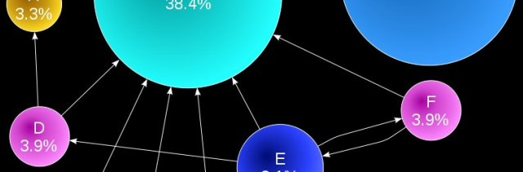
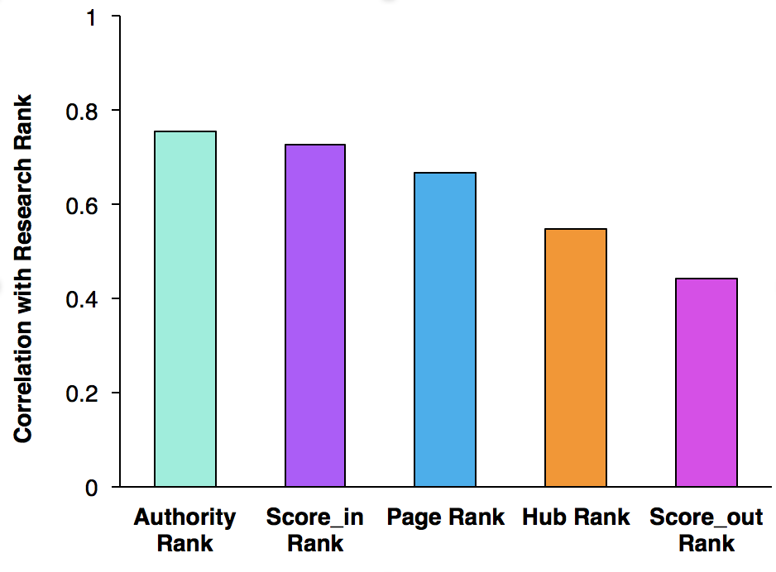
China University Ranking and Webpage links
CSIC 5011 Project 2
Fall 2017
Presented by
Wang Genomics Lab
Quanhua Mu¹ and Yoonhee Nam² | {qmu, ynam}@connect.ust.hk | ¹ Department of Chemical and Biological Engineering, HKUST, ² Division of Life Science, HKUST
Problem / Question
Results
Results
-Various link analysis
-PageRank’s correlation with the recent ranking
Figure 1 does not include any ranking information, but includes only link information. However, the universities with high reputation (in general) show bigger nodes, meaning that it is plausible to use links from the webpage to compare to university ranking.
Project Overview
Link analysis including HITS and PageRank were performed on Universities in China. The results were compared with research ranking in 2001/2002, and also the recent 2017 ranking. The effect of various hyperparameters α on PageRank result was explored.
Figure 4. PageRank (α = 0.85) and research rank difference and its relationship between the updated university rank 2017. The no shows universities with PageRank less than research rank, overestimated shows universities with PageRank having higher rank than research rank. P = 0.16
Dataset
Figure 2. Authority rank shows the highest correlation (𝞺 = 0.754) with the research rank. Spearman correlation was used. α = 0.85 for PageRank.
Conclusion
Authority rank had the best correlation with the research rank. The hyperparameters α values only affected the last 6 universities in PageRank. We observed a trend that the overestimated universities by PageRank have higher rank in 2017.
Reference
New 2017 ranking: http://www.shanghairanking.com/Chinese_Universities_Rankings/Overall-Ranking-2017.html
Figure 3. Effect of various hyperparameters α on PageRank result. Interestingly, only the bottom 6 universities from research rank changed there ranks on PageRank with different α values.
Contribution
Figure 1. Visualizes the links between universities. The size of the node and name represent number of edges (regardless of direction).
Quanhua Mu: Visualization, link analysis, 2017 rank analysis
Yoonhee Nam: PageRank, Authority Rank

