Slide 1
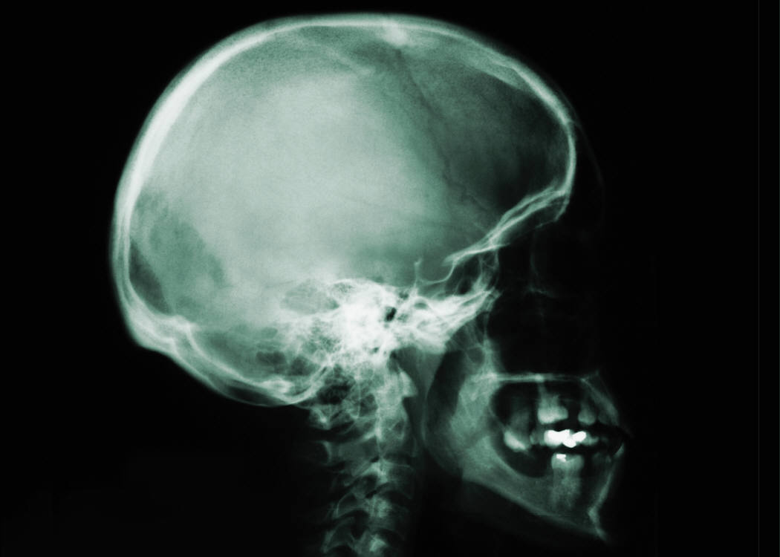
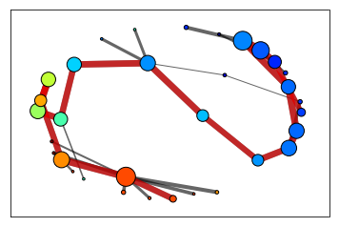

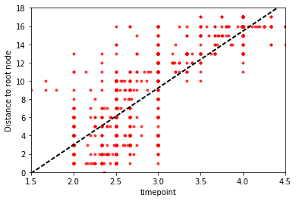
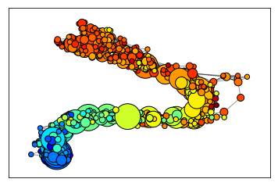
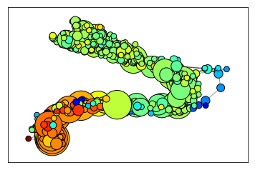
Topological Data Analysis on Glioma
Quanhua Mu¹ and Yoonhee Nam² | {qmu, ynam}@connect.ust.hk | ¹ Department of Chemical and Biological Engineering, HKUST, ² Division of Life Science, HKUST
Abstract
results
Results
Although single cell sequencing is arising in the field of genomic studies, bulk tissue sequencing data is still more widely available. In this project, we tweaked the single cell topological data analysis (scTDA) code for tissue topological data analysis. We used glioma tissue sequencing data and saw several trends in some genes as the grades of tumor increase by scTDA.
grade 5
grade 1
Background / Data
(Left) PCA analysis of the total samples. Overall, the samples are well clustered according to their grades. This distribution was used for mapping with TDA algorithm Mapper. (Right) Topological features in low-dimensional representation built by Mapper. A node was assigned to each cluster of samples, and nodes were connected by edges if the clusters intersect in the high-dimensional space. Here the nodes are connected sequentially as the grade increase, suggesting the gliomas with high grade tends to be more different compared to normal brain tissues (grade 1) while low grade gliomas are more alike to the normal.
Gliomas are brain tumors that start in the glial cells. They can be classified according to their grades which is determined pathology. Out of grade I ~ IV, grade III and IV gliomas are more fast growing with worse prognosis. Here we have downloaded mRNA sequencing data of 701 samples including normal, grade II ~ IV glioma, and recurrent grade IV glioma tissues from The Cancer Genome Atlas (TCGA). For the rooting purpose, we annotated the samples by their grades. However, because there are no grade I glioma in this cohort, we annotated the normal samples as 1. Although classified as grade IV, the recurrent grade IV glioma was annotated as 5 for our exploratory purpose since it is a relapsed tumor from the primary(initial) grade IV glioma.
Based on the dispersion and centroid from scTDA analysis,
we found a very interesting gene, CCDC140, which is highly expressed in only grade 4 glioma (a.k.a. GBM). This gene seems to be the biomarker of GBM, distinguishing from other grade gliomas. It seems to have some potential in clinical usage but further experiments will be needed.
conclusions
High
Low
Although scTDA was developed to be used in single cell analysis, it was also shown to be usable in bulk tissue sequencing samples, which the samples are from many different individuals. It also helped to visualize and select some genes which their expression gradually changes according to the grade of tumors. It provides a valuable clue on glioma progression.
Annotation | # of samples | Explanation
1 | 5 | Normal tissue
2 | 222 | Grade II glioma
3 | 309 | Grade III glioma
4 | 152 | Primary Grade IV glioma
5 | 13 | Recurrent Grade IV glioma
Total | 701
(Left) Timepoint (the grades) correlates very well to the distance to the root node (root: grade 1).
(Right) Differentiation trajectory using scTDA. The nodes are sets of samples with similar expression level of all genes, and the sizes correspond to number of samples in that set. Edges connect the nodes that have at least one sample in common. The color however, corresponds to the expression of specific genes (GABBR1, top; EGFR, bottom). By scTDA, expression of GABBR1 decrease as the grade increase, while the expression of EGFR increase with the grade.
Reference
Ceccarelli, M., Barthel, F.P. et al.,Molecular Profiling Reveals Biologically Discrete Subsets and Pathways of Progression in Diffuse Glioma, In Cell, Volume 164, Issue 3, 2016, Pages 550-563, ISSN 0092-8674, https://doi.org/10.1016/j.cell.2015.12.028.
Rizvi, A. H.*, Camara, P. G.*, Kandror, E. K., Roberts, T. J., Scheiren, I., Maniatis, T., and Rabadan, R., "Single-Cell Topological RNA-Seq Analysis Reveals Insights Into Cellular Differentiation and Development", Nat. Biotechnol. (2017) 35: 551-560.
ConTribution
Quanhua Mu: scTDA analysis
Yoonhee Nam: data preprocessing, poster preparation

