Slide 1
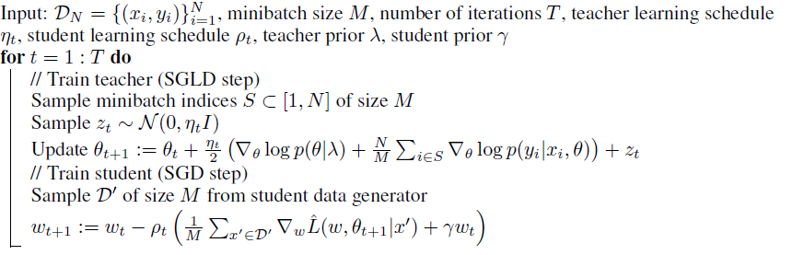
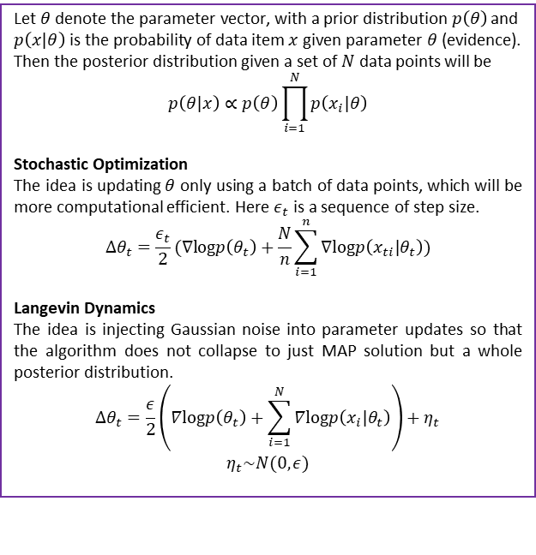
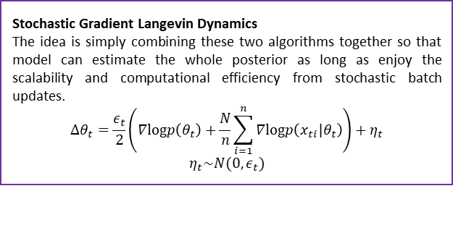
CSIC 5011 Final Project: Application of Bayesian Dark Knowledge Model
Ye Yushi and Mao Hongyu {yyeaf, hmaoab }@ust.hk
Department of Mathematics, HKUST
1. Introduction
Stochastic Gradient Langevin Dynamics
The idea is simply combining these two algorithms together so that model can estimate the whole posterior as long as enjoy the scalability and computational efficiency from stochastic batch updates.
$$∆θ_{t}=\frac{ε_{t}}{2}\left(∇logp\left(θ_{t}\right)+\frac{N}{n}\sum_{i=1}^{n}{∇logp\left(x_{ti}|θ_{t}\right)}\right)+η_{t}$$
$$η_{t}\sim N(0,ε_{t})$$
5. A toy example
In mini project 2, our team explored two Bayesian Neural Network models (Kendall and Gal, 2017 and Wang etc. 2016). BNN has many advantages, such as uncertainty prediction and robustness (check the details in our mini-project 2) but may suffer from training issues and not so computational efficient compared to traditional neural networks. In this project we will focus on the topic of how to train BNN efficiently and apply one new model called Bayesian Dark Knowledge on MNIST datasets.
Bayesian Dark Knowledge in MXNet
In the following example, we use SGLD to draw samples from the posterior of Bayesian neural network and fit a student network use these teaching samples. The student network is trained by using samples from MNIST. We will show that BDK can achieve similar performance as the SGLD teacher while being much faster for inference.
6. Performance and conclusion
2. Stochastic Gradient Langevin Dynamics (SGLD)
4. Bayesian Dark Knowledge
Number of Iterations | Time Spent | Accuracy
 |  | Student |  | Teacher
 |  | Test | Train | Test | Train
2000 | 71.82 | 0.8456 | 1.0000 | 0.6945 | 0.9900
4000 | 68.81 | 0.8557 | 1.0000 | 0.7187 | 0.9940
6000 | 68.61 | 0.8559 | 1.0000 | 0.7320 | 1.0000
8000 | 68.40 | 0.8541 | 1.0000 | 0.7264 | 0.9980
10000 | 68.50 | 0.8488 | 1.0000 | 0.7264 | 0.9980
12000 | 68.42 | 0.8585 | 1.0000 | 0.7593 | 1.0000
14000 | 68.34 | 0.8602 | 1.0000 | 0.7563 | 1.0000
16000 | 68.48 | 0.8559 | 1.0000 | 0.7345 | 0.9940
18000 | 68.65 | 0.8523 | 1.0000 | 0.7618 | 1.0000
20000 | 68.82 | 0.8637 | 1.0000 | 0.7600 | 1.0000
Let $θ$ denote the parameter vector, with a prior distribution$p\left(θ\right)$ and
$p\left(x|θ\right)$ is the probability of data item $x$ given parameter $θ$ (evidence). Then the posterior distribution given a set of $N$ data points will be
$$p\left(θ|x\right)∝p\left(θ\right)\prod_{i=1}^{N}{p\left(x_{i}|θ\right)}$$
Stochastic Optimization
The idea is updating $θ$ only using a batch of data points, which will be more computational efficient. Here $ε_{t}$ is a sequence of step size.
$$∆θ_{t}=\frac{ε_{t}}{2}(∇logp\left(θ_{t}\right)+\frac{N}{n}\sum_{i=1}^{n}{∇logp\left(x_{ti}|θ_{t}\right)})$$
Langevin Dynamics
The idea is injecting Gaussian noise into parameter updates so that the algorithm does not collapse to just MAP solution but a whole posterior distribution.
$$∆θ_{t}=\frac{ε}{2}\left(∇logp\left(θ_{t}\right)+\sum_{i=1}^{N}{∇logp\left(x_{i}|θ_{t}\right)}\right)+η_{t}$$
$$η_{t}\sim N(0,ε)$$
SGLD has a disadvantage that at test time, it need to predict many times based on a number of parameter values so we may suffer from computation or memory saving issues. To solve it, Korattikara etc. (2015) introduce a model called Bayesian Dark Knowledge. It combines SGLD and the idea of distillation of “dark knowledge”, which in short is the idea of training a smaller model (student) in replicating the behavior and performance of a much larger model (teacher), by essentially training the student to match the outputs of the teacher. In BDK, the teacher is the original model trained by SGLD, which is easy to train but hard to use; while the student is the model used for practical predicting and it should match the output of teacher model accurately. The details of BDK is shown below.
7. References
[1] Balan, Anoop Korattikara, et al. "Bayesian dark knowledge." Advances in Neural Information Processing Systems. 2015.
[2] Welling, Max, and Yee W. Teh. "Bayesian learning via stochastic gradient Langevin dynamics." Proceedings of the 28th International Conference on Machine Learning (ICML-11). 2011.
[3] Hinton, Geoffrey, Oriol Vinyals, and Jeff Dean. "Distilling the knowledge in a neural network." arXiv preprint arXiv:1503.02531 (2015).

