Slide 1
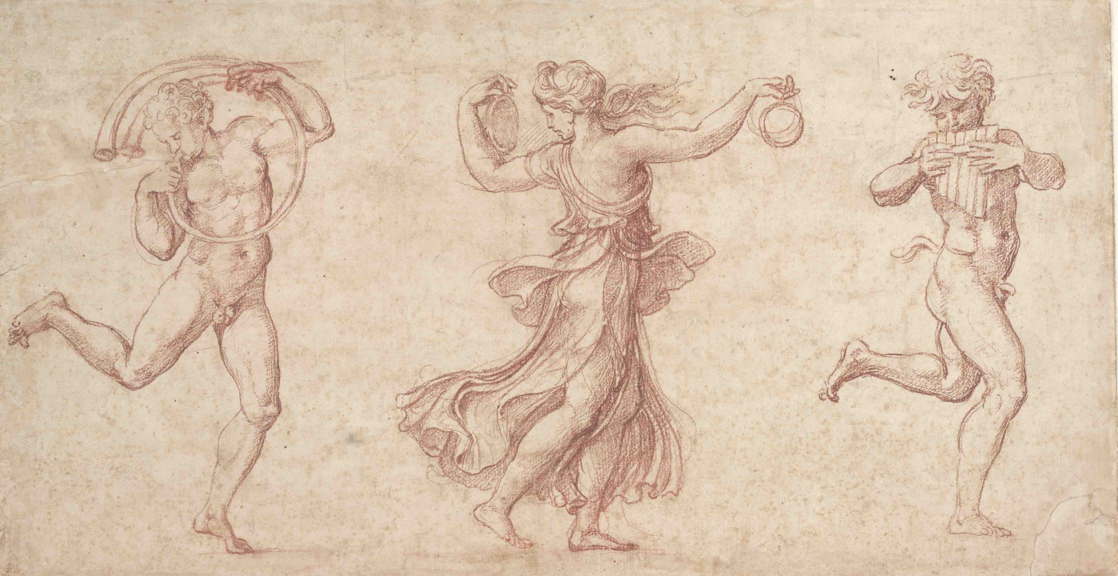
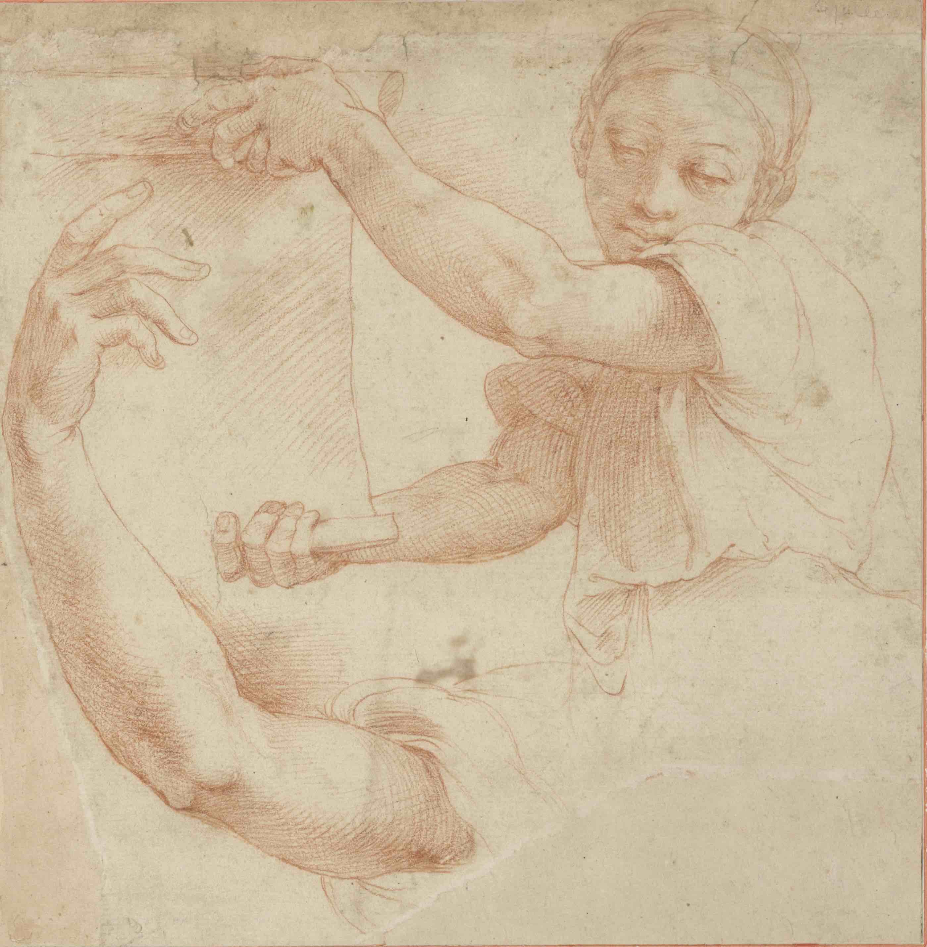
Identification Of Raphael’s Paintings From The Forgeries
WU Aoyu
Introduction
Feature Descriptor
Leave-one-out Cross Validation
This project aims to discriminate Raphael’s paintings from the forgeries. The original data includes 28 high-quality scans of Raphael style paintings, among which 12 are authenticated to be genuine, 9 are authenticated as forgeries and 7 remained disputed. We compute image descriptors includes image intensity statistics and textual feature as suggested in [1]. Several classification models are then trained and tested via leave-one-out cross validation. It is observed that gray-level co-variance matrix level performs the best with accuracy 85.71%. Finally, we predict those disputed paintings.
Image Intensity Statistics
To describe the intensity of a grayscale image, we calculate the following statistical features: global mean, variance, histogram of intensity values and histogram features including skewness, kurtosis and entropy. The histogram models the distribution of intensity levels in a image. The shape of the histogram provides information about image characteristics.
Texture Based Features
Although no formal definition of image texture exists, we extract texture features based on a commonly accepted approach – the gray-level co-occurrence matrix (GLCM) [2], which models the positions of pixels with similar gray level values. For each computed GLCM, we extract the following four features:
Contrast: Local variations
Correlation: Joint probability occurrence of specified pixel pairs
Energy: The sum of squared elements
Homogeneity: The closeness of the distribution
 | DT | SVM | DA | kNN
Image Intensity | 64.29% | 71.43% | 71.43% | 42.86%
Texture Based | 71.43% | 85.71% | 85.71% | 85.71%
It is observed that gray-level co-variance matrix method performs relatively well disregarding the classification methods. GLCM captures the details of paintings and help discriminate the genuine paintings, while image intensity only captures low-level information which is easy to cheat. Consider the following training data, the genuine (left) and forgery have similar color but vary in details.
Dataset
The dataset is provided by Prof. Yang WANG from HKUST, which contains a 28 high-quality digital paintings of Raphael of forgeries. The average size of 4019*3963.
7. Reference
Classification
Prediction
[1] C. Eva and G. Sonja. Automated painter recognition based on image feature extraction, ELMAR, 2013 55th International Symposium, 2013.
[2] R. M. Haralick. "Statistical and structural approaches to texture," Proceedings of the IEEE , vol.67, no.5, pp.786-804, May 1979.
We implement the following models for classification:
Decision Tree with Early Prune (DT)
Support Vector Machine (SVM): Quadratic kernel is adopted.
Discriminant Analysis (DA)
K-Nearest Neighbor (kNN)
The results of prediction are as follows:
1 | 7 | 10 | 20 | 23 | 25 | 26
Y | N | N | Y | Y | Y | Y

