Slide 1
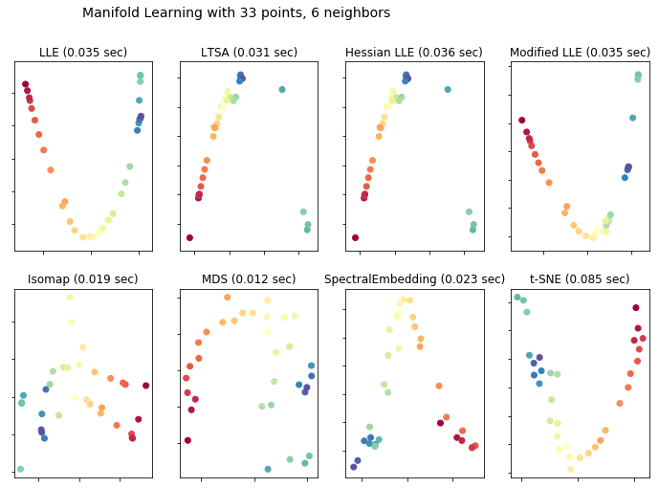
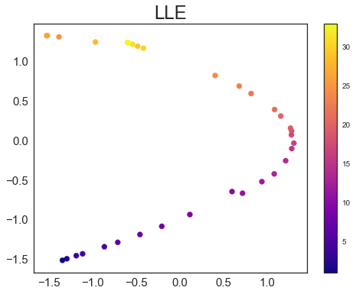
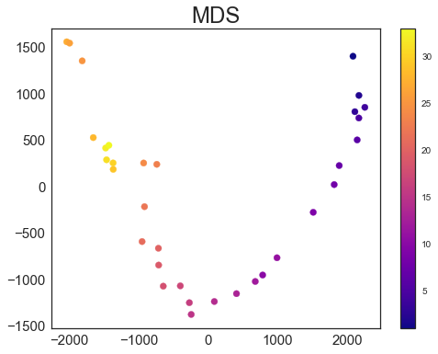
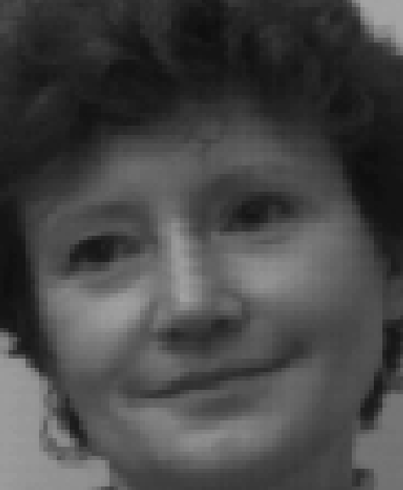
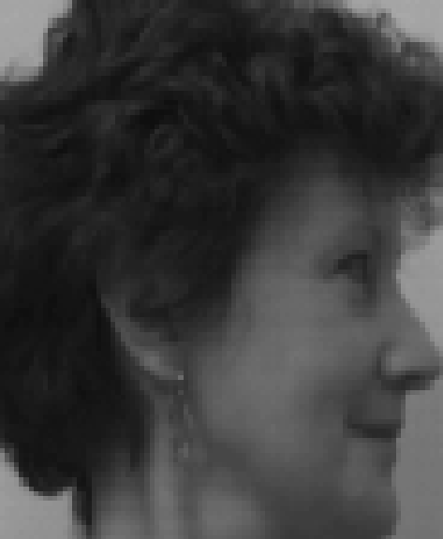
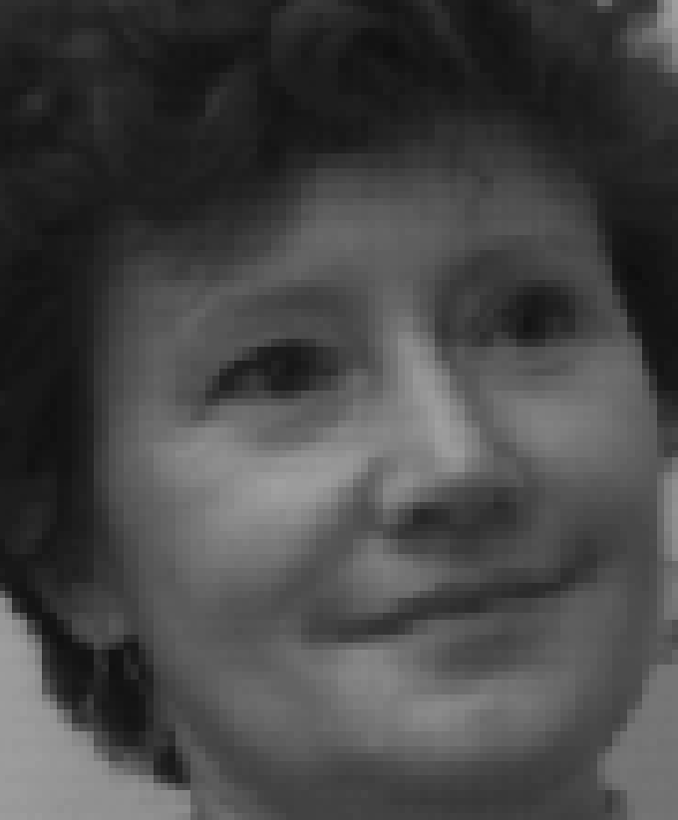
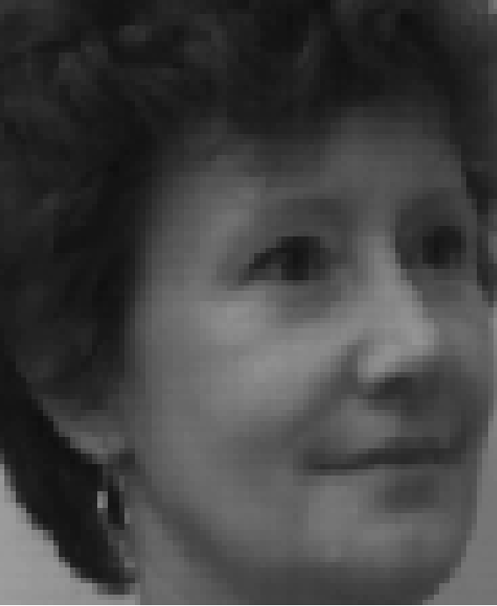
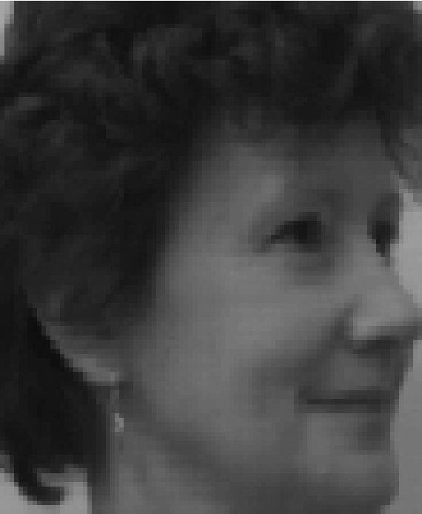
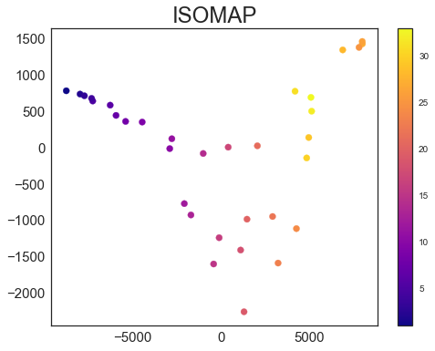
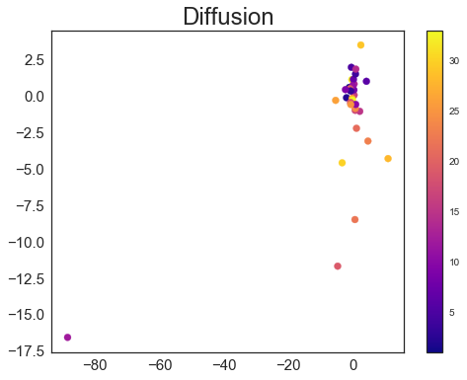
CSIC 5011 Mini-Project 2
CHEN Yiyun (ychenab@connect.ust.hk) ZENG Wenshu (wzengaa@connect.ust.hk)
Division of Life Science, HKUST
1. Introduction
3. Results
Face recognition algorithms are fast-developing during the past two decades, for its wide usage on identification, security and 3D remodeling. Either using 2D photos generated from cameras, or 3D facial recognition using 3D sensors, we capture various information about the faces. It is essential to construct an algorithm to study and distinguish facial features, such as the contour of the eye sockets, nose, and chin. Previously, we have utilized dimensionality reduction algorithms, such as PCA and MDS, for face recognition. In this project, we further applied diffusion map, ISOMAP, LLE, t-SNE and several other algorithms to reorder 33 photos taken from different angles of the same face. The comparison of these methods will provide us with some clues of their performances in facial characterization tasks.
A
B C
25
25
1
33
33
17
9
1
9
17
D E
1
25
29
17
33
9
2. Data and methods
22
33 facial images of the same person but taken from different angles were applied as our input data. After projected onto a 2D plot, we compare whether the algorithms can reorder these images correctly. Various algorithms, including ISOMAP, LLE, MDS, spectral embedding, t-SNE and diffusion map, were utilized. These dimensionality reduction methods assume that the data lied in a hyperplane, and can be visualized in a low-dimensional space. The codes are composed in Matlab and Python.
12
24
Figure A. Comparison of results and speed of 8 manifold learning methods.
Figures B-E. Detailed analysis of distributions of photos after analysis by LLE (which performs the best), MDS, ISOMAP, and Diffusion map. Representative photos are placed adjacent to the pictures. The color bar represents photo ID.
19
19
12
4. Conclusion
5. Contribution
Among these dimensional reduction methods, LLE is the best one that can reorder the photos according to different angles of the face. Comparatively, diffusion map and other manifold learning methods could not order the faces very well. Photos from multiple angles are tangled together in diffusion map, while ISOMAP classified similar photos to distinct clusters. We conclude that classical and modified LLE are well-suited for face recognition challenges.
ZENG Wenshu
Constructed MDS, ISOMAP, LLE, Diffusion map in Matlab
CHEN Yiyun
Produced manifold learning results in python

