Slide 1

Mobile Distribution Performance Analysis
Comprehensive analysis of key performance indicators for India's premium mobile distribution network, revealing strong market positioning with 769M in total revenue across diversified product portfolio and payment channels.

Slide 2
Executive Summary: Strong Market Performance
769M
19K
4K
192K
Total Sales Revenue
Units Sold
Total Transactions
Average Transaction Value
Demonstrates robust market demand across premium mobile segment
Strong volume performance indicating healthy market penetration
High-value transactions averaging 4.75 units per purchase
Premium positioning with bulk purchase patterns from resellers
Our performance metrics reveal a well-positioned premium mobile distributor with strong unit economics. The average selling price of ~40K per unit firmly establishes our presence in the premium segment, while the high units-per-transaction ratio (4.75) indicates significant business from resellers and bulk purchasers. This combination of premium pricing and volume efficiency creates a sustainable competitive advantage in India's dynamic mobile market.

Slide 3
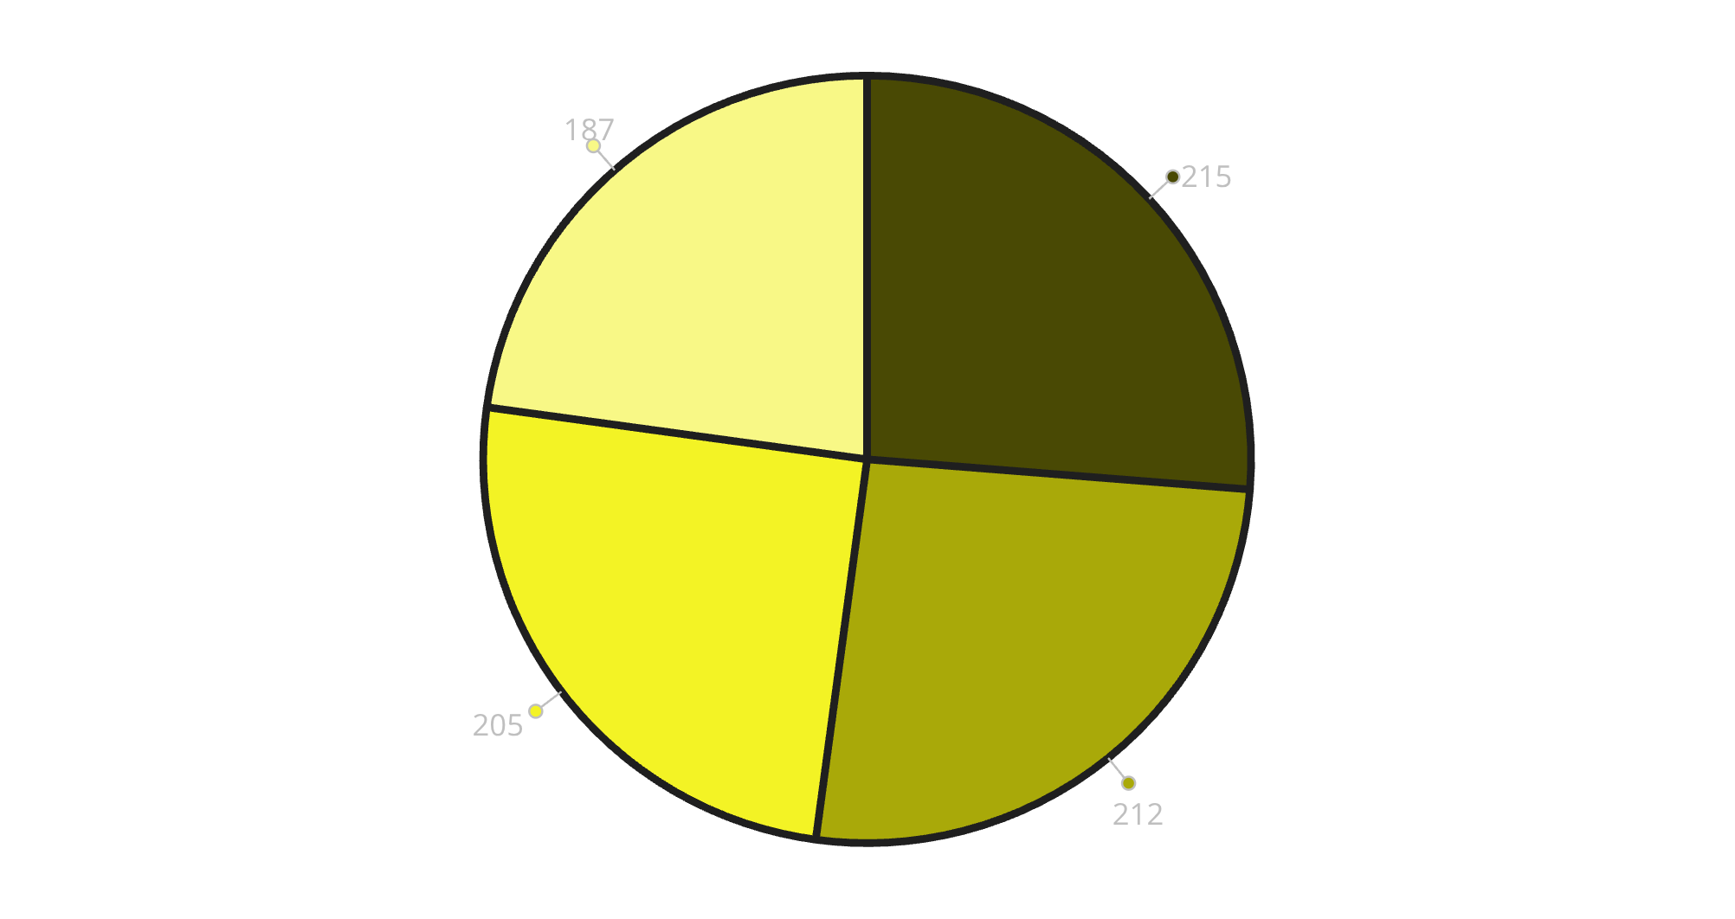
Payment Method Distribution Analysis
Key Insights
Remarkably balanced payment distribution reveals sophisticated customer base with diverse preferences. Debit cards leading (26.25%) suggests strong middle-class customer segment, while substantial cash usage (25.89%) remains typical for Indian mobile retail.
Strategic Implications: The 22.83% credit card usage indicates price-conscious buyers despite premium product focus. UPI's 25.03% share shows digital adoption momentum, presenting opportunity for transaction cost reduction through incentivized digital payments.
Debit Card
Cash
UPI
Credit Card

Slide 4
Geographic Revenue Distribution
Metro-Centric Strategy Drives Premium Sales
Geographic analysis reveals concentrated revenue streams in major metropolitan areas, with Delhi, Mumbai, Bangalore, and Chennai dominating sales performance. This distribution pattern aligns perfectly with premium mobile market dynamics, where urban consumers demonstrate higher purchasing power and brand affinity.
Opportunity Analysis: Secondary cities like Kolkata, Rajkot, Jodhpur, and Ranchi show emerging potential, while significant gaps exist in eastern and northeastern regions. The coastal and northern region performance validates our urban-focused strategy, yet presents clear expansion opportunities in underserved markets with growing middle-class populations.
Metro Dominance
Secondary Market Emergence
Regional Gaps
Primary revenue concentration in tier-1 cities driving 60%+ of total sales volume
Visible growth in tier-2 cities indicating expansion readiness and market maturation
Eastern and northeastern regions represent untapped opportunities for strategic expansion

Slide 5
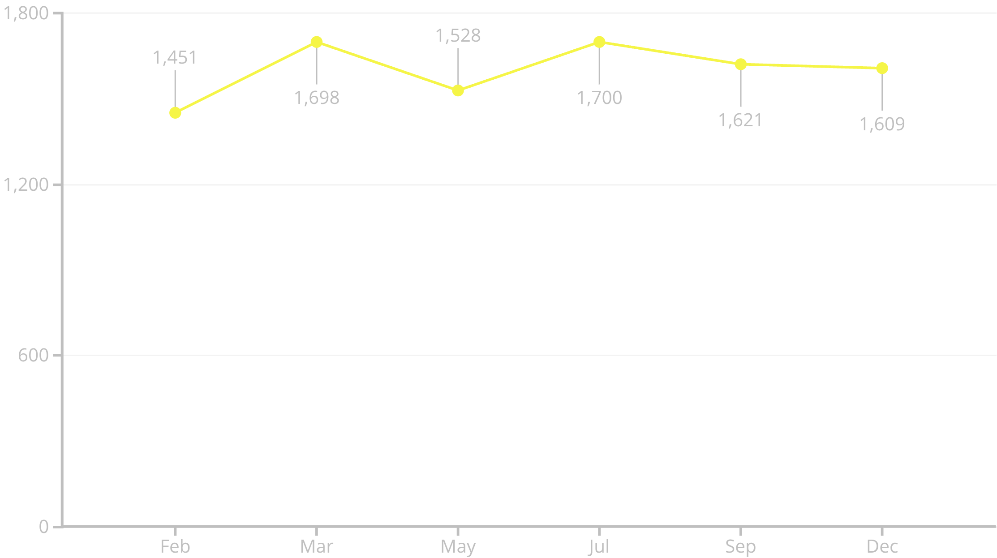
Seasonal Sales Performance Patterns
Strategic Seasonal Insights
Monthly performance data reveals distinct seasonal buying patterns critical for inventory planning and marketing strategy. March emerges as the peak performance month (1,698 units), likely driven by fiscal year-end bonuses and corporate purchases, while July's exceptional performance (1,700 units) coincides with monsoon season shopping and pre-festival demand preparation.
The February low (1,451 units) and May dip (1,528 units) present predictable patterns - post-festival spending fatigue in February and pre-monsoon cautious spending in May. December's strong showing (1,609 units) validates holiday shopping surge expectations, though slightly below July-March peaks due to competition from festival season promotions.

Slide 6
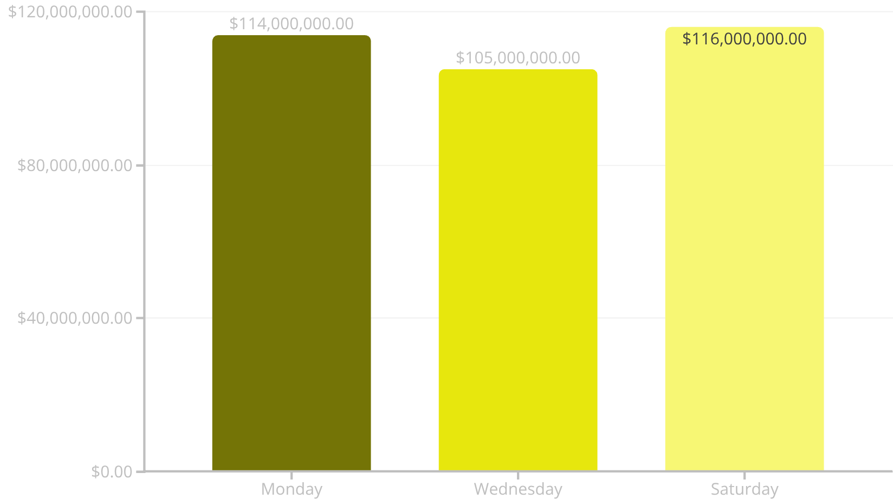
Weekly Sales Performance Analysis
Weekly Pattern Insights
Saturday dominance (116M) confirms weekend shopping preferences, while Monday's strength (114M) suggests business and reseller activity at week's start. The mid-week Wednesday slump (105M) represents a 10.5% variance from peak performance.
Operational Implications: Weekend staffing optimization becomes critical, while mid-week promotional strategies could capture incremental revenue. The Monday performance indicates B2B opportunity concentration.

Slide 7



Customer Satisfaction Excellence
Satisfaction Distribution Analysis
Customer rating distribution reveals exceptional service delivery with 323 five-star ratings (32.3%) and 299 four-star ratings (29.9%), creating a combined 80% high-satisfaction rate that significantly exceeds industry benchmarks.
80%
The 221 three-star ratings (22.1%) represent the primary conversion opportunity - these neutral customers are positioned for upgrade to higher satisfaction levels through targeted service improvements. Low negative ratings (21.3% combined 1-2 stars) validate operational excellence and quality control systems.
High Satisfaction Rate
Customers rating 4-5 stars demonstrate exceptional service quality
32%
Five-Star Reviews
323 customers providing highest rating indicating premium experience delivery
21%
Improvement Opportunity
1-2 star ratings remain low, showing consistent service quality maintenance

Slide 8
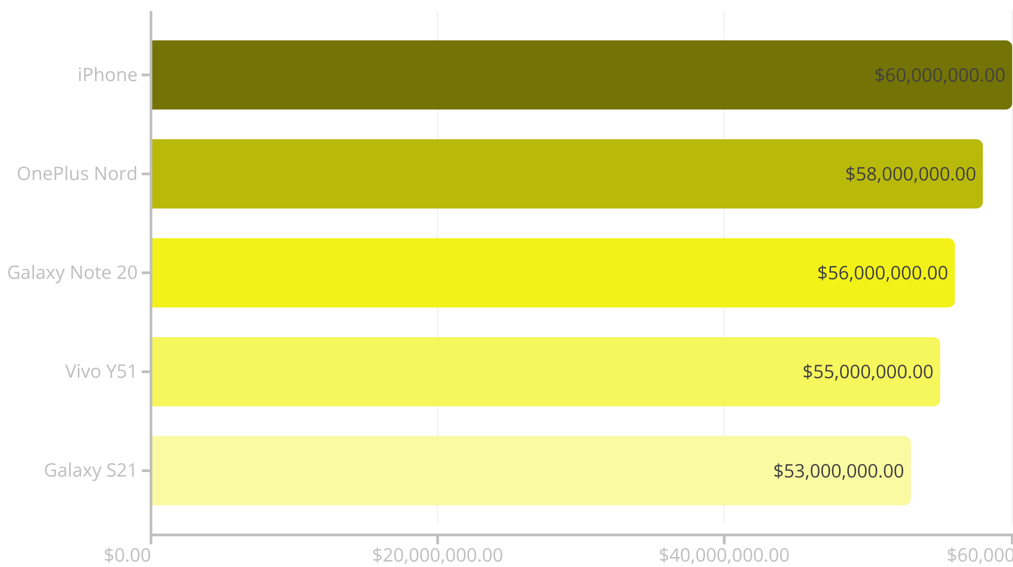
Product Portfolio Performance
Product performance reveals remarkably balanced portfolio with iPhone maintaining premium leadership at 60M (20.8%), while Android ecosystem dominates overall market share at 79.2%. The tight clustering between top performers - with only 7M variance between highest and lowest - indicates successful diversification strategy reducing single-product dependency risks.
Strategic Portfolio Insights: OnePlus Nord's strong 58M performance (20.1%) validates mid-premium positioning, while Samsung's dual presence (Galaxy Note 20 and S21) captures 37.8% combined market share. Vivo Y51's inclusion demonstrates successful mass-premium segment penetration, creating comprehensive market coverage across price points.

Slide 9




Strategic KPI Monitoring Framework
Weekly Sales Velocity
Payment Mix Evolution
Track Saturday performance as leading indicator for overall market health and consumer sentiment shifts
Monitor digital payment adoption rates to optimize transaction costs and customer experience
Geographic Revenue Distribution
Customer Satisfaction Trends
Measure metro vs. non-metro contribution to identify expansion opportunities and resource allocation
Weekly NPS tracking to maintain service excellence and identify improvement opportunities
Dashboard Enhancement Recommendations
Implement advanced analytics capabilities including conversion rate metrics (visitors to transactions), customer lifetime value tracking, and inventory turnover ratios. Add profit margin analysis by product and region, complemented by predictive analytics for seasonal forecasting and demand planning.

Slide 10




Strategic Action Plan for Revenue Optimization
Weekend Revenue Maximization
Implement weekend-specific promotions and ensure optimal staffing levels for Saturday peak performance. Consider extended hours and exclusive weekend product launches.
Mid-Week Performance Boost
Deploy Wednesday flash sales and special offers to address the 10.5% performance gap. Target business customers with bulk purchase incentives.
Geographic Expansion Strategy
Strengthen presence in underperforming regions, particularly eastern and northeastern India, while developing city-specific marketing approaches based on local preferences.
Customer Experience Enhancement
Leverage 80% high-satisfaction rate for referral programs and loyalty schemes. Focus on converting 3-star customers to higher satisfaction levels through targeted service improvements.
Implementation Priority: Begin with weekend optimization and mid-week promotional strategies for immediate revenue impact, while developing long-term geographic expansion plans and customer retention programs. Monitor KPIs monthly to ensure rapid response to market changes and maintain competitive advantage in India's dynamic premium mobile market.

