Slide 1

Vidyavardhaka College of Engineering
Autonomous Institute, Affiliated to VTU, Belagavi Accredited by NBA & NAAC with A Grade
Gokulam 3rd Stage, Mysuru – 570 002, Karnataka, India
VLSI
ZeroDelay: Real-Time Traffic Control System
TEAM NAME: SILICON SYNDICATE PSID:SYM0101
DHRUTHIKA R
CHANDANA A R
JAYANTH K
VIKAS M N
APRIL 24-25 2026

Slide 2
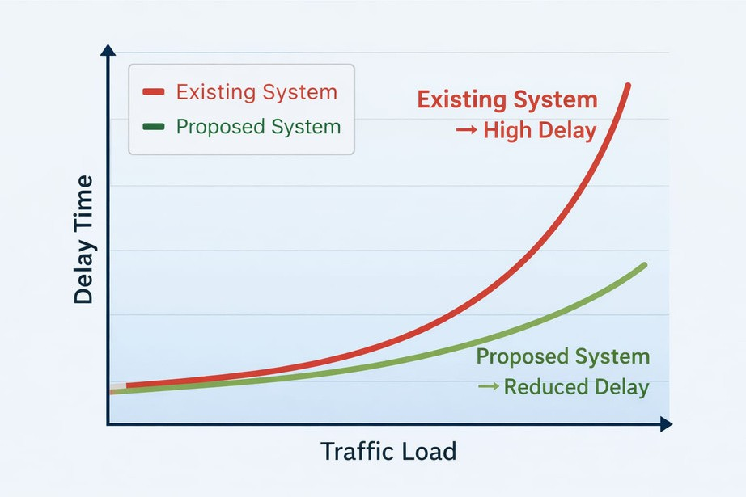
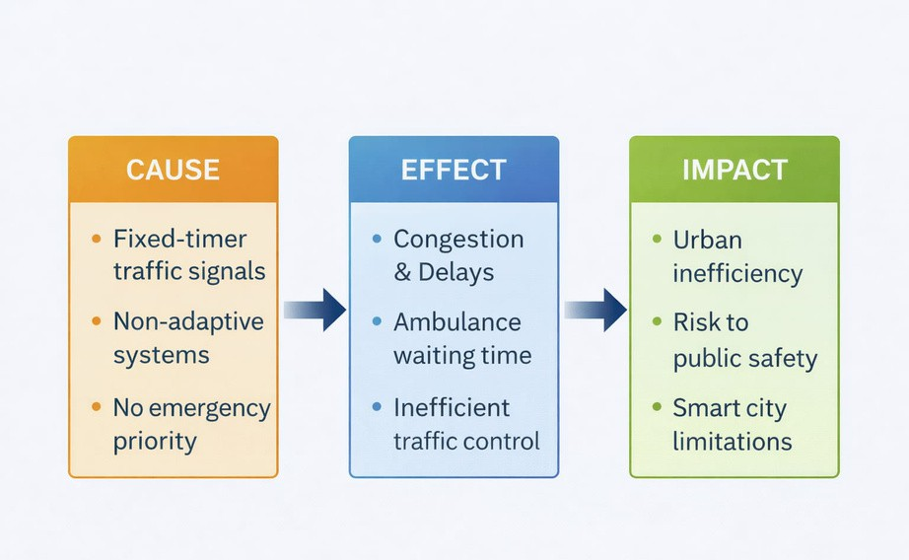
problem statement
Content:
High latency and inefficient real-time control in fixed-timer traffic systems, with no priority handling for emergency vehicles.
Reliance on static timing, absence of real-time hardware decision-making, and inefficiencies in conventional traffic contr architectures.
Urban commuters, emergency services are significantly impacted due to increased delays and inefficiencies. Software-based systems introduce high latency, limiting real-time traffic control.

Slide 3
Our Approach to solve
Our Solution: FPGA‑Based Adaptive Traffic Controller with Emergency Preemption
We have designed a real‑time, hardware‑only traffic signal controller that eliminates software latency, provides deterministic timing, and gives instant priority to emergency vehicles – all while retaining pedestrian crossing periods.
Our solution: Pure hardware FSM (finite state machine) running on FPGA.
No CPU, no OS, no software overhead → nanosecond‑level responsiveness.
State transitions and timer countdown happen in parallel on dedicated logic.
Result: Zero latency between sensor input (emergency button) and light change
Emergency inputs (emergency_force_red, emergency_green_*) are combinational – they override state immediately.
The FSM freezes timer during emergencies and resumes exactly where it left off (soft reset).
Decision is made inside hardware at the speed of logic gates.
Wrong‑way / rule‑breaking ambulance → emergency_force_red → ALL RED + timer freeze.
Normal ambulance (correct direction) → emergency_green_<dir> → that direction gets immediate GREEN, all others RED.
Soft reset restores normal cycle after emergency passes
All 12 traffic states + pedestrian phases + emergency preemption run on one hardware module.
Emergency vehicles get instant green or all‑red – reduces response time by avoiding waiting at red lights.
Commuters benefit from predictable timing and quick return to normal operation after emergency (soft reset).
Hard reset available for complete system refresh if needed.

Slide 4
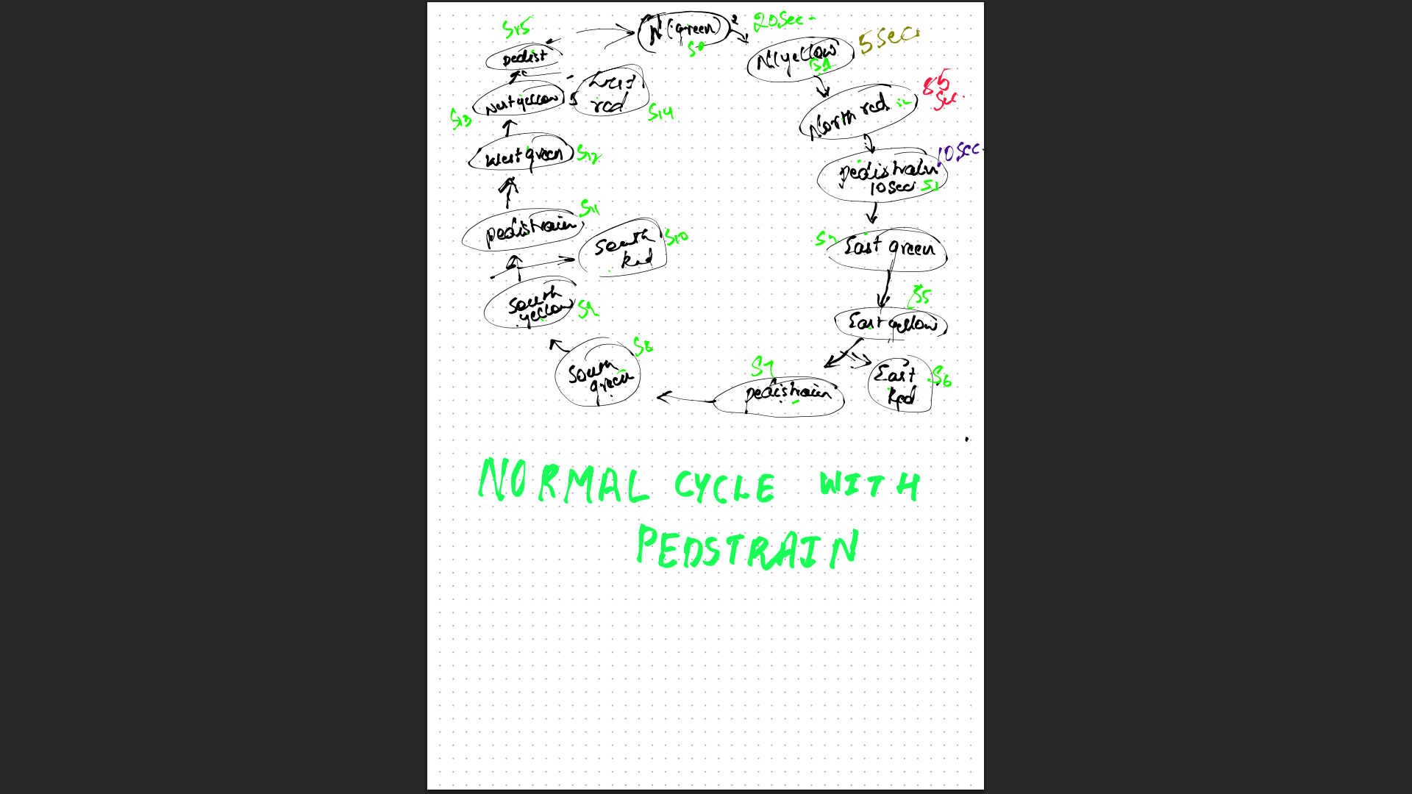
ARCHITECTURE FSM MODEL DESIGN

Slide 5
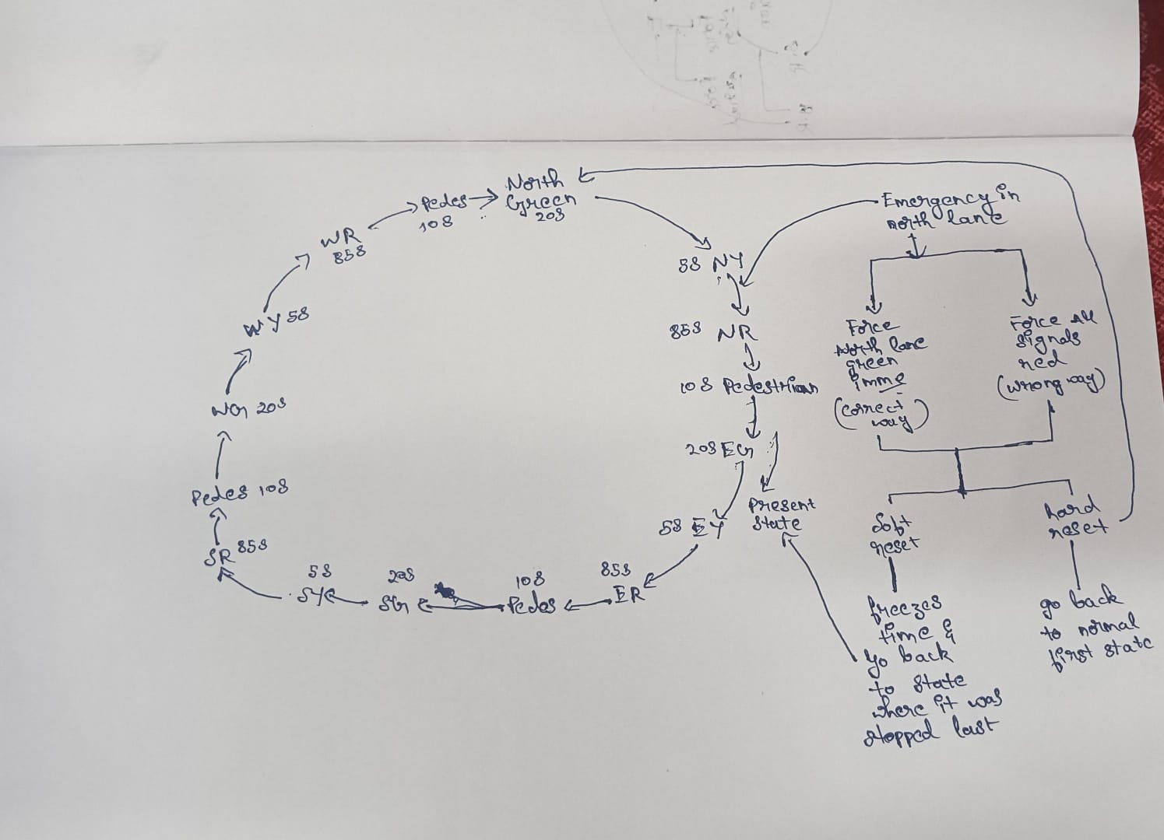
ARCHITECTURE FSM MODEL DESIGN for Normal Cycles along with Emergency Override

Slide 6
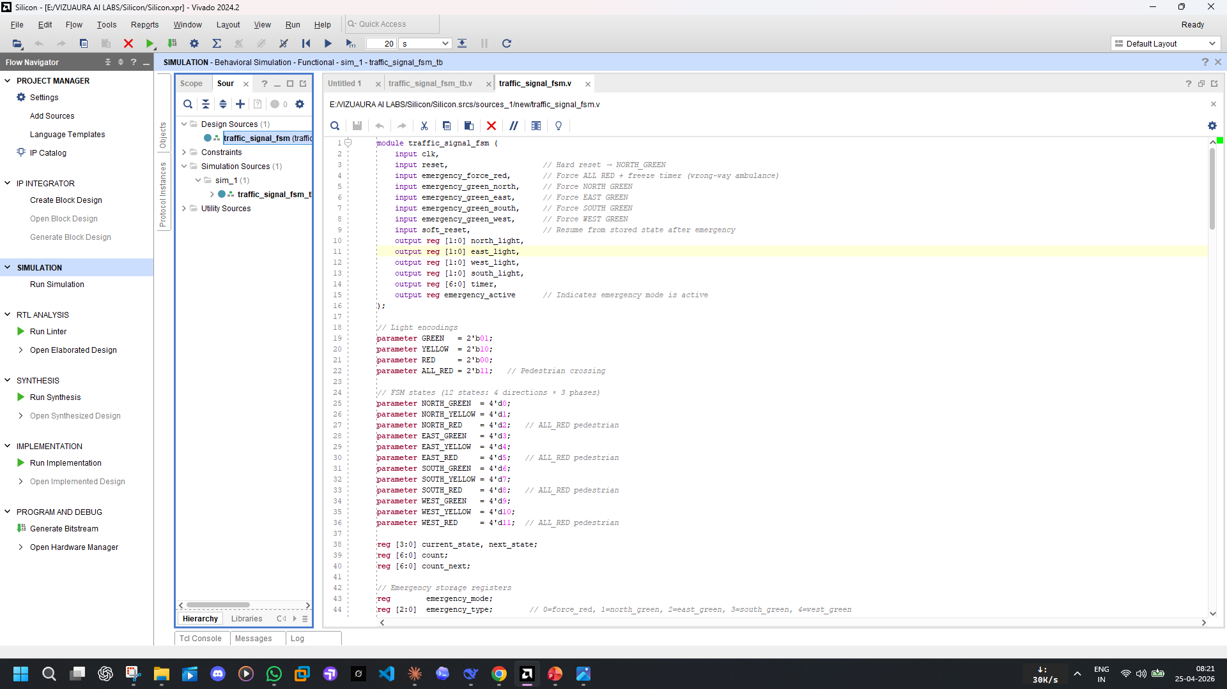
Implementation Flow Normal Verilog Code + Verilog Testbench

Slide 7
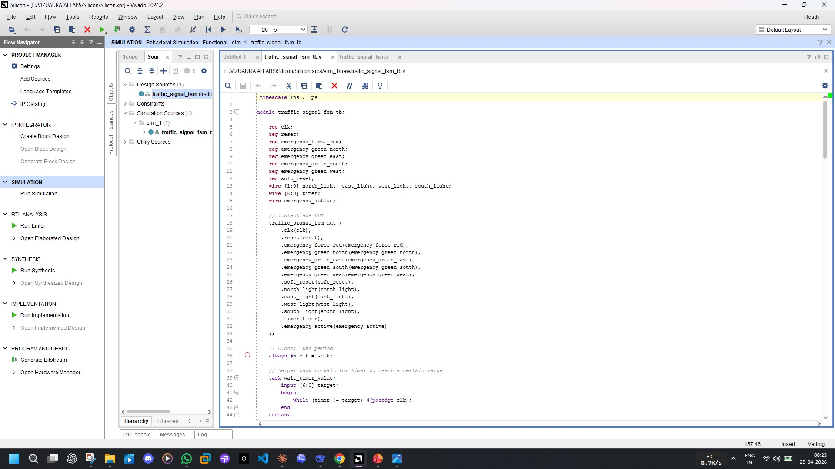
Implementation Flow Normal Verilog Code + Verilog Testbench

Slide 8
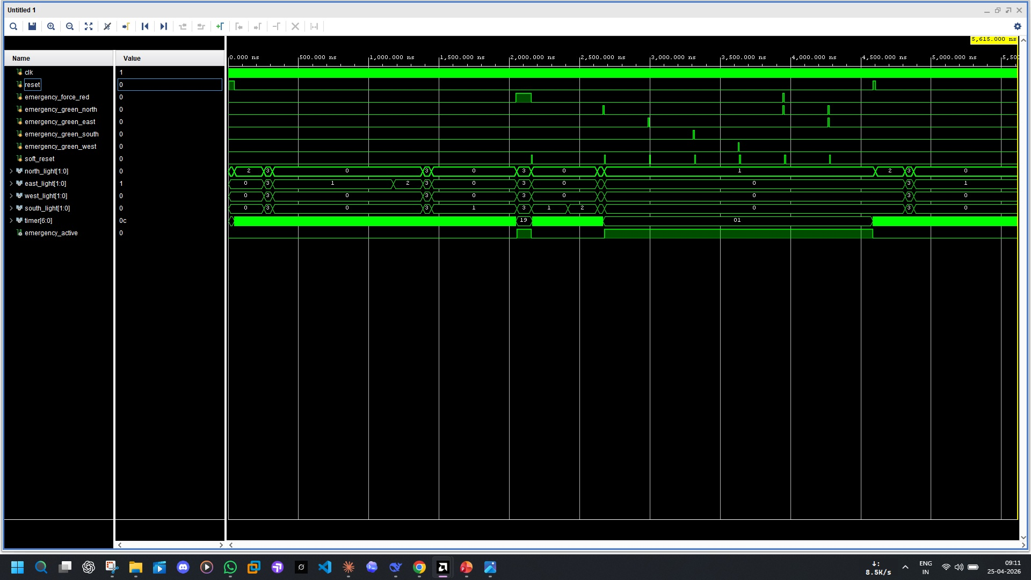
Simulation Waveforms

Slide 9

DESIGN.BUILD.DEPLOY

