Slide 1

SMART INDIA HACKATHON 2026
TITLE PAGE
Problem Statement ID : ____________
Problem Statement Title : Blockchain-Secured Digital Document & Case Management
Theme : Smart Justice & Public Safety
PS Category : Software
Team ID : ____________
Team Name (Registered on portal) : ____________

Slide 2
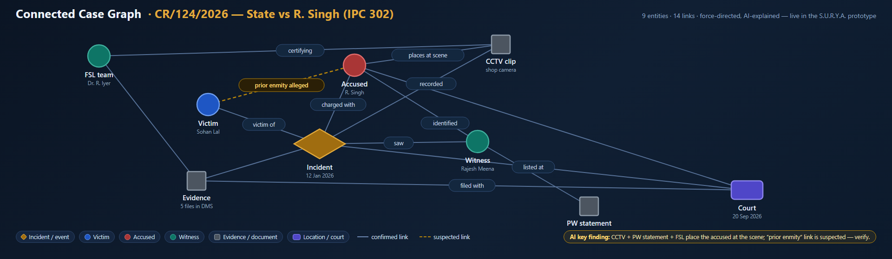
S.U.R.Y.A. — Blockchain-Secured Digital Document & Case Management Platform
Your Team Name
Proposed Solution (Describe your Idea/Solution/Prototype)
S.U.R.Y.A. (Smart Unified Resource for Judicial Assistance) is a blockchain-anchored digital Document Management System giving every case document — FIR, investigation record, witness statement, charge sheet, evidence record, forensic report, judgment — one tamper-evident, access-controlled, fully auditable digital life.
How it addresses the problem
• Unique Case ID (e.g. CR/124/2026) is the single key — retrieve all related documents instantly, ending scattered drives and email silos.
• Role-based access control (6 official roles) + case-level permission: cross-case needs go through access requests approved by the System Admin.
• SHA-256 hash chain + Polygon anchoring make tampering cryptographically detectable; corrections only as new ledger-anchored versions (version control).
• Every document open logged in an append-only audit trail; digital signatures & chain-of-custody for evidence records (IT Act §65B-ready).
Innovation and uniqueness of the solution
• Trust layer, not storage layer: only hashes go on-chain — tampering becomes detectable, not just harder.
• Connected Case Graph (below, live in prototype): AI-explained network of victim, accused, witness, evidence & court — reveals suspected links like “prior enmity alleged” for verification, a first-of-its-kind bridge from a blockchain system of record to the integrated Judicial Assistance suite (citizen / lawyer / student).

Slide 3
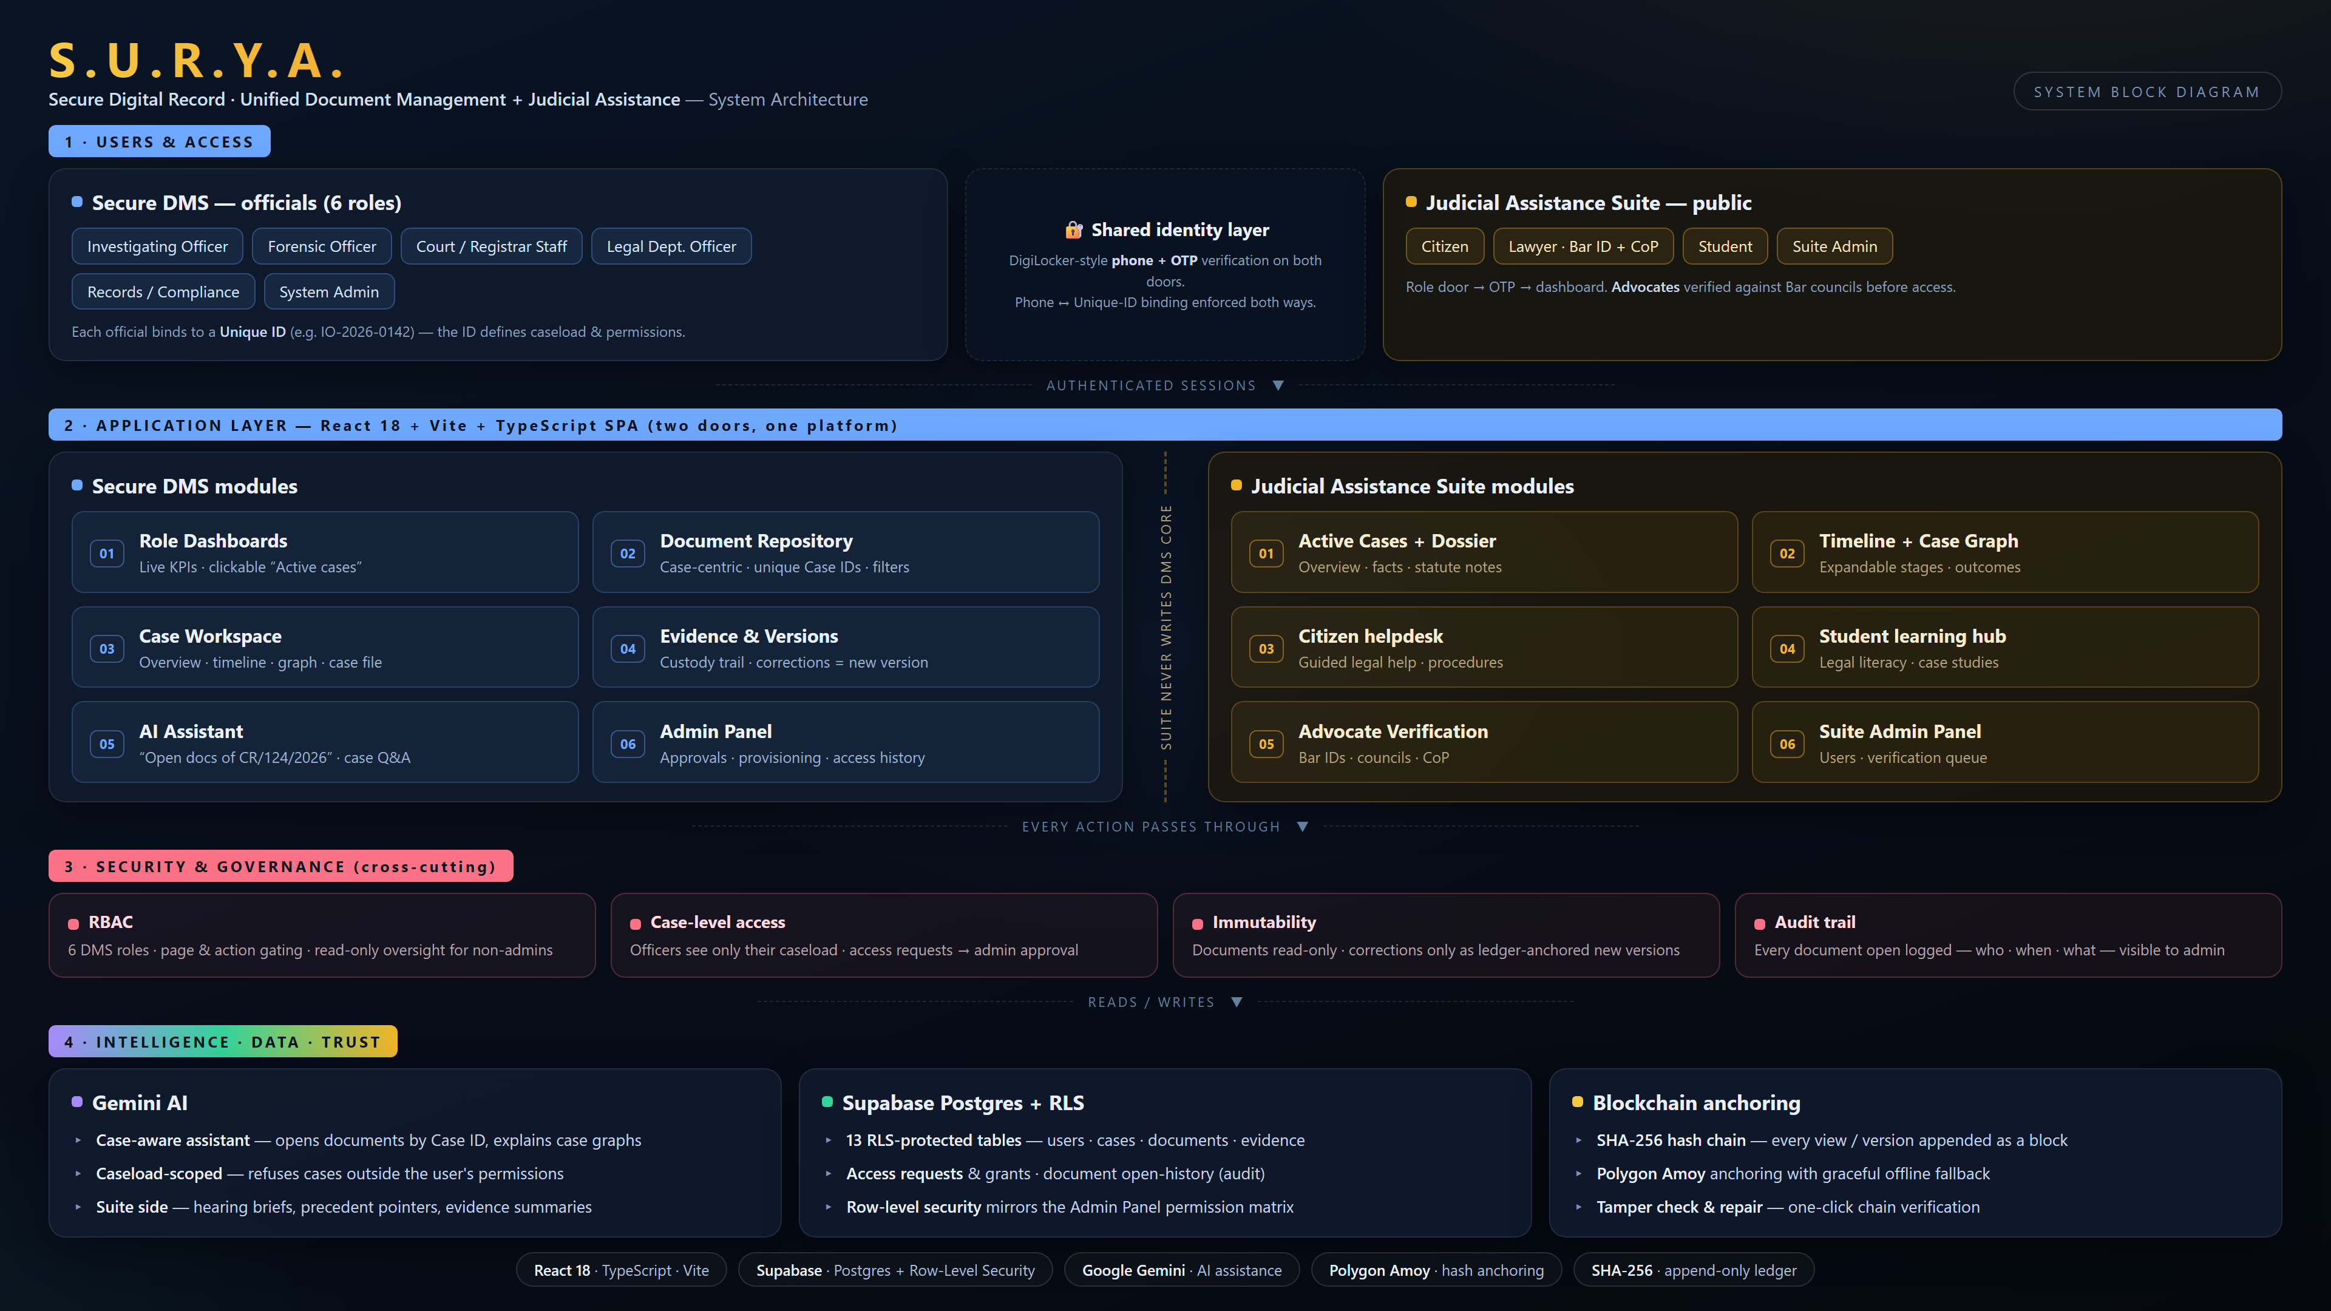
TECHNICAL APPROACH
Your Team Name
Technologies to be used
React 18 + TypeScript (Vite SPA) · Supabase Postgres with Row-Level Security (13 RLS tables) · SHA-256 append-only hash ledger · Polygon Amoy anchoring (graceful offline fallback) · Google Gemini AI · DigiLocker-style Aadhaar-aligned OTP identity binding.
Methodology and process for implementation
① Phone + OTP identity verification; phone ↔ Unique-ID binding enforced both ways.
② Role-based dashboard loads the officer's active caseload (unique case IDs).
③ Case-centric repository: immutable viewer; every document open logged.
④ Upload/view/correction → SHA-256 hash → ledger block → Polygon Amoy anchor.
⑤ Cross-case need? Access request → System Admin approval → permissioned, logged access.
⑥ AI assistant retrieves permissioned documents and explains the case graph (left).
Architecture (block diagram, left)
Users & access → application layer → security & governance → intelligence · data · trust (Gemini AI, Postgres RLS, SHA-256 + Polygon anchoring).

Slide 4
FEASIBILITY AND VIABILITY
Your Team Name
Analysis of the feasibility of the idea
• Working prototype already demonstrates every claimed flow: OTP identity → caseload → case workspace → immutable documents → hash anchoring → access-request approvals → audit history.
• Built entirely on managed, government-deployable infrastructure (Supabase/Postgres, public blockchain testnet) — no exotic hardware; runs on commodity cloud; aligns with MeitY cloud-first posture.
Potential challenges and risks
• Legacy migration of paper records at scale · bandwidth-constrained PSUs · field-officer usability · identity spoofing · chain bloat · legal admissibility of e-records.
Strategies for overcoming these challenges
• Phased rollout (digitize-in-flight cases → back-scanning drives) with OCR-assisted bulk ingestion · offline-first PWA + low-bandwidth fallbacks · on-chain anchors only (tiny, cheap) with re-anchoring batching · IT Act 2000 §65B-compliant certificates and audit exports for court admissibility.

Slide 5
IMPACT AND BENEFITS
Your Team Name
Potential impact on the target audience
• Investigating officers & forensic labs: document retrieval in seconds by Case ID; zero ambiguity on “which version is current”; custody slips replaced by digital chain-of-custody.
• Courts & legal departments: verifiable, signed filings; disclosure workflows instead of email silos; faster hearings — less delay from document friction.
• Citizens, lawyers, students: the integrated S.U.R.Y.A. suite delivers legal aid, case learning and advocate verification on top of a trustworthy record layer.
Benefits of the solution (social, economic, environmental, etc.)
• Social: witness & minor identity protection through enforced confidentiality; public trust via independent tamper-evidence.
• Economic: paper, courier, storage and re-work savings across police/forensic/court back offices; leakage and litigation risk reduced.
• Environmental: millions of printed pages eliminated each year; Governance fit: RTI support, retention schedules, auditable compliance — ready for Ministry-grade infrastructure.

Slide 6
RESEARCH AND REFERENCES
Your Team Name
Details / Links of the reference and research work
• IT Act 2000 & §65B Evidence Act certification requirements — indiacode.nic.in
• National Data Sharing & Accessibility Policy; MeitY cloud-first policy — meity.gov.in
• eCourts Mission Mode Project (Phase III) & Virtual Courts — ecourts.gov.in
• Interoperable Criminal Justice System (ICJS) — mha.gov.in
• CCTNS — crime and criminal tracking network — mha.gov.in
• NIST SP 800-63 Digital Identity Guidelines; W3C Verifiable Credentials —nist.gov, w3.org
• Ethereum/Polygon official docs (proof-of-stability anchoring patterns) — polygon.technology
• DigiLocker API ecosystem (issuer/requester architecture) — digilocker.gov.in
• IEEE papers on blockchain-based document integrity & chain-of-custody (hash-chaining, Merkle anchoring).

