Slide 1
Automation Connections ISA EXPO 2006
Wed, 1:00 Oct 18

Slide 2

WBF: Business To Manufacturing Markup Language (B2MML)
Dennis Brandl
BR&L Consulting, Inc.

Slide 3
Business to Shop Floor Integration
Integration of business systems to shop floor systems is an important final phase in an ERP implementation
  Companies are discovering that the true value in a logistics system only comes when it is connected to real world shop floor information.
The ISA 95 and IEC 62264 standards define the standard for business to manufacturing integration
The WBF B2MML (Business to Manufacturing Markup Language) defines an XML implementation emerging as the preferred integration method
www.wbf.org

Slide 4
Official Names
ANSI/ISA 95.00.01 “Enterprise - Control System Integration - Part 1: Models and Terminology”
  IEC 62264-1:2003
ANSI/ISA 95.00.02 “Enterprise - Control System Integration - Part 2: Object Attributes”
  IEC 62264-2:2004
B2MML V03 – Business to Manufacturing Markup Language
  Developed by the WBF
  Implementation of ISA 95 Parts 1 and 2
ANSI/ISA 95.00.05 “Enterprise - Control System Integration - Part 5: Business to Manufacturing Transactions”
  Draft – in final vote
B2MML V04 – Business to Manufacturing Markup Language
  Developed by the WBF
  Implementation of ISA 95 Parts 1, 2, & 5
  Currently in review for release ASAP
Notes:
Explain a little bit about ISA and what it does in the standards area.
ISA Is the international society for measurement and control
Formally the Instrument Society of America
Explain the S95.01 is the draft standard and that SP95 was the committee.
Mention that this is a USA standard, under the auspices of ANSI

Slide 5
ISA 95 & B2MML
The WBF B2MML schemas are becoming a popular method for ERP to MES integration
  Especially for companies integrating MES to SAP systems.
The B2MML schemas are being used by control system vendors, ERP vendors, and directly by end users to simplify and speedup integration projects.
Many projects completed in 2-3 months instead of 2-3 years
B2MML is used by several control vendors to internally tie together their application suites
Next version will be compatible with OAGiS and UN/CEFACT

Slide 6


Shared Information
Product
definition
Resource
information
Production
capability
Production
schedule
Production
performance
Detailed
production
scheduling
Production
resource
management
Production
tracking
Production
dispatching
Production
Performance
analysis
Product
definition
management
Production
data
collection
Production
execution
management
Equipment and process
specific production rules
Operational
commands
Operational
responses
Equipment and process
specific data
Level 1-2 Functions

Slide 7
A B2MML Document
Material Lot
<Material
<MaterialLot>
<ID> W89 </ID>
<Description> A lot of material </Description>
<MaterialDefinitionID “WXE908” /> <Location> Tank 1 </Location>
<Quantity UnitOfMeasure = "KL" > 4500
</Quantity>
<MaterialLotProperty>
<ID> dateTimeProduction </ID>
<Value> 2001-01-06T00:14:23+11:30 </Value>
</MaterialLotProperty>
<MaterialLotProperty>
<ID> Quality Status </ID>
<Value> Good </Value>
</MaterialLotProperty>
</MaterialLot>
</Material>

Slide 8
XML - Material Model
Information About
Material Classes
Information About
Material Definitions
Information About
Material Lots & Sublots
Material
Class
Defines
a grouping
Material
Definition
0..n
Material Lot
Made up of
Material
Sublot
0..n
0..n
1..1
Defined by
0..n
Has
properties
of
Has
properties
of
Has
values for
0..n
May be made up
of sublots
0..n
0..n
0..n
Material
Class
Property
Material
Definition
Property
Maps to
Material Lot
Property
May
map to
Is associated
with a
Is tested
by a
1..n
Is tested
by a
1..n
0..n
Records the
execution of
QA Test
Result
0..n
QA Test
Specification
0..n
Defines a
procedure for
obtaining a
Information
About QA Tests
0..n

Slide 9
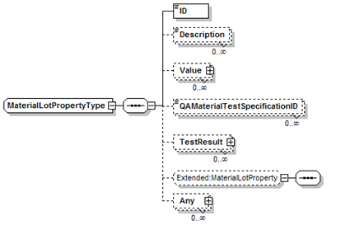
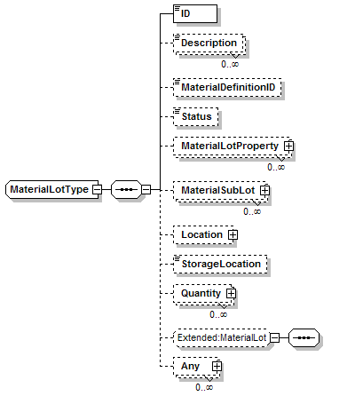
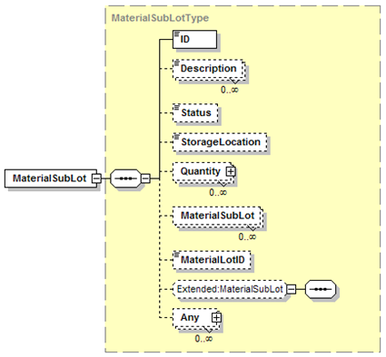
Material Lot and Material Sublot
Contains a recursive definition for sublots

Slide 10
Production Schedule
Directly mapped from the ISA 95 Part 1 mode
Production
Schedule
Is made up of
Corresponds
to a
1..n
Production
Request
Product
Production
Rule
Is made up of
1..n
0..n
Process
Segment
Corresponds
to a
Segment
Requirement
0..n
Requested
Segment
Response
May contain
0..n
0..n
0..n
0..n
0..n
0..n
Production
Parameter
Personnel
Requirement
Equipment
Requirement
Material Produced
Requirement
Material Consumed
Requirement
Consumable
Expected
1..n
1..n
1..n
1..n
1..n
Personnel
Requirement
Property
Equipment
Requirement
Property
Material Produced
Requirement
Property
Material Consumed
Requirement
Property
Consumable
Expected
Property

Slide 11
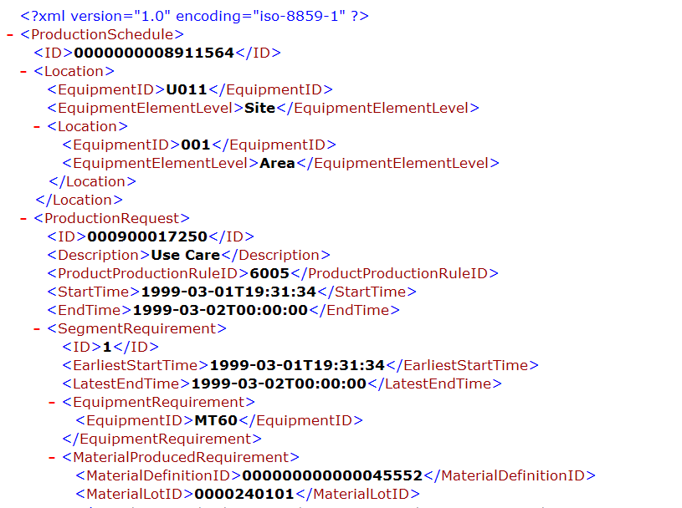
B2MML Document – Production Schedule
Production Schedule
Production Request
Segment Requirement
Material Produced

Slide 12
Production Performance Model
Production
Performance
Is made up of
1..n
Production
Response
Is made up of
1..n
0..n
Segment
Response
Corresponds
to a
Process
Segment
May
contain
May contain
0..n
0..n
0..n
0..n
0..n
0..n
Production
Data
Personnel
Actual
Equipment
Actual
Material Produced
Actual
Material Consumed
Actual
Consumable
Actual
1..n
1..n
1..n
1..n
1..n
Personnel
Actual
Property
Equipment
Actual
Property
Material Produced
Actual
Property
Material Consumed
Actual
Property
Consumable
Actual
Property

Slide 13

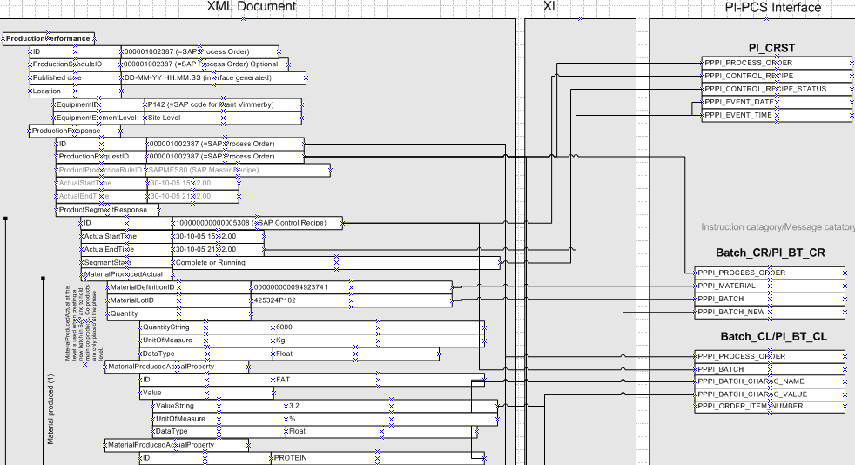
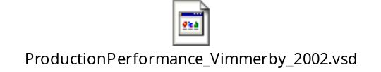
Production Performance
Mapped to SAP PI-PCS Interface

Slide 14
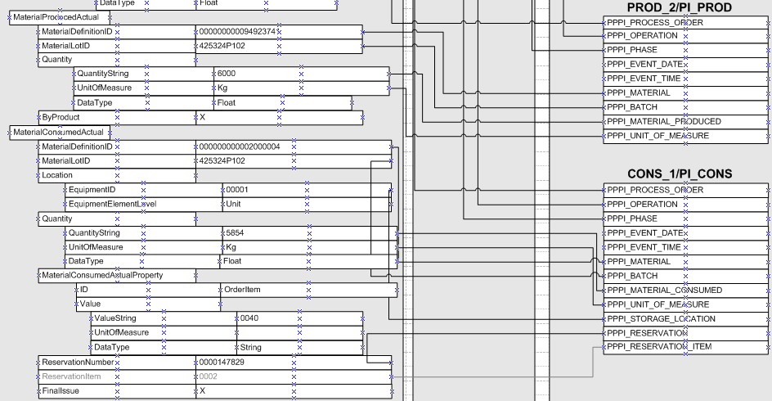
Material Produced,
Material Consumed to SAP

Slide 15
User Extensions
Substitution Groups
Allows for XML validation of extended schemas
  Works with development tools like Microsoft .Net Studio
Addition of 1 new schema
  B2MML-V0300-Extensions
  Contains 1 substitution group for each complex type that can be extended
B2MML-V0300-Extensions
  Is the only schema designed to be edited by the end user
  Contents of substitution groups are edited to extend B2MML complex types
  Allows simultaneous multiple vendor extensions

Slide 16
Transactions
A Preview of ISA 95 Part 5 and B2MML V04

Slide 17
Transaction Support
Adds new top level XML elements to each schema file
One new element for each message type
Based on the OAGiS 9.0 verb specifications
  GET – SHOW
  PROCESS, CHANGE, CANCEL
  SYNC ADD, SYNC CHANGE, SYNC DELETE
Transaction messages defined for each top level object currently defined in B2MML
Uses the OAGiS definitions of the UN/CEFACT Core Components
  Makes B2MML consistent with emerging business transaction standards

Slide 18
Typical Transaction
GET Equipment
Application Identification Area
Information Provider
Data Area
Information User
VERB = GET
Noun = Equipment
ID= “ABC”
GET
Local
processing
SHOW Equipment
Application Identification Area
Data Area
VERB = SHOW
Noun = Equipment
ID= “ABC”
Description = “Simple equipment”
Equipment Property
ID = “Throughput”
Value = “200”
Value Unit of Measure = “PPM”
Description = “Throughput as parts
per minute”
…
SHOW

Slide 19
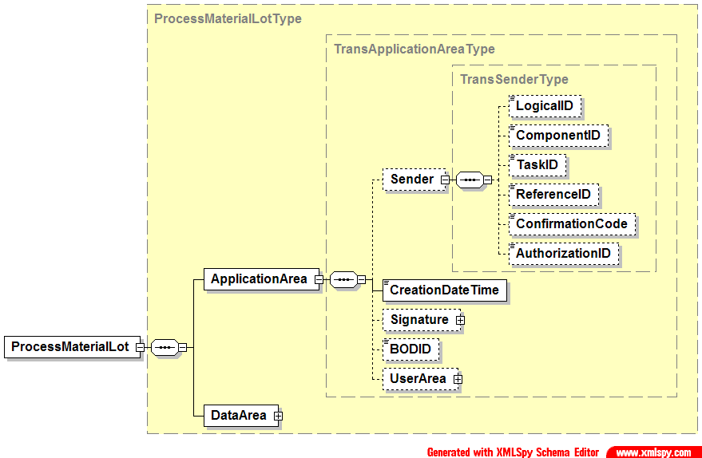
OAGiS Format Application Area
Defines who sent the message, when it was sent, electronic signature (if required)
Defined to allow a response to be sent
Same for all new transaction messages

Slide 20
PUSH MODEL – Production Schedule / Production Performance
ERP
Level 4
Production Scheduling
MOM
Level 3
PROCESS – Production Schedule
PROCESS – Production Performance
Some work
complete
PROCESS* – Production Performance
All work finished
Scenario assumptions:
1. ERP send production schedule to MOM for processing
2. MOM (Manufacturing Operations Management) sends production performance to ERP for processing
* Message contains a FINAL flag to indicate that the message is the final production performance for the associated production schedule.

Slide 21
Summary
It is here
It works
It significantly reduces integration times
It is being supported by all major ERP vendors
It is being supported by all major MES vendors
It is being supported by all major control vendors
It is getting even better with OAGiS & UN/CEFACT support
Notes:
List benefits and key points that you will cover in your presentation.

Slide 22
Questions and Discussion
Notes:
List benefits and key points that you will cover in your presentation.

