Slide 1
Sales Analysis Report
Prepared by Vikas | Tool Used: Tableau

Slide 2
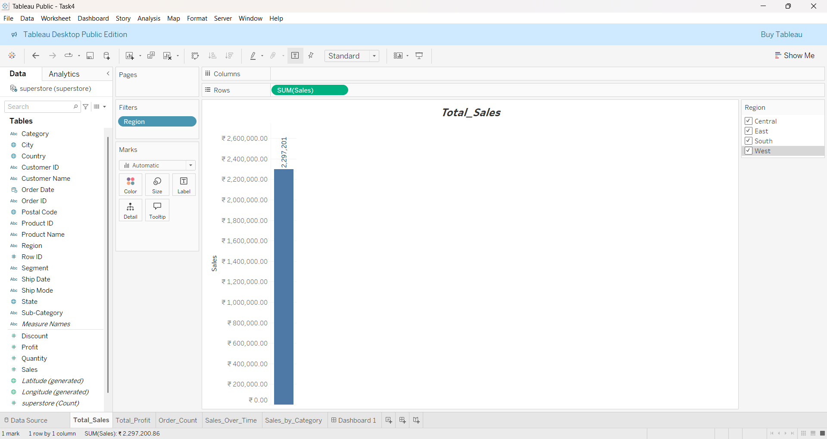
Total Sales
📌 Insight: - The company has achieved a healthy total sales figure. - High concentration of sales in specific regions and categories. - Opportunity to grow underperforming segments.

Slide 3
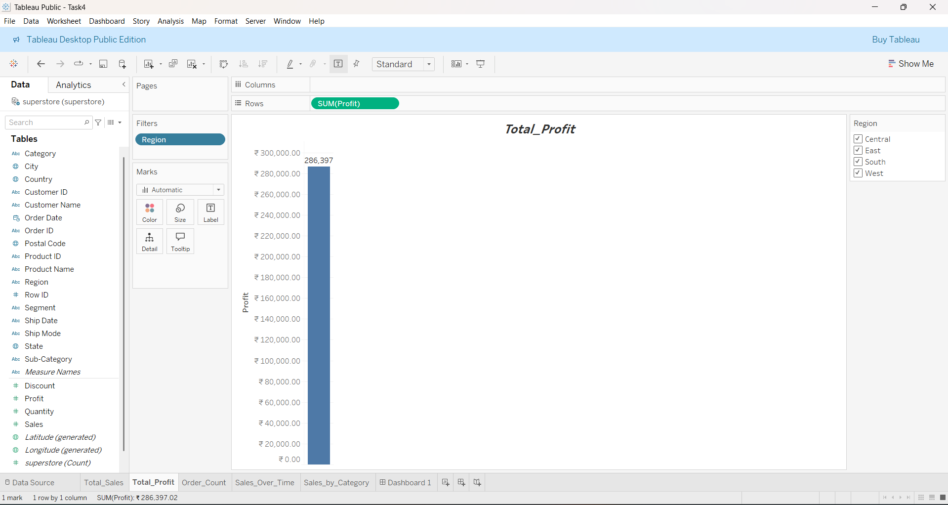
Total Profit
📌 Insight: - Profit margins vary across categories. - Technology category is highly profitable, Furniture less so. - Suggests review of cost and discount strategies.

Slide 4
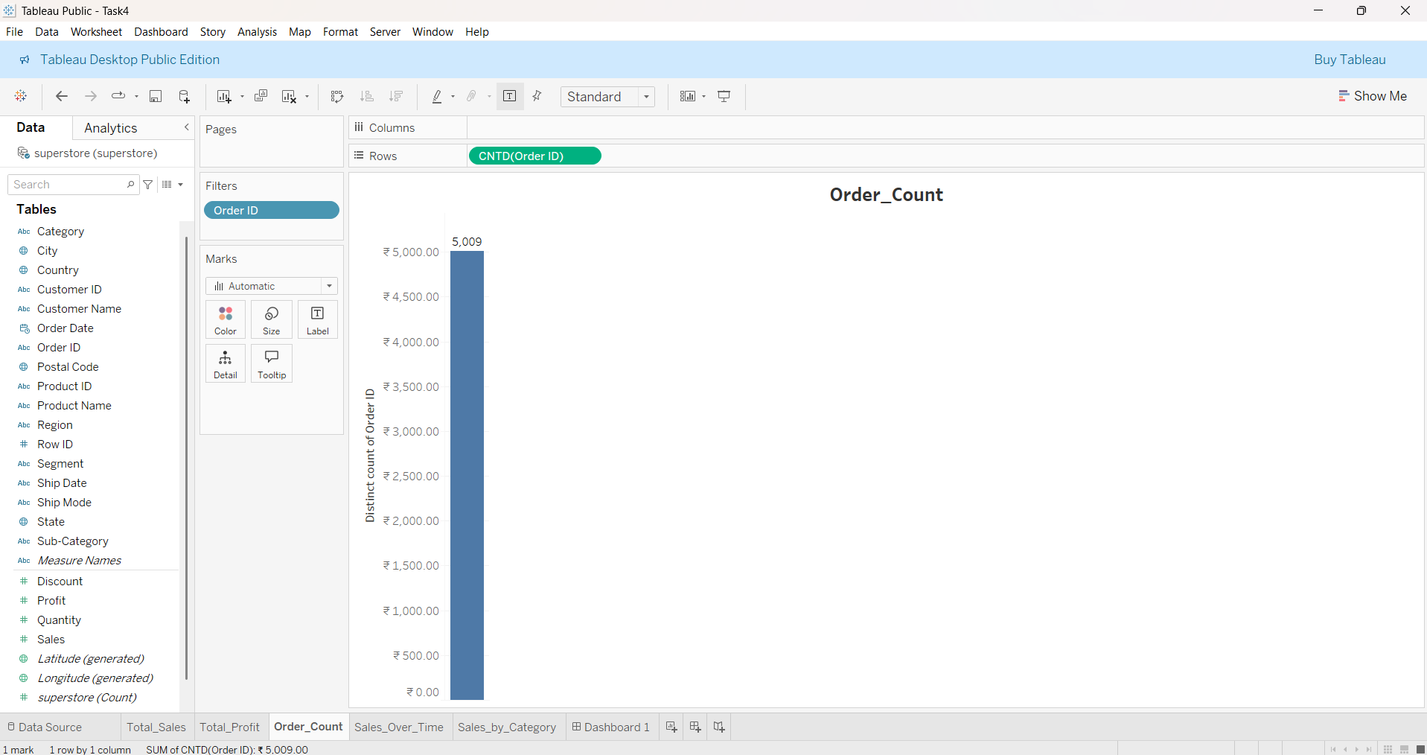
Order Count
📌 Insight: - Order count shows consistent customer activity. - Many orders have low ticket value. - Consider upselling or product bundling.

Slide 5
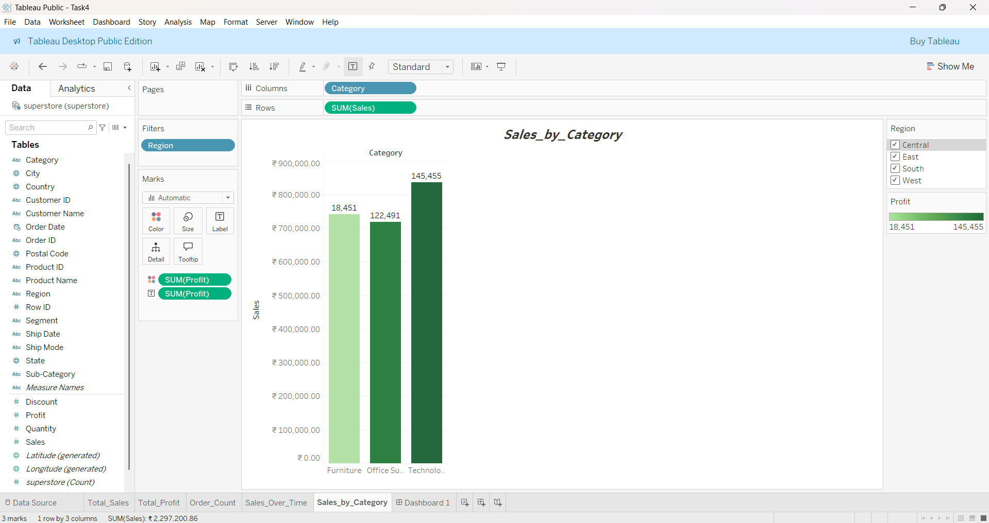
Sales by Category
📌 Insight: - Technology leads in revenue. - Office Supplies and Furniture lag behind. - Suggest focused strategy on high-performing categories.

Slide 6
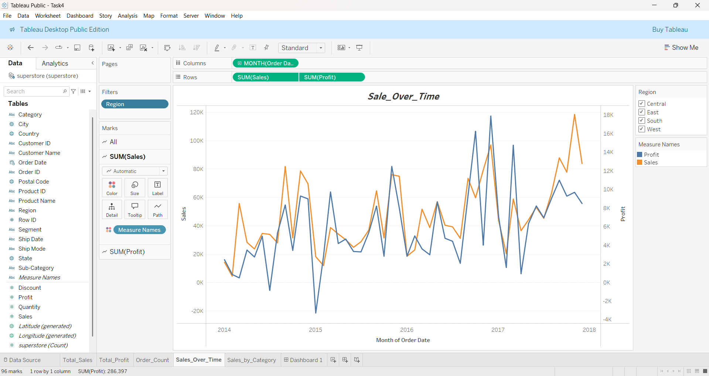
Sales Over Time
📌 Insight: - Seasonal trends are evident with end-of-year peaks. - Opportunity in mid-year months with slower sales. - Plan promotions accordingly.

Slide 7
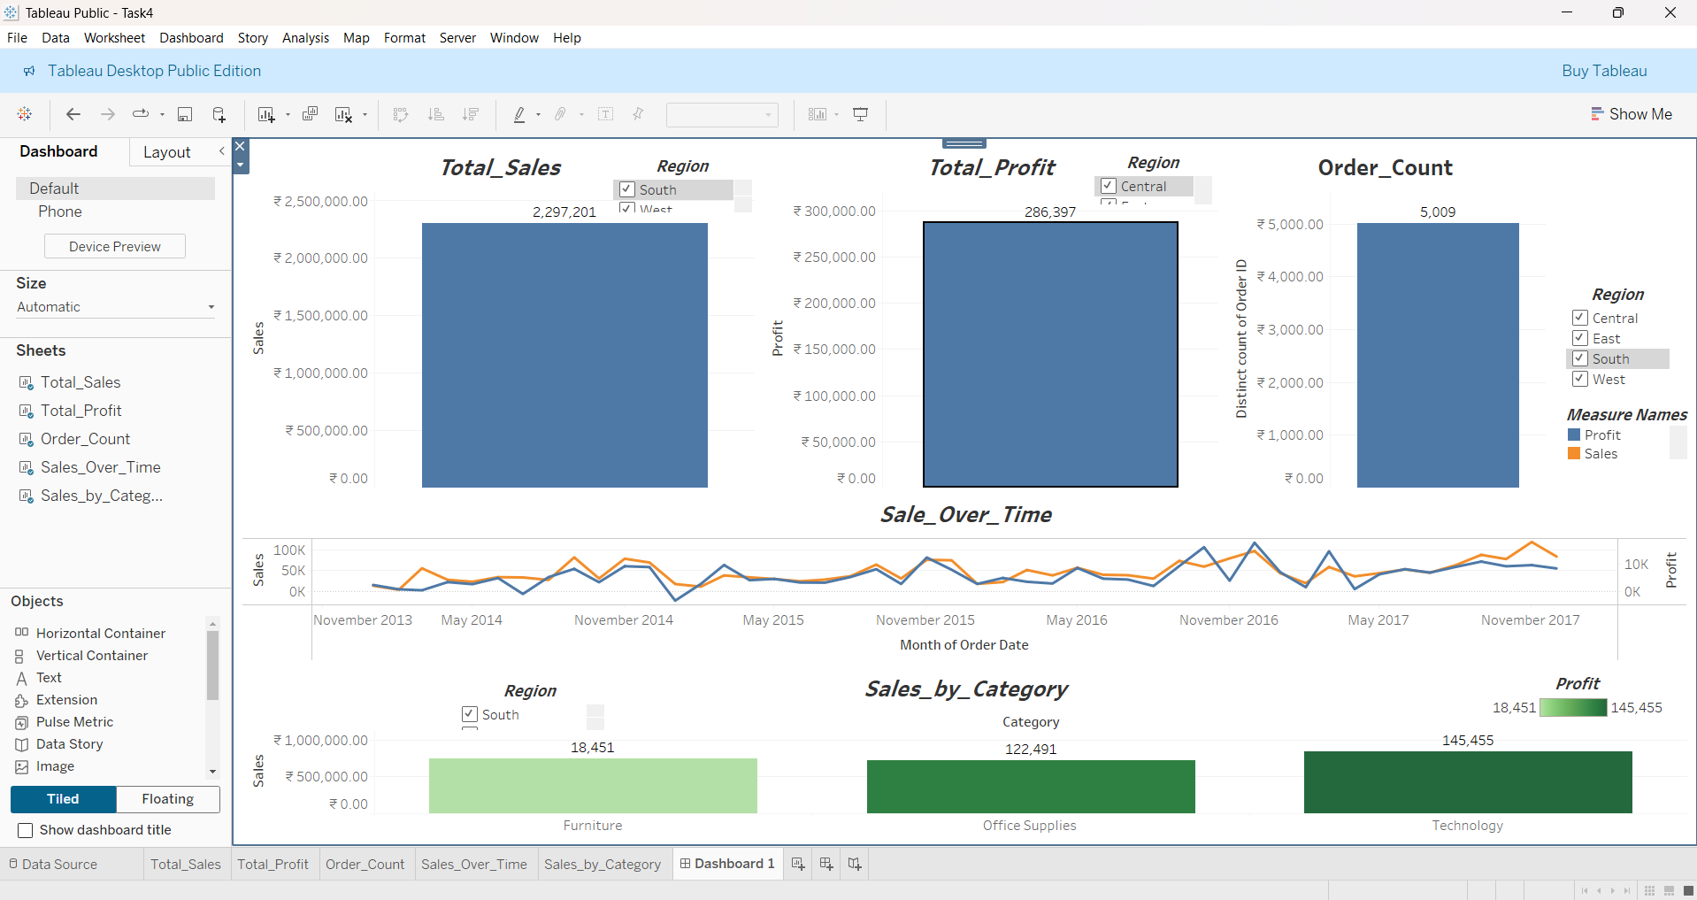
Dashboard Overview
📌 Insight: - Dashboard offers a comprehensive overview. - Highlights both strong and weak areas. - Useful for quick, informed decision-making.

