Slide 1

Data Visualization Project
Kpi Dashboard for a hospitality client
Designed and Presented By
Vikas Paliwal

Slide 2
Business objective
AtliQ is a company that owns multiple hotel chains across various cities of India
The Managing director / CEO of AtliQ wants to incorporate ‘Business and Data Intelligence’ to identify and track the source of revenue for AtliQ hotels
Hence, it is decided to develop a KPI Dashboard for AtliQ, using May-22 to July-22 data, which can help track its revenue sources and other relevant KPIs across various dimensions
It’ll help the management take strategic business decisions based on the insights generated from the dashboard

Slide 3
Problem statement / Project scope
Identify the data sources pertaining to revenue management
Clean and model the data as per requirement for analysis
Create a revenue dashboard that measures important KPIs
Relevant filters need to provided to slice and dice the data
The dashboard should depict both high level and granular insights

Slide 4
Solution approach
There are 5 tables provided for tracking revenue, 3 dimension tables (date, hotel, room) and 2 fact tables (bookings, aggregated bookings)
Power BI was the tool used for creating the visualization/dashboard
The data was imported, analysed and transformed as per necessity within Power Query
The relationships between the tables were created within Power Pivot

Slide 5
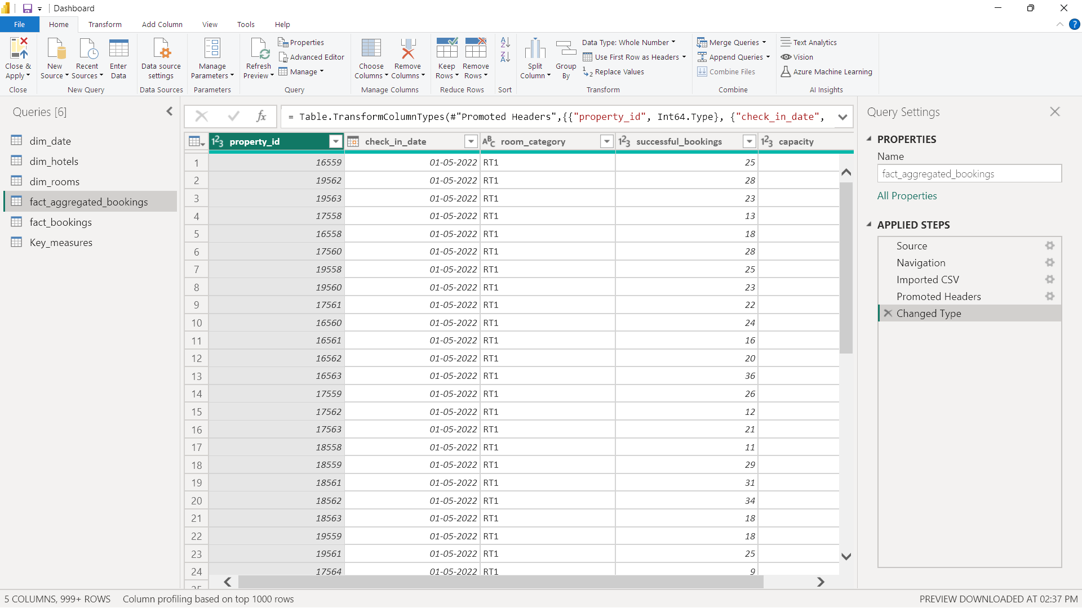
Data cleaning/transformation in Power Query

Slide 6
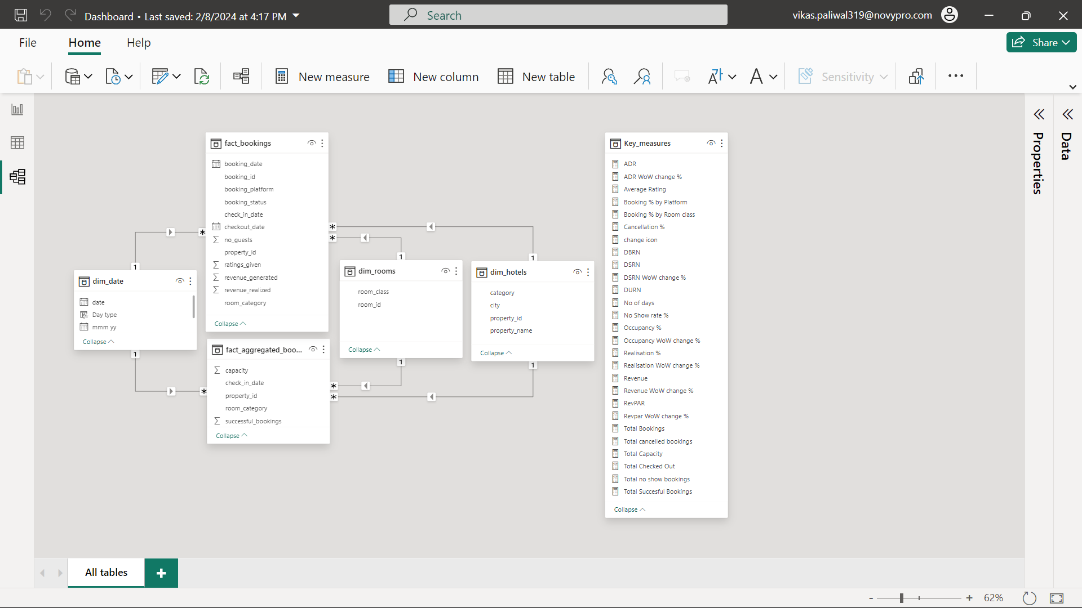
Data modelling in Power Pivot

Slide 7
Solution approach
A few measures were created to calculate the KPIs as shown below:
Revenue = Sum of revenue_realized from Bookings table (in Rs.)
Total bookings = Count of booking_id from Bookings table
Avg rating = Average of ratings from Bookings table
Total capacity = Sum of capacity from Aggregated bookings table
Total successful bookings = Sum of successful bookings from Aggregated bookings table

Slide 8
Solution approach
A few measures were created to measure the KPIs as shown below:
Occupancy rate = Total successful bookings / Total capacity (in %)
Total cancelled bookings = Count of booking_id with status=‘cancelled’ from Bookings table
Cancellation rate = Total cancelled bookings / Total bookings (in %)
Total Checked Out = Count of booking_id with status=‘checked out’ from Bookings table

Slide 9
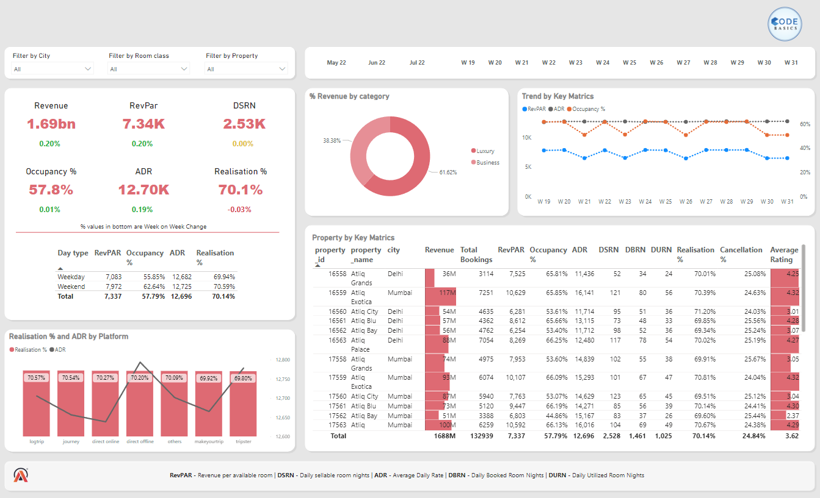
Revenue Dashboard

Slide 10
Features of the dashboard
The following 4 visuals were provided:
Revenue by category = The donut chart displays the revenue in the luxury/business hotels category
Trend by key matrics = The line chart illustrates the percentage of rooms occupied, RevPAR, and ADR on weekly basis
Realisation % and ADR by platform = The combined line and clustered column chart present the percentage of realized revenue and ADR.
KPI table = A matrix visual (pivot table) showcases various KPIs across different properties

Slide 11
Features of the dashboard
A bunch of card visuals were placed to show the values of important KPIs
The following filters were provided to slice and dice the data:
City
Room class
Properties
Month
week
The theme of the dashboard is based on the logo of the company
The visuals are interactive in nature
Tooltips pop-up when hovering over a visual for more information about the data point

Slide 12
Important business insights derived from the
Revenue Dashboard

Slide 13
Cities in Focus: Revealing Revenue, Occupancy, and Ratings in Mumbai, Hyderabad, Bangalore and Delhi
 | Mumbai | Hyderabad | Bangalore | Delhi
Revenue (M) | 660.64 | 321.17 | 415.03 | 290.92
Occupancy(%) | 58.0 | 57.8 | 55.7 | 60.4
Rating (1-5) | 3.65 | 3.66 | 3.41 | 3.78
Mumbai generate the highest revenue (660M) followed by Bangalore, Hyderabad and Delhi.
Delhi toped both in occupancy and rating followed by Hyderabad, Mumbai and Bangalore.

Slide 14
Properties in Focus: Revealing Revenue, Occupancy, and Ratings in different properties
 | Revenue (M) | Occupancy (%) | Rating (1-5)
Atliq Bay | 256.96 | 58.3 | 3.71
Atliq Blu | 257.70 | 61.9 | 3.96
Atliq City | 282.15 | 59.4 | 3.69
Atliq Exotica | 316.47 | 57.2 | 3.62
Atliq Grands | 208.91 | 52.5 | 3.10
Atliq Palace | 300.29 | 59.9 | 3.75
Atliq Seasons | 65.29 | 44.6 | 2.30
Atliq Blu has the highest occupancy of 61.9 % and rating of 3.96 .
Atliq Exotica perform better compare all 7 types of property with 316.47 M revenue.

Slide 15
Day Type in Focus: Revealing RevPAR, Occupancy, ADR, and Realisation in Weekday and Weekend
 | Weekdays | Weekends
RevPAR | 7083 | 7972
Occupancy % | 55.85 | 62.64
ADR | 12682 | 12725
Realisation % | 69.94 | 70.59
The occupancy rate is higher during weekends across all cities, months and booking platforms. Leverage this insight to increase revenue generated during weekends.
The ADR is almost equal in both weekdays and weekends.

Slide 16
Conclusion
A revenue dashboard was built for AtliQ hotels depicting its various KPIs visually
Relevant filters along with tooltips and interactions was provided in the dashboard
This dashboard can be used for both high-level and in-depth analysis of KPIs across various dimensions

Slide 17
Thank you!

