Slide 1
Virtualization
CSE 511

Slide 2
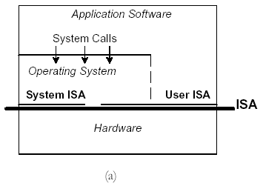
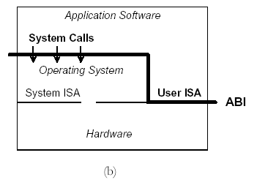
H/W Interface vs. App. Interface
ISA
ABI (Appln. Binary Interface)
Not everything goes through OS
(for efficiency!)
CSE 511

Slide 3
Consequent Problems
Inter-operability (write-once run-anywhere) whether tailored for an OS or an ISA!
Inflexibility to change Syscalls, OS or ISA (innovation oppurtunities lost!)
Need to support diverse hardware, diverse OS within same facility
Server and Code Sprawl
Lost opportunities for customizability and extensibility
Performance Suffers
CSE 511

Slide 4
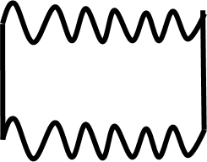
Virtualization – an engineering solution
Interface you want
Virtualization
Layer
Interface available
CSE 511

Slide 5
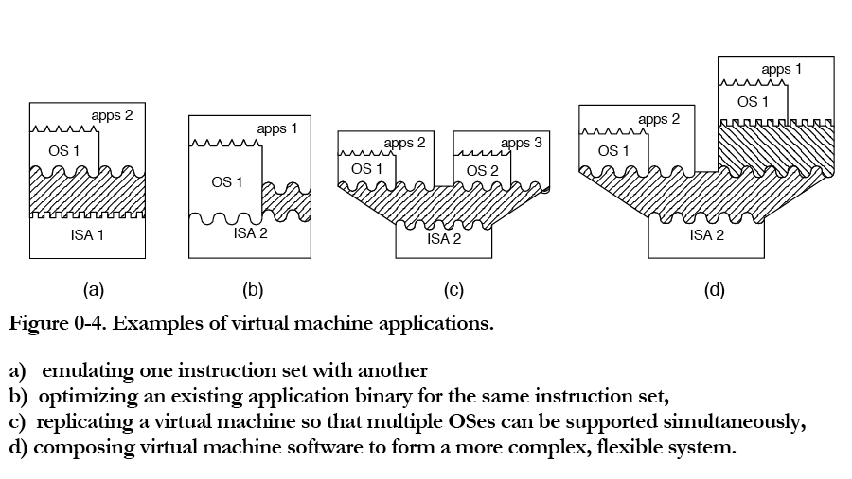
Virtualization Possibilities
CSE 511

Slide 6
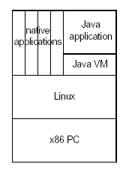
Broad Classification
Process VMs (e.g. JVM)
  Goal: Provide ABIs to Apps
  Just App-level ISAs, runtime environment, etc.
  No real protection, only 1 process to underlying system
System VMs (e.g. UML, Xen, VmWare)
  Goal: Provide ISAs and complete (virtual) system view to Apps and OS.
CSE 511

Slide 7
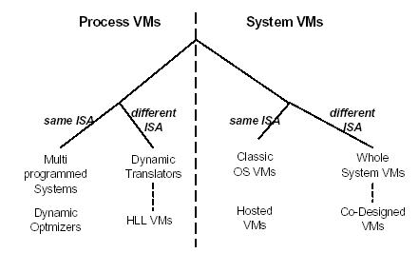

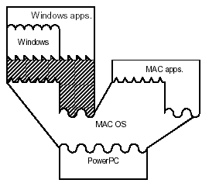
Taxonomy
Taxonomy
Our focus!
Purpose: Resource Mgr
(serving the role of an
OS for the hosted Oses)
Purpose: Resource Mgr +
Emulator/translator
CSE 511

Slide 8
Popek-Goldberg (1974) Requirements
Sufficient Conditions for the hardware to support virtualization
Theorem: Sensitive instructions should be a subset of Privileged instructions
  Sensitive Instns: Those that change state of the machine or depend on the state of the machine (with respect to others)
  Privileged Instns: Can execute only in privileged mode (and trap otherwise).
Forms the basis for System Virtualization
CSE 511

Slide 9
x86 Possibly Sensitive and non-Privileged instructions
SGDT
SLDT
SIDT
SMSW
PUSHF
POPF
LAR
LSL
VERR
VERW
PUSH
POP
CALL
JMP
INT n
RET
STR
MOVE
How do you ensure ONLY Privilege-mode access when these
occur with the “sensitive” arguments?
CSE 511

Slide 10
System Level VMs
User-Mode Linux (UML)
VmWare Workstation
Xen (Para-virtualization)
VmWare ESX Server
CSE 511

Slide 11
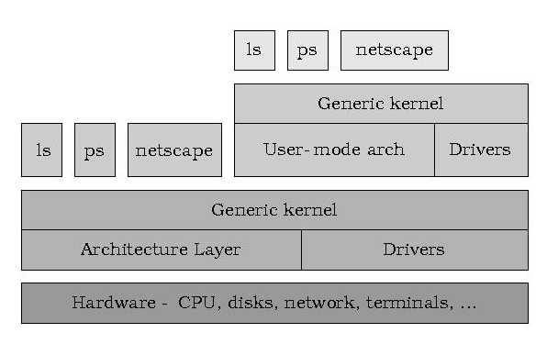
User-Mode Linux (UML)
Run Linux as a user-process (Guest) on top of native Linux
Access to system hardware goes through native (Host) Linux.
Guest Kernel
Host Kernel
CSE 511

Slide 12
UML: Virtualizing Hardware
CPUs
  ISA-compatible (so no translation)
  Processes of Guest are also Processes of Host
  Guest OS is itself a process
  Guest OS can switch (stop/start) its processes (using Syscalls to Host)
Memory
  Done using memory-mapped files
  Guest creates files with different modes (using Host Syscalls)
  Accesses are caught by Guest when violated and handled.
Devices
  Guest creates abstractions and exposes the interfaces to its processes
  Handles as many of these as it can, and then calls Host Syscalls when necessary.
All sensitive instructions are executed ONLY by Host OS (which runs in Privileged mode).
Trapping on all (potentially) sensitive instructions to privileged mode can be a lot of overhead.
CSE 511

Slide 13

UML on x86 Rings
Original
Re-assignment
User Processes
+
Guest OS
User Processes
Ring 3
Ring 3
Ring 2
Ring 2
Ring 1
Ring 1
OS
Ring 0
Ring 0
Host OS
CSE 511

Slide 14
Xen – Para-virtualization
Modify the Guest OS/drivers – Statically (no longer “stock” OSes!)
Make them slightly “more” privileged than user processes.
Still make these Guest OS-es use as few sensitive/privileged instructions as possible
Switch to a privileged mode only when necessary
CSE 511

Slide 15
Xen 2.0 Architecture
VM0
VM1
VM2
VM3
Device
Manager &
Control s/w
Unmodified
User
Software
Unmodified
User
Software
Unmodified
User
Software
GuestOS
(XenLinux)
GuestOS
(XenLinux)
GuestOS
(XenLinux)
GuestOS
(XenBSD)
Back-End
Back-End
Native
Device
Driver
Native
Device
Driver
Front-End
Device Drivers
Front-End
Device Drivers
Control IF
Safe HW IF
Event Channel
Virtual CPU
Virtual MMU
Xen Virtual Machine Monitor
Hardware (SMP, MMU, physical memory, Ethernet, SCSI/IDE)
CSE 511

Slide 16
Xen on x86 Rings
Original
Re-assignment
User Processes
Ring 3
Ring 3
User Processes
Ring 2
Ring 2
Ring 1
Ring 1
Modified
Guest OSes
OS
Ring 0
Ring 0
VMM
CSE 511

Slide 17
VMWare ESX Server
Dynamically monitor and modify the OS.
Either emulation or dynamic binary modification.
Traps generated for sensitive instructions in Guest OS, that get translated/emulated/over-written.
However, optimize for the common case/repeated use to avoid such traps.
E.g. Guest OS does one level of virtual to physical page mapping, which then goes through 1 more level of translation to machine address in the VMM (shadow page tables).
i.e. VP -> PP -> MP
First time, the virtual to physical page mapping will be done by guest OS, and then will miss in TLB/actual-PT. This trap will be caught by VMM, which will then fill TLB with VP -> MP mapping, which will subsequent not trap.
Works with “stock” Oses.
CSE 511

Slide 18
VMWare ESX on x86 Rings
Original
Re-assignment
User Processes
+
Unmodified Guest OS
User Processes
Ring 3
Ring 3
Ring 2
Ring 2
Ring 1
Ring 1
OS
Ring 0
Ring 0
Host OS
CSE 511

