Slide 1
MapReduce & HDFS
CSE 511

Slide 2
Outline
Need for datacenter scale computing
MapReduce programming paradigm
System support for MapReduce

Slide 3

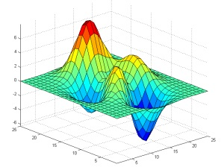

Motivation
Desktop Class
HPC
Data processing

Slide 4
Computing requirements
Increasing demand of large-scale data processing
Crawled docs, web request logs, sensor data, etc…
Index construction for search, event detection, frequent queries in a day, etc.
Storage support
Data easily exceeds Peta bytes
Compute support
Requires 1000s of CPUs to finish in reasonable time
Datacenter scale computing!

Slide 5

Datacenters are large scale computers
100000 of servers, associated power and cooling infrastructure.
Do not want the hassle of managing the infrastructure!

Slide 6
Datacenters are large scale computers
Cost matters at large scale!

Slide 7
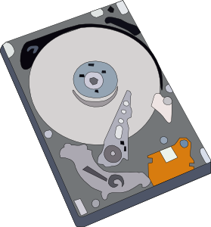
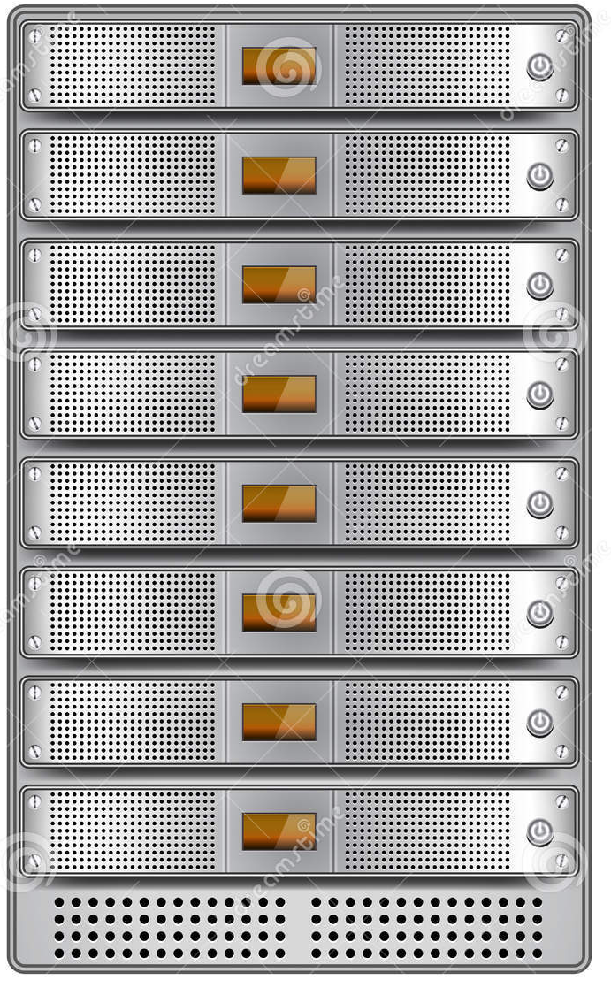


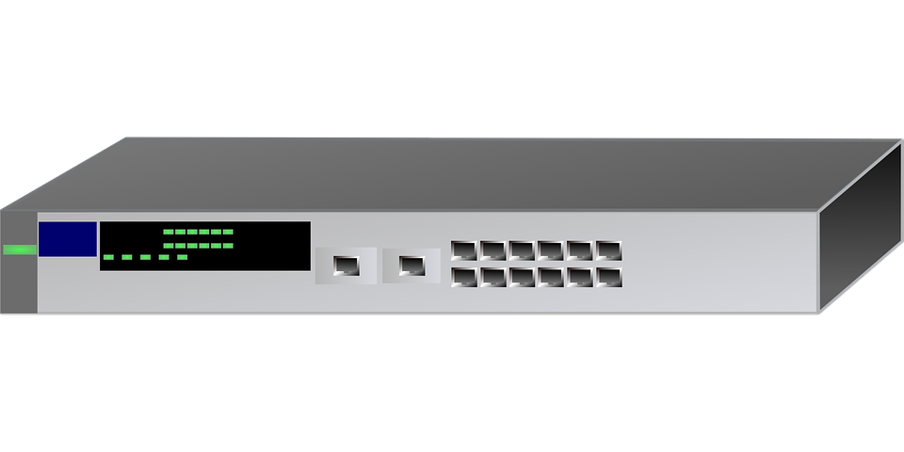
Built on commodity hardware
Datacenter
Rack-1
Rack-50
…

Slide 8
Built on commodity hardware
Commodity cluster, hundreds/thousands of machines
Failures are common
Commodity networking
Bandwidth is a relatively scarce resource
Inexpensive disks directly attached to machines
Data distribution, load balancing, availability

Slide 9
Workload characteristics
Computations are conceptually straightforward
Suitable for parallelization
Write once, read multiple times
Simple coherency model

Slide 10
Problem Statement
Goal: Solve large scale data processing
Challenge: Runs on large scale commodity hardware
Opportunity: Data parallel computation with write once, read multiple time access

Slide 11
Outline
Need for datacenter-as-a-computer
MapReduce programming paradigm
System support for MapReduce

Slide 12
Map-Reduce Introduction
Simple data-parallel programming model designed for scalability and fault-tolerance on large cluster of commodity machines
Pioneered by Google
Processes 20 petabytes of data per day
Popularized by open-source Hadoop project
Used at Yahoo!, Facebook, Amazon, …

Slide 13
Map-Reduce Introduction
Two steps of a application:
Map: an initial ingestion and transformation step, in which individual input records can be processed in parallel.
Reduce: An aggregation or summarization step, in which all associated records must be processed together by a single entity

Slide 14
Map-Reduce Introduction
Many problems can be phrased this way
e.g. parallel grep, web indexing, counting, etc.
Easy to distribute across nodes
All Map functions are data flow independent
Retry/failure semantics

Slide 15
Programming model
Map (user)
Input: key/value pairs
Output: intermediate key/value pairs
Shuffle/Sort
Group together all intermediate value associated with the same intermediate key and pass them to reducers
Reduce (user)
Input: intermediate key and a set of values of that key
Output: merge together these values to form a smaller set of values

Slide 16
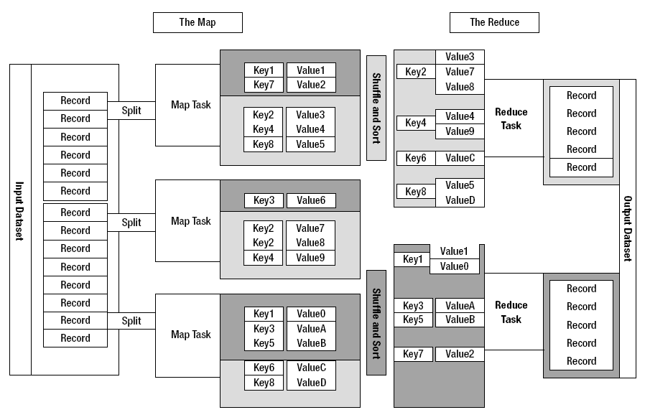
Map-Reduce Data Flow

Slide 17
High-level MapReduce Word Count
def mapper(line):
foreach word in line.split():
output(word, 1)
def reducer(key, values):
output(key, sum(values))
17
Notes:
17

Slide 18
Word Count Example
Input
Map
Shuffle & Sort
Reduce
Output
are, 1
nittany, 1
lions, 1
we are nittany lions
Map
are, 2
lions, 1
nittany, 1
penn, 2
we, 1
Reduce
are, 1
penn, 1
we are
penn state
Map
we, 1
state, 1
state, 2
university, 1
we, 2
penn, 1
Reduce
penn state
university
Map
state, 1
university,1

Slide 19
Outline
Need for datacenter-as-a-computer
MapReduce programming paradigm
System support for MapReduce

Slide 20
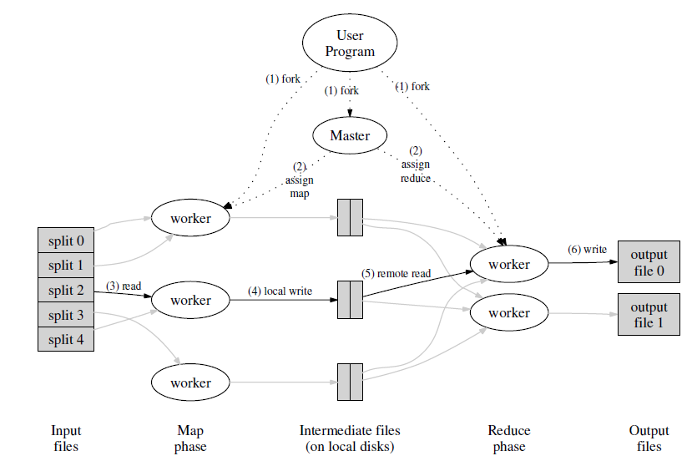
Distributed Execution

Slide 21
Hadoop
At Google, MapReduce operation are run on a special file system called Google File System (GFS) that is highly optimized for this purpose.
Hadoop: Apache Software Foundation top-level project: develops open-source software for reliable, scalable, distributed computing. Core components:
MapReduce framework
Hadoop Distributed File System (HDFS)
21

Slide 22
What would a MR filesystem need?
General use case: large files
Long sequential reads, write once/append, read multiple times
Scalability:
Adding or losing machines should be relatively easy
Computation close to data
Minimize moving data between machines
Failure is common
Fault tolerance mechanisms
22

Slide 23
HDFS
Designed for storing very large files with streaming data access patterns, running on clusters of commodity hardware
Not a good fit for:
Low latency data access (NVM FS e.g. NOVA)
Lots of small files (Namenode holds metadata in memory)
Multiple writers, arbitrary file modifications (one writer, append at the end of file)
Interactive uses (designed for batch processing)
23

Slide 24
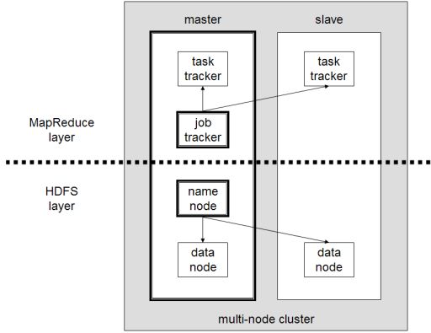
Hadoop cluster
24

Slide 25
HDFS Architecture
HDFS has a master / slave architecture
An HDFS cluster consists of
A single NameNode, which is a master server
Multiple DataNodes, usually one per node in the cluster
Exposes a file system namespace and allows user data
to be stored in files
Internally, a file is split into one or more blocks
These blocks are stored in a set of DataNodes
25

Slide 26
HDFS Architecture
NameNode: management of the file system metadata, and provides management and control service
Keep entire namespace in RAM
Single point of failure
Checkpoint Node
BackupNode
DataNode: provides block storage and retrieval services
Handshake, registration, heartbeat to the Master
Block size: 64MB (default), 128MB …
Replication factor: 3 (default)
HDFS Client: a code library that exports HDFS interface
User application access the file sytem using HDFS client
Operations: create, read, write, delete
26

Slide 27
Locality
Collocate computation with data
Unlike conventional file system, HDFS exposes the locations of a file blocks
JobTracker tries to schedule a map task on a datanode that has a copy of its input data

Slide 28
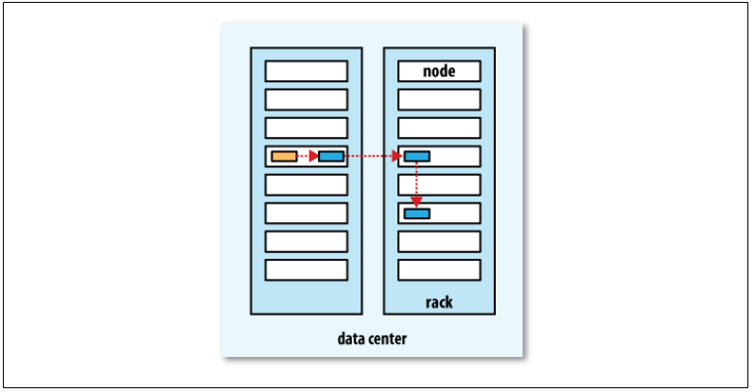
Replica Placement
Rack-aware replica placement strategy
First replica on the same node as the client, second replica on a different rack, third replica on the same rack as the second one, but a different node
28

Slide 29
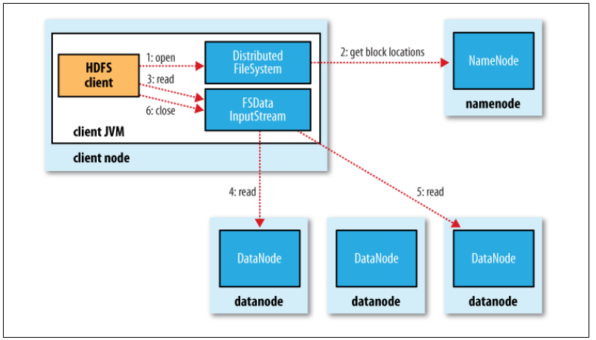
File I/O: read
29

Slide 30
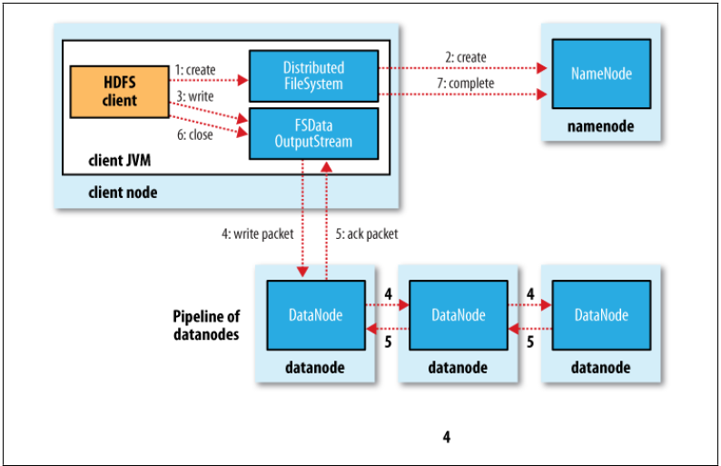
File I/O: write
30

Slide 31
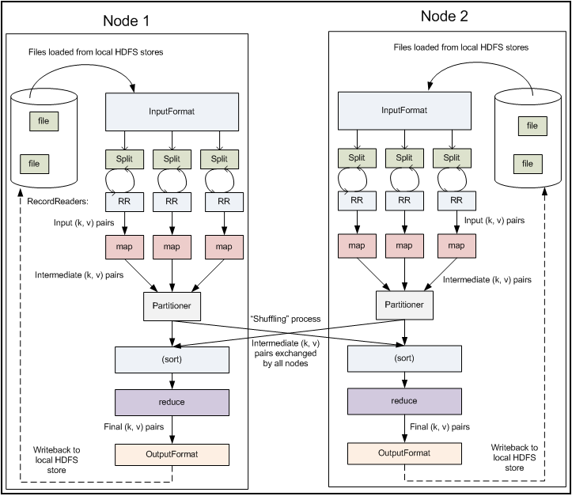
MapReduce Flow on HDFS
31

Slide 32
What are the types of failures ?
Data failures
Node failures
Software/Input bugs
Performance degradation/soft-failures

Slide 33
Fault Tolerance (HDFS)
Data corruption
Checksum in metadata file of DataNode
Data loss
Replication
All data-replication information is stored by the NameNode
The NameNode makes all decisions regarding replication of blocks

Slide 34

Fault Tolerance (HDFS)
DataNode failure
NameNode periodically receives a Heartbeat and a Blockreport from each of the DataNodes in the cluster
If not received in certain amount of time, NameNode schedules creation of new replicas of those blocks on other DataNodes
NameNode failure
Checkpoint, backup

Slide 35
Fault Tolerance (MR)
Worker machine failure
Heartbeat: mark the worker as failed if no response for a while
Re-execution
Completed map task needs re-execution, but no need for completed reduce task
Master machine failure
Periodic checkpoints
Aborts computation since failure is unlikely/rare

Slide 36

Fault Tolerance (MR)
Task failure
Start up a new task
Input failure: Map/Reduce functions sometimes fail for particular inputs
Best solution is to debug & fix
Not always possible ~ third-party source libraries
If master sees two failures for same record:
Next worker is told to skip the record

Slide 37

Fault Tolerance (MR)
Slow workers significantly delay completion time (Straggler)
Other jobs consuming resources on machine
Bad disks w/ soft errors transfer data slowly
Solution: Near end of phase, spawn backup tasks
Whichever one finishes first "wins"
Dramatically shortens job completion time

Slide 38
Summary
Datacenter scale computing
MapReduce programming paradigm
System support for MapReduce
Move computation to data
Distributed File System optimized for MR
Fault tolerance and Scalability

Slide 39
Reference
Dean and Ghemawat. MapReduce: Simplified Data Processing on Large Clusters, OSDI 2004 Shvachko et al.
The Hadoop Distributed File System, MSST 2010

