Slide 1
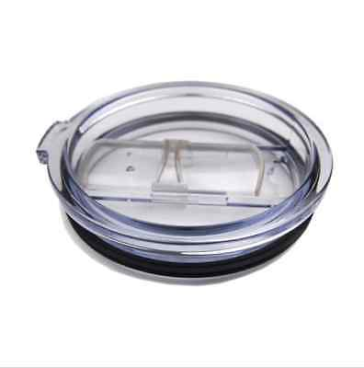
The Next Gen Yeti
Today’s Yeti’s spill too easily
We have made this better
Rubber lid conforms to top of cup & straw
More liquid-tight
Straw has suction valve
→Even more spill proof
Why Rubber?
More insulated than plastic
The lid is the weakest component – rubber is stronger than plastic

