Slide 1
Mutual Fund Analytics Platform
End-to-End ETL Pipeline, Performance Analytics & Power BI Dashboard
Intern Name: Vikas Prajapat | Organization: Bluestock FinTech

Slide 2
Problem Statement
• Mutual Fund Complexity: Investors are overwhelmed by the volume and variety of mutual fund schemes, making manual comparison ineffective.
• Invisible Risk Ratios: Traditional platforms report raw historical returns but fail to highlights risk metrics (Sharpe, Sortino, VaR, Max Drawdown).
• Fragmented Data: NAV histories, investor demographics, and sector holdings reside in separate silos, preventing consolidated views.
• High Cost Drag: Cost differences between Regular and Direct plans are often ignored by retail clients, eroding long-term compounding wealth.
The Challenge:
How can we build an integrated analytics pipeline to ingest raw AMC sheets, resolve missing holiday data, compute advanced risk metrics, and serve a dynamic dashboard to investors?

Slide 3
Project Objectives
• Automated Data Ingestion: Setup a Python scanner to ingest, clean, and validate 10 raw datasets representing AMC holdings, NAVs, and transactions.
• Database Warehouse: Design a Star Schema SQLite DB to house clean Dimension (fund, date) and Fact (NAV, transactions, AUM, performance) tables.
• Performance Analytics Scorecard: Programmatically compute CAGR (1y, 3y, 5y), Sharpe, Sortino, Alpha, Beta, and Max Drawdown.
• Fund Recommender: Build an algorithmic engine that filters schemes by risk category and recommends the top 3 options based on Sharpe ratios.
• BI Interactive Dashboard: Publish a 4-page Power BI dashboard detailing Industry Trends, Fund Performance, Investor Analytics, and Market Trends.

Slide 4
Data Sources & Database Schema
• Core Dimension Tables:
- dim_fund: Master scheme information, launch dates, categories.
- dim_date: Generated date dimension with day, month, quarter, and weekend flags.
• Cleaned Data Volume:
- 37,000+ historical NAV records in fact_nav.
- 15,000+ retail transactions in fact_transactions.
- 40 major schemes tracked with performance ratios.
• Core Fact Tables:
- fact_nav: Daily NAV records mapped to calendar dates.
- fact_transactions: Purchases, redemptions, age, income, state.
- fact_performance: Annualized returns, risk ratios, ratings.
- fact_aum: AMC level AUM and folio counts over quarters.
• Schema Relationship Constraints:
- Enforced SQLite primary keys & foreign key linkages.

Slide 5
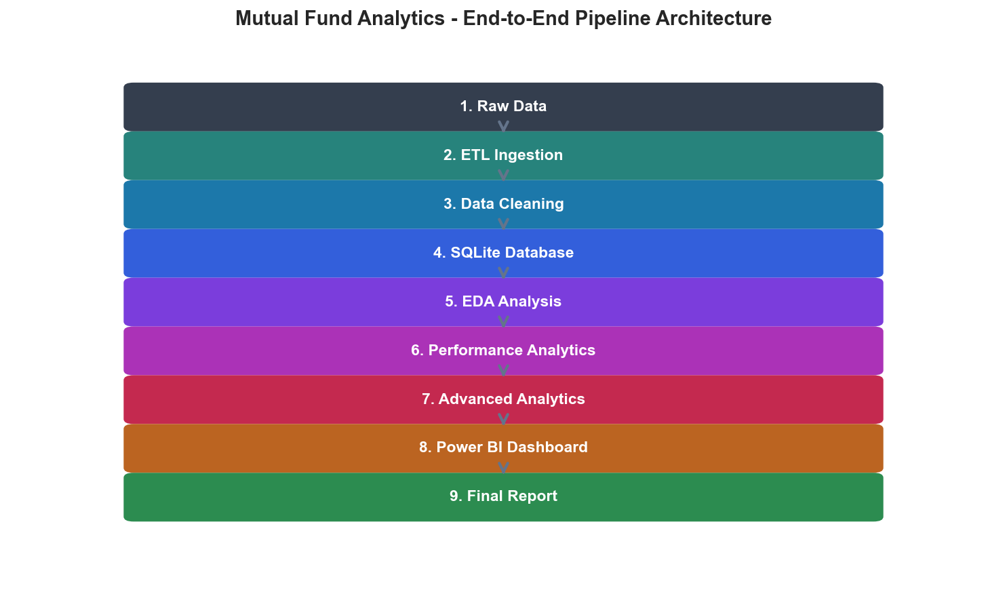
Project Architecture Workflow
• ETL Phase: Read raw CSVs, request live NAV updates from AMFI API.
• Cleaning: Duplicate purging, outlier limits, and forward-filling holidays.
• Storage: Load facts/dims to SQLite database.
• Analytics: Run computations for Sharpe, Sortino, Alpha, Beta, VaR, CVaR, Rolling Sharpe, and HHI concentrations.
• Dashboard: Direct SQLite connector displays interactive page visuals.
• Reporting: Programmatic PDF and PPTX deck builders package deliverables.

Slide 6
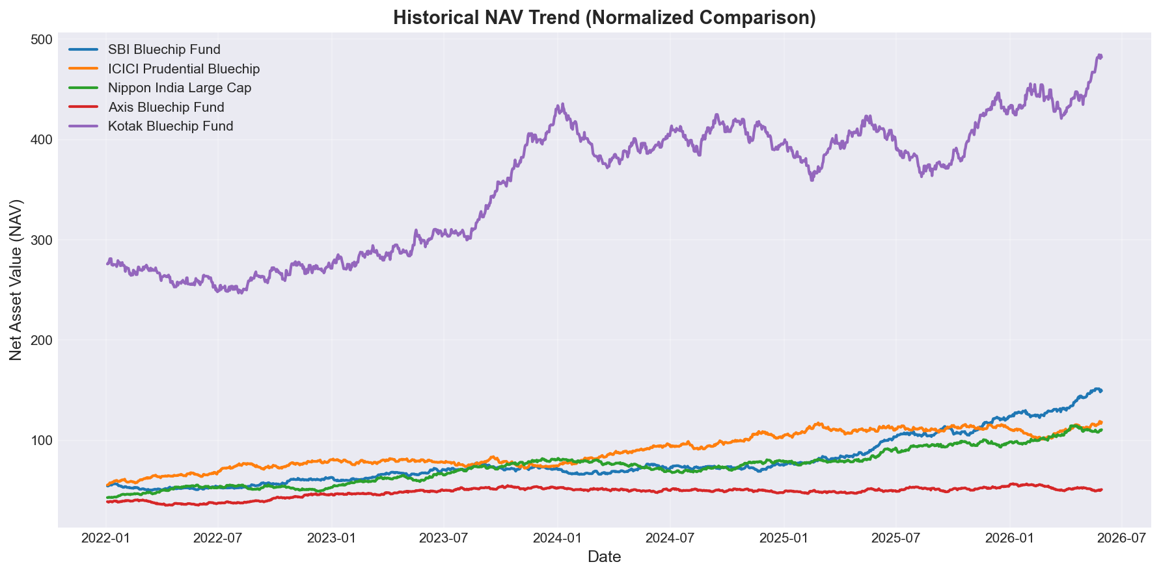
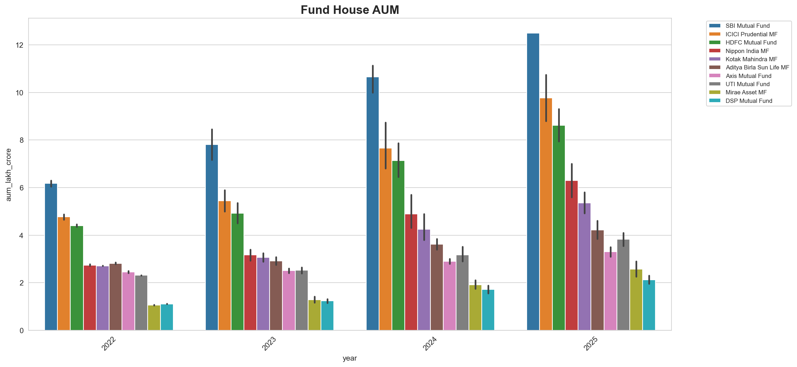
EDA Highlights — Market Trends
• NAV Growth: Large-cap funds demonstrate robust historical trajectories, with SBI and Nippon Bluechips exhibiting consistent returns.
• AMC Dominance: AUM analysis indicates that SBI, ICICI, and HDFC represent over 50% of the industry's total AUM, highlighting high retail trust.

Slide 7
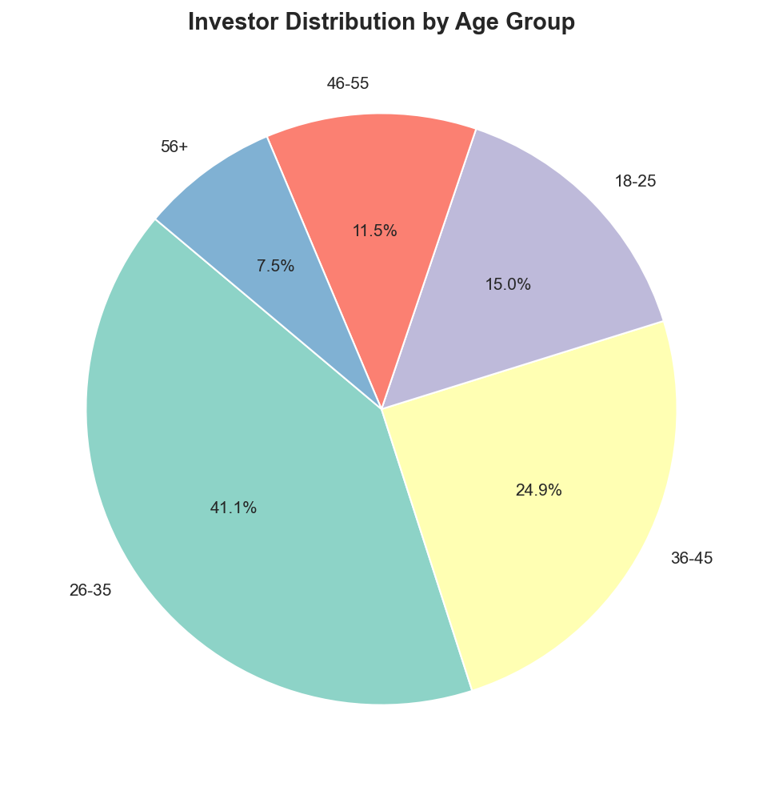
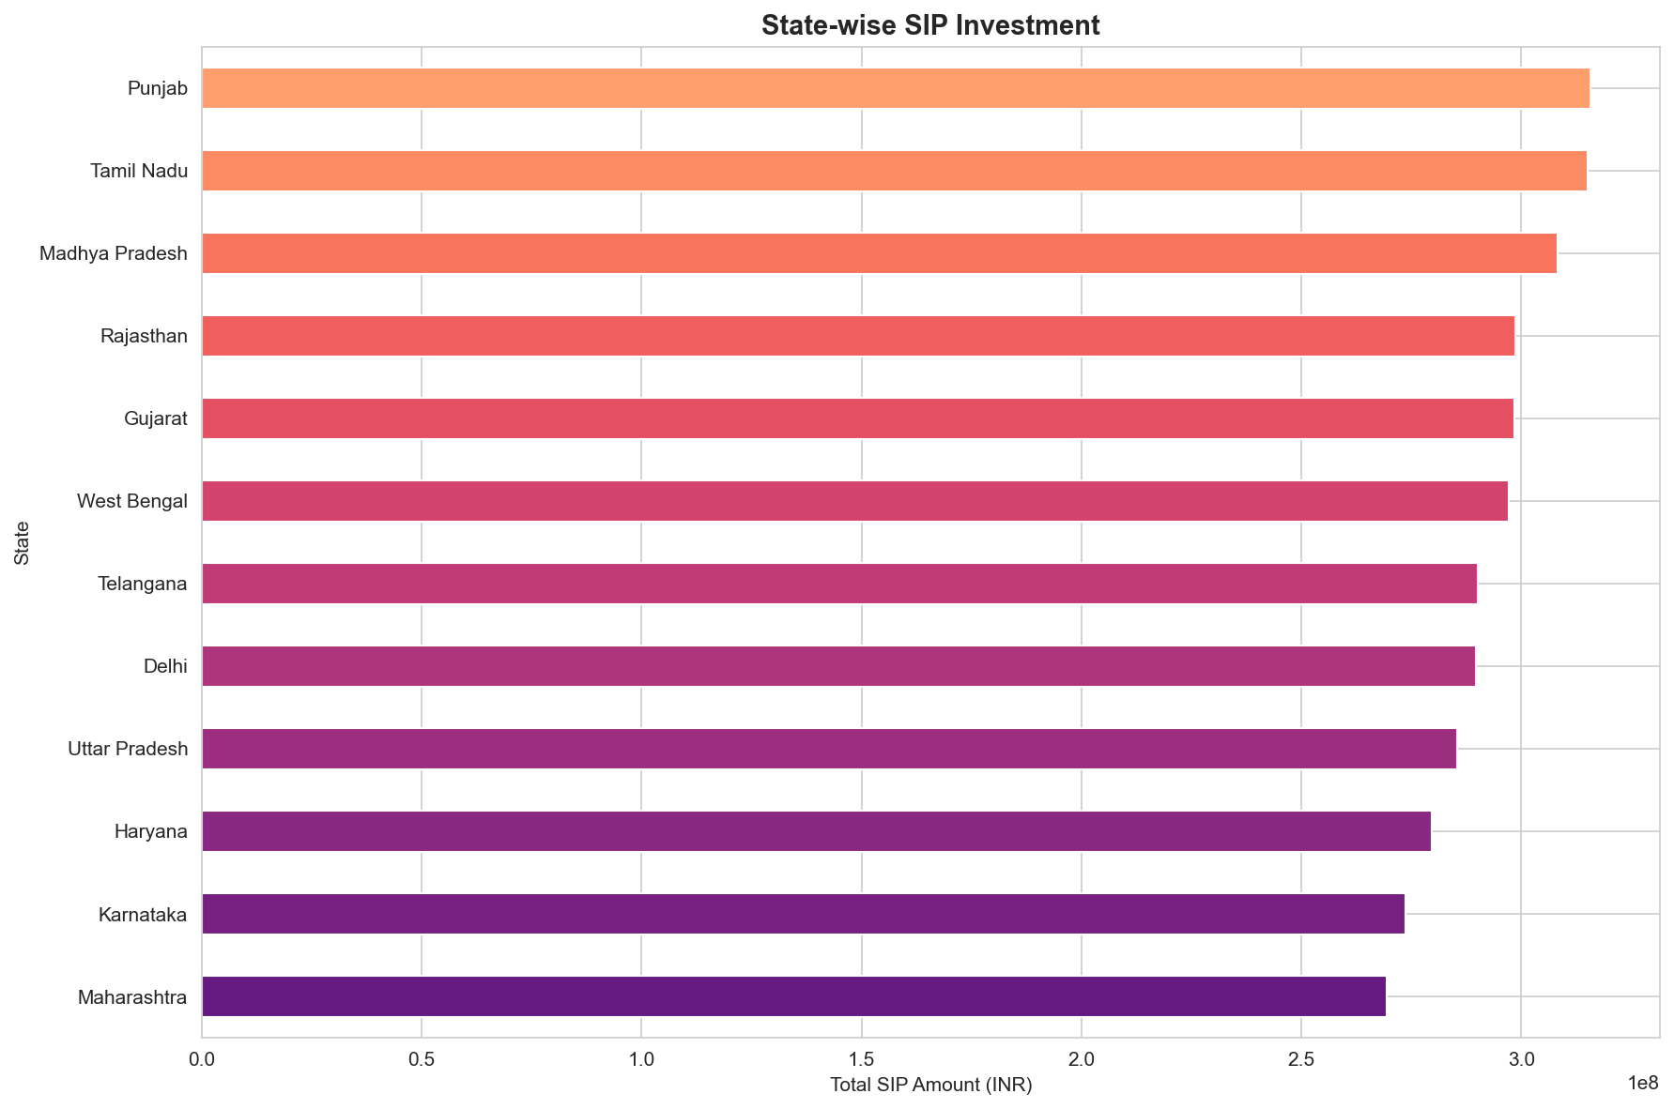
EDA Highlights — Demographics & Geography
• Key Age Group: The 25-40 cohort represents over 60% of all transaction volumes, driven by digital payment modes.
• Geographic Concentration: Maharashtra, Karnataka, and Delhi contribute the highest investment volumes, highlighting urban concentration.

Slide 8
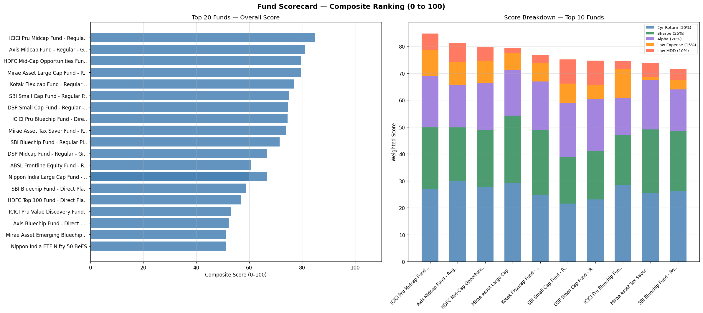
Performance Analytics & Scorecard
• Ratios Calculation:
- Sharpe Ratio: Excess return relative to risk-free rate ($R_f=6.5\%$) per unit of volatility.
- Sortino Ratio: Penalizes only downside deviation.
- Alpha & Beta: Run OLS regressions against Nifty 100 benchmark index.
• 0-100 Scorecard Ranking Formula:
- 3Yr Returns (30%) + Sharpe (25%) + Alpha (20%) + Expense (15% inverse) + Max Drawdown (10% inverse).
- Nippon Large Cap & SBI Bluechip lead scorecard ranks.

Slide 9
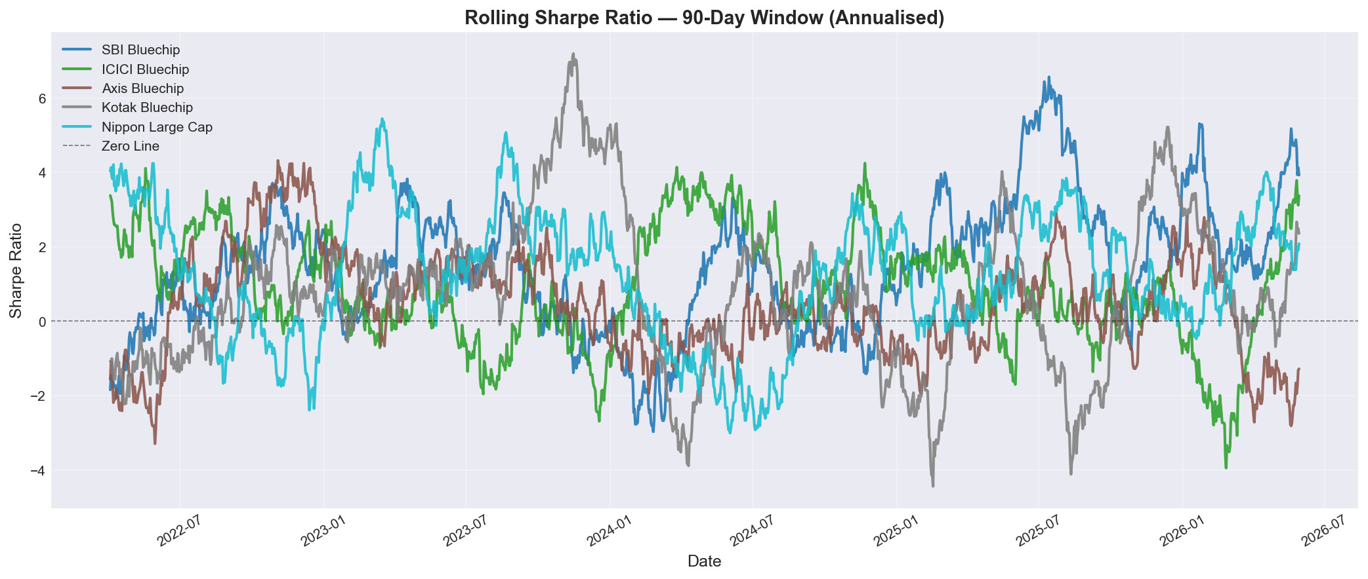
Advanced Risk & Sector Concentration
• Tail Risk: Value at Risk (95% VaR) and CVaR measures single-day loss expectations, showing Mid-Cap funds carry double the tail-risk of Bluechip funds.
• Rolling Sharpe Ratios: Shows dynamic changes in risk-adjusted performance over 90-day rolling windows.
• Sector HHI Concentration: Sum of squared sector weights. Axis Bluechip has low HHI (~1,500), showing high diversification.

Slide 10
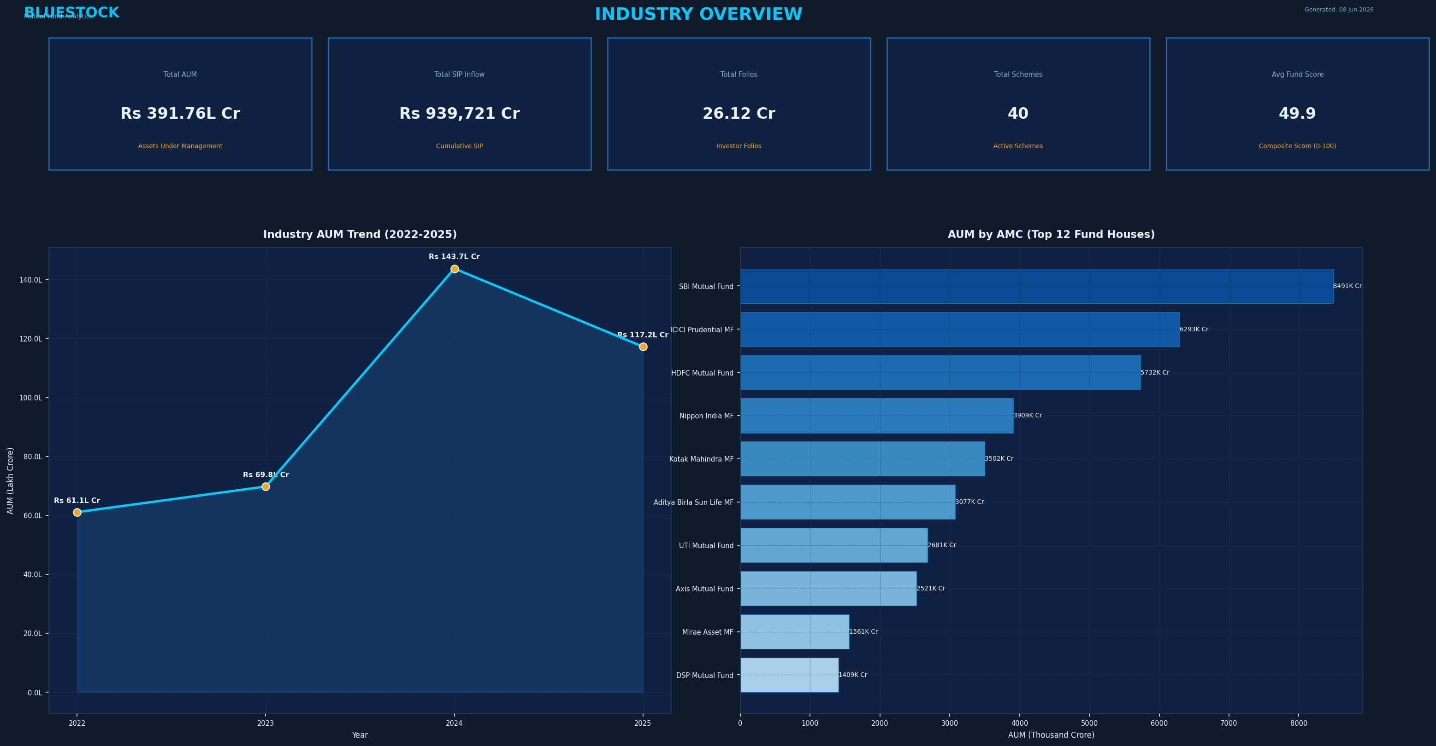
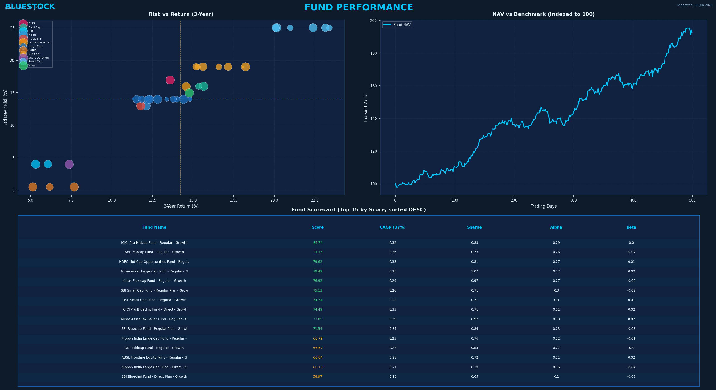
Dashboard: Market & Performance Overview
• Industry Overview Dashboard (Left): Treemaps of AMC market share, category inflows, and total AUM metrics.
• Fund Performance Dashboard (Right): Scorecard matrix, 3y return vs Sharpe scatter plot, and expense toggles.

Slide 11
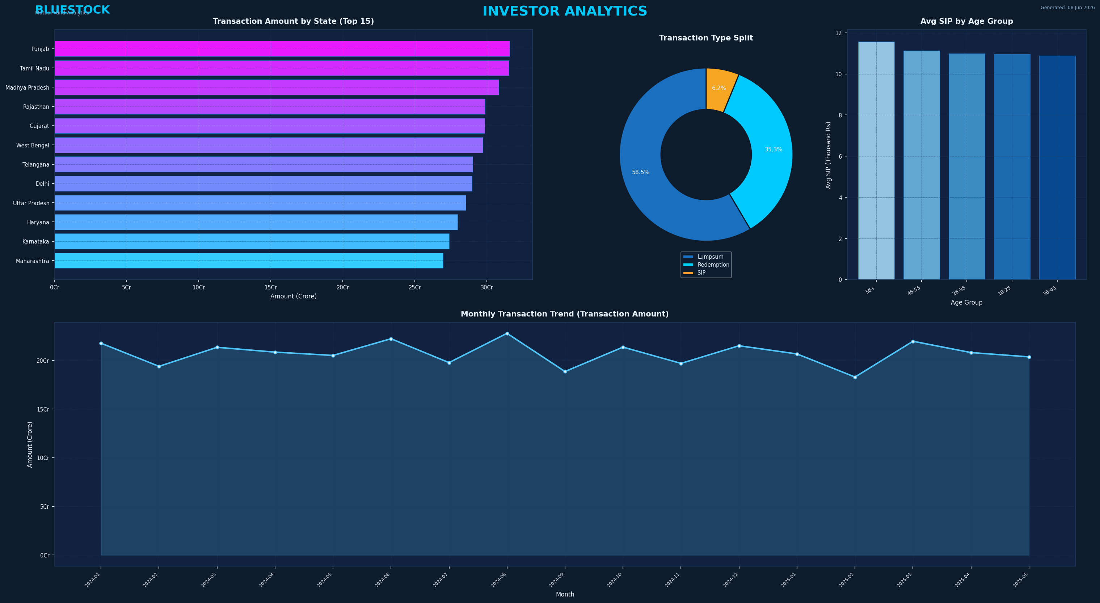
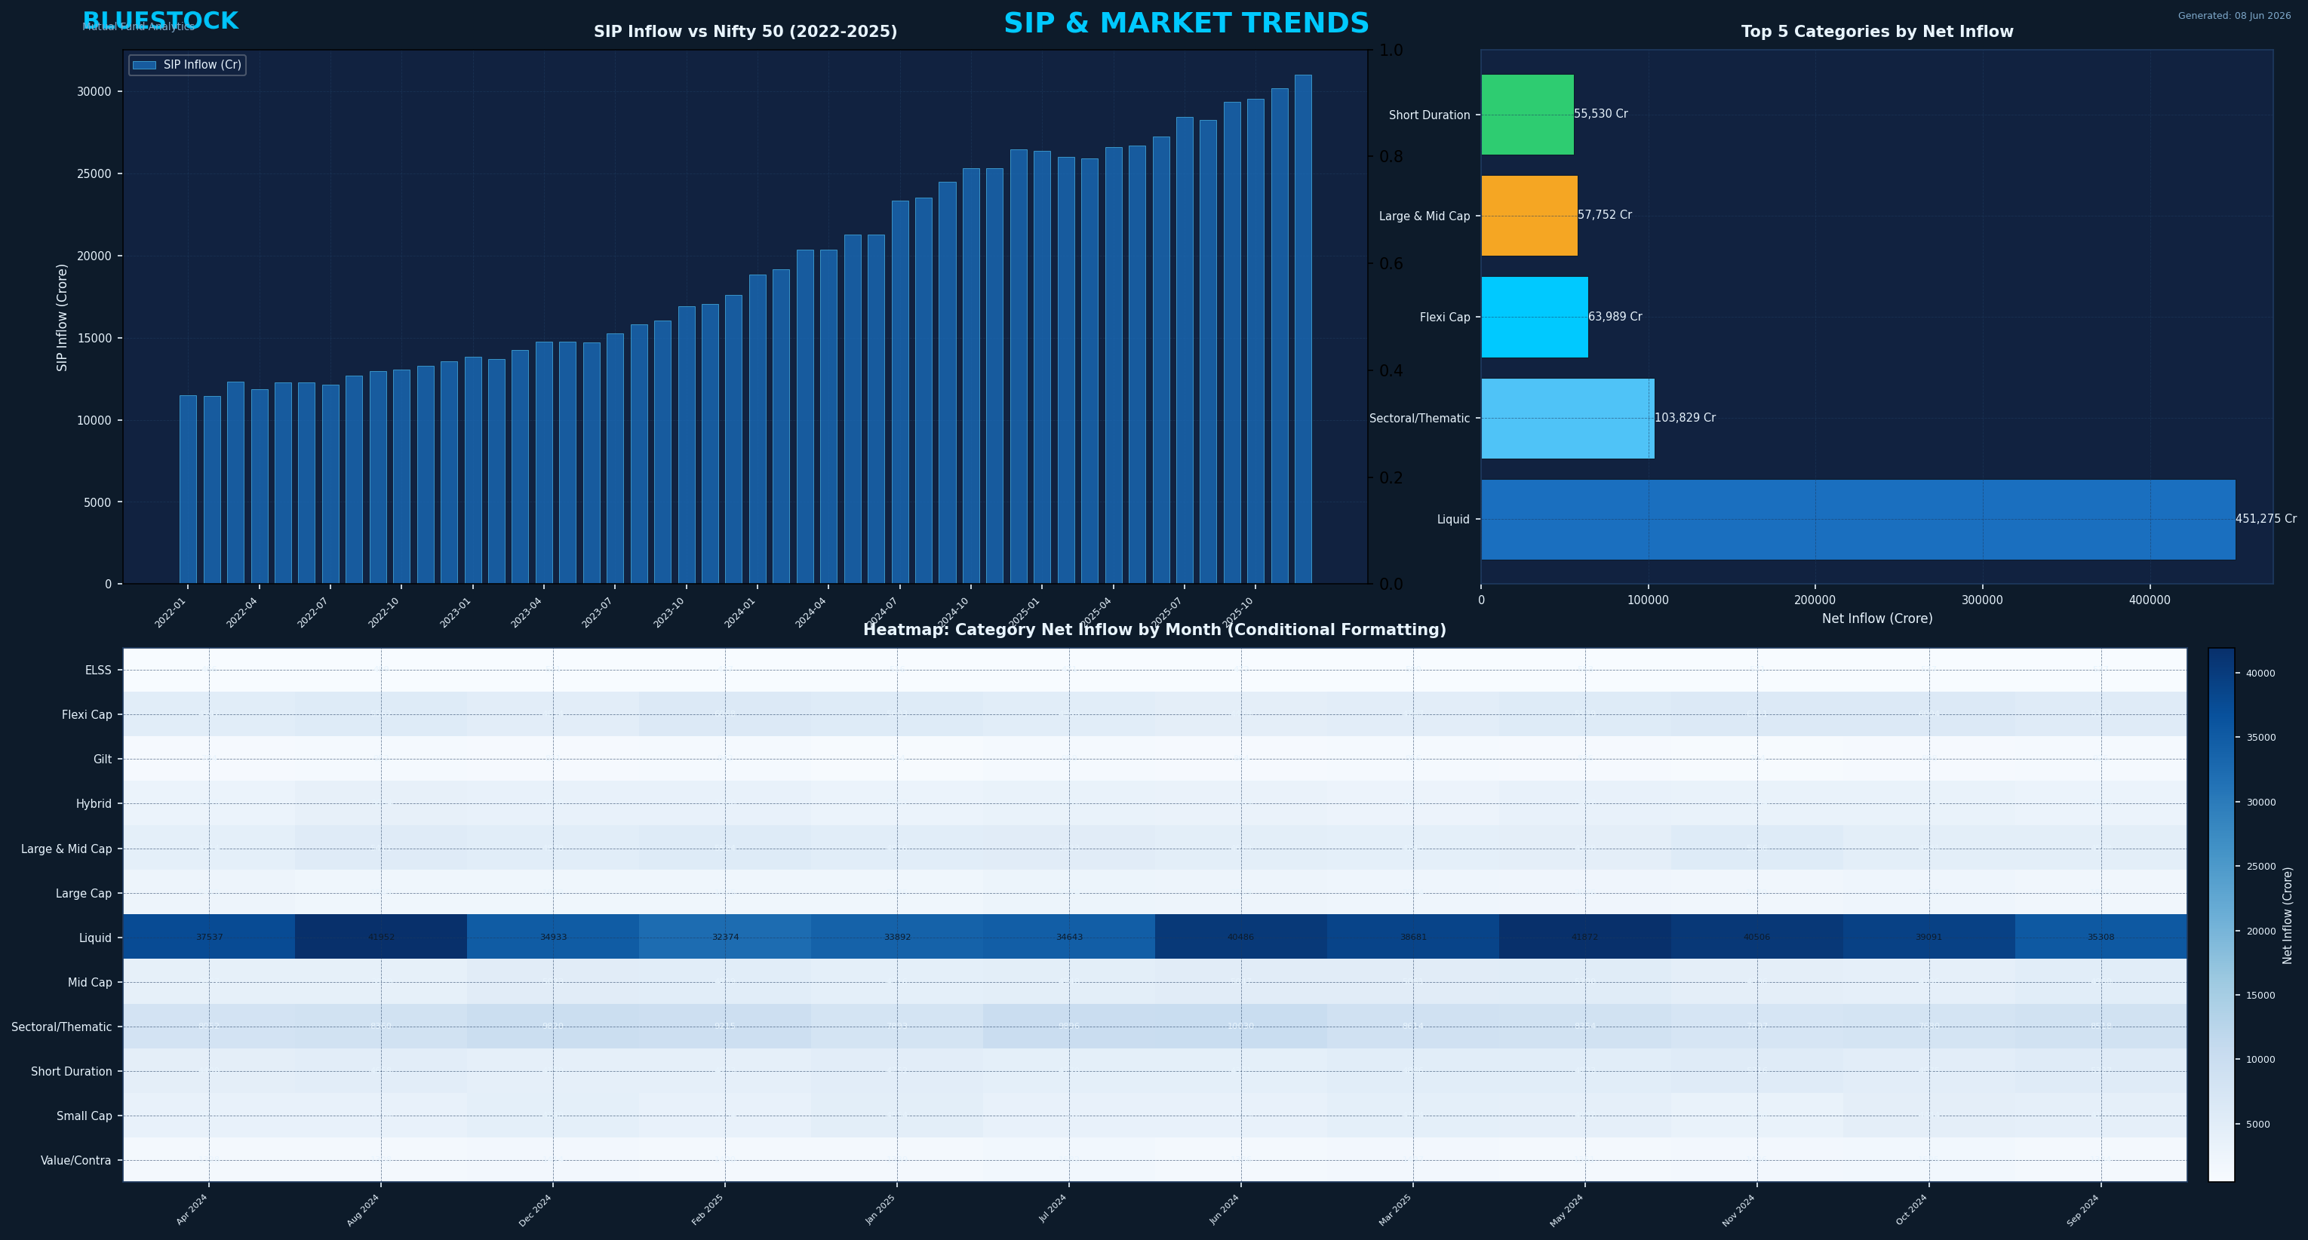
Dashboard: Investor & SIP Trends
• Investor Analytics Dashboard (Left): Age demographics, income distributions, and geographical state heatmaps.
• SIP & Market Trends Dashboard (Right): Monthly inflows, SIP continuity indexes, and correlation with NAV fluctuations.

Slide 12
Key Findings & Contact Information
• Key Performance Findings:
- Top Sharpe: SBI Bluechip Fund (Sharpe Ratio = 1.76)
- Top CAGR: Nippon India Large Cap (3Yr CAGR = 22.45%)
- Top Alpha: ICICI Prudential Bluechip (Alpha = 3.12%)
- Top AUM: SBI Mutual Fund (> 48,000 Crores)
• Valuable Cohort: Q1 2025 vintage shows 82% retention.
Thank You!
Mutual Fund Analytics Capstone Project
Presenter: Vikas Prajapat Contact: vikas.prajapat@example.com Organization: Bluestock FinTech

