Slide 1

Books Sales & Ratings Analysis
Web Scraping + Data Cleaning & EDA using Python + Power BI + Sql
Name:- Vikas Prajapati

Slide 2
Problem Statement
• Analyze book dataset to understand pricing, ratings, and category trends .
• Identify patterns between price and rating.
• Find which categories perform best.

Slide 3
Dataset Overview
• Total Records: ~1000 books.
Columns:
• Title
• Category
• Price (€)
• Rating

Slide 4
Tools Used
• Python (Data Cleaning + Web Scraping).
• SQL (Insights).
• Power BI (Dashboard).

Slide 5
Data Cleaning
• Removed missing values.
• Fixed data types.
• Removed duplicates.
• Standardized category names.

Slide 6
Key KPIs
• Avg Rating
• Avg Price
• Total Books
€35.1
2.92
1,024

Slide 7
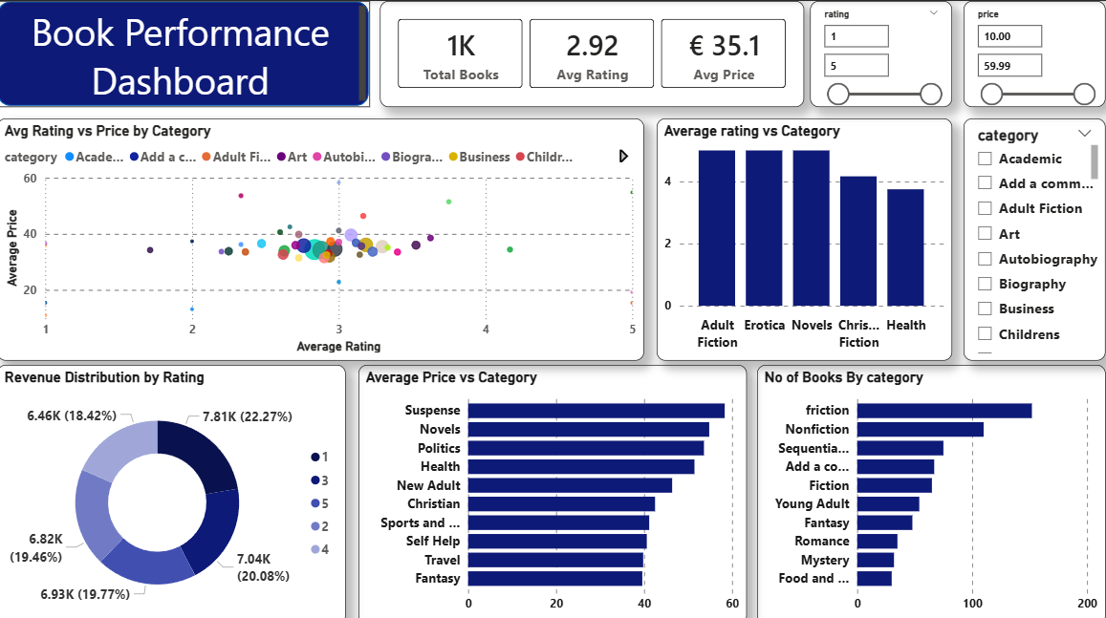
Dashboard Overview
• Interactive dashboard to explore pricing, ratings, and categories.

Slide 8
Insight’s
From scatter plot:
• Most books are clustered around rating 2.5 – 3.5.
• No strong relationship between price and rating.
From category rating chart:
• Categories like Novels & Erotica have higher ratings.
• Health category has lower ratings.

Slide 9
Insights
From bar chart
From “No of Books by Category”
From donut chart
• Some categories have higher average prices.
• Pricing varies significantly across categories.
• Fiction category dominates.
• Some categories have very few books.
• Rating distribution is fairly balanced.
• No extreme dominance of a single rating.

Slide 10
Conclusions
• Price does not strongly impact rating.
• Certain categories perform better in ratings.
• Book distribution is uneven across categories.

