Slide 1

Global Superstore Business Insights Dashboard
Tools: Python | SQL | Power BI
Name:- Vikas Prajapati

Slide 2
Problem Statement
Analyze sales, profit, and customer behavior
Identify key business issues
Provide data-driven recommendations

Slide 3
Tools & Approach
Python
Data Cleaning
SQL
Data Analysis
Power bi
Data Visualization

Slide 4
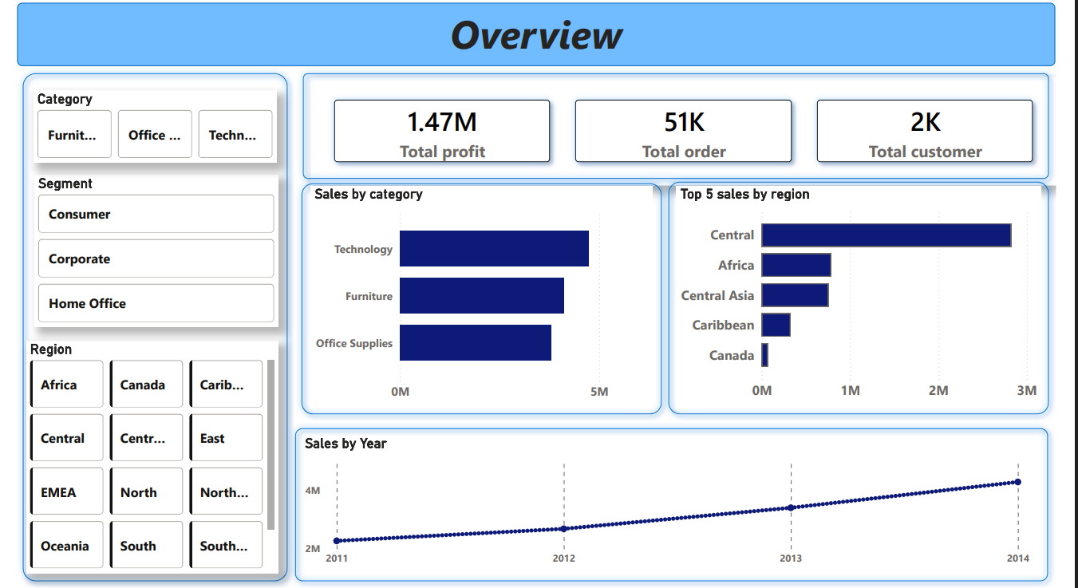
Overview Insights
• Technology category generates the highest sales among all categories
• Sales show a consistent upward trend from 2011 to 2014
• Central region contributes significantly higher sales compared to other regions

Slide 5
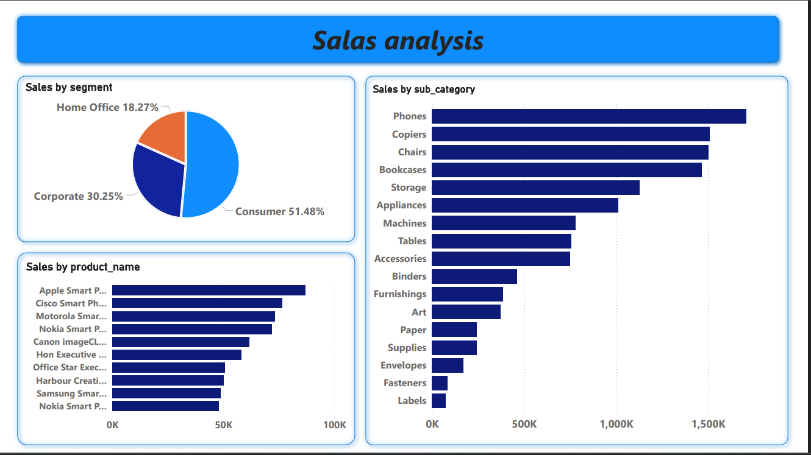
Sales Insights
Technology category drives highest sales
Few products generate most revenue
Most sales are concentrated in consumer segment

Slide 6
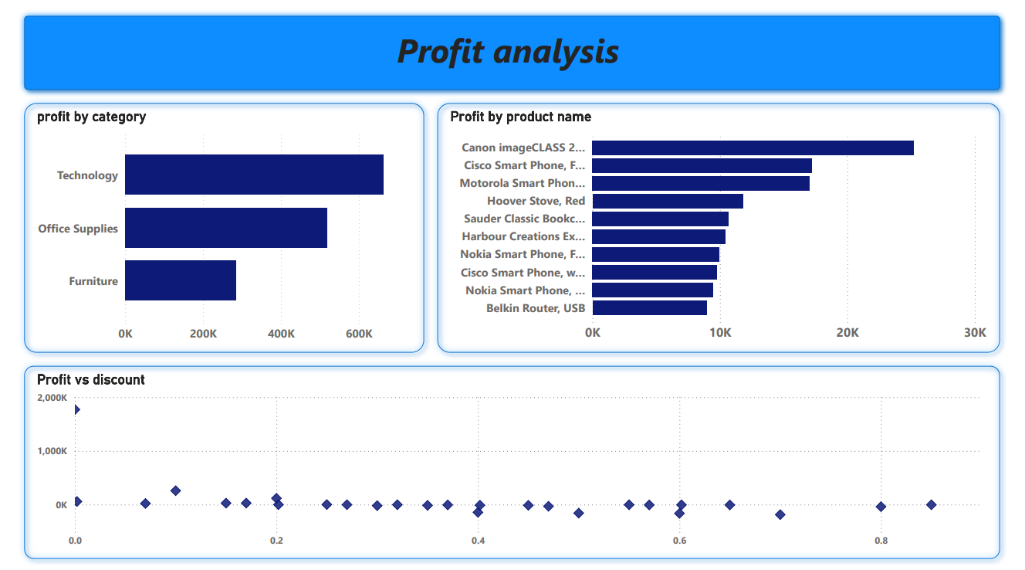
Profit Insights
Profit varies across categories
Some products generate good profit
High discounts reduce profitability

Slide 7
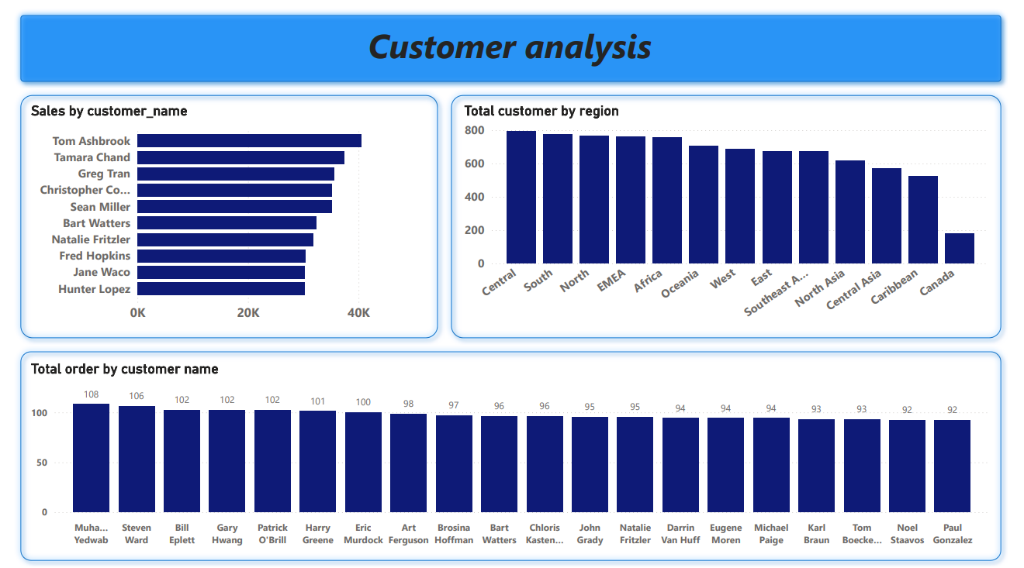
Customer Insights
Revenue is concentrated among top customers
Some customers place frequent orders
Customer base varies by region

Slide 8
Business Recommendations
Reduce excessive discounting
Focus on high-margin products
Retain top customers with loyalty programs
Improve low-performing regions

