Slide 1


Healthcare Data Cleaning & Exploratory Data Analysis
Name:- vikas prajapati
Tools: Python (Pandas, NumPy, Matplotlib, Seaborn)
Date:- 22/04/2026

Slide 2
Introduction
• Data in raw form is often messy and inconsistent
• Data cleaning is a crucial step before analysis
• Exploratory Data Analysis (EDA) helps understand patterns
• This project focuses on cleaning and analyzing healthcare data using Python

Slide 3
Project Objective
• Clean and preprocess raw healthcare dataset
• Handle missing and inconsistent data
• Perform EDA
• Extract meaningful insights from the dataset

Slide 4
: Dataset Overview
• The dataset contains healthcare-related records
• Includes patient and hospital information
• Key features:
• Age
• Gender
• Medical Condition
• Admission Date
• Billing Amount
• Insurance Provider
• medication

Slide 5
Data Cleaning Steps
• Removed duplicate records
• Correct name columns (name)
• Converted incorrect data types
• Standardized column names

Slide 6
Exploratory Data Analysis (EDA)
• Analyzed distribution of data
• Identified trends and patterns
• Compared different variables
• Used visualization for better understanding

Slide 7
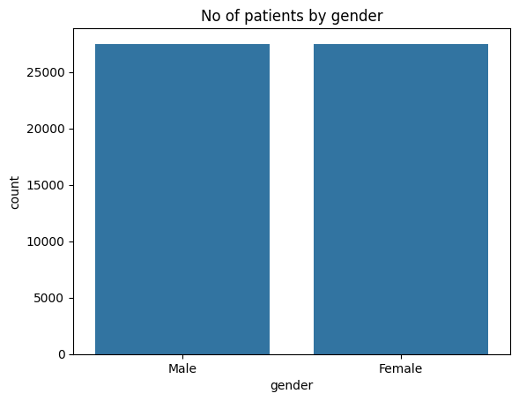
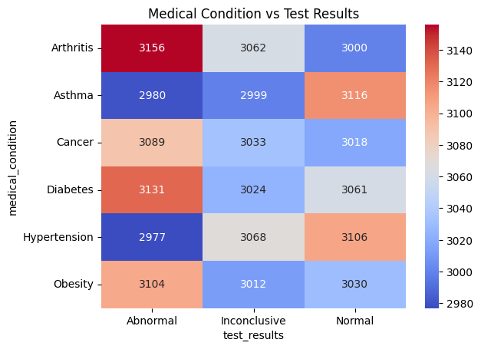
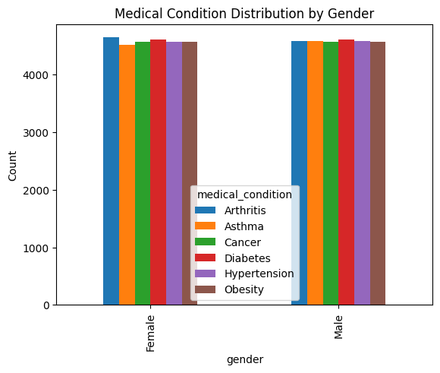
Visualizations Used
• Bar Charts → No patient by gender & Medical condition distribution by gender
• Heat map →Medical condition by test result

Slide 8
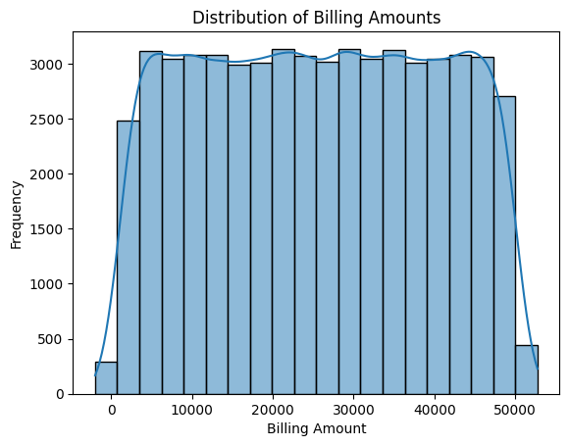
Analysis Performed
• Age distribution of patients
• Gender-wise analysis
• Most common diseases
• Billing amount trends

Slide 9
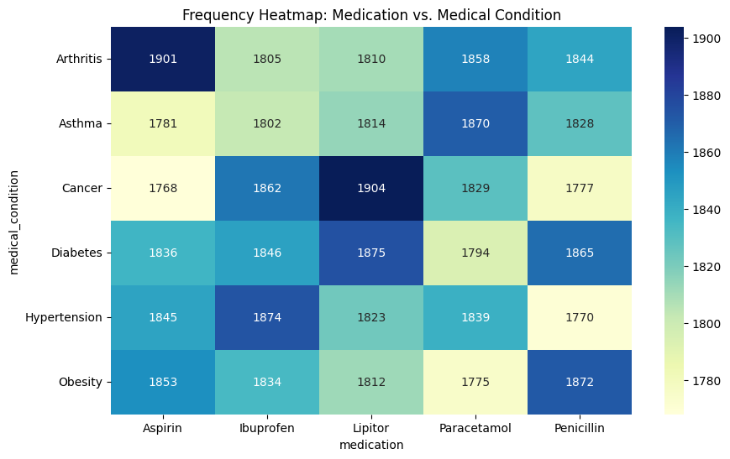
Key Insights
Majority of patients belong to age group :- 50 – 65
• Most Used Medication per Condition:-
- Arthritis → Highest with Aspirin (1901)
- Asthma → Highest with Paracetamol (1870)
- Cancer → Highest with Lipitor (1904)
- Diabetes → Highest with Lipitor (1875)
- Hypertension → Highest with Ibuprofen (1874)
- Obesity → Highest with Penicillin (1872)
Billing amount is higher for ___obesity patients
Data cleaning improved analysis accuracy

Slide 10
Conclusion
• Data cleaning is essential before analysis
• EDA helps uncover useful insights
• Python is effective for data analysis tasks
• Clean data leads to better decision-making

