Slide 1
Gradle
Atul Kahate

Slide 2
What is Gradle?
It is a build automation tool
Helps in
Compiling
Running tests
Packaging (Jar/War/Docker)
Deploy and run (Local/On Cloud)
Before Gradle
Ant
Maven

Slide 3
Convention over Configuration
Gradle (Like Maven) asks us to follow a folder structure (convention) rather than we defining it (configuration)
Makes life simple, since every project will have the same folder structure
MyProject
src/main/java
src/main/resources
src/test/java
src/test/resources

Slide 4
Configuration file
Gradle uses Groovy or Kotlin scripts for configuration, unlike Maven (which uses XML)
Called as DSL (Domain Specific Language)
The file used for configuration is build.gradle

Slide 5
Incremental Build
Does not rebuild the whole thing again – makes it very fast

Slide 6
Gradle Installation
Search for Install gradle
Gradle needs Java 1.8 or higher
Click on Install manually
Download the file
Extract in your local drive
Add
gradle directory (C:\gradle-7.4.1) to a new variable GRADLE_HOME and
the bin folder (C:\gradle-7.4.1\bin) to path
Check gradle version gradle -v on the command prompt

Slide 7
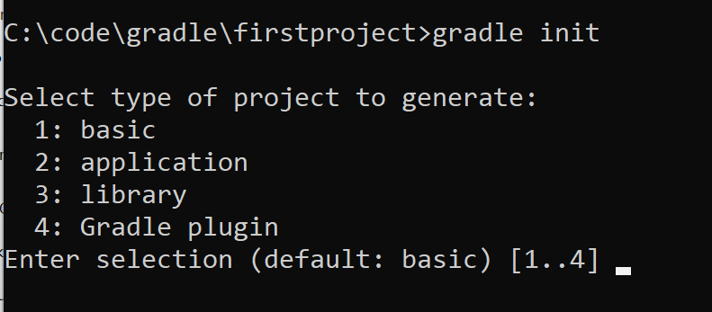
First gradle project
Create a folder (e.g. C:\code\gradle\firstproject)
To make this folder a gradle project, we need to add a file build.gradle
Instead of manually creating this file, open command prompt in this folder and type gradle init
Select all the defaults and proceed

Slide 8
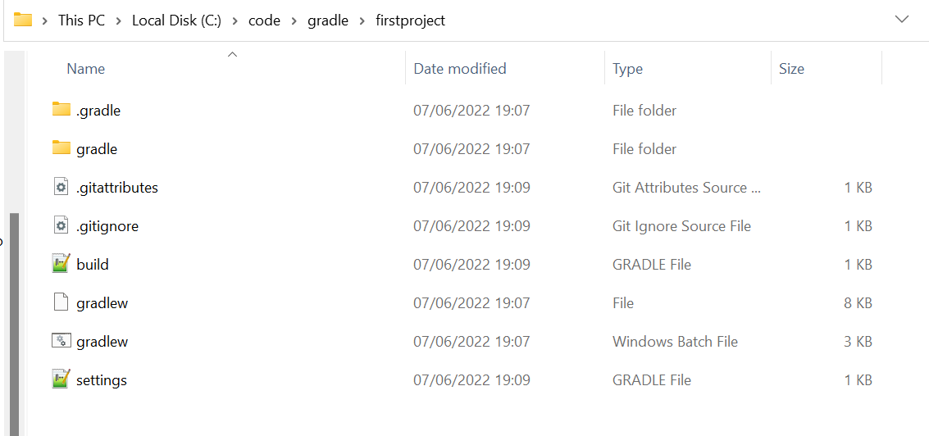
Check directory
Create a folder (e.g. C:\code\gradle\firstproject)

Slide 9
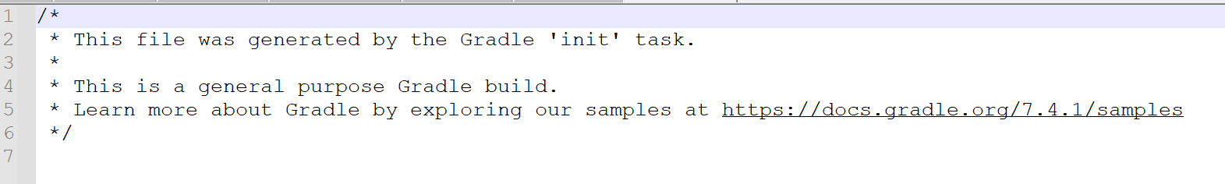
Open build.gradle – Will be empty
Go to the command prompt and type gradle tasks --all
This command looks at build.gradle file and executes the tasks mentioned there, but since the file is empty, nothing will happen

Slide 10
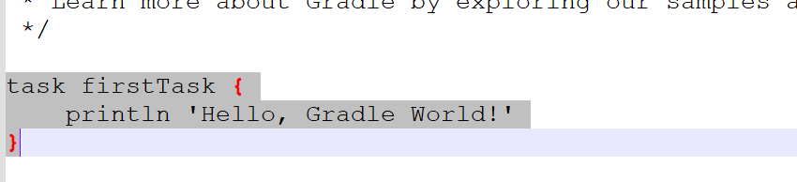
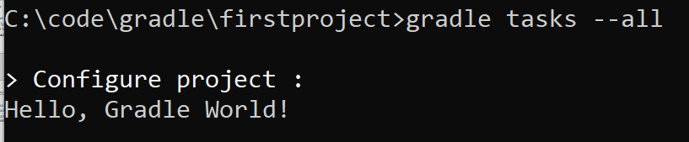
Now edit build.gradle
Add
task firstTask {
println 'Hello, Gradle World!’
}
Run gradle tasks –all again

Slide 11
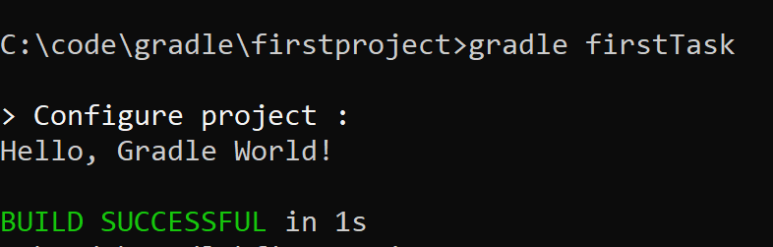
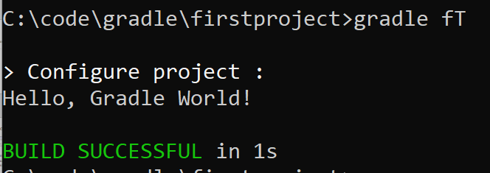
Execute the Task
gradle firstTask
Gradle fT
(camelCase)

Slide 12
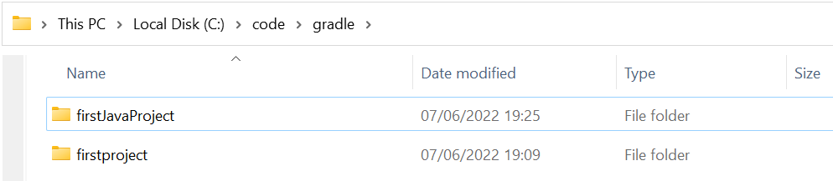
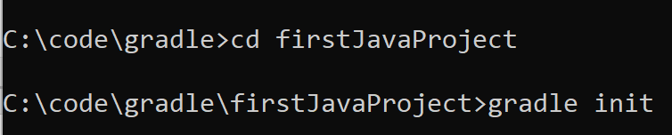
Create a Java Project
Create a new folder firstJavaProject inside C:\code\gradle
Options, respectively: 2, 3, 1, 1, no, 1, Source package: com.cdac.gradle

Slide 13
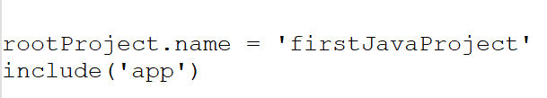
app Concept
Open settings.gradle file in this Java project
We will see that app is a directory in the project
That contains src, and then the Java source code
Also, App.java is created inside
Similarly, the test folder also contains code for testing

Slide 14
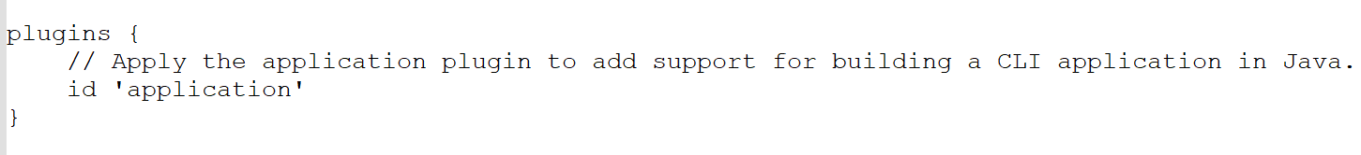
Build and Run – 1
On the command prompt, type gradle tasks --all
It will show us all the possible tasks – note that they are different from the earlier non-Java project
Where are they coming from? Open build.gradle file (C:\code\gradle\firstJavaProject\app)
The following plugin knows how to build a Java application

Slide 15
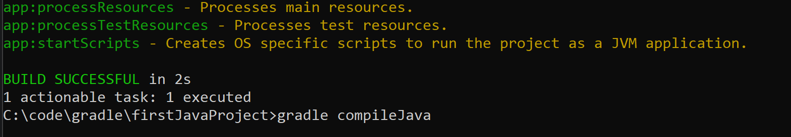
Build and Run – 2
On the command prompt, type gradle compileJava
Note that a build folder has been created, with compiled code
If we want to do a build again, gradle clean

Slide 16
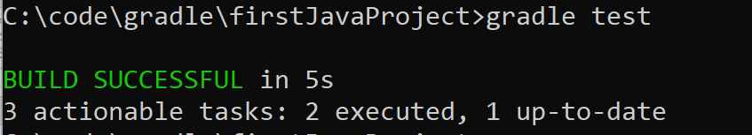
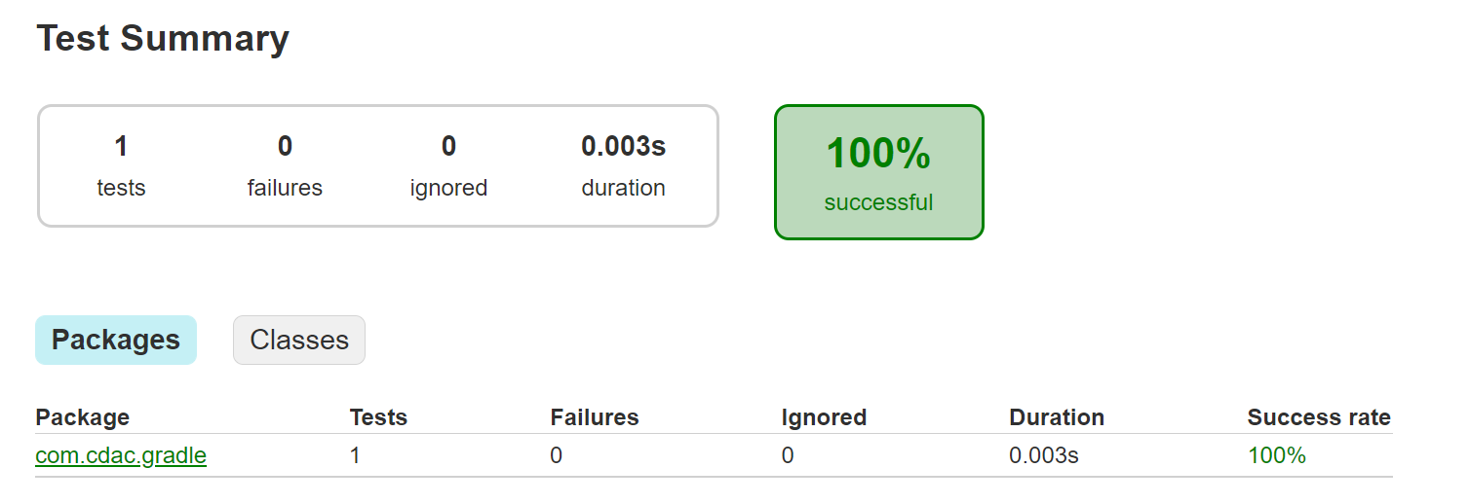
Test – 1
gradle test
How to verify? Open C:\code\gradle\firstJavaProject\app\build\reports\tests\test\index.html file

Slide 17
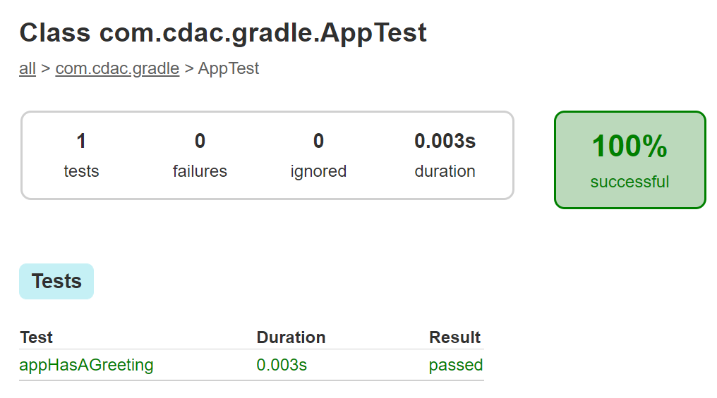
Test – 2
Click on the link and the next link
Let us try to make it fail the test

Slide 18
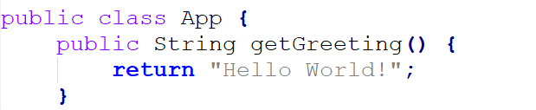
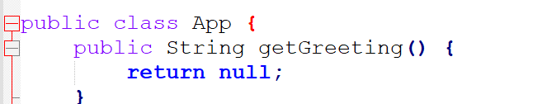
App.java
Change the return statement to return null
Original Modified
Again test – Next slide

Slide 19
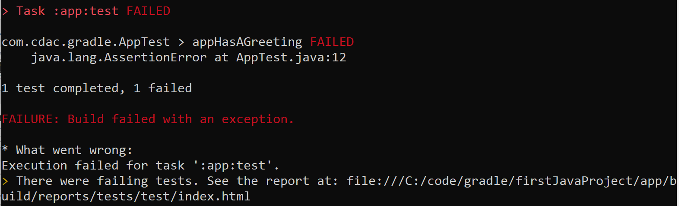
Test fails
gradle test

Slide 20
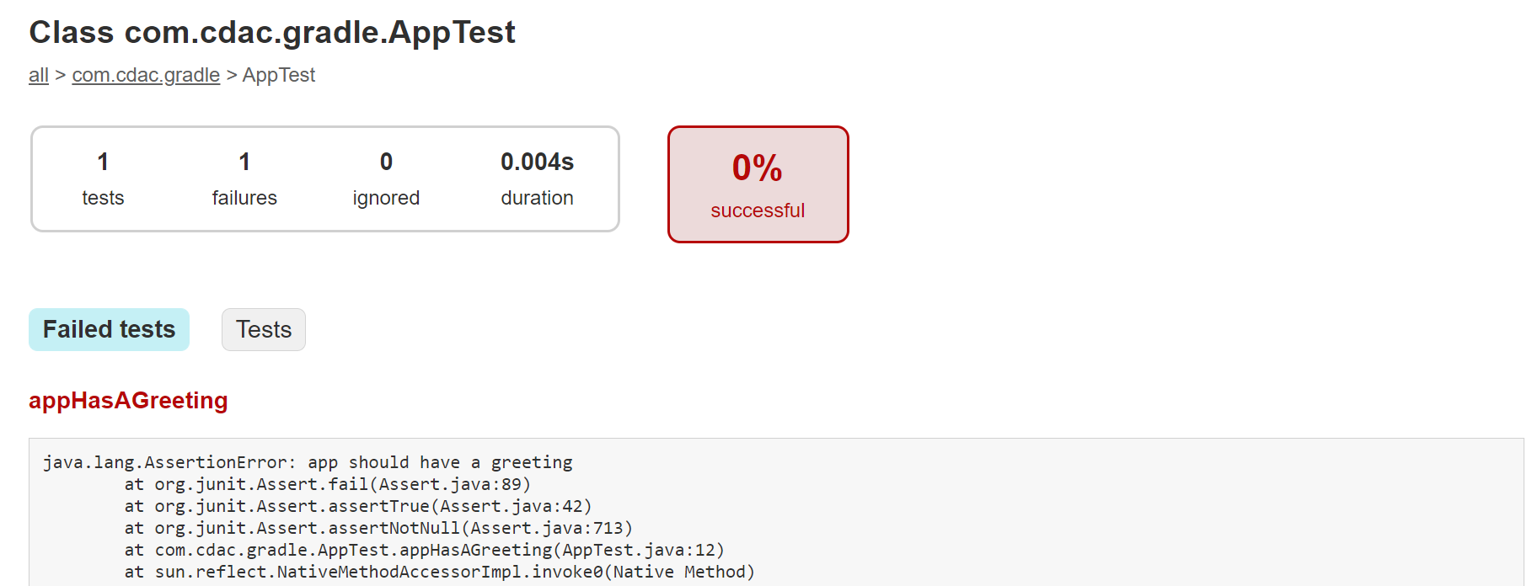
Recheck the test results file

Slide 21
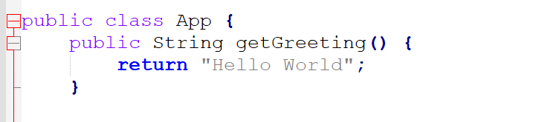
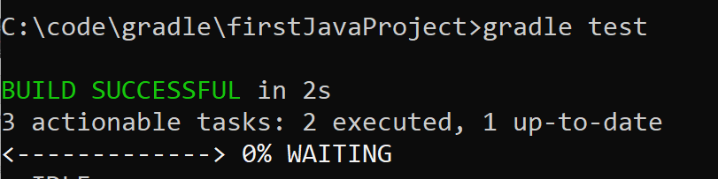
Retest with a correct greeting

Slide 22
Accepting User Input

Slide 23
Problem
Accept 3 integers from the user and display the result of the multiplication of the smallest and the largest numbers

Slide 24
Point to Note
By default, the system.in of your Gradle build is not wired up with the system.in of the run (JavaExec) task.
So, gradle compileJava will work, but when you do gradle run, it will exit with an error Exception in thread "main" java.util.NoSuchElementException
How to fix?
The gradle.build file should have an additional task:
run {
standardInput = System.in
}

Slide 25
Java Code
/*
* This Java source file was generated by the Gradle 'init' task.
*/
package com.cdac.acts;
import java.util.Scanner;
public class App {
public static void main(String[] args) {
int n1, n2, n3;
Scanner sc = new Scanner (System.in);
System.out.println ("Enter the first number: ");
n1 = sc.nextInt ();
System.out.println ("Enter the second number: ");
n2 = sc.nextInt ();
System.out.println ("Enter the third number: ");
n3 = sc.nextInt ();
int largest = 0;
int smallest = 0;
if (n1 >= n2 && n1 >= n3)
largest = n1;
else
if (n2 >= n3 && n2 >= n3)
largest = n2;
else
largest = n3;
if (n1 <= n2 && n1 <= n3)
smallest = n1;
else
if (n2 <= n3 && n2 <= n3)
smallest = n2;
else
smallest = n3;
System.out.println (largest * smallest);
}
}

Slide 26
build.gradle
/*
* This file was generated by the Gradle 'init' task.
*
* This generated file contains a sample Java application project to get you started.
* For more details take a look at the 'Building Java & JVM projects' chapter in the Gradle
* User Manual available at https://docs.gradle.org/7.4.1/userguide/building_java_projects.html
*/
plugins {
// Apply the application plugin to add support for building a CLI application in Java.
id 'application'
}
repositories {
// Use Maven Central for resolving dependencies.
mavenCentral()
}
dependencies {
// Use JUnit test framework.
testImplementation 'junit:junit:4.13.2'
// This dependency is used by the application.
implementation 'com.google.guava:guava:30.1.1-jre'
}
application {
// Define the main class for the application.
mainClass = 'com.cdac.acts.App'
}
run {
standardInput = System.in
}

Slide 27
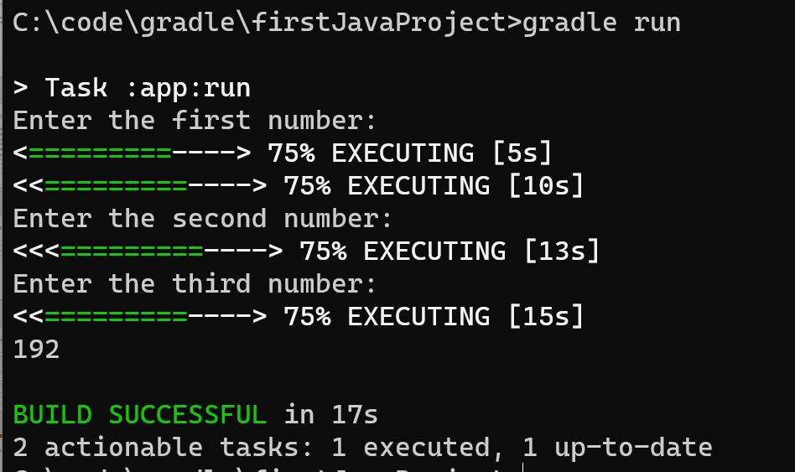
Test

Slide 28
Creating a JAR File

Slide 29
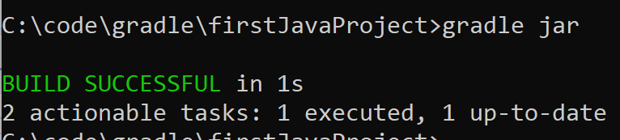
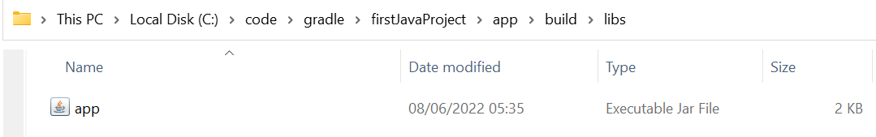
Create a jar file
gradle jar

Slide 30
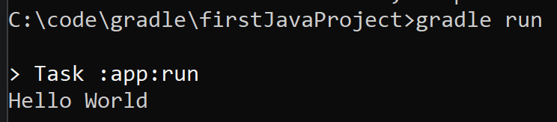
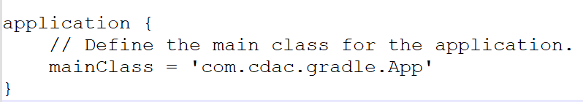
Execute the code
gradle run
How does this happen? Look at build.gradle, so it knows which class in the Jar file to use

Slide 31
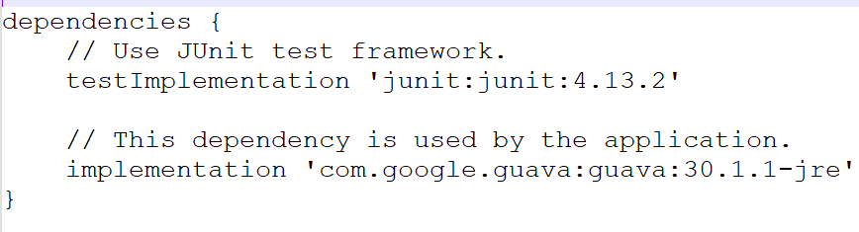
Dependencies in build.gradle file
The libraries our code needs to compile and execute the project
implementation 'com.google.guava:guava:30.1.1-jre’
Says that gradle will use this JRE – so if this statement is missing, gradle will try to use the default JRE installed on our computer
Three parts, separated by colon → com.google.guava – group id, guava – artifact/library id, 30.1.1-jre – version
Implementation and testImplementation – called as configurations
testImplementation: Use only for compile the test and execute test, implementation: for compile and execute

Slide 32
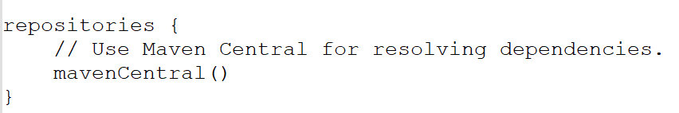
Repositories in build.gradle file
Specifies where the libraries mentioned in dependencies come from
mavenCentral is the most popular library for this purpose (https://mvnrepository.com/repos/central)
Gradle downloads and hashes them to store them locally (See C:\Users\akaha\.gradle\caches\modules-2\files-2.1)
This way, gradle does not have to download them every time we do a fresh build – it can use the locally cached versions to make the process much faster
If the dependencies mentioned have other dependencies, they are automatically downloaded, too

Slide 33
Type of dependencies in gradle
Implementation: Available for compiling and running the code
testImplementation: Available for compiling and running the testing code
compileOnly: Available during compilation only, not during run-time
runtimeOnly: Available during execution only
Similarly, we have testCompileOnly and testRuntimeOnly

Slide 34
Build a Web Application using Gradle

Slide 35
Application flow
index.html
Ask the user to click on a link called as Get Coupon
CouponServlet.java
Show the coupon code to the user
User needs to copy the coupon code

Slide 36
Application flow
index.html
User enters the coupon code and clicks on the Get Discount button
DiscountServlet.java
Prepare the discount message to be sent to the user
response.jsp
Show the discount message to the user

Slide 37
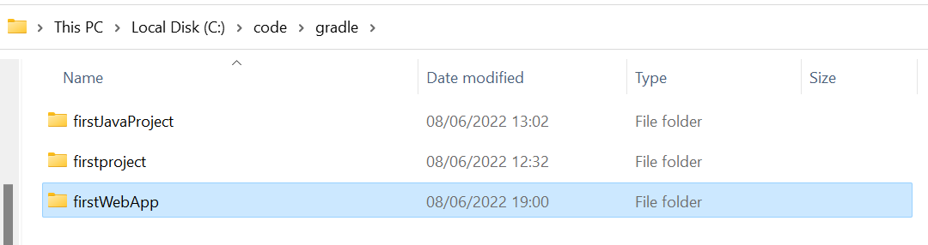
Creating the folder
Create a folder firstWebApp inside C:\code\gradle
Run gradle init inside the folder’s command prompt
Select 2, 3, 1, 1, no, 1, firstWebApp, com.cdac.ditiss

Slide 38
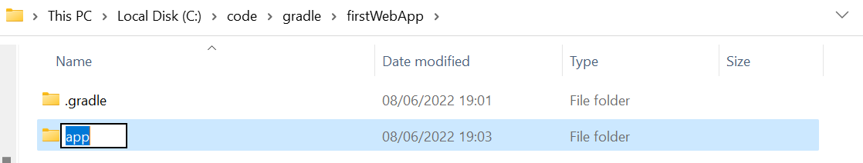
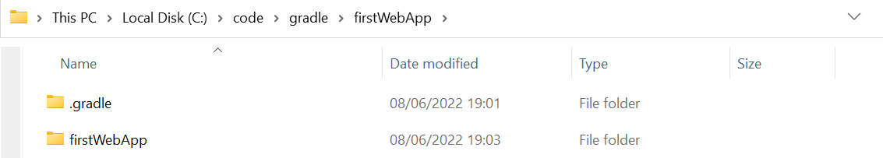
Folder changes – 1
Rename the app folder to firstWebApp
Open settings.gradle file and change the include declaration to: include(‘firstWebApp’) instead of include(‘app’)
Delete App.java from C:\code\gradle\firstWebApp\firstWebApp\src\main\java\com\cdac\ditiss folder
Go to C:\code\gradle\firstWebApp\firstWebApp\src\test\java and delete the entire remaining part (com.cdac…..)

Slide 39
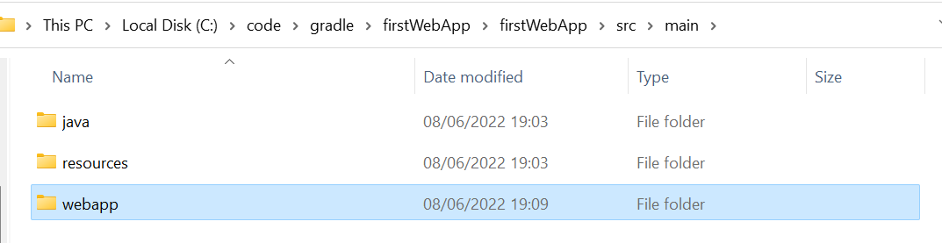
Folder changes – 1
Create a folder webapp under main

Slide 40
Create Servlet skeleton (C:\code\gradle\firstWebApp\firstWebApp\src\main\java\com\cdac\ditiss\CouponServlet.java)
package com.cdac.ditiss;
import java.io.IOException;
import java.io.PrintWriter;
import javax.servlet.ServletException;
import javax.servlet.annotation.WebServlet;
import javax.servlet.http.HttpServlet;
import javax.servlet.http.HttpServletRequest;
import javax.servlet.http.HttpServletResponse;
public class CouponServlet extends HttpServlet {
protected void doGet(HttpServletRequest request, HttpServletResponse response)
throws ServletException, IOException {
}
}

Slide 41
C:\code\gradle\firstWebApp\firstWebApp\src\main\webapp\index.html
(Hint: Use https://www.tutorialspoint.com/online_html_editor.php, it will also show you the result of the code as you create it)
<!DOCTYPE html>
<html>
<title>Home</title>
<head>
</head>
<body>
<a href=“coupon">Get Coupon</a>
<form>
Coupon Code: <input type = "text" name = "coupon">
<input type = "submit" value = "Get Discount“ method = "post" action ="discount" >
</form>
</body>
</html>

Slide 42

What should happen when the user views this page?
When user clicks on the link, we want it to go to CouponServlet, by calling its get method
It should return a coupon code
So, make changes to CouponServlet (See next slide)

Slide 43
CouponServlet.java – Note the changes
import …
…
@WebServlet("/coupon")
public class CouponServlet extends HttpServlet {
protected void doGet(HttpServletRequest request, HttpServletResponse response)
throws ServletException, IOException {
response.getWriter().print ("SUPERSALE");
}

Slide 44
Now the discount logic – Again edit index.html, changes highlighted
<!DOCTYPE html>
<html>
<title>Home</title>
<head>
</head>
<body>
<a href=“coupon">Get Coupon</a>
<form method = "post" action = “discount">
Coupon Code: <input type = "text" name = "coupon">
<input type = "submit" value = "Get Discount">
</form>
</body>
</html>

Slide 45
DiscountServlet (C:\code\gradle\firstWebApp\firstWebApp\src\main\java\com\cdac\ditiss\DiscountServlet.java)
package com.cdac.ditiss;
import java.io.IOException;
import java.io.PrintWriter;
import javax.servlet.ServletException;
import javax.servlet.annotation.WebServlet;
import javax.servlet.http.HttpServlet;
import javax.servlet.http.HttpServletRequest;
import javax.servlet.http.HttpServletResponse;
@WebServlet("/discount")
public class DiscountServlet extends HttpServlet {
protected void doPost(HttpServletRequest request, HttpServletResponse response)
throws ServletException, IOException {
String coupon = request.getParameter ("coupon");
request.setAttribute ("discount", "Discount for coupon " + coupon + " is 50%");
request.getRequestDispatcher ("response.jsp").forward (request, response);
}
}

Slide 46
Create C:\code\gradle\firstWebApp\firstWebApp\src\main\webapp\response.jsp
<%@ page contentType = "text/html" %>
<!DOCTYPE html>
<html>
<head>
<title>Discount Page</title>
</head>
<body>
<h3> ${discount} </h3>
</body>
</html>

Slide 47
Create WAR file
Open build.gradle file and it should look like this after your changes:
plugins {
// Apply the application plugin to add support for building a CLI application in Java.
id 'war'
}
repositories {
// Use Maven Central for resolving dependencies.
mavenCentral()
}
dependencies {
}

Slide 48
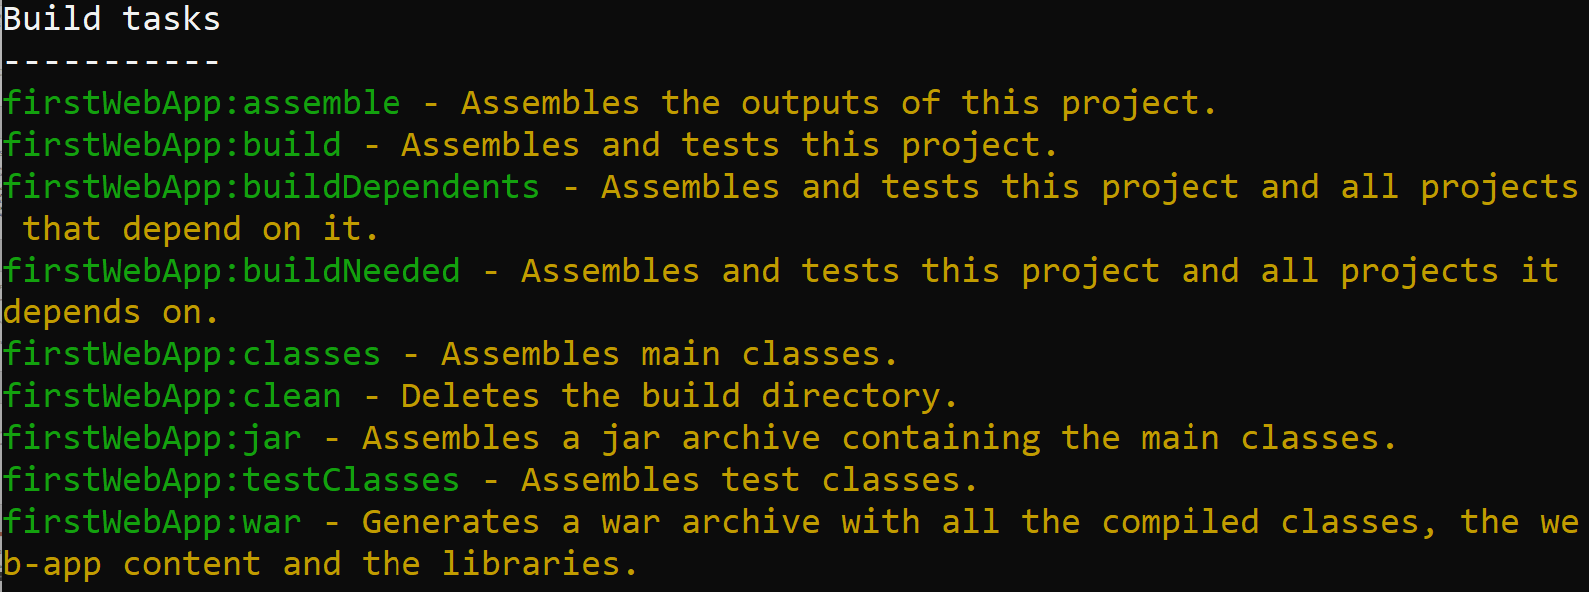
See what tasks are available
On the command prompt, gradle tasks --all and scroll all the way up

Slide 49
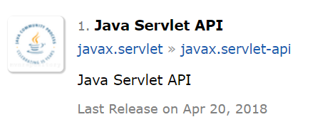
Servlet Dependency
We need library for compiling Java servlets
Search for servlet api gradle dependency in google
Select
Click on the link ‘javax.servlet-api’ above

Slide 50
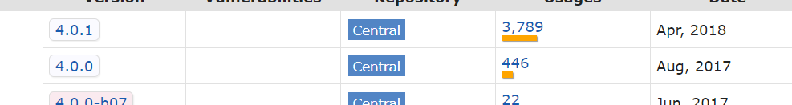
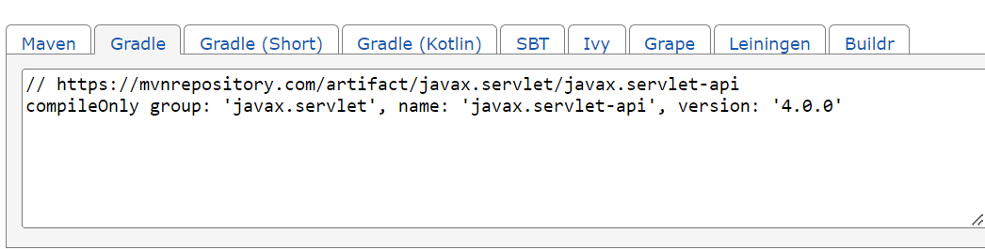
Servlet Dependency
Click on 4.0.0
Click on ‘Gradle’ – it automatically copies the dependency
Paste it inside build.gradle file and remove the comment link (See next slide)

Slide 51
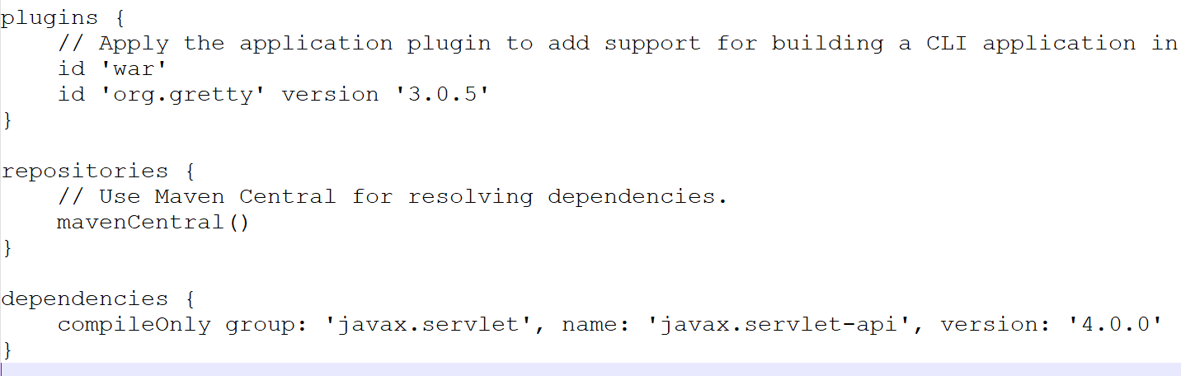
Modified build.gradle file

Slide 52
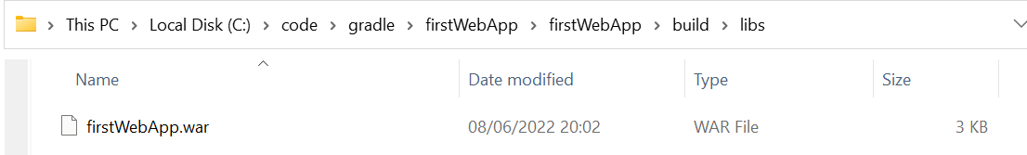
Let us create the WAR file now
Type gradle war at the command prompt

Slide 53
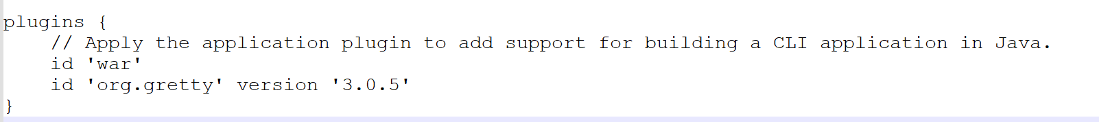
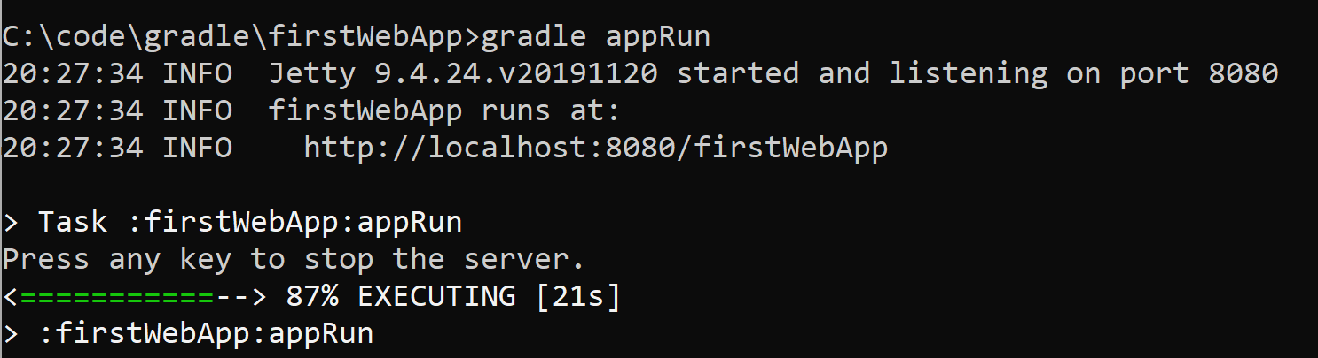
Run the app – Because this is a Web App, we need a Web Server
We can use a built-in Web server called as gretty
gradle appRun

Slide 54
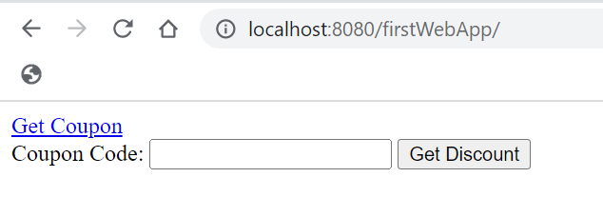
Test in the Browser
http://localhost:8080/firstWebApp/
Click on Get Coupon link
Copy the code
Come back and paste and click on Get Discount

Slide 55

Discount page

Slide 56
Exercise

Slide 57
Enhance the Coupon/Discount Application
Instead of one coupon code, show three discount codes
Depending on which coupon code the user selects, show a different discount

Slide 58
Changed CouponServlet
package com.cdac.ditiss;
import java.io.IOException;
import java.io.PrintWriter;
import javax.servlet.ServletException;
import javax.servlet.annotation.WebServlet;
import javax.servlet.http.HttpServlet;
import javax.servlet.http.HttpServletRequest;
import javax.servlet.http.HttpServletResponse;
@WebServlet("/coupon")
public class CouponServlet extends HttpServlet {
protected void doGet(HttpServletRequest request, HttpServletResponse response)
throws ServletException, IOException {
response.getWriter().print ("SUPERSALE DIWALISALE CHRISTMASSALE");
}
}

Slide 59
Changed DiscountServlet
package com.cdac.ditiss;
import java.io.IOException;
import java.io.PrintWriter;
import javax.servlet.ServletException;
import javax.servlet.annotation.WebServlet;
import javax.servlet.http.HttpServlet;
import javax.servlet.http.HttpServletRequest;
import javax.servlet.http.HttpServletResponse;
@WebServlet("/discount")
public class DiscountServlet extends HttpServlet {
protected void doPost(HttpServletRequest request, HttpServletResponse response)
throws ServletException, IOException {
String coupon = request.getParameter ("coupon");
int discountValue = 0;
if (coupon.equals ("SUPERSALE"))
discountValue = 10;
else if (coupon.equals ("DIWALISALE"))
discountValue = 15;
else if (coupon.equals ("CHRISTMASSALE"))
discountValue = 20;
request.setAttribute ("discount", "Discount for coupon " + coupon + " is " + discountValue + "%");
request.getRequestDispatcher ("response.jsp").forward (request, response);
}
}

