Slide 1
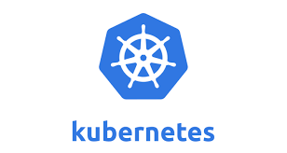

Slide 2
Kubernetes
Kubernetes is a portable, extensible open-source platform for managing containerized workloads and services.
Google open-sourced the Kubernetes project in 2014.
Kubernetes provides a container-centric management environment.

Slide 3
Kubernetes
The name Kubernetes originates from Greek, meaning helmsman or pilot.
K8s is an abbreviation derived by replacing the 8 letters “ubernete” with “8”.
With modern web services, users expect applications to be available 24/7, and developers expect to deploy new versions of those applications several times a day.

Slide 4
Kubernetes
Containerization helps package software to serve these goals, enabling applications to be released and updated in an easy and fast way without downtime.
Kubernetes helps you make sure those containerized applications run where and when you want, and helps them find the resources and tools they need to work.

Slide 5
Kubernetes Cluster
A Kubernetes cluster is a collection of hosts, storage and networking resources that Kubernetes uses to run the various workloads.

Slide 6
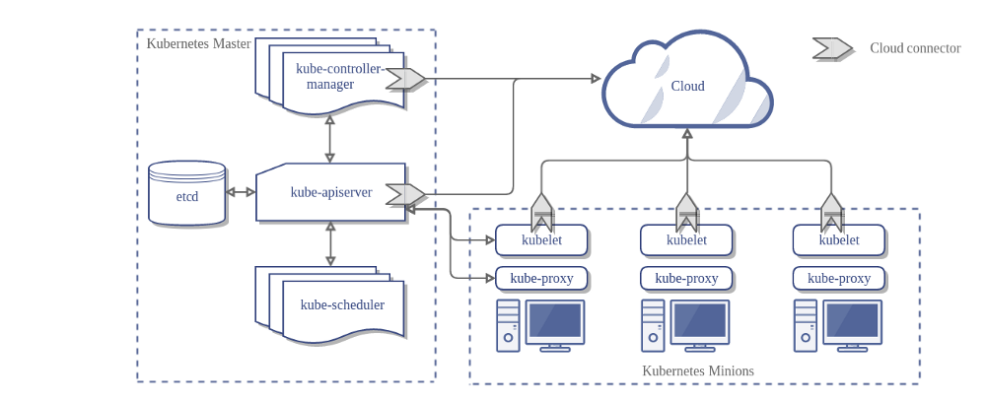
Kubernetes Architecture
Without Cloud Controller.

Slide 7
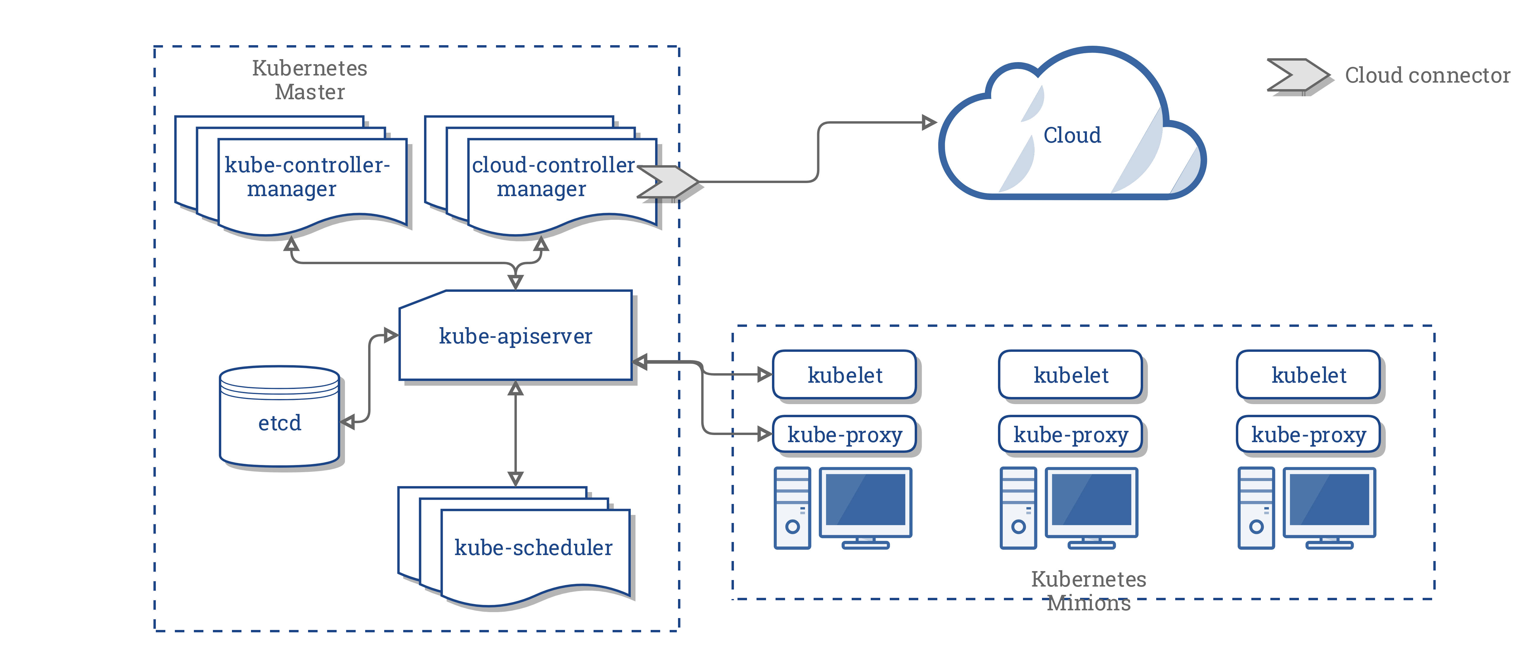
Kubernetes Architecture
With Cloud Controller..

Slide 8
Kubernetes Architecture
Master Components
Master components provide the cluster’s control plane.
Master components make global decisions about the cluster (for example, scheduling), and they detect and respond to cluster events .

Slide 9
Kubernetes Architecture
Master components can be run on any machine in the cluster.
However, for simplicity, set up scripts typically start all master components on the same machine, and do not run user containers on this machine.

Slide 10
Kubernetes Architecture
kube-apiserver
Component on the master that exposes the Kubernetes API. It is the front-end for the Kubernetes control plane.
It is designed to scale horizontally – that is, it scales by deploying more instances.

Slide 11
Kubernetes Architecture
etcd
Consistent and highly-available key value store used as Kubernetes’ backing store for all cluster data.
Kubernetes uses etcd to store all its data – its configuration data, its state, and its metadata.
Kubernetes is a distributed system, so it needs a distributed data store like etcd. etcd lets any of the nodes in the Kubernetes cluster read and write data.

Slide 12
Kubernetes Architecture
kube-scheduler
Component on the master that watches newly created pods that have no node assigned, and selects a node for them to run on.
Factors taken into account for scheduling decisions include individual and collective resource requirements, hardware/software/policy constraints, affinity and anti-affinity specifications, data locality, inter-workload interference and deadlines.

Slide 13
Kubernetes Architecture
kube-controller-manager
Component on the master that runs controllers .
Logically, each controller is a separate process, but to reduce complexity, they are all compiled into a single binary and run in a single process.

Slide 14
Kubernetes Architecture
These controllers include:
Node Controller: Responsible for noticing and responding when nodes go down.
Replication Controller: Responsible for maintaining the correct number of pods for every replication controller object in the system.
Endpoints Controller: Populates the Endpoints object (that is, joins Services & Pods).
Service Account & Token Controllers: Create default accounts and API access tokens for new namespaces.

Slide 15
Kubernetes Architecture
cloud-controller-manager
cloud-controller-manager runs controllers that interact with the underlying cloud providers.
cloud-controller-manager runs cloud-provider-specific controller loops only.
cloud-controller-manager allows the cloud vendor’s code and the Kubernetes code to evolve independently of each other.

Slide 16
Kubernetes Architecture
The following controllers have cloud provider dependencies:
Node Controller: For checking the cloud provider to determine if a node has been deleted in the cloud after it stops responding
Route Controller: For setting up routes in the underlying cloud infrastructure
Service Controller: For creating, updating and deleting cloud provider load balancers
Volume Controller: For creating, attaching, and mounting volumes, and interacting with the cloud provider to orchestrate volumes.

Slide 17
Kubernetes Architecture
Node Components
Node components run on every node, maintaining running pods and providing the Kubernetes runtime environment.
A node is a worker machine in Kubernetes, previously known as a minion.

Slide 18
Kubernetes Architecture
A node may be a VM or physical machine, depending on the cluster.
Each node contains the services necessary to run pods and is managed by the master components.
The services on a node include the container runtime, kubelet and kube-proxy.

Slide 19
Kubernetes Architecture
kubelet
An agent that runs on each node in the cluster. It makes sure that containers are running in a pod.
The kubelet takes a set of PodSpecs that are provided through various mechanisms and ensures that the containers described in those PodSpecs are running and healthy.
The kubelet doesn’t manage containers which were not created by Kubernetes.

Slide 20
Kubernetes Architecture
kube-proxy
kube-proxy is a network proxy that runs on each node in the cluster.
It enables the Kubernetes service abstraction by maintaining network rules on the host and performing connection forwarding.
kube-proxy is responsible for request forwarding.
kube-proxy allows TCP and UDP stream forwarding or round robin TCP and UDP forwarding across a set of backend functions..

Slide 21
Kubernetes Architecture
Container Runtime
The container runtime is the software that is responsible for running containers.
Kubernetes supports several container runtimes: Docker, containerd, cri-o, rktlet and any implementation of the Kubernetes CRI (Container Runtime Interface).

Slide 22
Kubernetes Architecture
Addons
Addons are pods and services that implement cluster features.
DNS
While the other addons are not strictly required, all Kubernetes clusters should have cluster DNS, as many examples rely on it.

Slide 23
Kubernetes Architecture
Cluster DNS is a DNS server, in addition to the other DNS server(s) in your environment, which serves DNS records for Kubernetes services.
Containers started by Kubernetes automatically include this DNS server in their DNS searches.
Web UI (Dashboard)
Dashboard is a general purpose, web-based UI for Kubernetes clusters. It allows users to manage and troubleshoot applications running in the cluster, as well as the cluster itself

Slide 24
Kubernetes Architecture
Container Resource Monitoring
Container Resource Monitoring records generic time-series metrics about containers in a central database, and provides a UI for browsing that data.
Cluster-level Logging
A Cluster-level logging mechanism is responsible for saving container logs to a central log store with search/browsing interface.

Slide 25
Kubernetes Components
Pod
Pods are important feature of Kubernetes.
A pod is the unit of work in Kubernetes.
Each pod contains one or more containers.
Pods are always scheduled together (always run on the same machine).

Slide 26
Kubernetes Components
Pod
All the containers in a pod have the same IP address and port space; they can communicate using localhost or standard inter-process communication.
In addition, all the containers in a pod can have access to shared local storage on the node hosting the pod.
The shared storage will be mounted on each container. .

Slide 27
Kubernetes Components
Label
Labels are key-value pairs that are used to group together sets of objects, very often pods.
This is important for several other concepts, such as replication controller, replica sets, and services that operate on dynamic groups of objects and need to identify the members of the group.

Slide 28
Kubernetes Components
There are certain restrictions by design on labels.
Each label on an object must have a unique key.
The label key must adhere to a strict syntax.
It has two parts: prefix and name.
The prefix is optional.

Slide 29
Kubernetes Components
If it exists then it is separated from the name by a forward slash (/) and it must be a valid DNS sub-domain.
The prefix must be 253 characters long at most.
The name is mandatory and must be 63 characters long at most.

Slide 30
Kubernetes Components
Names must start and end with an alphanumeric character (a-z, A-Z, 0-9) and contain only alphanumeric characters, dots, dashes, and underscores.
Values follow the same restrictions as names.

Slide 31
Kubernetes Components
Annotation
Annotations let you associate arbitrary metadata with Kubernetes objects.
Kubernetes just stores the annotations and makes their metadata available.
Unlike labels, they don't have strict restrictions about allowed characters and size limits.

Slide 32
Kubernetes Components
Label selector
Label selectors are used to select objects based on their labels.
Equality-based selectors specify a key name and a value.
There are two operators, = (or ==) and !=, for equality or inequality based on the value.
For example:
role = webserver
This will select all objects that have that label key and value.

Slide 33
Kubernetes Components
Replication controller and replica set
Replication controllers and replica sets both manage a group of pods identified by a label selector and ensure that a certain number is always up and running.
The main difference between them is that replication controllers test for membership by name equality and replica sets can use set-based selection.

Slide 34
Kubernetes Components
Kubernetes guarantees that you will always have the same number of pods running as you specified in a replication controller or a replica set.
Whenever the number drops due to a problem with the hosting node or the pod itself, Kubernetes will fire up new instances.
Note that, if you manually start pods and exceed the specified number, the replication controller will kill some extra pods.

Slide 35
Kubernetes Components
Service
Services are used to expose some functionality to users or other services.
They usually encompass a group of pods, usually identified by a label.
You can have services that provide access to external resources, or to pods you control directly at the virtual IP level.
Native Kubernetes services are exposed through convenient endpoints.

Slide 36
Kubernetes Components
Volume
Local storage on the pod is ephemeral and goes away with the pod.
Sometimes that's all you need, if the goal is just to exchange data between containers of the node, but sometimes it's important for the data to outlive the pod, or it's necessary to share data between pods.
The volume concept supports that need.

Slide 37
Kubernetes Components
There are many volume types.
Kubernetes currently directly supports following volume type.
awsElasticBlockStore
azureDisk
azureFile
cephfs
cinder
configMap
csi

Slide 38
Kubernetes Components
downwardAPI
emptyDir
fc (fibre channel)
flexVolume
flocker
gcePersistentDisk
gitRepo (deprecated)
glusterfs
hostPath
iscsi
local
nfs
persistentVolumeClaim
projected
portworxVolume
quobyte
rbd
scaleIO
secret
storageos
vsphereVolume

Slide 39
Kubernetes Components
Secret
Secrets are small objects that contain sensitive info such as credentials and tokens.
They are stored as plaintext in etcd, accessible by the Kubernetes API server, and can be mounted as files into pods that need access to them.
The same secret can be mounted into multiple pods.

Slide 40
Kubernetes Components
Kubernetes itself creates secrets for its components, and you can create your own secrets.
Another approach is to use secrets as environment variables.
Note that secrets in a pod are always stored in memory (tmpfs in the case of mounted secrets) for better security.

Slide 41
Kubernetes Components
Name
Each object in Kubernetes is identified by a UID and a name.
The name is used to refer to the object in API calls.
Names should be up to 253 characters long and use lowercase alphanumeric characters, dash (-) and dot (.).

Slide 42
Kubernetes Components
Name
If you delete an object, you can create another object with the same name as the deleted object, but the UIDs must be unique across the lifetime of the cluster.
The UIDs are generated by Kubernetes.

Slide 43
Kubernetes Components
Namespace
A namespace is a virtual cluster.
You can have a single physical cluster that contains multiple virtual clusters segregated by namespaces.
Each virtual cluster is totally isolated from other virtual clusters, and they can only communicate through public interfaces.

Slide 44
Kubernetes Components
Namespace
Note that Node objects and persistent volumes don't live in a namespace.
Kubernetes may schedule pods from different namespaces to run on the same node.
Likewise, pods from different namespaces can use the same persistent storage.

Slide 45
Minikube Installation

Slide 46
Minikube
Minikube is a tool that makes it easy to run Kubernetes locally.
Minikube runs a single-node Kubernetes cluster inside a Virtual Machine (VM) on your laptop for users looking to try out Kubernetes or develop with it day-to-day.

Slide 47
Minikube
Minikube Installation
Minikube installation on Centos 7
Disable SELINUX
vi /etc/selinux/config and change SELINUX=enforcing to SELINUX=disabled and save the file.
Disable firewalld.
systemctl disable firewalld

Slide 48
Minikube
Restart the system once.
init 6 or restart
After restart Install Oracle VirtualBox
1. yum update -y
2. yum install kernel-devel kernel-headers gcc make perl -y
3. wget https://www.virtualbox.org/download/oracle_vbox.asc
4. rpm --import oracle_vbox.asc

Slide 49
Minikube
5. wget http://download.virtualbox.org/virtualbox/rpm/el/virtualbox.repo -O /etc/yum.repos.d/virtualbox.repo
6. yum install VirtualBox-6.0
7. /usr/lib/virtualbox/vboxdrv.sh setup
8. usermod -aG vboxusers root
Install Kubectl
1. curl -LO https://storage.googleapis.com/kubernetes-release/release/$(curl -s https://storage.googleapis.com/kubernetes-release/release/stable.txt)/bin/linux/amd64/kubectl

Slide 50
Minikube
2. mv kubectl /usr/local/bin
3. chmod +x /usr/local/bin/kubectl
Install minikube
1. wget https://storage.googleapis.com/minikube/releases/latest/minikube-linux-amd64
2. mv minikube-linux-amd64 /usr/local/bin/minikube
3. chmod +x /usr/local/bin/minikube

Slide 51
Minikube
Start minikube cluster
1. minikube start
This command creates and configures a Virtual Machine that runs a single-node Kubernetes cluster. This command also configures your kubectl installation to communicate with this cluster.

Slide 52
Minikube
Check Minikube
use command minikube status

Slide 53
Minikube
Get list of minikube services
minikube service list

Slide 54
Minikube
Minikube cluster info
kubectl cluster-info

Slide 55
Minikube
Deploy nginx application on minikube
Create a pod for the application
kubectl run firstapp1 --image=nginx --port=80

Slide 56
Minikube
Create a service for the pod
kubectl expose deployment firstapp --type=NodePort
check with kubectl get pods

Slide 57
Kubernetes - Services
Although each Pod has a unique IP address, those IPs are not exposed outside the cluster without a Service.
Services allow your applications to receive traffic. Services can be exposed in different ways by specifying a type in the ServiceSpec.

Slide 58
Kubernetes - Services
ClusterIP (default) - Exposes the Service on an internal IP in the cluster. This type makes the Service only reachable from within the cluster.
NodePort - Exposes the Service on the same port of each selected Node in the cluster using NAT. Makes a Service accessible from outside the cluster using <NodeIP>:<NodePort>. Superset of ClusterIP.

Slide 59
Kubernetes - Services
LoadBalancer - Creates an external load balancer in the current cloud (if supported) and assigns a fixed, external IP to the Service. Superset of NodePort.
ExternalName - Exposes the Service using an arbitrary name (specified by externalName in the spec) by returning a CNAME record with the name. No proxy is used. This type requires v1.7 or higher of kube-dns.

Slide 60
Minikube
Get info about the services
kubectl get services
Find node ip with minikube ip

Slide 61
Minikube
Access the service

Slide 62
Minikube
Dashboard
To access the Kubernetes Dashboard, run this command in a shell after starting Minikube to get the address:
1. minikube dashboard

Slide 63
Minikube
Dashboard

Slide 64
Minikube
Delete service and deployment

Slide 65
Minikube
Stop minikube cluster
Delete minikube cluster

Slide 66
Deploy Kubernetes Cluster - Centos 7

Slide 67
Deploy Kubernetes Cluster
The following steps will configure a 3 node Kubernetes cluster.
One node will be the master and other 2 nodes will be the worke nodes (minions).
You can use physical servers or virtual servers to perform this practical.
For all nodes minimum 2 processors are recommended

Slide 68
Deploy Kubernetes Cluster
Allocate 2 to 4 GB RAM based on the configuration.
Perform the following tasks on all the nodes which will be part of the kubernetes cluster.
Install Centos on all the nodes and update the OS.
Configure IP address and hostname. (If you are using virtual machines then configure network adapter for bridged mode.)

Slide 69
Deploy Kubernetes Cluster
Update the hosts file with IP address and hostname for each node.
Similarly disable SELINUX. Edit the /etc/selinux/config file and change SELINUX=Enforcing to SELINUX=disabled and save the file
Give setenforce 0 command. (Its zero and not O)

Slide 70
Deploy Kubernetes Cluster
Enable br_netfilter kernel module
Give the following commands
modprobe br_netfilter
echo '1' > /proc/sys/net/bridge/bridge-nf-call-ip6tables
echo '1' > /proc/sys/net/bridge/bridge-nf-call-iptables
To make these settings permanent, create following file and add following parameters.
vi /etc/sysctl.d/k8s.conf and add
net.bridge.bridge-nf-call-ip6tables = 1
net.bridge.bridge-nf-call-iptables = 1

Slide 71
Deploy Kubernetes Cluster
Disable Swap
Give command swapoff -a to disable swap immediately.
To permanently disable swap edit /etc/fstab file and put a # infront of the line that mounts swap partition.

Slide 72
Deploy Kubernetes Cluster
Install Docker
Install following packages first. The packages may be already installed based on installation type selected.
yum install -y yum-utils device-mapper-persistent-data lvm2
Then install docker.
yum install docker -y

Slide 73
Deploy Kubernetes Cluster
Check Docker version installed.
The docker version installed should be minimum 1.13.0.

Slide 74
Deploy Kubernetes Cluster
Check the cgroup driver used by the docker.
Make sure the Cgroup driver is systemd.
Now you are ready to install kubernetes packages.
Configure the kubernetes repository first.

Slide 75
Deploy Kubernetes Cluster
Go to the yum.repos.d directory cd /etc/yum.repos.d
create a file vi kubernetes.repo and add following lines
[kubernetes]
name=Kubernetes
baseurl=https://packages.cloud.google.com/yum/repos/kubernetes-el7-x86_64
enabled=1
gpgcheck=1
repo_gpgcheck=1
gpgkey=https://packages.cloud.google.com/yum/doc/yum-key.gpg https://packages.cloud.google.com/yum/doc/rpm-package-key.gpg

Slide 76
Deploy Kubernetes Cluster
Now install the kubernetes packages
yum install -y kubelet kubeadm kubectl
Start and enable docker service
systemctl start docker
systemctl enable docker
Start and enable kubelet service
systemctl start kubelet
systemctl enable kubelet

Slide 77
Deploy Kubernetes Cluster
You have to perform all these earlier steps on all the nodes which will participate in the kubernetes cluster.

Slide 78
Deploy Kubernetes Cluster
Initialize the Kubernetes Cluster
Perform the following steps only on the node which will perform as a master node in the cluster.
Configure following firewall rules
firewall-cmd --permanent --add-port=6443/tcp
firewall-cmd --permanent --add-port=2379-2380/tcp
firewall-cmd --permanent --add-port=10250/tcp
firewall-cmd --permanent --add-port=10251/tcp
firewall-cmd --permanent --add-port=10252/tcp
firewall-cmd --permanent --add-port=10255/tcp
firewall-cmd --reload

Slide 79
Deploy Kubernetes Cluster
Now start cluster initialization using followng command.
kubeadm init
Once the command completes successfuly, it will display a join token that you need to execute on the worker nodes to join them as nodes in the cluster,
Copy this join token in a file and save it for later use on the nodes.

Slide 80
Deploy Kubernetes Cluster
Copy and configure the admin token to root user home directory so as to manage the kubernetes cluster.
mkdir -p $HOME/.kube
sudo cp -i /etc/kubernetes/admin.conf $HOME/.kube/config
sudo chown $(id -u):$(id -g) $HOME/.kube/config

Slide 81
Deploy Kubernetes Cluster
Add te network plugin for kubernetes.
There are several network pluggins are available, but here we use weave network plugin.
export kubever=$(kubectl version | base64 | tr -d '\n')
kubectl apply -f "https://cloud.weave.works/k8s/net?k8s-version = $kubever"

Slide 82
Deploy Kubernetes Cluster
Now the master node is ready.
To make sure master is working correctly use following commands.
The status of all the services should be running.

Slide 83
Deploy Kubernetes Cluster
The following command will display only the master node entry.
Also check with following command.

Slide 84
Deploy Kubernetes Cluster
Add nodes to the cluster
Perform following steps on the nodes which will join the cluster as a worker node.
copy the join token stored in a file on the master node to the worker node.
You can use scp command to copy file to all the worker nodes.

Slide 85
Deploy Kubernetes Cluster
Once the file is copied execute the join command.
Execute the command on all the worker nodes.
Now check on master node whether the worker nodes are successfully added.

Slide 86
Deploy Kubernetes Dashboard
The kubernetes cluster is ready now.
To install web UI for kubernetes cluster (dashboard) use following command
kubectl apply -f https://raw.githubusercontent.com/kubernetes/dashboard/master/aio/deploy/recommended/kubernetes-dashboard.yaml

Slide 87
Deploy Kubernetes Dashboard
Create a dashboard-admin.yaml file.
Add following to the file.
apiVersion: rbac.authorization.k8s.io/v1beta1
kind: ClusterRoleBinding
metadata:
name: kubernetes-dashboard
labels:
k8s-app: kubernetes-dashboard
roleRef:
apiGroup: rbac.authorization.k8s.io
kind: ClusterRole
name: cluster-admin
subjects:
- kind: ServiceAccount
name: kubernetes-dashboard
namespace: kube-system

Slide 88
Deploy Kubernetes Dashboard
Assign full admin privileges to the service account for dashboard
kubectl create -f dashboard-admin.yaml
To access dashboard only on the master node you can give the command kubectl proxy.
To access dashboard from anywhere give
nohup kubectl proxy --address="Master-node-ip" -p 443 --accept-hosts='^*$' &
Access dashboard using following URL
http://Master-node-ip:443/api/v1/namespaces/kube-system/services/https:kubernetes-dashboard:/proxy/

Slide 89
Thanks!

