Slide 1
Variable Length Subnet Mask (VLSM)

Slide 2
VLSM Concept
Early routing protocols only supported Fixed Length Subnet Masking (FLSM) where all subnets had to be the same size.
You couldn’t have a subnet with 14 hosts and another subnet with 64 hosts in the same network.
All modern routing protocols support Variable Length Subnet Masking (VLSM).
This allows us to size subnets differently according to how many hosts they have.

Slide 3
VLSM Considerations
How many locations do we have in the network?
How many hosts are in each location?
What are the IP addressing requirements for each location? (Should different departments or types of host be in different subnets?)
What size is appropriate for each subnet? (Don’t waste addresses, but leave room for growth.)

Slide 4
VLSM Example
Suppose there is an administrator that has four departments to manage.
These are sales and purchase department with 120 computers, development department with 50 computers, accounts department with 26 computers and management department with 5 computers.
If the administrator has IP 192.168.1.0/24, how can department wise IPs be allocated?

Slide 5
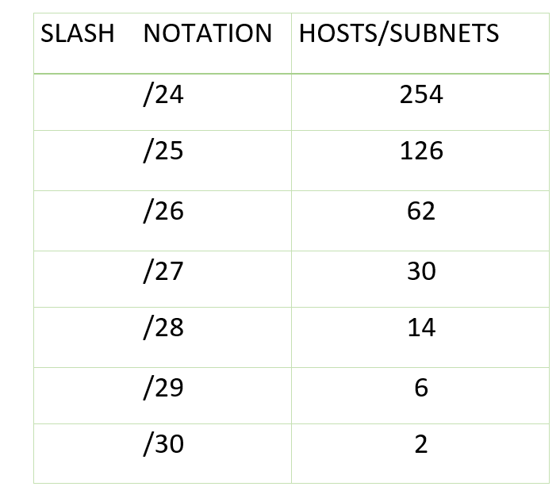
Variable Length Subnet Mask (VLSM)
Step 1: For each segment select the block size that is >= the actual requirement. Make a list of subnets possible:

Slide 6
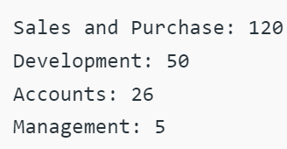
Variable Length Subnet Mask (VLSM)
Step 2: Arrange all the segments in descending order based on the block size that is from highest to lowest requirement:

Slide 7
Variable Length Subnet Mask (VLSM)
Step 3: The highest IP available has to be allocated to highest requirement, so the sales and purchase department gets 192.168.1.0/25, which has 126 valid addresses that can easily be available for 120 hosts. The subnet mask used is 255.255.255.128.
Step 4: The next segment requires an IP to handle 50 hosts. The IP subnet with network number 192.168.1.128/26 is the next highest which can be assigned to 62 hosts thus fulfilling the requirement of development department. The subnet mask used is 255.255.255.192.

Slide 8
Variable Length Subnet Mask (VLSM)
Step 5: Similarly the next IP subnet 192.168.1.192/27 can fulfill the requirements of the accounts department, as it has 30 valid hosts IP which can be assigned to 26 computers. The mask used is 255.255.255.224.
Step 6: The last segment requires 5 valid hosts IP which can be fulfilled by the subnet 192.168.1.224/29 which has the mask as 255.255.255.248 is chosen as per the requirement. The IP with the mask 255.255.255.240, could be chosen but it has 14 valid host IPs and the requirement is less in comparison so the one that is comparable with the requirement is chosen. Thus there is less IP wastage in VLSM as compared to FLSM.

Slide 9
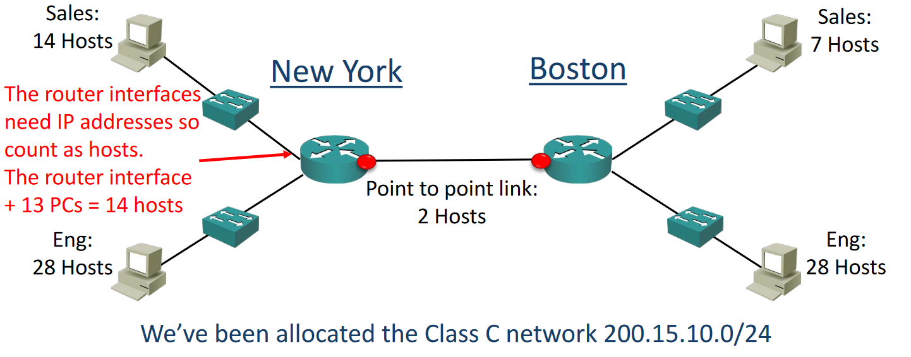
VLSM Example

Slide 10
VLSM Example – Design Steps
Find the largest segment and allocate a suitable subnet size for it.
Allocate this subnet at the start of the address space.
Continue going down the list.

Slide 11
VLSM Example – Design Steps
The Engineering departments in both sites have 28 hosts.
For our example we’ve been told that the departments will not grow and we need to use the smallest subnets possible to maximise our address space.
Calculate the optimal subnet mask for the Engineering departments.
Also determine the network and broadcast addresses that will be allocated to both Engineering departments, and the range of host addresses.

Slide 12
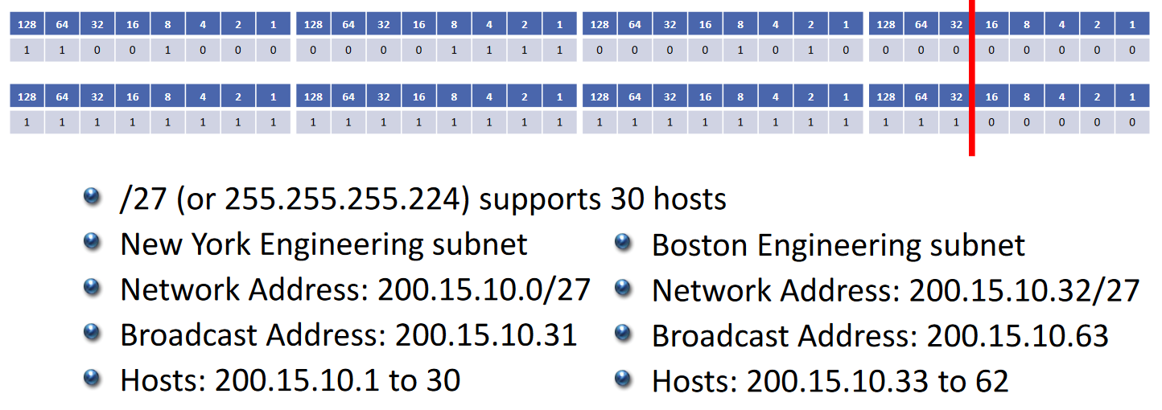
Engineering Departments
We’ve been allocated 200.15.10.0/24

Slide 13
New York Sales Department
The next largest subnet is New York Sales which requires 14 hosts.
Calculate the optimal subnet mask.
Also determine the network and broadcast addresses that we will allocate, and the range of host addresses.

Slide 14
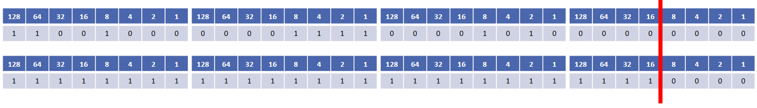
New York Sales Department
We’ve been allocated 200.15.10.0/24
New York Sales Department
We’ve been allocated 200.15.10.0/24
/28 (or 255.255.255.240) supports 14 hosts
200.15.10.0 to 200.15.10.63 are already in use by the Engineering departments, so this network address will start at 200.15.10.64
The network address goes up in values of 16, so the next one is 200.15.10.80
Our broadcast address is 200.15.10.79
Valid host addresses are 200.15.10.65 to 200.15.10.78

Slide 15
Boston Sales Department
The next largest subnet is Boston Sales which requires 7 hosts.
Calculate the optimal subnet mask.
Also determine the network and broadcast addresses that we will allocate, and the range of host addresses.

Slide 16
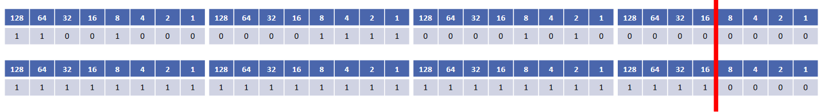
Boston Sales Department
We’ve been allocated 200.15.10.0/24
/28 (or 255.255.255.240) supports 14 hosts
/29 does not support 8 hosts! Remember to subtract 2 for the network and broadcast address
200.15.10.0 to 200.15.10.79 are already in use, so this network address will start at 200.15.10.80
The network address goes up in values of 16, so the next one is 200.15.10.96
Our broadcast address is 200.15.10.95
Valid host addresses are 200.15.10.81 to 200.15.10.94

Slide 17
Are we done?
Don’t forget the links between routers

Slide 18
New York to Boston Link
The last subnet is the link between the New York and Boston routers.
Calculate the optimal subnet mask.
Also determine the network and broadcast addresses that we will allocate, and the range of host addresses.

Slide 19
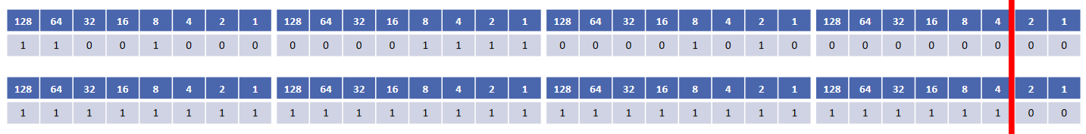
New York to Boston Link
We’ve been allocated 200.15.10.0/24
/30 (or 255.255.255.252) supports 2 hosts
200.15.10.0 to 200.15.10.95 are already in use, so our network address will be 200.15.10.96
The network address goes up in values of 4, so the next one is 200.15.10.100
Our broadcast address is 200.15.10.99
Valid host addresses are 200.15.10.97 to 200.15.10.98

