Slide 1

Centre of Development of Advanced Computing(C-DAC), Pune
Production Ready DevOps Environment
Presented by:
Aboli Waikos PRN: 230340127001
Sanika Bhanage PRN: 230340127006
Siddhesh Rupesh Kachkure PRN: 230340127010
Vikas Rai PRN: 230340127013
Indrajeet Kumar PRN: 230340127036

Slide 2
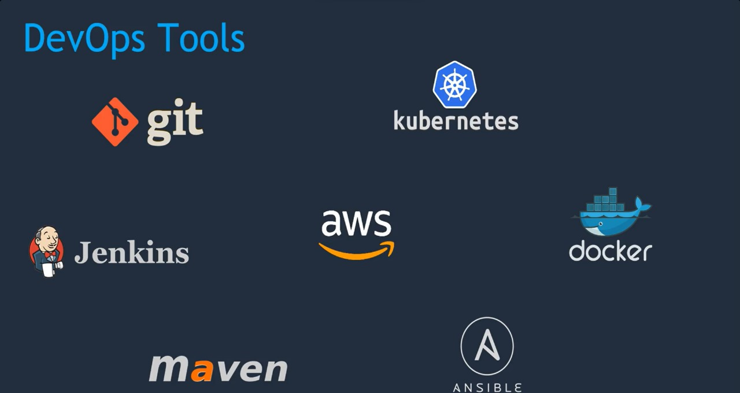

Slide 3
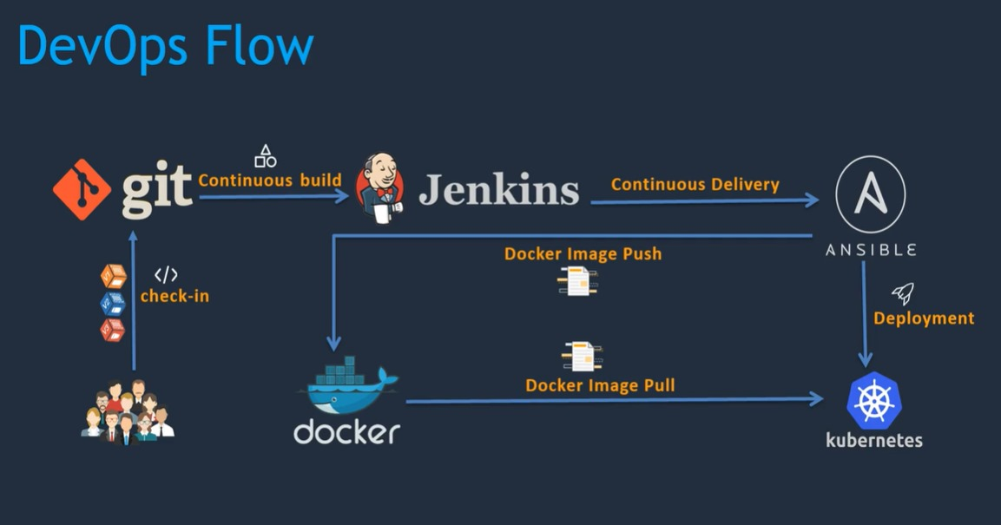

Slide 4
Understanding CI/CD Pipeline
This pipeline serves as the backbone of our software development process, enabling us to build, test, and deploy applications seamlessly. Let's dive into the details.
Understanding CI/CD Pipeline
In modern software development, a CI/CD pipeline automates various stages of our workflow. Continuous Integration (CI) focuses on merging code changes into a shared repository frequently. Continuous Deployment (CD) takes this a step further, automating the deployment of these changes to production-like environments.
2. To set up our CI/CD pipeline, we needed a toolbox of technologies.
Tools for CI/CD*-
*Git:* Our version control system to manage code changes and collaboration.-
*Jenkins:* An automation server that orchestrates our CI/CD pipeline stages.-
*Maven:* A build tool that compiles our source code and packages it into deployable artifacts.
Jenkins Installation
Git setup
Maven setup

Slide 5

MAVEN

Slide 7
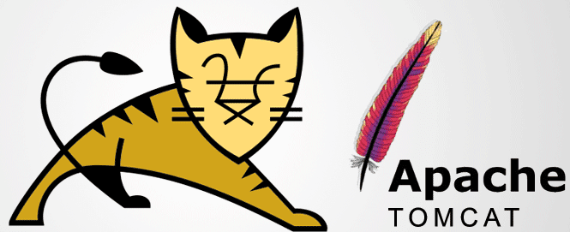
TOMCAT

Slide 8
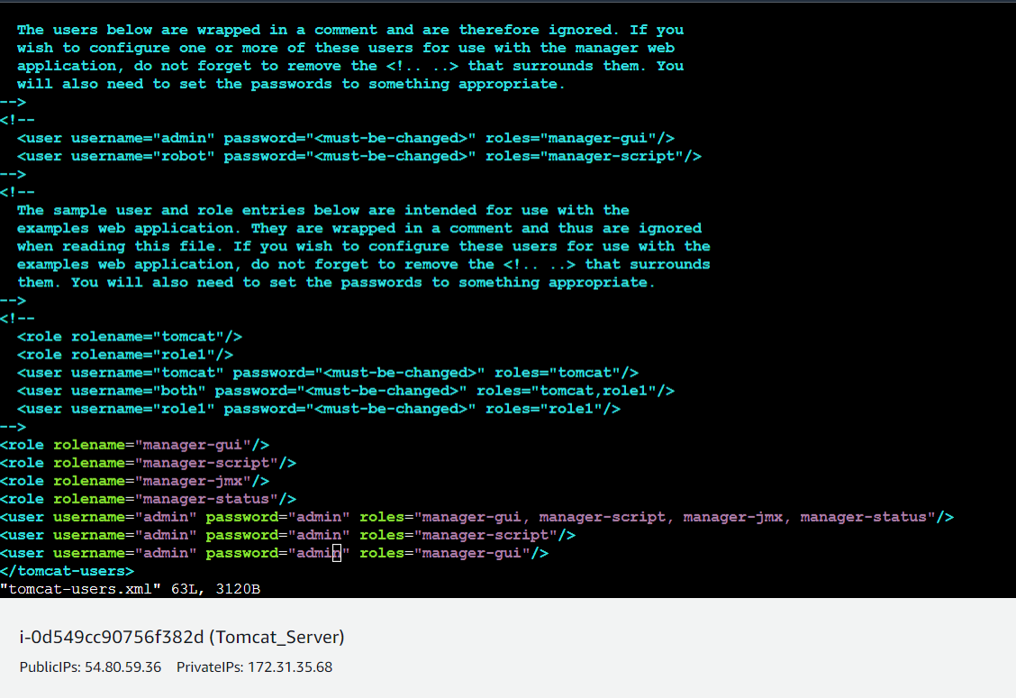
Update users information in the tomcat-users.xml file
goto tomcat home directory and Add below users to conf/tomcat-users.xml file

Slide 9
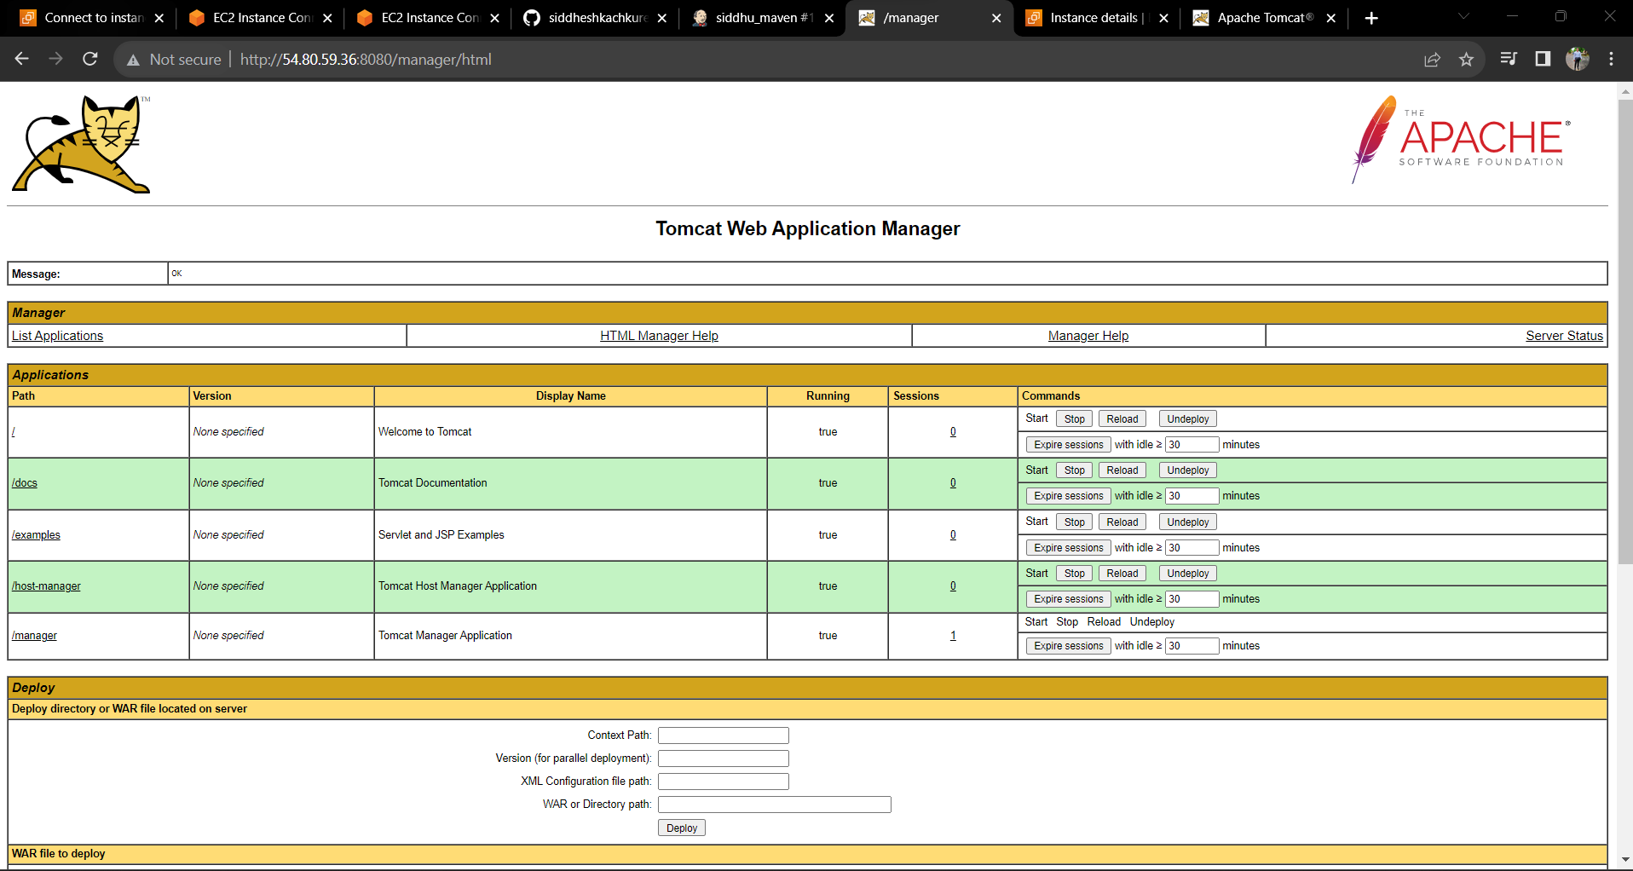

Slide 10
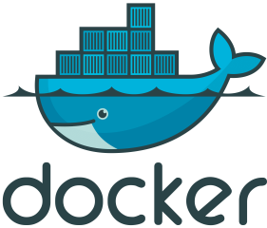
Docker
Containerization
encapsulating an application and its dependencies into a portable unit.
Docker is an open platform that enables developing, shipping, and running applications.
Docker provides the ability to package and run an application in a loosely isolated environment called a container.

Slide 11
Integrating Docker into Jenkins
Created ec2 instance
Installed docker on the ec2 instance
Create user dockeradmin & add that in docker group
Pulled docker tomcat image
Goto Jenkins server and installed required plugin “publish over SSH”.
Using that plugin integrated docker into Jenkins
7. Enable PasswordAuthentication as yes
8. Job Builded successfully.

Slide 12
Why we used Docker?
Public ip of the tomcat server changes.
We have to manually change that public ip to build the job.
Hence we required tomcat server image that will be use to build the job.

Slide 13

Ansible
Ansible is open-source IT configuration management,deployment and orchestration tool.
Aim to provide large productivity gains to a wide varity of automation challeges
Manages configuration like, RAM, management,storage,software and ip address
Management means Software updatation, add ,delete
Uses Playbook to Automate Docker related Tasks

Slide 14
Setting up Ansible Environment
Created EC2 Instance for Ansible server
Installed python and Ansibile
Created user Ansadmin to provide all previlleges
Integrated Ansible with Jenkins using Publish Over SSH plugin
Wrote a playbook to first create project image using docker and deploy on dockerhub in Ansible Sever
Wrote second playbook to pull image from docker hub and used that image to create container
Run this playbook using Jenkins only one job
By this step we could able access the web page using docker host public ip

Slide 15
Why We used Ansible ?
To create images and store it on docker registry
We used Ansible in our Project to Automate the tasks using playbook
Ansible is used to deploy configurations required for the application to run, providing a uniform environment for various stages.
To manage multiple jobs

Slide 16
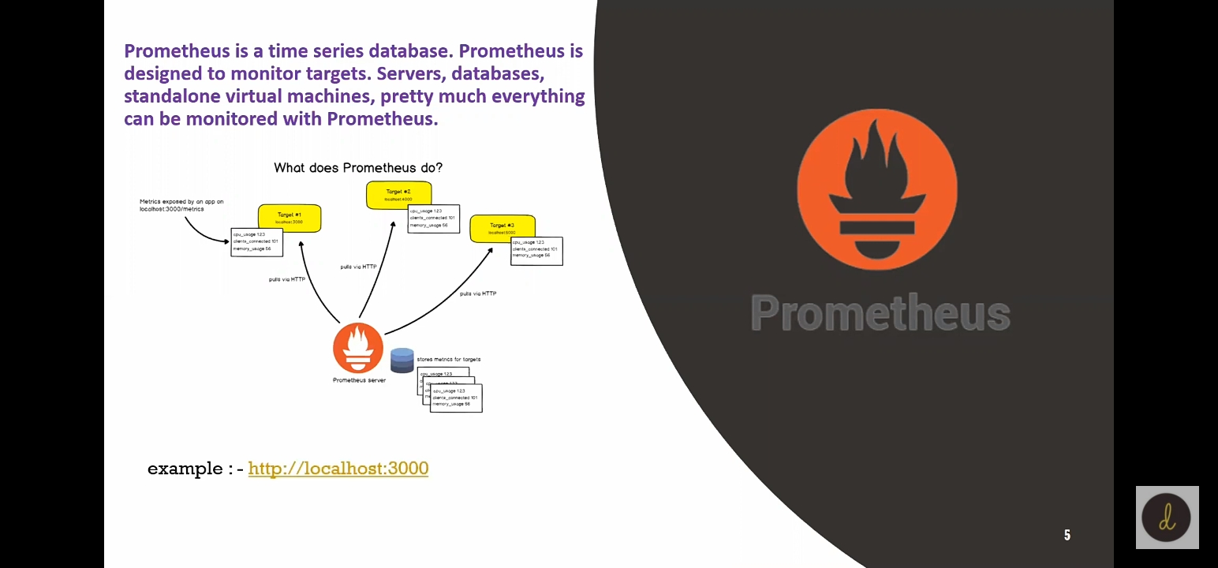
PROMETHEUS

Slide 17
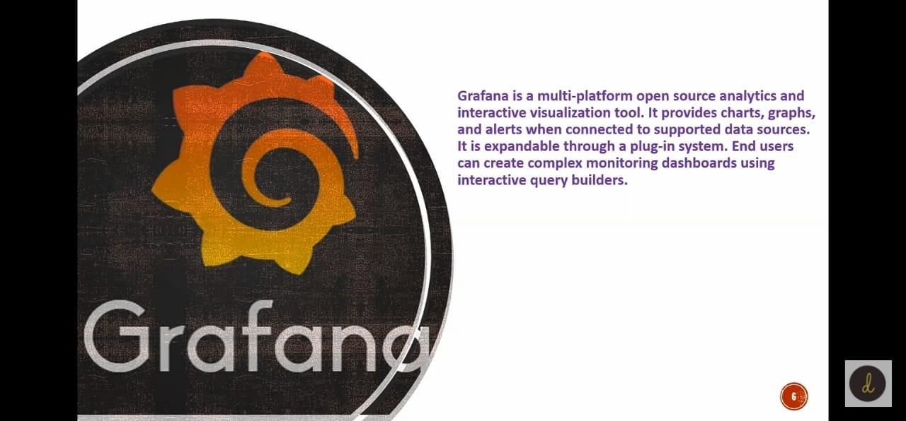
GRAFANA

Slide 18
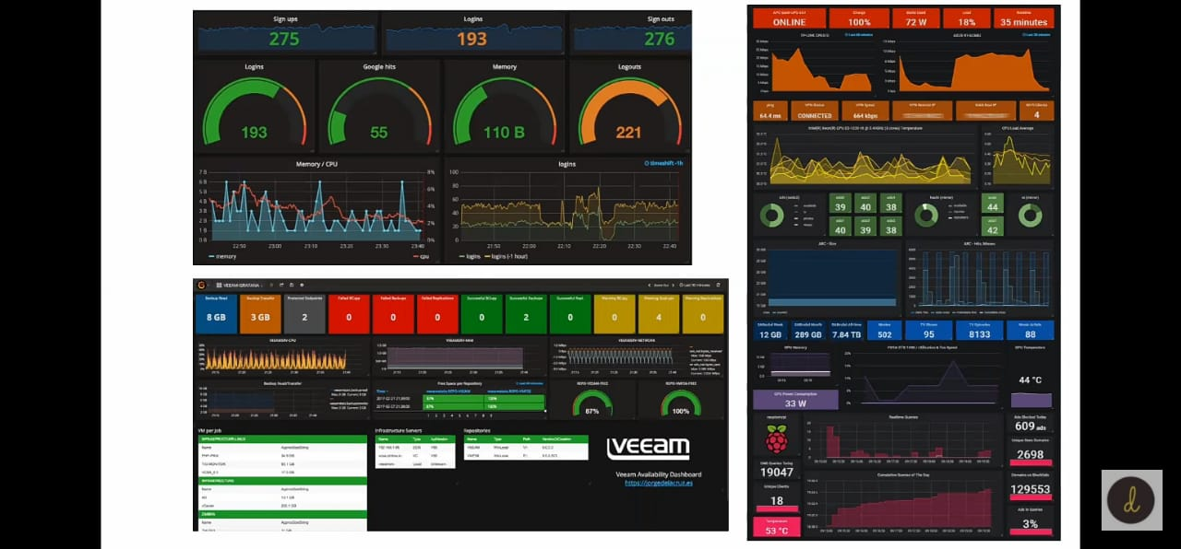

Slide 19
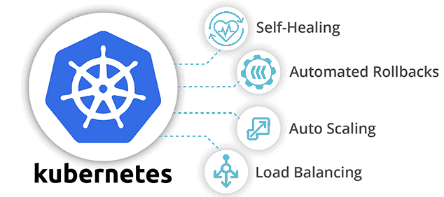
Kubernetes
By orchestrating the interplay of these DevOps tools, the CI/CD pipeline ensures a cohesive, automated, and efficient journey from code development to production deployment.
For Future development we will use kubernetes

Slide 20


