Slide 1

Introduction to iSCSI
Definition: iSCSI is a networking standard used for linking data storage devices over a network, enabling remote data transport for block-level data transfers
History: Developed by IBM and Cisco, iSCSI was ratified by the Internet Engineering Task Force in
Importance: iSCSI allows for the creation of SANs over standard LAN infrastructure, resulting in cost savings and increased scalability

Slide 2
•
Why iSCSI?
• Storage Area Networks (SANs) based on serial gigabit transports overcome the distance, performance, scalability and availability restrictions of parallel SCSI implementations.
What is iSCSI?
•
iSCSI (Internet SCSI) (1)
•
•
•
Internet SCSI (iSCSI) protocol
Defined by the IP Storage work group of the IETF
IETF RFC 3720

Slide 3
Understanding SCSI
Explanation of SCSI: It is a set of standards for physically connecting and transferring data between computers and peripheral devices
Function: SCSI is most commonly used for hard drives and tape drives but can connect a wide range of other devices
Role in iSCSI: iSCSI encapsulates SCSI commands and packages data for transport over IP networks

Slide 4
Basics of iSCSI
How iSCSI works: iSCSI packages SCSI commands into IP packets and transports them over an Ethernet connection
Key components: Initiator , Target , and LUN
Naming conventions: IQN , EUI , NAA

Slide 5
iSCSI Architecture
iSCSI employs a client-server architecture where an iSCSI initiator communicates with an iSCSI target
iSCSI session , iSCSI connection

Slide 6
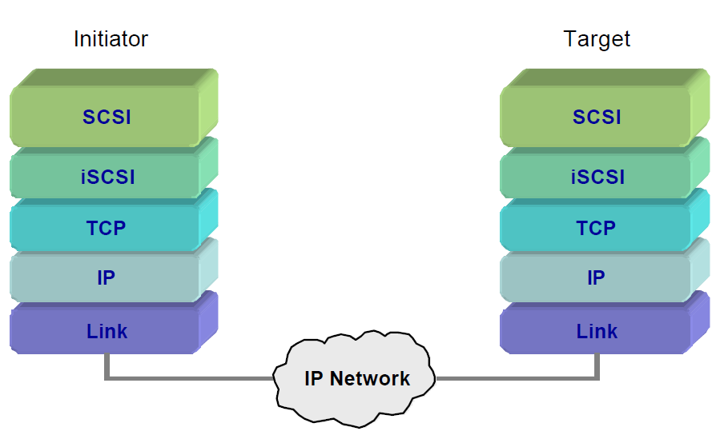
• iSCSI Protocol Layering Model
iSCSI (Internet SCSI) (2)

Slide 7
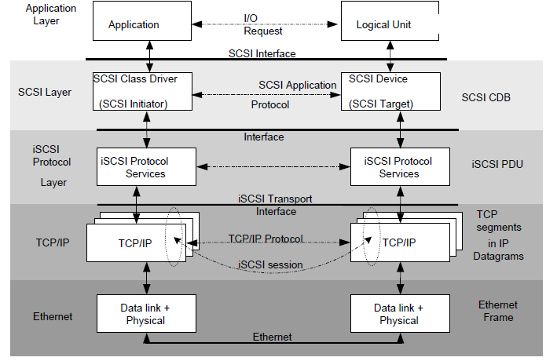
iSCSI (Internet SCSI) (3)

Slide 8
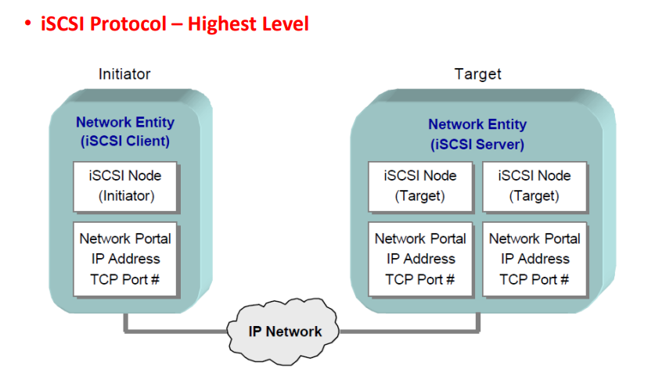
iSCSI (Internet SCSI) (4)

Slide 9
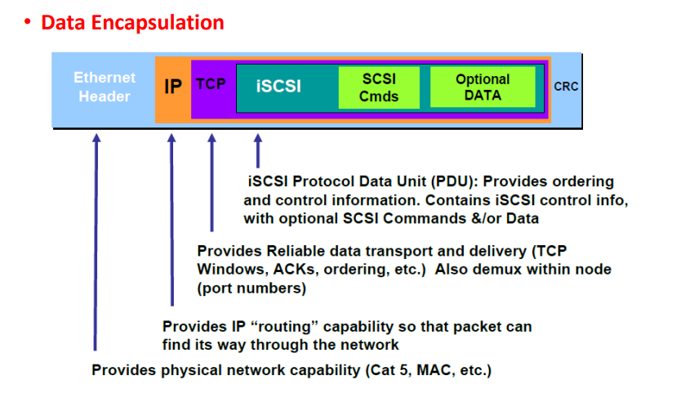
iSCSI (Internet SCSI) (5)

Slide 10
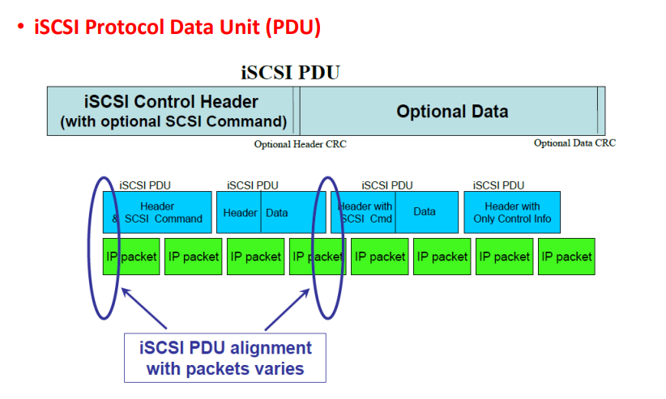
iSCSI (Internet SCSI) (6)

Slide 11
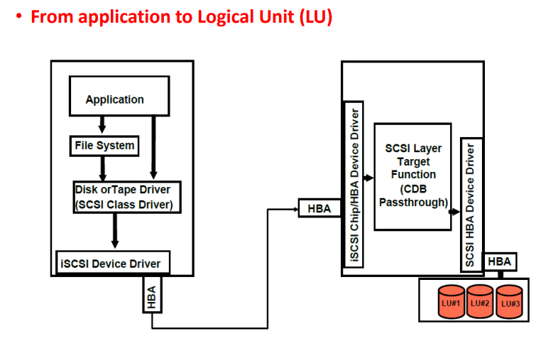
iSCSI (Internet SCSI) (6)

Slide 12
iSCSI vs. Fibre Channel
Fibre Channel Vs ISCSI cost, scalability, performance, and ease of implementation
Pros of iSCSI: Lower cost, leverages existing Ethernet infrastructure, and easy to implement
Cons of iSCSI: Lower performance compared to Fibre Channel

Slide 13
iSCSI Protocols and Commands
iSCSI protocol: It works on top of the Transport Control Protocol and allows the SCSI command to be sent end-to-end over local-area networks , wide-area networks or the Internet
Key iSCSI commands: SendTargets, Login, Logout, SCSi Command, Data-In, Data-Out
Role of TCP/IP in iSCSI: TCP/IP provides the communication path for data transfer between the initiator and target

Slide 14
Setting up iSCSI Environment
Guide on setting up an iSCSI environment including the installation of iSCSI initiator software, connecting to iSCSI targets, and managing iSCSI sessions
Different software and hardware requirements: iSCSI initiator software, Ethernet hardware, storage hardware

Slide 15
iSCSI Security
Security features: Use of Challenge-Handshake Authentication Protocol for authentication and IPSec for encryption
Explanation of how CHAP and IPSec work
Steps to enhance iSCSI security: Use VPNs, dedicated VLANs, and firewalls

Slide 16
Performance of iSCSI
Factors affecting iSCSI performance: Network bandwidth, latency, quality of service , and hardware performance
Methods to optimize iSCSI performance: Jumbo frames, multipath I/O, and link aggregation
Performance comparison with other technologies such as Fibre Channel and FCoE

Slide 17
Use Cases of iSCSI
Scenarios where iSCSI is beneficial: Small and medium businesses for cost-effective shared storage, backup and recovery solutions, virtualization storage
Benefits and drawbacks of iSCSI in these scenarios: Cost-effectiveness vs. potential performance limitations

Slide 18
Troubleshooting iSCSI
Common issues: Connection failures, slow performance, authentication errors
Solutions: Checking network connectivity, optimizing network performance, verifying CHAP credentials
Tools for troubleshooting: iSCSI initiator utilities, network monitoring tools

Slide 19
Future of iSCSI
Trends: Ongoing improvements in network technology are continually enhancing iSCSI performance
Future enhancements: Integration with cloud storage, advancements in security and performance optimization
Emerging technologies: Hyper-converged infrastructure , software-defined storage , and their potential impact on iSCSI

Slide 20
Conclusion
Recap of the key points: iSCSI is a key technology for implementing cost-effective, scalable storage solutions
Relevance: Despite challenges, iSCSI remains an essential part of modern network storage due to its ability to leverage existing infrastructure
Closing remarks: With continuous advancements, iSCSI will continue to evolve, offering improved performance and security

