Slide 1

Introduction to Logical Volume Manager
LVM is a device mapper framework provided by Linux to manage disk drives
It provides a more flexible way of managing disk space compared to traditional methods

Slide 2
Benefits of using LVM
Greater flexibility in managing storage
Easier disk space expansion and reduction
Snapshot capability

Slide 3
LVM Architecture
Disks or partitions that are made available to the LVM
The PV is where the actual data is stored in an LVM infrastructure

Slide 4
Volume Groups
Pool of disk space formed by one or more PVs
Logical Volumes are allocated to a file system or application from a VG

Slide 5

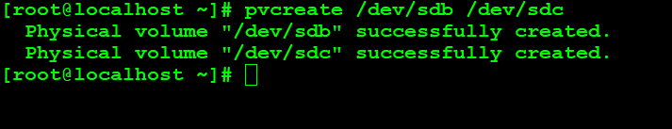
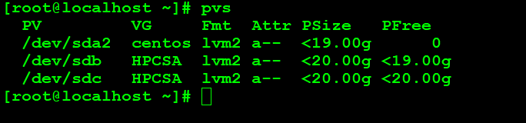
Physical Volumes
Use the pvcreate command to create a PV from a physical hard disk or a disk partition

Slide 6

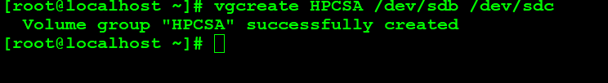
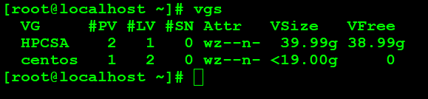
Making a Volume Group
Use the vgcreate command to create a volume group from one or more PVs

Slide 7

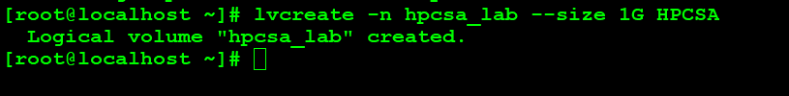
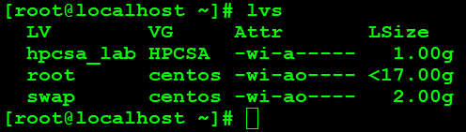
Making a Logical Volume
Use the lvcreate command to create a logical volume from a volume group

Slide 8
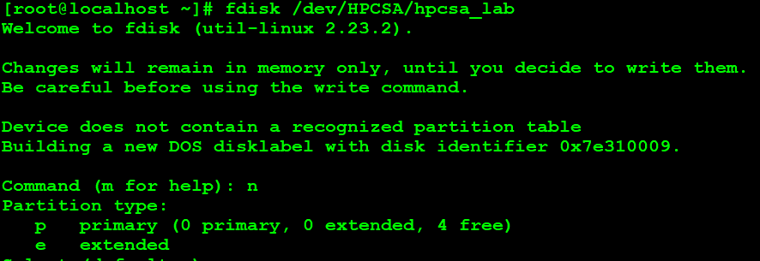

Slide 9
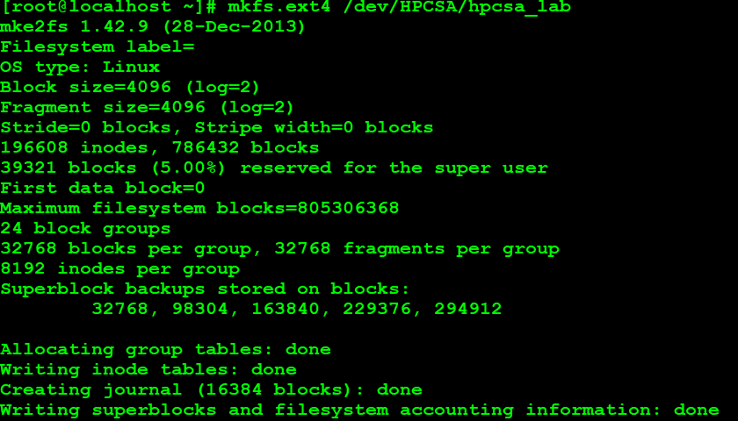

Slide 10

Extending Logical Volumes
Use the lvextend command to extend the size of a logical volume

Slide 11
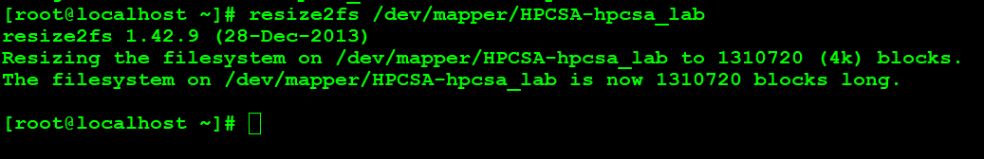
Extending Logical Volumes

Slide 12

Reducing Logical Volumes
Use the lvreduce command to reduce the size of a logical volume

Slide 13
Creating an LVM Snapshot
Use the lvcreate command to create a snapshot of a logical volume

Slide 14
Restoring from a Snapshot
Use the lvconvert command to merge a snapshot back into a logical volume

Slide 15

Creating an LVM Mirror
Use the lvconvert command to convert a logical volume into a mirror volume

Slide 16

Creating an LVM Stripe
Use the lvcreate command to create a striped logical volume

