Slide 1
Migration engineering as code
by
Vikas Rajput Gujarat Java User Group Meetup @ June Meetup, York IE 28th June 2025

Slide 2




Vikas rajput
Sr. Java Consultant, Techxplore (11 years of exp)
Loves writing blogs & sharing my experience online
VikasRajput.in
@vikasrajputin
@vikasrajputin
@vikasrajputin
An avid book reader & loves spending time with my toddler

Slide 3
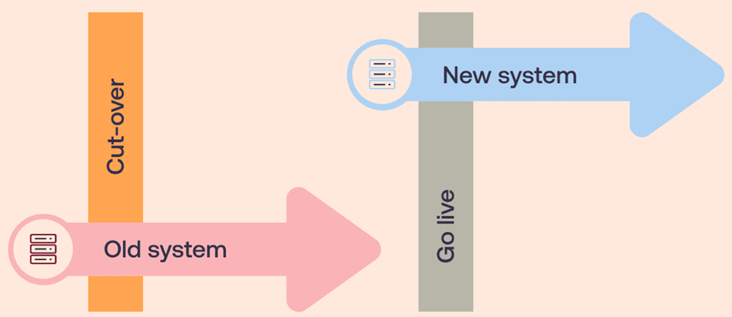
What is software migration?
Notes:
1. Presenter : Nagendra 2. Vikas Ask: Can you introduce us to Engineering Terminology used within the Industry that represents a Migration?

Slide 4
engineering side of migration
Update – vulnerability/security patching
Upgrade – New Version, No Data Change
Rewrite – Discard Existing, Startover afresh
Transpile – Switch Language
Linters – IDE Checks
SCA Fixes – Static Code Analysis
Migration – API/Schema/Data Changes
Refactoring – Create Space for New Feature
Notes:
1. Presenter : Nagendra 2. Nagendra Ask to Vikas: Having known these terms, does any specific migrations that all of us see in the Java World?

Slide 5
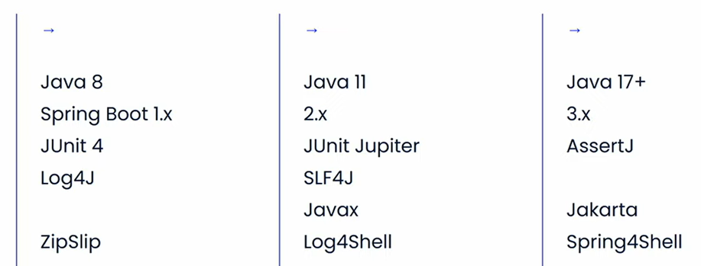
Migrations projects
Notes:
1. Presenter : Vikas 2. Nagendra Ask to Vikas : Can dwell deeper into who these Migrations are Done Currently taking a specific example say for Junit 4 to Junit 5 to understand the Manual Steps..

Slide 6
Migration as document
https://www.linkedin.com/pulse/migrating-from-java-8-11-17-rachit-mehrotra/
https://docs.oracle.com/en/java/javase/17/migrate/migrating-jdk-8-later-jdk-releases.html
https://github.com/spring-projects/spring-boot/wiki/Spring-Boot-3.0-Migration-Guide
https://www.arhohuttunen.com/junit-5-migration/
Notes:
1. Presenter : Vikas

Slide 7
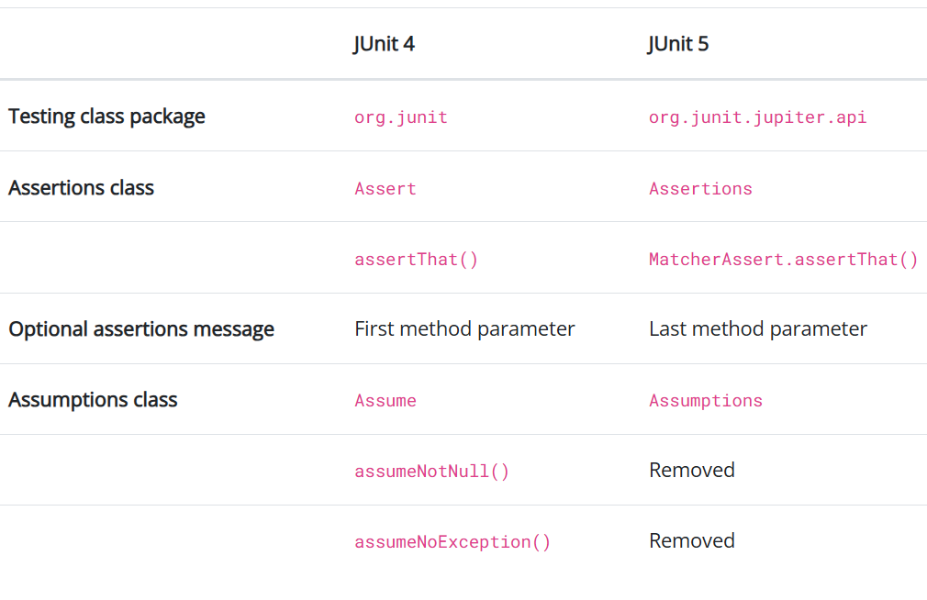
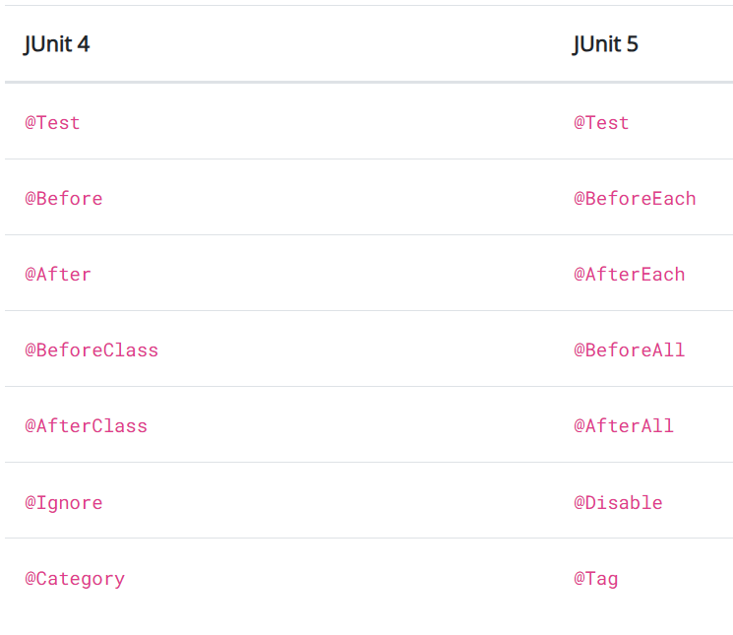
JUNIT4 TO JUNIT5
Notes:
1. Presenter : Vikas 2. Vikas Ask for Nagendra: In order to Understand Migration Engineering, Are we aware of anything close to relate too as we have majority of them are Developers..?

Slide 8
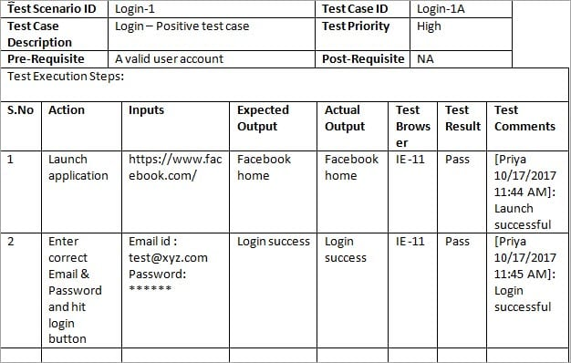
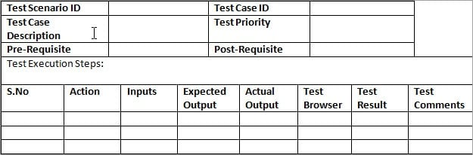
Testcase as document
Notes:
1. Presenter : Nagendra 2. Nagendra to Ask Vikas: In order to get deeper into Migration as a Code, if agree testcases as document as shown here.. Can you help me understand how testcases are converted to code.. ?

Slide 9
Tests As a Code (taaC)
Unit Tests JUnit 5, TestNG
Integration Tests testcontainers, pact
E2E Tests Cucumber
API Tests RestAssured
Functional Tests Selenium
Mutation Tests PITest
Notes:
1. Presenter: Vikas 2. Vikas Ask to Nagendra : Similar to these frameworks that makes Test Document as CODE, what frameworks exists to make Migration as CODE?

Slide 10
Migration as code – frameworks
Moderne - OpenRewrite
Google - Errorprone Refaster
Eclipse - JDT
Notes:
1. Presenter : Nagendra
2. Vikas Ask to Nagendra - What is the Purpose of these Frameworks to enable the migration easy 3. Then Nagendra Would Ask Vikas: As we have taken Test As a Code similarity to help the developers, Vikas, can you cover some value of any of these frameworks that helps developers in writing Unit Tests? 2. Nag - Can you help me understand what is the importance of Junit Framework

Slide 11
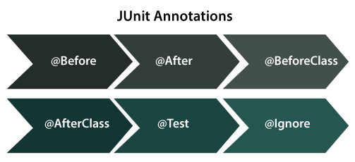
Tests as code basics
Notes:
1. Presenter Vikas 2. Vikas Ask for Nagendra – In the test world I clearly know the importance these basics provided by Junit framework, can help me understand what the similar basics in the context of Migration Engineering Frameworks?

Slide 12
JUNIT4 TO JUNIT5
Notes:
1. Presenter : Nagendra 2. Nagendra to Ask Vikas: Before I dwell into engineering side of migration, seeing this previous slide slide of yours, can you help me understand how does migration happen these days from JUnit4 to Junit 5 3. Vikas to Nagendra : Can you Summarize this approach now what forms the basis for Migration Engineereing?

Slide 13
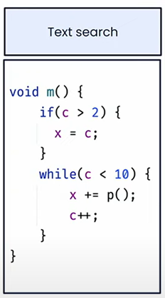
MIGRATION AS A CODE BASICS
Lexical/Text Search
Regular Expression Search
Semantic Search
Notes:
1. Presenter Nagendra

Slide 14
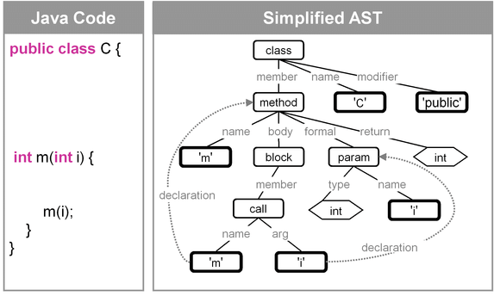
Abstract syntax tree
Notes:
1. Presenter: Nagendra
2. Vikas Ask For Nagendra: Wow, I know of Semantic Search and AST in the context of compilers etc.. Hard to visualize it in the context of Applications, can you help any visual way to comprehend this..

Slide 15
MIGRATION AS A CODE BASICS (CONT.)
Structural Search
Notes:
1. Demo-0 2. Presenter: Nagendra

Slide 16
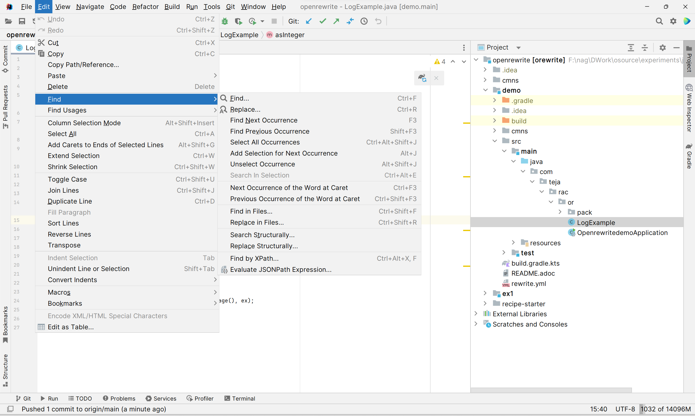
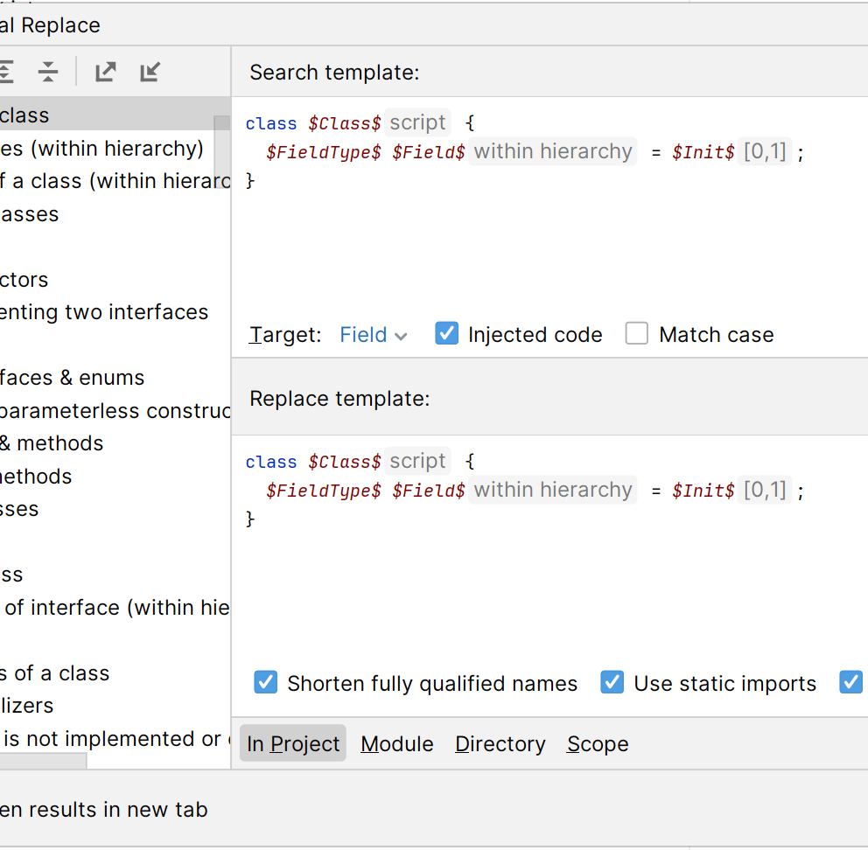
IntelliJ search structurally
Safe Code Transformation
Notes:
1. Presenter : Nagendra

Slide 17
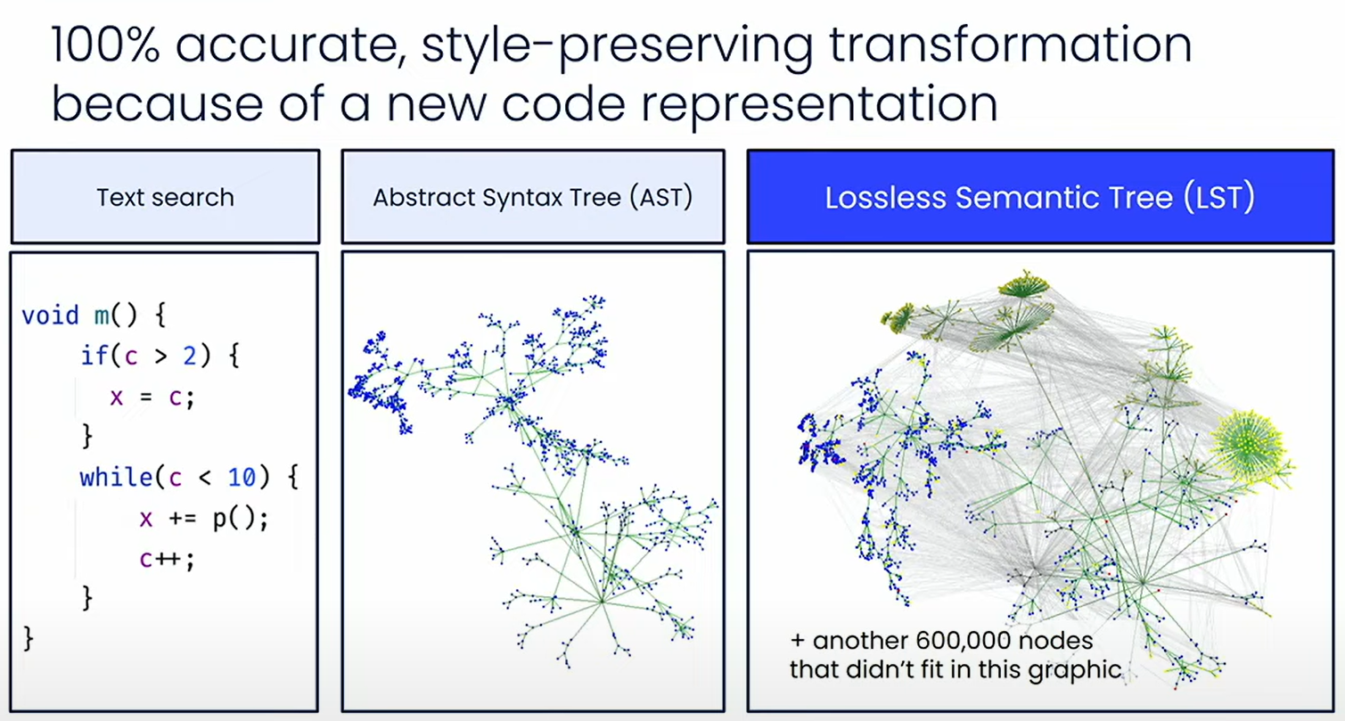
Notes:
1. Presenter : Nagendra 2. Nagendra Ask to Vikas: Vikas, as we both have been using open rewrite, can we introduce OR to Audience at 20k feet level?

Slide 18
Open-rewrite
Open-source automated refactoring tool
Based on Lossless Semantic Tree
2500+ Prepackaged Recipies
Expanding Language & Framework Support
Notes:
1. Presenter – Vikas 2. Vikas Ask to Nagendra : Can you a Basic Demos..e.g how to rename a package..

Slide 19
code run-through OpenRewrite Demo-1
Log4J 1.x to 2.x
remove all System.out
Convert System.out to logger
JDK 8 to 17
Custom Recipes
Add License Header
Package Rename
Spring 2.x to 3.x
JUnit 4 to JUnit 5
Notes:
1. Presenter: Nagendra 2. Demo 1 3. Nagendra Ask to Vikas: I have used so many existing receipes, can you show our developers if any market place exists and any classification of the same for them to find any relevant recipes to use for their work

Slide 20
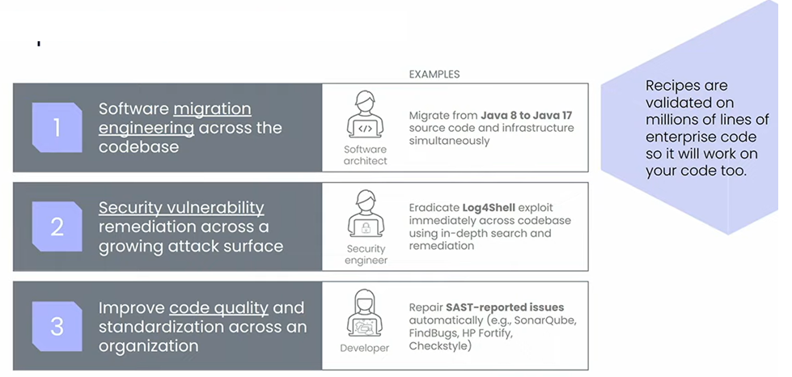
Popular OpenRewrite recipes
Notes:
1. Presenter: Vikas

Slide 21
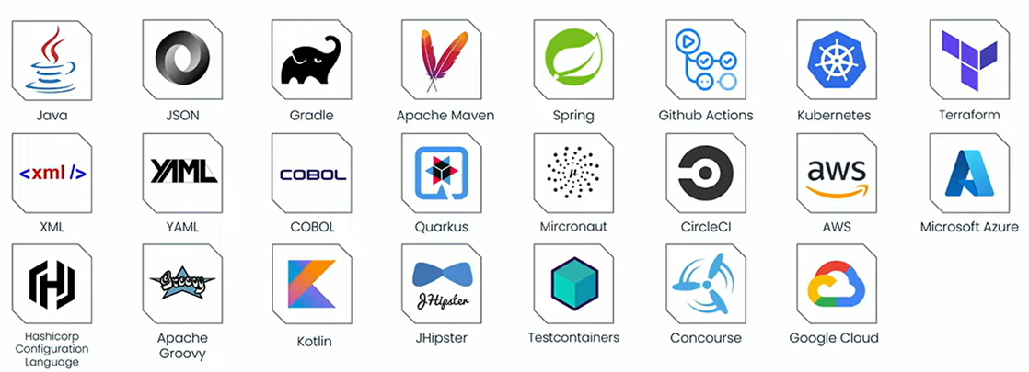
docs.openrewrite.org/recipes
Notes:
1. Presenter: Vikas
2. Nagendra Ask to Vikas: We see lots of buzz around AI, how to exploit AI in Migration. Can you explain and show any demos if any?

Slide 22

Open Rewrite + AI
Notes:
1. Presenter: Vikas 2. Vikas Ask to Nagendra : AI accuracies are low and can give different results each time you ask them with same info, can you share some usecases where you promote integration of OR with AI?

Slide 23
References
https://www.youtube.com/watch?v=q-Le1dx2-t8
https://www.youtube.com/watch?v=o3rMdXR2bIU
https://www.youtube.com/watch?v=Vv-54qhnndU
https://www.youtube.com/watch?v=G824962s4MI
Notes:
1. Presenter : Nagendra 2. Vikas to Nagendra: Can you pl. summaries takeaways to our developers?

Slide 24
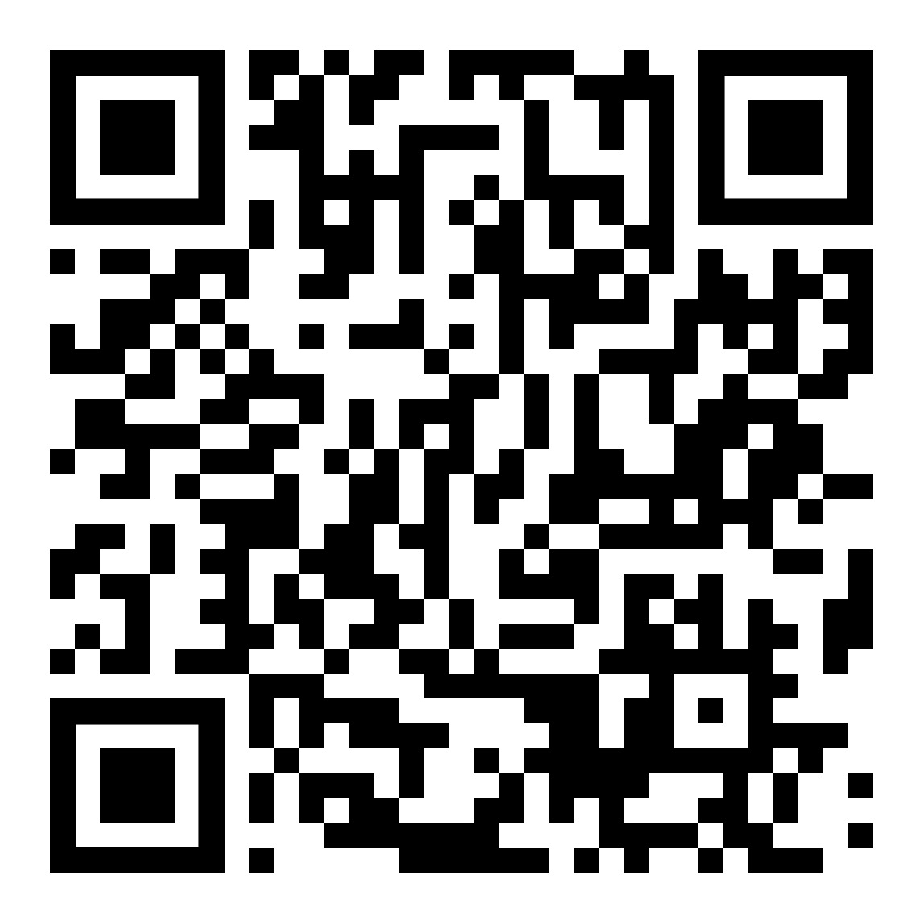
Source code of demos

Slide 25

Q&A
Endless CODE Intellect
Fast, repeatable refactoring for developers
Automated mass refactoring of source code.
Refactoring at scale

