Slide 1
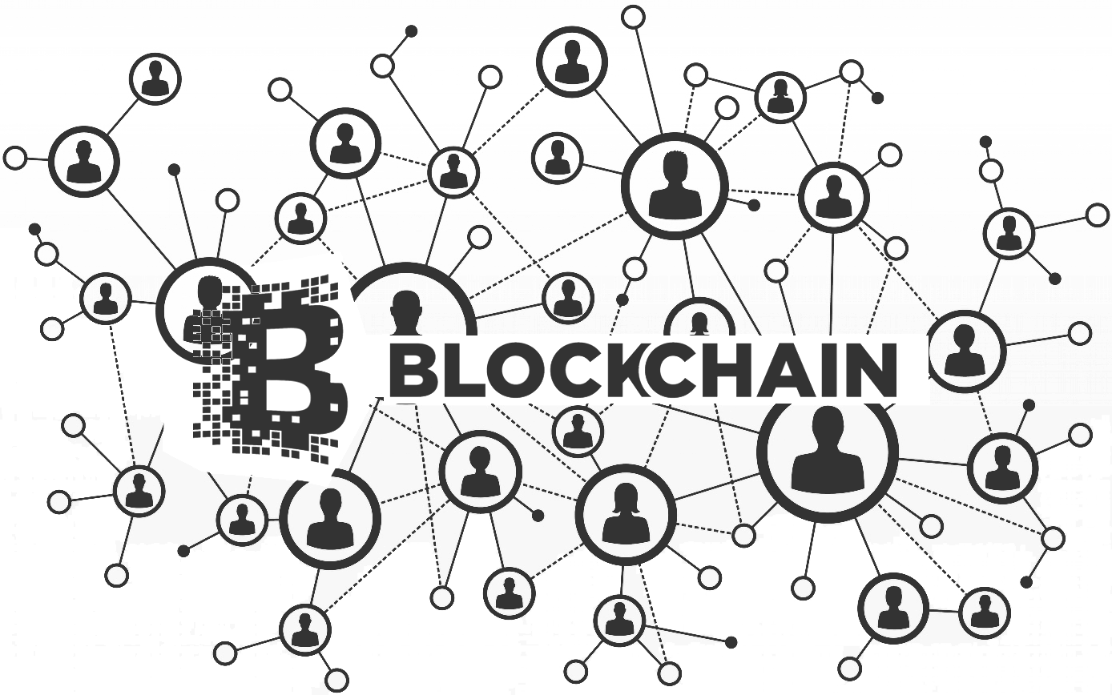

Slide 2
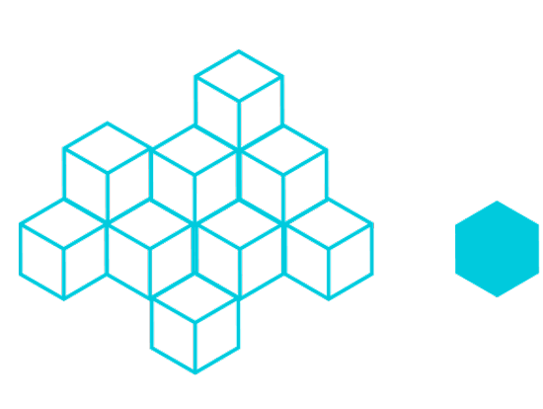
What is Blockchain
The blockchain is the shared, distributed ledger that facilitates the process of recording transactions and tracking assets in a business network.
The blockchain is the combination of the cryptography and the distributed computing technology.

Slide 3
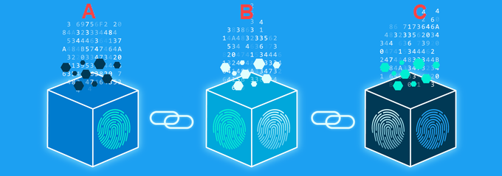
Why is it called so
It is because of the way it stores the data. It keeps the transaction data in the form of the blocks that are linked together in the form of a chain.

Slide 4
Characterstics Of Blockchain
1.) Consensus :- For a transaction to be valid, all participants must agree on its validity.
2.) Provenance :- Participants know where the asset came from and how its ownership has changed over time.
3.) Immutability :- No participant can tamper with a transaction after it’s been recorded to the ledger. If a transaction is in error, a new transaction must be used to reverse the error, and both transactions are then visible.
4.) Finality:- A single, shared ledger provides one place to go to determine the ownership of an asset or the completion of a transaction.

Slide 5
Why we use Blockchain
1.) Reduce costs and complexity
2.) Improve discoverability
3.) Trusted recordkeeping
5.) Shared trusted processes

Slide 6
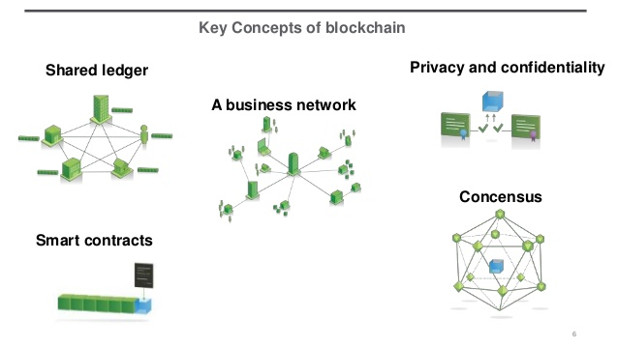
Blockchain's Components
To understand the working of the blockchain we need to understand the four concepts of blockchain which are the foundation of it.

Slide 7
Shared Ledger
1.) Shared ledger is an immutable record of all transactions on the network.
2.) A record that all network participants can access.
3.) In this ledger, transactions are recorded only once, eliminating the duplication of effort.

Slide 8
Permission
1.) Blockchains can be permissioned or permissionless.
2.) With a permissioned blockchain, each participant has a unique identity, which enables the use of policies to constrain network participation and access to transaction details. With the ability to constrain network participation, organizations can more easily comply with data protection regulations.
3.) Permissioned blockchains are also more effective at controlling the consistency of the data that gets appended to the blockchain.
4.) Any dissemination, distribution, or unauthorized use is strictly prohibited.Participants can specify the transaction information they’re willing to allow others to view.
5.) In addition, some participants may be authorized to view only certain transactions, while others, such as auditors, may be given access to a broader range of transactions.

Slide 9
Consensus
In a business network where participants are known and trusted, transactions can be verified and committed to the ledger through various means of consensus (agreement), including the following:
1.) Proof of stake: To validate transactions, validators must hold a certain percentage of the network’s total value.Proof-of-stake might provide increased protection from amalicious attack on the network by reducing incentives forattack and making it very expensive to execute attacks.
2.)Multi-signature: A majority of validators (for example, three out of five) must agree that a transaction is valid.
3.) Practical Byzantine Fault Tolerance (PBFT): An algorithm designed to settle disputes among computing nodes (network participants) when one node in a set of nodes generates different output from the others in the set.

Slide 10
Smart Contract
1.) A smart contract is an agreement or set of rules that govern a business transaction. It’s stored on the blockchain and is executed automatically as part of a transaction.
2.) Smart contracts may have many contractual clauses that could be made partially or fully self-executing, self-enforcing, or both.
3.) Their purpose is to pro-vide security superior to traditional contract law while reducing the costs and delays associated with traditional contracts.

Slide 11
Participants on a Blockchain
1.) Blockchain user
2.) Regulator
3.) Blockchain developer
4.) Blockchain network operator
5.) Traditional processing platforms
6.) Traditional data sources
7.) Certificate authority

Slide 12
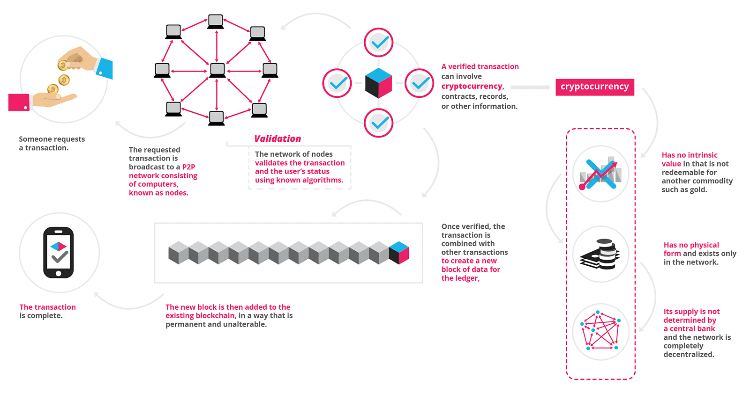
Blockchain Working

